Slide 1

JImpact Arbiter – An Automated Tool to test Fault Prone Components using Hybrid Genetic Algorithm based approach
Dr. D. Jeya Mala* and K. Sabari Nathan#
*Associate Professor, Thiagarajar College of Engineering, Madurai.
#PG Student, Thiagarajar College of Engineering, Madurai

Slide 2
Objective
To identify and verify fault prone components from the given software using Dynamic Impact Analysis and Hybrid Genetic Algorithm (HGA) based test case generation and optimization approach.

Slide 3
Research problem
Characteristics of Real time Complex Systems
More number of Fault-Prone or Critical Components
Problem in Exhaustive Testing (100%)
Causes of Failures in non-identification of Fault-prone Components
Hence, it is of paramount importance to identify and verify these components prior to release is the need of the hour.

Slide 4
Key Words
Fault Prone Components
Pareto principle - 20% of components lead to 80% of the problems [6]
Decide the entire functionality and error free operation of the software
have a higher level of functionality and or a higher level of dependability with other components.
errors in them lead to erroneous operations, system failure, high cost and resource wastage etc.

Slide 5
Key Words Contd..
Software Under Test (SUT)
Java based system is taken as input.
Mutants
Components which are artificially seeded with faults are called as mutants.
Mutation Analysis
Mutation Score(MS) to identify the fault revealing capability of each test case for effective test cases generation.
Impact Analysis
Identifies the impact of mutated component over its connected components.
Fault Prone Components Testing
Execution of the fault-prone components using the test cases generated using Hybrid Genetic Algorithm based approach.

Slide 6
Proposed WORK
Step 1: Read SUT
Step 2: Extract components from it.
Step 3: Generate and execute random test cases over the SUT
and store the results.
Step 4: Perform Impact Analysis using the following steps:
a) Mutant generation.
b) Mutant execution.
c) Extract connected components .
d) Impact analysis of each component over the connected components.
Step 4: Fault Prone Components verification using the
following steps:
a) Test case generation and optimization using HGA
b) Unit-Testing using HGA based test cases
c) Integration-Testing using HGA based test cases
Step 5: Experimentation results and comparative study.

Slide 7
Phase I - Fault Prone Components Identification
Pseudo Code :
Extract the components C_{i} from the SUT where i=1 to n.
Generate the mutants M₁ to M_{m} for Ci. (where ‘m’ is total number of mutants.)
Execute Test Cases TC_{j} over C_{i} and M_{j,} where i =1 to n and j=1 to m.
Examine the impact of M₁ to M_{m} on execution of the test cases based on the category I1-Catastrophic, I2-Critical, I3-Marginal, and I4-Minor.
Based on the categories, final set of fault-prone components are identified.

Slide 8
Implementation
Software Under Test (SUT) Analysis
Choose any Java based system (from simple to complex) as input
Extract all packages, classes and methods in it
Execution of SUT
Test case generation
Test case execution and
Test evaluation

Slide 9
Implementation
Mutant Generation
Generate mutants for each component using the set of mutation operators prescribed by Offutt [7] using five mutation operators
Absolute value Insertion (ABS)
Arithmetic Operator Replacement (AOR)
Relational Operator Replacement (ROR)
Logical Connector Replacement (LCR)
Unary Operator Inclusion (UOI)
Offutt class level mutation operators
Java this keyword Deletion (JTD)
Java this keyword Insertion (JTI)

Slide 10
Implementation
Table 1: Offutt mutation operators
Abbreviation | Description | Example mutation
ABS | Absolute Value Insertion | z = a*b; -> z = a*abs(b);
AOR | Arithmetic Operator Replacement | z= a - b; -> z = a * b;
LCR | Logical Connector Replacement | z = a&&b -> z = a||b;
ROR | Relational Operator Replacement | if(a>=b) -> if( a<b)
UOI | Unary operator Inclusion | z = a + b; -> z = a + --b
JTD | this keyword deletion | z = this.x + y -> z = x + y
JTI | this keyword insertion | z = x + y -> z = this.x + y

Slide 11
Implementation
Connected Components Extraction
Using Cohesion and Coupling to measure intra connection within the component and inter connection among components is made in SUT [1].
Here the connected components are derived in term of message passing, inheritance and inner classes.

Slide 12
Implementation
Dynamic Impact Analysis
The test cases are executed over the mutated components to identify the impact level of each component over its connected components based on the classification given as per Ray and Mohapatra(2011) and Garousi et.al (2006) [18].
The impact level is categorized as,
Catastrophic
Critical
Marginal
Minor

Slide 13
Implementation
Catastrophic:
The outcome of the mutated method controls the flow of other components [1], by passing it control information or throws an exception. It is also called higher impact component or Fault Prone Component.
public class CheckBalance { public int validate(String ano, String at) { ----------code-------- if (ano != null) { // Mutated Statement ----------code-------- return 0; } ----------code-------- return 1; } } | public class Transaction { -------- code ---------- public int validate(String a, String atp) { ----------- code --------------- CheckBalance cb = new CheckBalance(); int i = cb.validate(an, at); if (i != 0) { FundTransfer fund = new FundTransfer(); fund.FundTrans(an, atp, an, atp, i); } else {…} return i; } ----- code ------- }

Slide 14
Implementation
Critical:
The outcome of the mutated method is in computational statement of other components by passing it information.
public class ChequeBook extends OnlineServices { public int GetDetails(String an, String at) { if (an != null || at.equals("")) //Mutated Statement { ----------code-------- return 0; } else { ----------code-------- if (rs.next()) { ----------code-------- return bal; } } } | public class User { public String Login(String uid, String pswd) { ----------code-------- ChequeBook chkb = new ChequeBook(); ----------code-------- float bal=cbal–chkb.GetDetails (accno,atype); ----------code-------- } }

Slide 15
Implementation
Marginal:
The mutated method might be frequently used by other components for simple viewing purpose.
public class Customer { public int viewBalance(String acctype, String atypeno) { ----------code-------- if (acctype.length() > 0 || atypeno.length() <= 0) { // Mutated Statement return 0; } ----------code-------- return bal; } } | public class Transaction { public void display(String ano) { ----------code-------- Customer cust = new Customer(); for(int i=0;i<n;i++) cust.viewBalance(actype, ano); ----------code-------- } }

Slide 16
Implementation
Minor:
The mutated method may be triggered few times in other components and is being simply used to insert a label like month, footnote, hyphenation in a report generation.
public class Month extends Statements { public void display(String ano) { if(ano.length()>0) { //Mutated Statement ----------code-------- } ----------code-------- while(r.next()) { jTable1.setValueAt(r.getString(1),i,j); ----------code-------- } } } | public class Customer extends User{ public String Validate(String acno) { ----------code-------- Month m = new Month(); m.display(ano); ----------code-------- } }

Slide 17
Phase – ii Fault prone Components Verification
Hybrid Genetic Algorithm (HGA)
Hybridization scheme
HGA an Evolutionary Algorithm (EA).
The HGA combines the local search with Genetic Algorithm (GA) which is a population based technique and is used for Evolutionary Testing.
Two novel improvement heuristics are introduced in local search:
Remove Top
Local Best

Slide 18
Implementation
Algorithm – HGA
Randomly initialize population of test cases (t).
Determine fitness of population based on mutation score and Branch Coverage Value (BVA).
Apply RemoveTop heuristic for initial population.
Apply LocalBest heuristic for initial population.
Repeat
Select parents from population (t) based on fitness value.
Perform crossover and mutation on parents to generate population (t+1).
Determine fitness of population based on the mutation score and the branch coverage value (t+1).
Apply RemoveTop heuristic for Offspring.
Apply LocalBest heuristic for Offspring.
Until the best individual is identified.
Repeat from step1 to Step5 for all the fault-prone components.

Slide 19
Implementation
Cross over :
Choose a random cross over point on the two individuals which act as parents. Split individuals at this crossover point. Create individuals by means of exchange of test data which act as parents.
Example:
Test Case1: {2000,”zzzz”,”xuit”, 30}
Test Case2: {2010,”yyyy”,”ophj”, 29}
Crossover point: 2
Test Case1: {2000,”zzz”,”ophj”, 29}
Test Case2: {2010,”yyyy”,”xuit”, 30}
Mutation :
Choose any one of test data in the parent. Change the test data using any one of arithmetic operators for numeric data, random word for string data, bit-wise operator and so on.
Example:
Test Case: {2000,”zzzz”,”xuit”, 30}
Mutation point: 4 30^1 = 31
Test Case: {2000,”zzzz”,”xuit”, 31}
Psuedo Code – Cuckoo Search

Slide 20
Implementation
Fitness Evaluation:
The generated population using crossover and mutation are executed against both the original and the mutants. Based on the outcome, the mutation score and the branch coverage value is calculated and it is used for test case adequacy criteria.
Fitness Evaluation – Mutation Score
There are three ways to calculate mutation score using the formulae (1)(2)(3)
MS (T) = ( |D|/ (|D|+|L|) ) * 100 (4)
MS (T) – Mutation Score against Test case (T).
D - No of Distinguished Mutants i.e. the mutants killed by the Test case (T).
L - No of Live Mutants i.e. the mutants cannot be killed by Test cases (T).
Fitness Evaluation – Branch Coverage
BCV (T) = |N_{m}| / |T_{m}|* 100 (5)
BCV (T) – Brach coverage value for Method (m) against Test case (T)
N_{m} - Number of branches covered using Test case (T) against Method (m)
T_{m} - Total number of branches in Method (m)
Psuedo Code – Cuckoo Search

Slide 21
Implementation
Fig 1:Mutated Components and its Score
public class mut33 extends Account { String an, at, sacn; int b; public int ViewBalance(String ano, String atp) { if (ano.length() <= 0 && atp.length() <= 0) { return 0; } ------------------code------------ if (sacn != null || !sacn.equals("")) { try { ---------------code--------------- if (r.next()) { b = r.getInt(1); } ---------------code--------------- } return b; }} | public class mut34 extends Account { String an, at, sacn; int b; public int ViewBalance(String ano, String atp) { if (ano.length() > 0 || atp.length() <= 0) { return 0; } ------------------code------------ if (sacn != null || !sacn.equals("")) { try { ---------------code--------------- if (r.next()) { b = r.getInt(1); } ---------------code--------------- } return b; }
Examp1e 1: Mut33 - Test Case : { “” ,”fd”} Status : Distinguished Mut34 - Test Case : { “”, ”fd”} Status : Distinguished Method wise Mutation Score : 1.0 Component wise Mutation Score : 1.0 | Example 2 : Mut33 - Test Case 2: { “a153”,”fd”} Status : Live Mut34 - Test Case 2: { “a153”,”fd”} Status : Distinguished Method wise Mutation Score : 0.5 Component wise Mutation Score : 0.5

Slide 22
Implementation
Remove Top:
This method removes the parents with lower fitness value. The Offspring with the highest fitness value becomes the new parent.
Pseudo code :
i = 1;
Best_MS = MS (TC_{i});
Best_BCV = BCV(TC_{i});
index=1;
For each TC_{i} in Test cases
if (MS(TC_{i}) > Best_MS && BCV (TC_{i}) > Best_BCV) then
Best_MS = MS (TC_{i});
Best_BCV= BCV(TC_{i});
index=i;
if (Best_MS > MS (parent1) && Best_BCV > BCV (parent1)) then
parent1 = TC_{index};
else if (Best_MS > MS (parent2) && Best_BCV > BCV (parent2)) then
parent2 = TC_{index};
else
Retain the parents
Psuedo Code – Cuckoo Search

Slide 23
Implementation
Example:
Parent1: {BCV=25%, MS =0.5}
Parent2: {BCV=53%, MS =0.6}
Offspring1 {BCV=25%, MS =0.6}
Offspring2 {BCV=65%, MS =0.8}
Offspring3 {BCV=45%, MS =0.52}
Offspring4 {BCV=32%, MS =0.53}
For next Iteration the parents are
New Parent 1 {BCV=65%, MS =0.8}
Parent2 {BCV=53%, MS =0.6}
Psuedo Code – Cuckoo Search

Slide 24
Implementation
Local Best:
This method finds the local best solution from each Offspring and removes it from the current parent i.e. the optimal Offspring is chosen as one of the parents. So, the parents will have different fitness values to obtain near optimal solution. If this heuristics is not used, the algorithm may always choose the same Offspring as the best one.
Pseudo code :
i = 1;
Optimal_MS = MS (Parent1);
Optimal_BCV = BCV (Parent1);
index=1;
For each TC_{i} in Test cases
if (Optimal_MS < MS (TC_{i} ) && Optimal_BCV < BCV (TC_{i}) ) then
Optimal_MS = MS (TC_{i});
Optimal_BCV = BCV (TC_{i});
index = i;
if (Optimal_MS <> MS (parent1) && Optimal_BCV <> BCV (parent1)) then
parent1 = TC_{index};
else if (Optimal_MS <> MS (parent2) && Optimal_BCV <> BCV (parent2)) then
parent2 = TC_{index};
else
Retain the parents.
Psuedo Code – Cuckoo Search

Slide 25
Implementation
Example:
Parent1: {BCV = 33%, MS = 0.6}
Parent2: {BCV = 33%, MS = 0.6}
Offspring1 {BCV = 25%, MS = 0.5}
Offspring2 {BCV = 33%, MS = 0.6}
Offspring3 {BCV = 23%, MS = 0.5}
Offspring4 {BCV = 33%, MS = 0.6}
For next Iteration the parents are
Parent1 {BCV = 33%, MS = 0.6}
New Parent2 {BCV = 25%, MS= 0.5}
Psuedo Code – Cuckoo Search

Slide 26
Testing
Unit Testing using HGA
Code instrumentation is done to identify the outcome of each method for all components in the SUT.
During the test case selection procedure of HGA, the mutation score and the branch coverage value are used for test adequacy criteria.
Hence, at the end of the HGA procedure the entire unit testing process itself will be completed with an assurance of at least 98% of fitness score.

Slide 27
Testing
Integration Testing using HGA :
Code Instrumentation is done for all components.
Execute the effective test cases generated by HGA against each component in the SUT
Identify the execution trace of each method and all intermediate results are compared against the test cases stored in the repository and also list the intermediate class name and its status.
Based on the status, the failure during integration of components can be identified.
Example:
Parent Method is starting (“Class name”)
Child Method1 is starting (“Class name”)
Grand Child Method1 is starting (“Class name”)
Grand Child Method1 is ending (“Class name”, “return value”)
Child Method1 is ending (“Class name”, “return value”)
Child Method2 is starting (“Class name”)
Child Method2 is ending (“Class name”, “return value”)
Parent Method is ending (“Class name”, “return value”)
It shows how execution trace is recorded for each method while it invokes the connected components.

Slide 28
Performance Evaluation
Experimentation Set up:
The proposed approach verified against 6 Application Software [AS] and 4 Real-Time Systems [RT] and listed them in table 2.
Table 2 Case Studies Undertaken
S.NO | Application Test Problems | Test Object No. | Test Problem #
1 | Blood Bank | AS1 | TP1
2 | Banking Application | AS2 | TP2
3 | Library | AS3 | TP3
4 | Hospital | AS4 | TP4
5 | Work Flow Management | AS5 | TP5
6 | IT Service Help Desk | AS6 | TP6
7 | Apache.ant.1.2 | RT1 | TP7
8 | JWalk | RT2 | TP8
9 | Flaka | RT3 | TP9
10 | Source of 800 synthetic Programs | RT4 | TP10

Slide 29
Experimentation Results
Impact Analysis results for Apache ant:
The table 3 shows the impact analysis for real time case study, i.e. Apache Ant [25]. Based on the impact analysis, we have extracted the critical components which are listed them in table 4.
Table 3:Impact Analysis for Apache Ant
Class Name | Class Affect | Impact
org.apache.ant.antunit.junit3.AntUnitTestCase | org.apache.ant.antunit.junit4.AntUnitSuiteRunner | Minor
org.apache.ant.antunit.junit3.AntUnitSuite | org.apache.ant.antunit.junit3.AntUnitTestCase | Minor
org.apache.ant.antunit.junit3.AntUnitSuite | org.apache.ant.antunit.junit4.AntUnitSuiteRunner | Minor
org.apache.ant.antunit.AntUnitScriptRunner | org.apache.ant.antunit.AntUnit | Catastrophic
org.apache.ant.antunit.AntUnitScriptRunner | org.apache.ant.antunit.junit3.AntUnitSuite | Marginal
org.apache.ant.antunit.LogContent | org.apache.ant.antunit.LogContent | Critical
org.apache.ant.antunit.LogContains | org.apache.ant.antunit.LogContains | Critical
org.apache.ant.antunit.ResourceExists | Exception* | Catastrophic
org.apache.ant.antunit.LogCapturer | org.apache.ant.antunit.LogContent | Marginal
org.apache.ant.antunit.LogCapturer | org.apache.ant.antunit.LogContains | Marginal
org.apache.ant.antunit.junit3.MultiProjectDemuxOutputStream | org.apache.ant.antunit.junit3.AntUnitSuite | Minor
org.apache.ant.antunit.AssertTask | Exception* | Catastrophic
org.apache.ant.antunit.AntUnit | Exception* | Catastrophic
Table 4: Critical Components for Apache Ant
Class Name
org.apache.ant.antunit.AntUnitScriptRunner
org.apache.ant.antunit.ResourceExists
org.apache.ant.antunit.AssertTask
org.apache.ant.antunit.AntUnit
org.apache.ant.antunit.LogContent
org.apache.ant.antunit.LogContains
*Because of mutation it throws an Exception and it is also called as Show-Stopper’.

Slide 30
Experimentation Results
Impact Analysis results for Banking Application
The table 5 shows the impact analysis for Application oriented sample case study, i.e. Banking application. Based on the impact analysis, we have extracted the fault-prone components which are listed them in table 6.
Table 5:Impact Analysis for Banking Application
Mutant Id | Class Affect | Impact
ibsm.Account1.mut1 | ibsm.Admin | Critical
ibsm.Admin1.mut5 | ibsm.User | Minor
ibsm.CheckBalance1.mut11 | ibsm.Deposit | Minor
ibsm.CheckBalance1.mut11 | ibsm.Withdraw | Minor
ibsm.CheckBalance1.mut11 | ibsm.CurrentAcc | Minor
ibsm.CheckBalance1.mut12 | ibsm.Transaction | Catastrophic
ibsm.CheckBalance1.mut12 | ibsm.Account | Minor
ibsm.CheckBalance1.mut12 | ibsm.OnlineServices | Minor
ibsm.ChequeBook1.mut15 | ibsm.User | Critical
ibsm.ChequeBook1.mut18 | Exception | Catastrophic
ibsm.CurrentAcc1.mut21 | ibsm.Account | Minor
ibsm.Customer1.mut24 | ibsm.CheckBalance | Catastrophic
ibsm.Deposit1.mut29 | ibsm.FundTransfer | Catastrophic
ibsm.FixedAcc1.mut33 | ibsm.Account | Minor
ibsm.FundTransfer1.mut35 | ibsm.Transaction | Minor
ibsm.Month1.mut37 | ibsm.Customer | Minor
ibsm.OnlineServices1.mut41 | ibsm.ProfileUpdation | Catastrophic
ibsm.ProfileUpdation1.mut43 | ibsm.User | Minor
ibsm.ProfileUpdation1.mut43 | ibsm.ChequeBook | Minor
ibsm.RecurringAcc1.mut47 | ibsm.Account | Minor
ibsm.SavingAcc1.mut49 | ibsm.Account | Minor
ibsm.Statements1.mut51 | ibsm.Year | Minor
ibsm.Statements1.mut52 | ibsm.Month | Minor
ibsm.Transaction1.mut53 | ibsm.Account | Minor
ibsm.User1.mut57 | ibsm.Admin | Critical
ibsm.User1.mut57 | ibsm.Transaction | Minor
ibsm.Withdraw1.mut62 | ibsm.FundTransfer | Catastrophic
ibsm.Year1.mut65 | ibsm.CheckBalance | Minor
Table 6: Critical Components for Banking Application
Class Name
ibsm.Deposit
ibsm.CheckBalance
ibsm.OnlineServices
ibsm.Customer
ibsm.Deposit
ibsm.Withdraw
ibsm..ChequeBook

Slide 31
Experimentation Results
Efficiency Analysis
The efficiency of proposed test case generation using HGA is compared with other optimization techniques like
Random,
Genetic Algorithm (GA) and
Memetic Algorithm (MA)
Table 7:Execution time in seconds
S.No | Test Problems | Random | GA | MA | HGA
1. | TP1 | 756.8 | 683.45 | 587.6 | 510.89
2. | TP2 | 975.12 | 872.63 | 647.56 | 512.58
3. | TP3 | 75.99 | 63.28 | 58.33 | 45.48
4. | TP4 | 589.22 | 365.47 | 352.64 | 295.67
5. | TP5 | 16.37 | 11.87 | 11.48 | 10.875
6. | TP6 | 1417.25 | 1167.28 | 1053.3 | 963.38
7 | TP7 | 5793.56 | 4693.756 | 4125.6 | 3963.7
8 | TP8 | 5957.45 | 3453.78 | 2578.3 | 1853.3
9. | TP9 | 5957.45 | 3453.78 | 2947.5 | 2853.7
10 | TP10 | 9958.45 | 7852.56 | 7125.6 | 6856.78

Slide 32
Experimentation Results
Table 8 : No. of Test Cases for Case Studies
S.No | Test Problems | Random | GA | MA | HGA
1. | TP1 | 1945 | 1765 | 1425 | 1126
2. | TP2 | 2546 | 1987 | 1559 | 1375
3. | TP3 | 1543 | 1353 | 1299 | 1252
4. | TP4 | 1759 | 736 | 658 | 631
5. | TP5 | 413 | 404 | 368 | 351
6. | TP6 | 1855 | 1125 | 1085 | 895
7. | TP7 | 3753 | 3225 | 3085 | 2825
8. | TP8 | 1799 | 1509 | 1456 | 1396
9. | TP9 | 3765 | 2974 | 2759 | 2574
10. | TP10 | 5789 | 3225 | 3085 | 2825

Slide 33
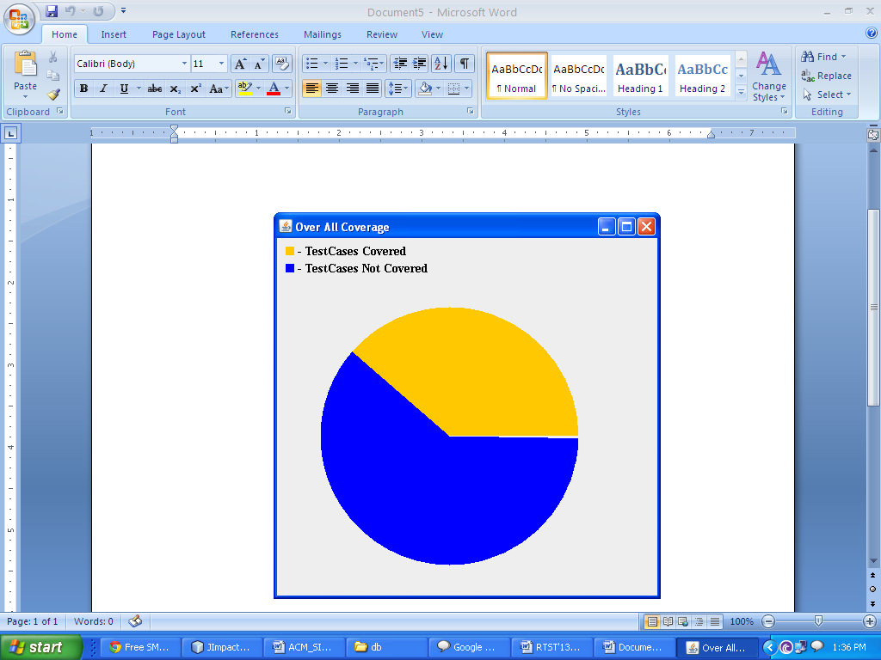
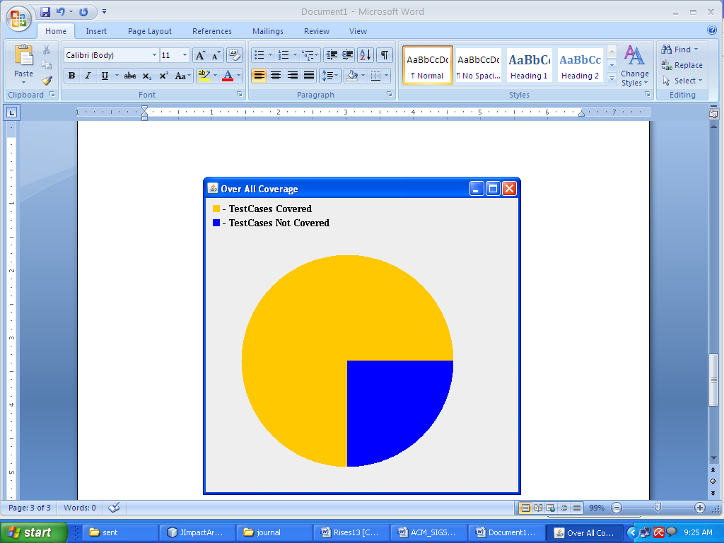
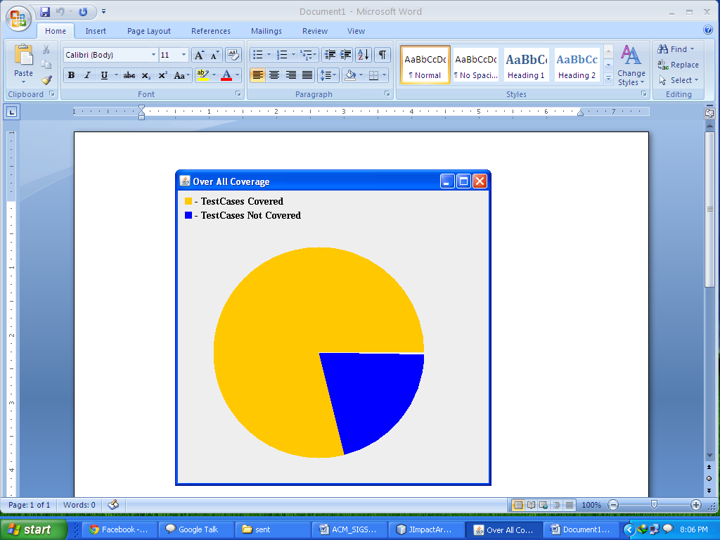
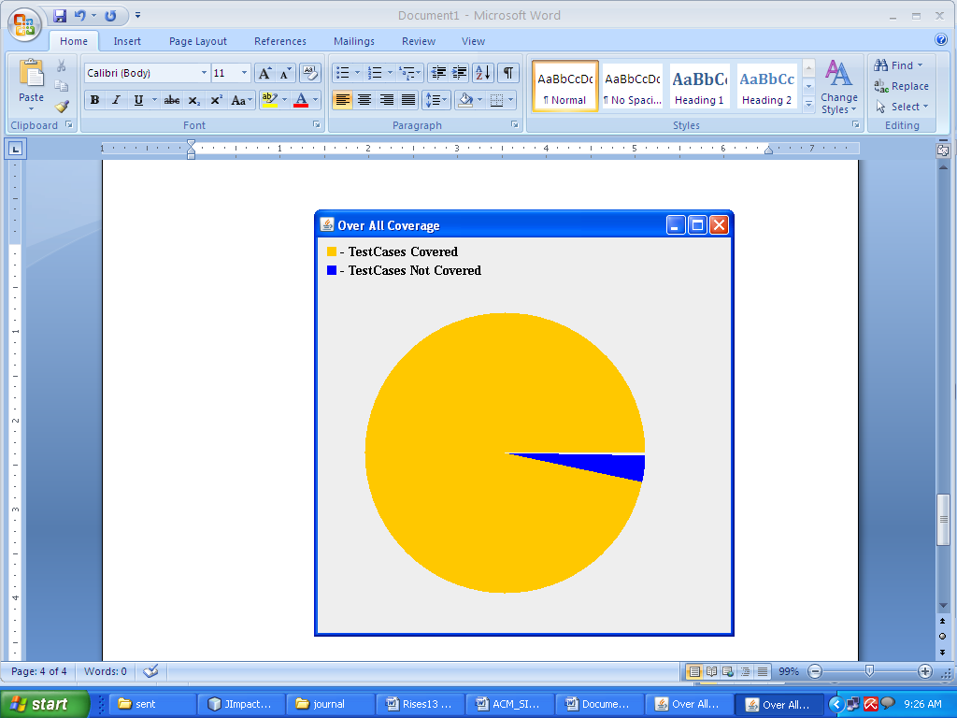
Test case efficiency
Test Case Efficiency using Random
Test Case Efficiency using GA
Test Case Efficiency using MA
Test Case Efficiency using HGA

Slide 34
Defect turn around time

Slide 35
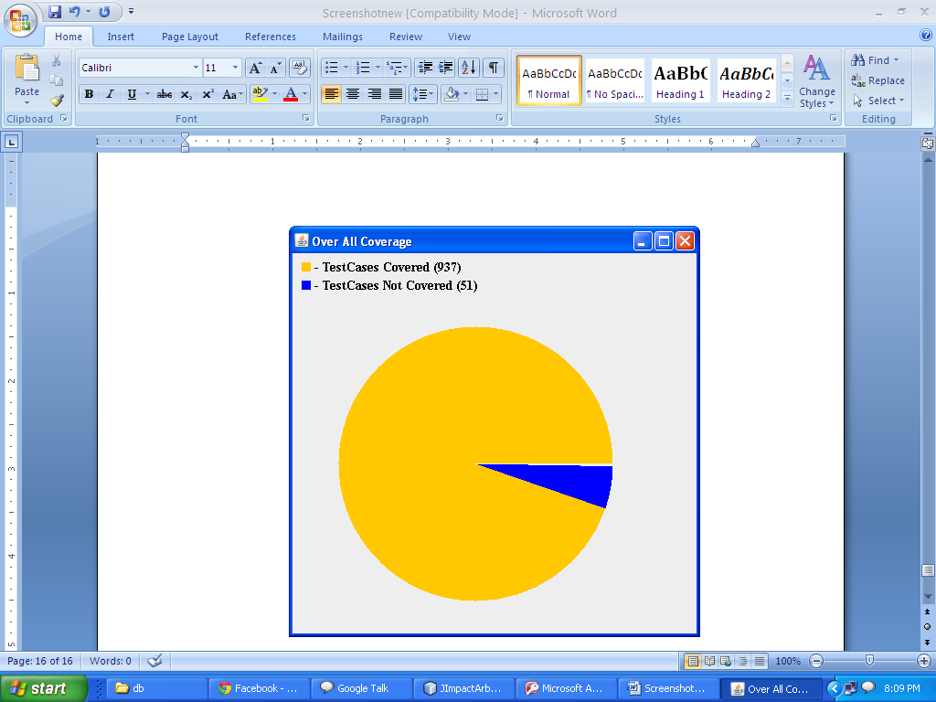
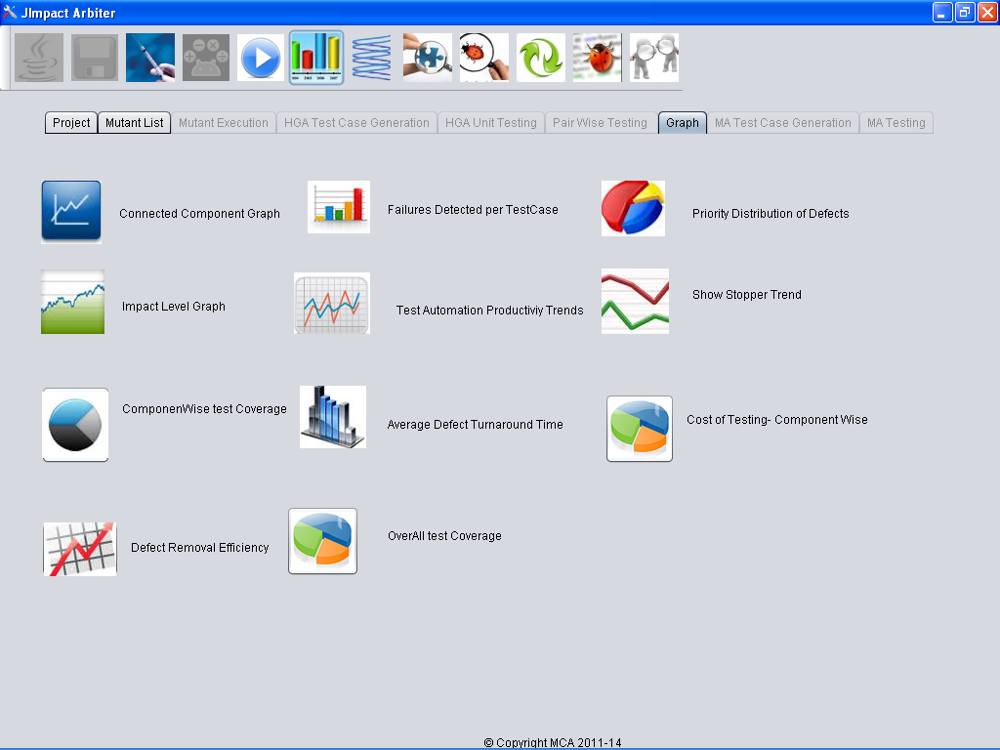
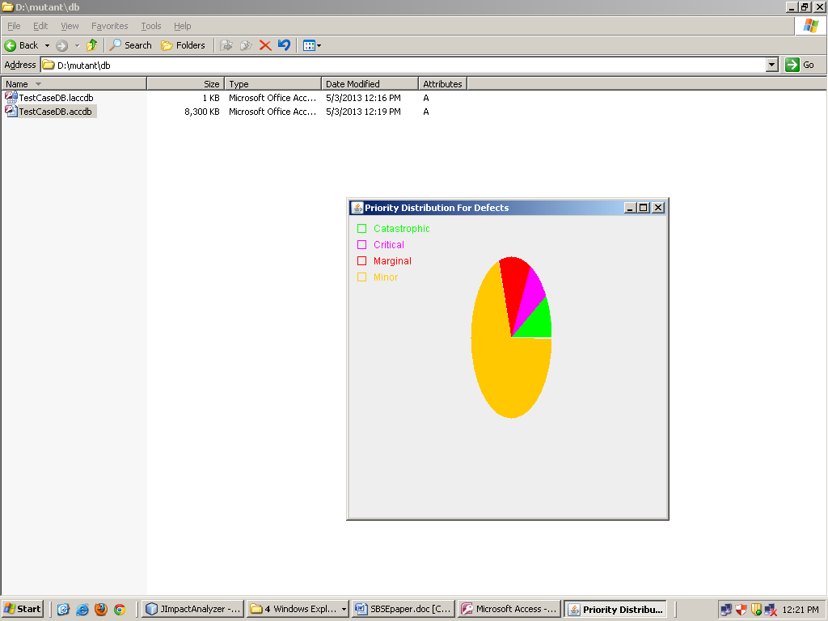
GraPHs
Banking Application:
The subsequent graphs are generated as per Infosys White Paper “Realizing Efficiency and Effectiveness in software through a Comprehensive metrics model” [24].
Graph Generation
Over All Test Coverage Graph
Priority Distribution for Defects Graph

Slide 36
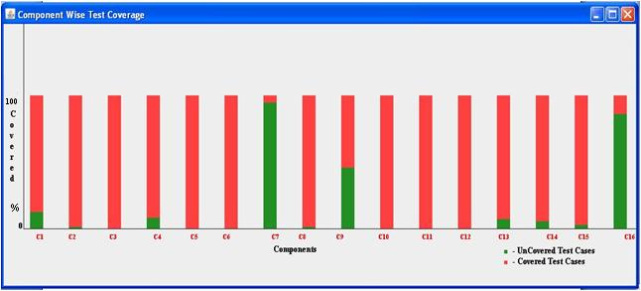
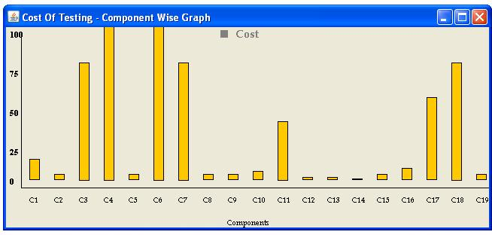
GRaphs
Component Wise Test Case Coverage Graph
Cost of Testing -Component Wise Graph

Slide 37
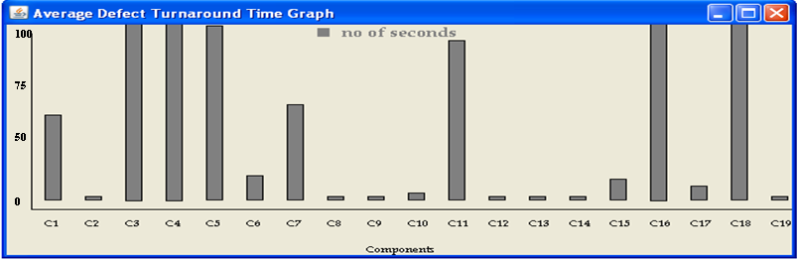
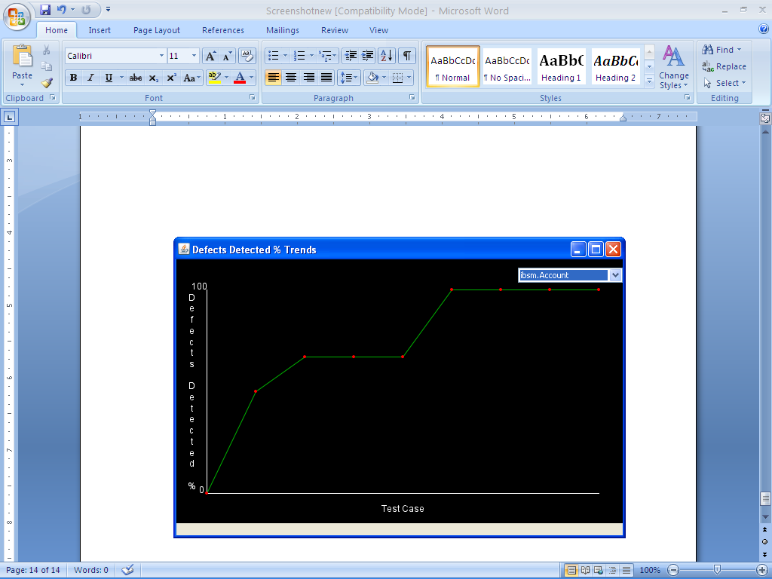
Graphs
Defect Turn around time Graph
Defect REMOVAL EFFICIENCY Graph
DRE (%) = [TM / (TM+AM) * 100]
TM – Total number of mutants
AM- Number of Mutants revealed per Test cycle execution

Slide 38
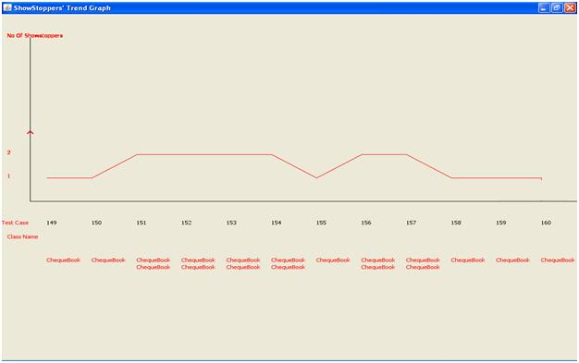
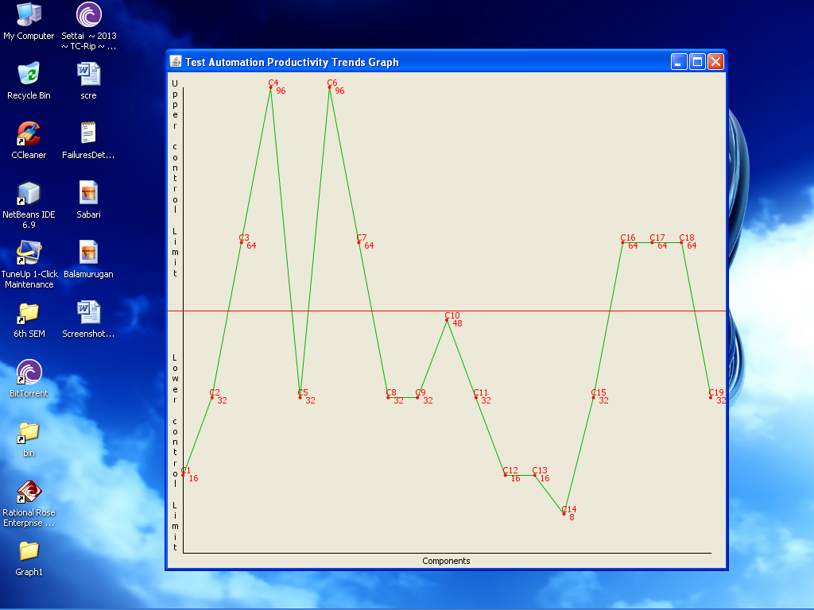
Graphs
Show stoppers’ Trend Graph
Test Automation Productivity Trends Graph

Slide 39
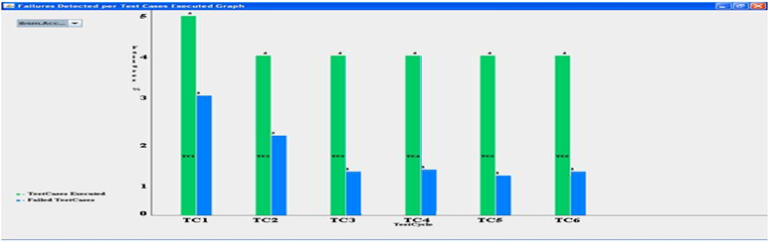
Graphs
Failures Detected Per Test cycle Executed Graph

Slide 40
Conclusion
A novel testing tool namely ‘JImpact Arbiter’ has been developed to analyse any given Java based software to identify and test the fault prone components in it.
The tool achieves objective in two phases
Phase I – Fault-Prone Components Identification
Phase II – Fault-Prone Components Verification
Phase I - Dynamic Impact analysis
Provides a complete list of fault-prone components
Phase II - HGA based approach
Fault prone components are tested in unit as well as integration testing rigorously using the test cases generated using HGA
The test cases are stored properly in data stores for later use

Slide 41
Contd..
The tool facilitates
Automatic generation of mutants from the source code
Dynamic code impact analysis
Automated test cases generation with unit & integration testing
Impact Analysis
catastrophic, critical, marginal and minor
Show Stoppers kind of error
Efficiency analysis
based on Infosys’s various metrics and measures
Report Generation
Graph based visualization
Test cases saved in .xls form
Pdf reports for test results

Slide 42
Future enhancement & acknowledgement
Future Enhancement
In future we will apply other test case optimization techniques like Ant Colony Optimization (ACO), Particle Swarm Optimization (PSO) and so on, for a comparative study.
Acknowledgement:
This research paper is the part of UGC Major Research Project supported by University Grants Commission, New Delhi, India.

Slide 43
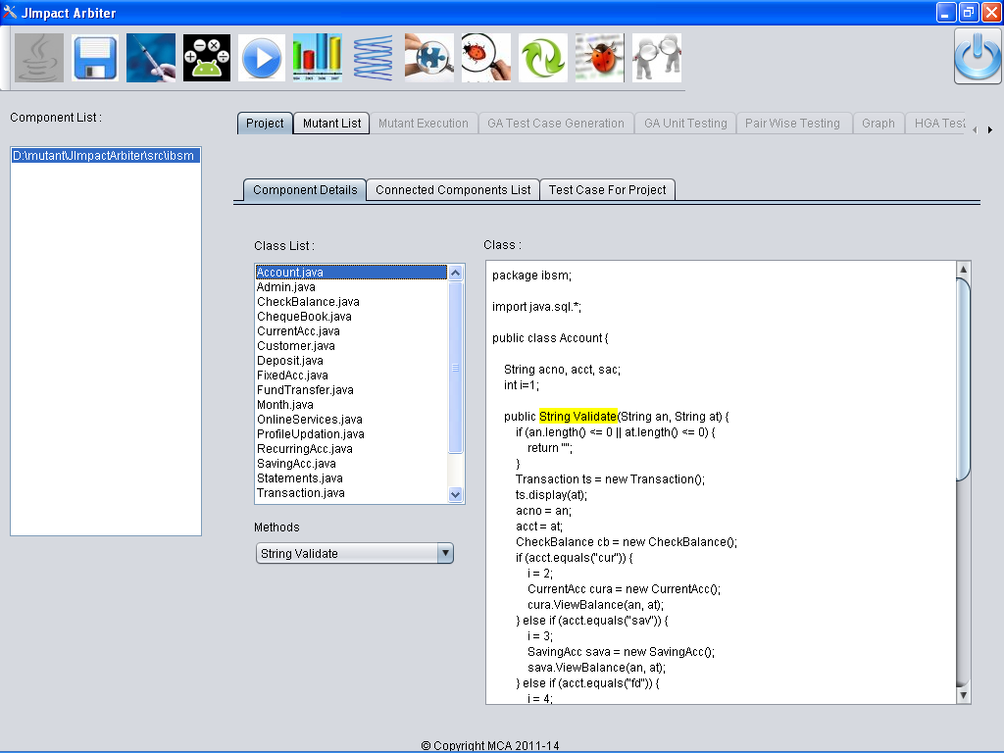
Screen Shots
Read The SUT

Slide 44
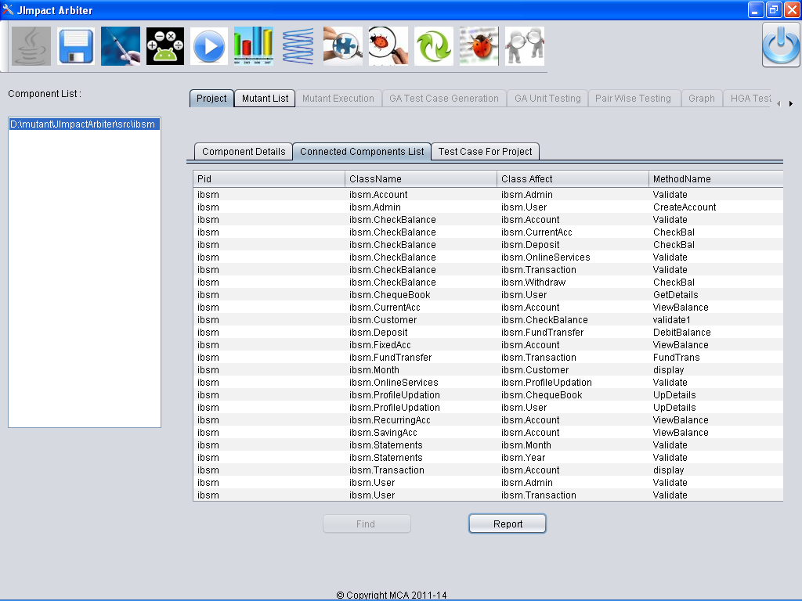
Connected Components Extraction

Slide 45
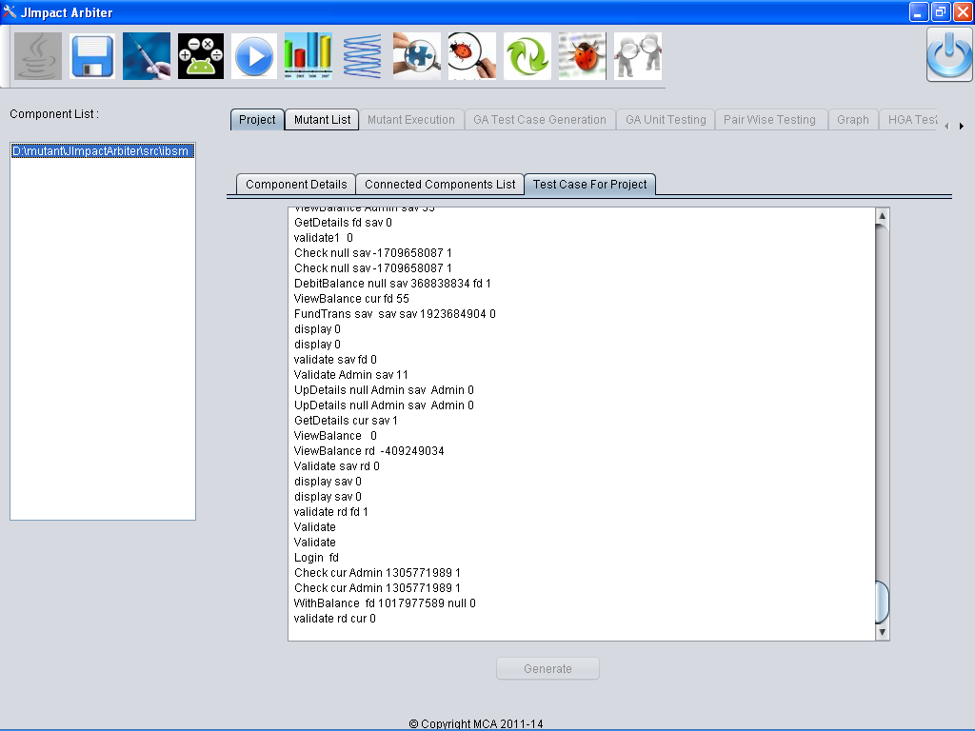
Screen Shots
Random Test Case Generation

Slide 46
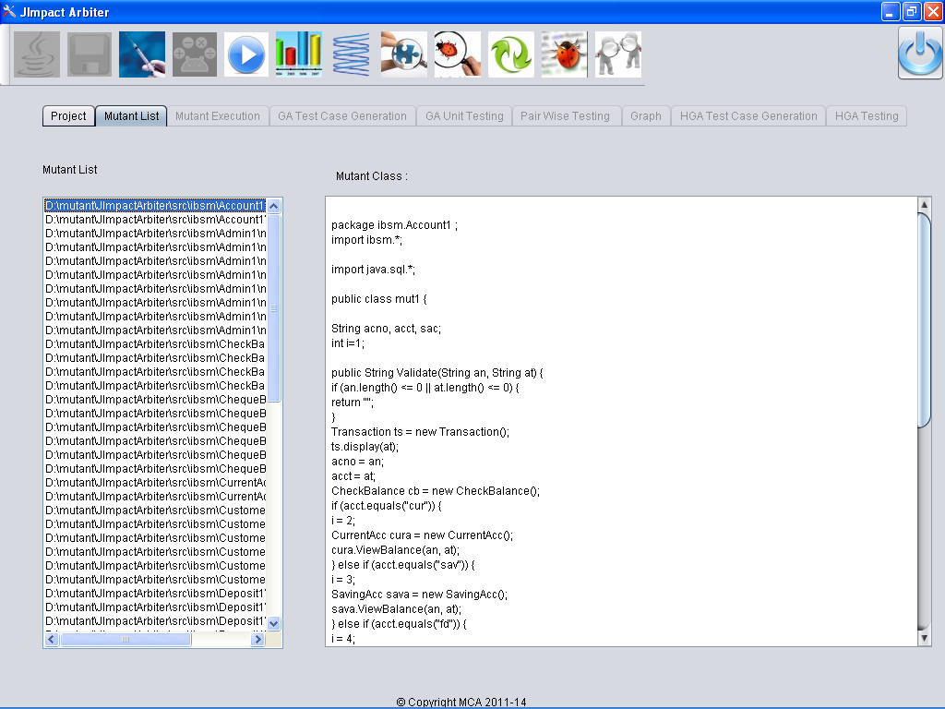
Mutant Generation

Slide 47
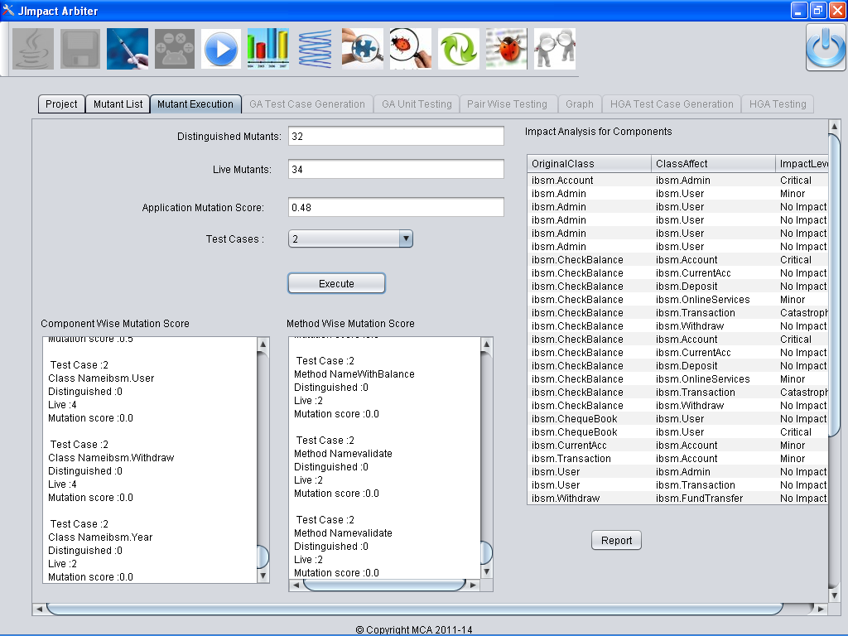
Screen Shots
Impact Analysis

Slide 48
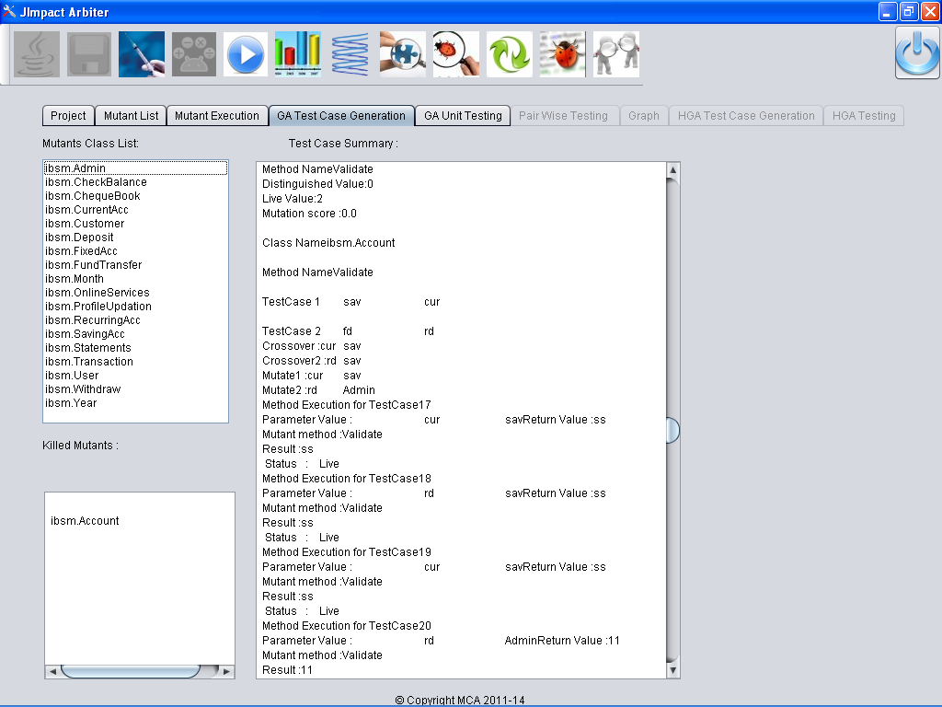
Test Case Generation using GA

Slide 49
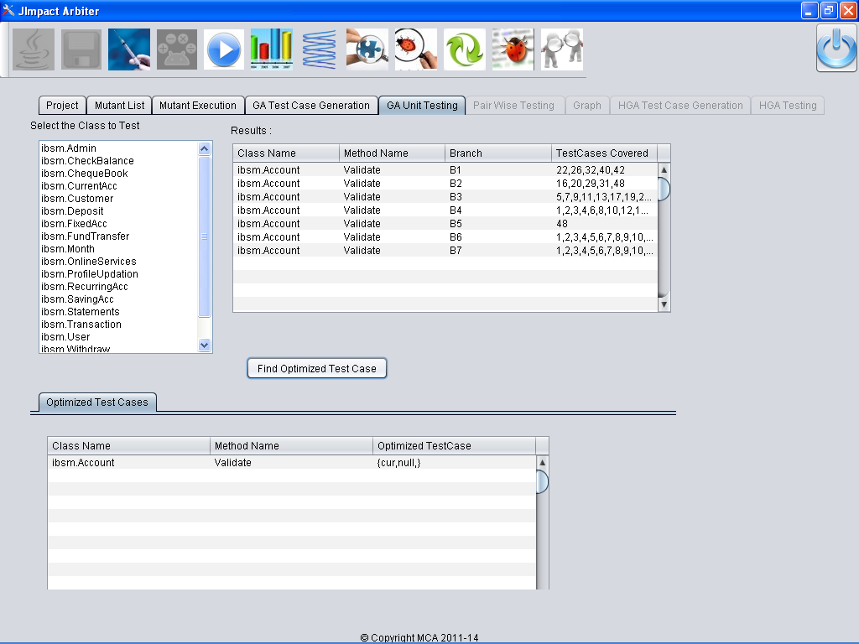
Screen Shots
Branch Coverage using GA

Slide 50
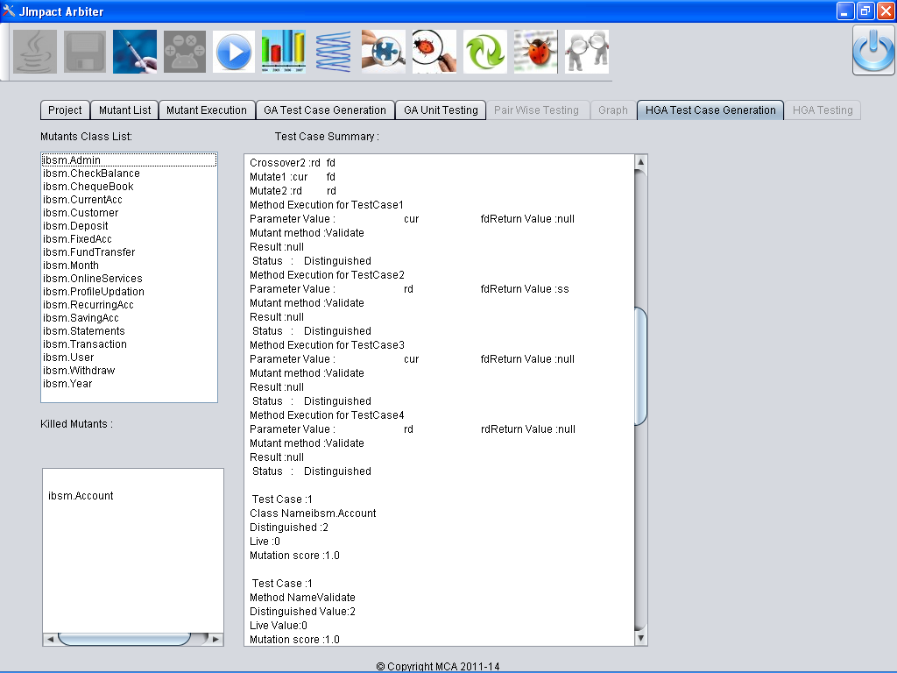
Test Case Generation Using HGA

Slide 51
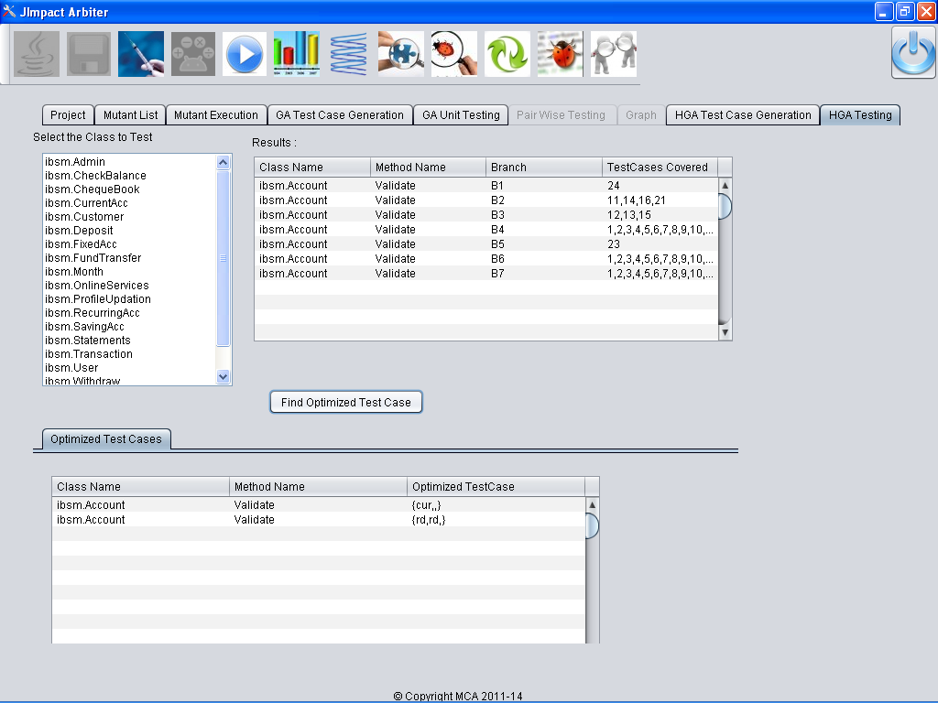
Screen Shots
Unit testing with Optimized test cases and Branch Coverage Using HGA

Slide 52
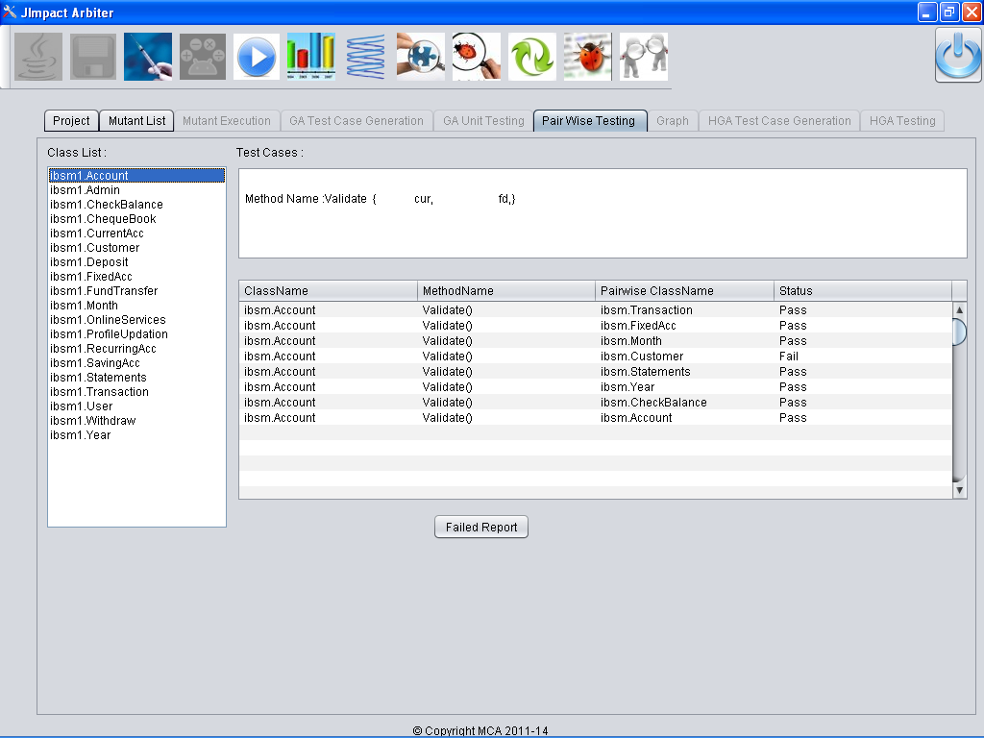
Integration Testing using HGA

Slide 53
References
Srinivasan Desikan, Gopalaswamy Ramesh, “Software Testing Principles & Practices” PEARSON Education, 2006.
Aditya P.Mathur, “Software Testing”, Pearson Education, Asia.
A.J.Ofutt, A. Lee, G. Rothermel, R. Untch, and C. Zapf, “An experimental determination of sufficient mutation operators”, ACM Transactions on Software Engineering Methodology, 5(2):99{118, April 1996.
MuJava homepage [Online]. Available: http://cs.gmu.edu/~offutt/mujava/
Yu-Seung Ma, Jeff Offutt, and Yong Rae Kwon, “MuJava: An Automated Class Mutation System”, Journal of Software Testing, Verification and Reliability, 15(2):97-133, June 2005.
Roger S. Pressman, “Software Engineering”, A Practitioner’s Approach 5th Edition, McGraw Hill, 1997.
A. Offutt, G. Rothermel, and C. Zapf, “An experimental evaluation of selective mutation,” in Proc. ICSE, 1993, pp. 100–107.
A R. A. DeMillo and R. J. Martin, “The Mothra software testing environment user’s manual”, Software Engineering Research Center, Tech.Rep., 1987.
P K Suri, Kumar Sandeep, “Simulator for Identifying Critical Components for Testing in a Component Based Software System”, IJCSNS International Journal of Computer Science and Network Security, Vol.10, No.6, 2010; pp. 250-257.
Zhou Yuming, Hareton Leung, “Empirical Analysis of Object-Oriented Design Metrics for Predicting High and Low Severity Faults”, IEEE Transactions on Software Engineering, Vol. 32, No. 10, 2006; pp.771-789.
Shatnawi A Raed, Li Wei,”The Effectiveness of Software Metrics in Identifying Error-Prone Classes in Post-Release Software Evolution Process”, Journal of Systems and Software, Vol. 81, 2008; pp.1868–1882.
Ray Mitrabinda, Prasad Mohapatra Durga, ”A novel methodology for software risk assessment at architectural level using UML diagrams”, SETLabs Briefings, Vol 9, No 4, 2011; pp.41-60.
Goseva-Popstojanova Katerina, Hassan Ahmed, Guedem Ajith, Abdelmoez Walid, M.Nassar Diaa Eldin, Ammar Hany, Mili Ali, “Architectural Level Risk Analysis”,IEEE Transactions on Software Engineering, Vol. 29, No.10.2003; pp. 946 – 960.

Slide 54
References
Land, M 1998. Evolutionary Algorithms with Local Search for Combinatorial Optimization. Ph.D. Thesis, University of California, San Diego, (1998).
D.Jeyamala, V.Mohan 2010. A Hybrid Test Optimization Framework– Coupling Genetic Algorithm with Local Search Technique. International Journal - Computing and Informatics,Vol.29, No.1, pp. 133-164, (2010)
D. Jeya Mala and K. Sabari Nathan. Component Impact Analyzer with genetic algorithm. ICTACT journal of Soft Computing Vol. 3, No 4 (July 2013).
Mala, D.J., Praba. M.R. 2011.Critical components identification and verification for effective software test prioritization. Advanced Computing (ICoAC), (2011) Third International Conference on , vol., no., pp.181,186, 14-16 (Dec. 2011) DOI: 10.1109/ICoAC.2011.6165171
D. Jeyamala, K. Sabari Nathan 2013. Critical Components Identification using Mutation based Components Impact Analysis. IJCSI International Journal of Computer Science and Informatics. Vol.3, No.2, (2013); pp. 24-33.
D. Jeyamala, S. Balamurugan 2013. Fault-prone Components Identification for Real-time Complex systems based on Criticality Analysis. IJCSI International Journal of Computer Science and Informatics. Vol.3, No.2, (2013); pp. 17-23.
D.Jeyamala, A.Jalila 2013. OCL formal Specification based Metrics a measure of complexity and fault proneness. IJCSI International Journal of Computer Science and Informatics. Vol.3, No.2, (2013); pp. 69-79.
D. Jeya Mala and A. Jalila. Empirical evidence on OCL formal specification-based metrics as a predictor of fault-proneness. ACM SIGSOFT Softw. Eng. Notes 38, 5 (August 2013), 1-10. DOI=10.1145/2507288.2507308
http://www.informit.com/guides/content.aspx
http://workbench.haefelinger.it/flaka/
http://www.infosys.com/engineering-services/white-papers/Documents/comprehensive-metrics-model.pdf
http://ant.apache.org/
http://staffwww.dcs.shef.ac.uk/people/A.Simons/jwalk/download.html
http://neo.lcc.uma.es/mase/index.php/problems/48-problems/121-source-of-800-sythetic-programs

Slide 55


