Slide 1
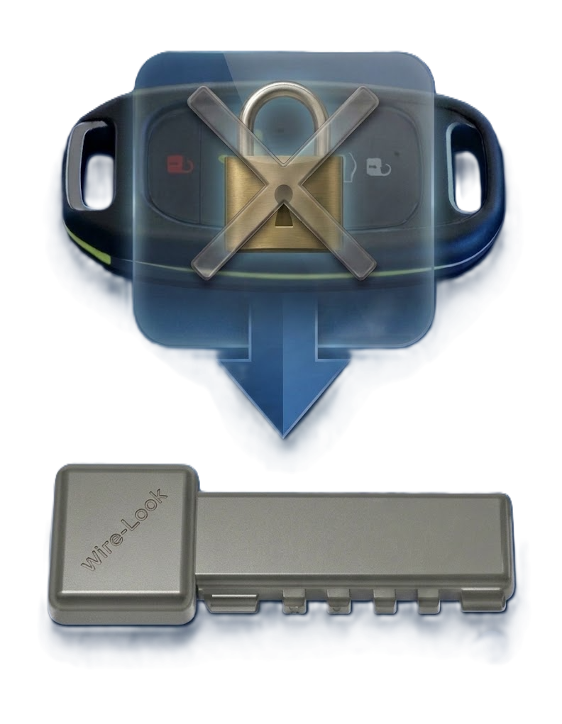
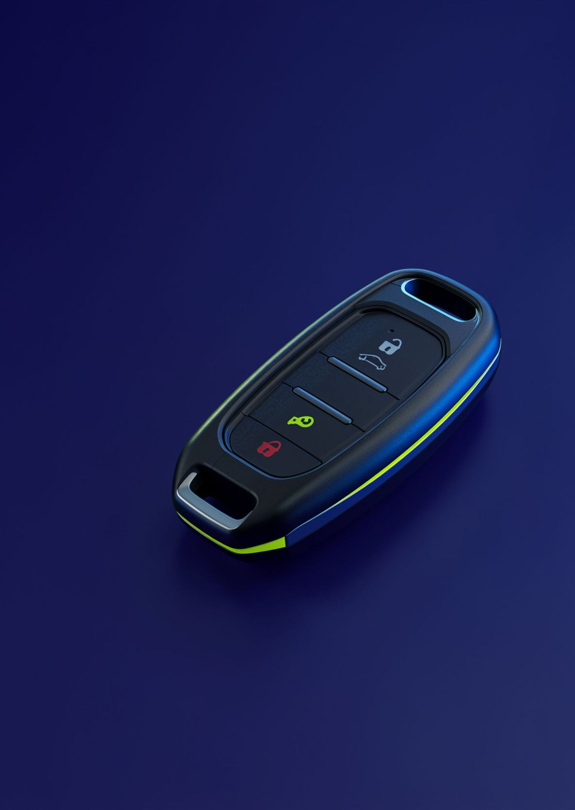


AUTOMOTIVE CYBERSECURITY
WireLock
The $2 Zero-RF Automotive Security Solution.
Eliminating relay attacks with physical cryptographic authentication.
JEYARAM B · +91 8309631052 · jeyaram.reddy.ece@gmail.com

Slide 2
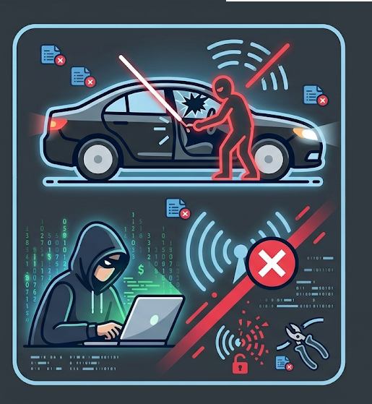
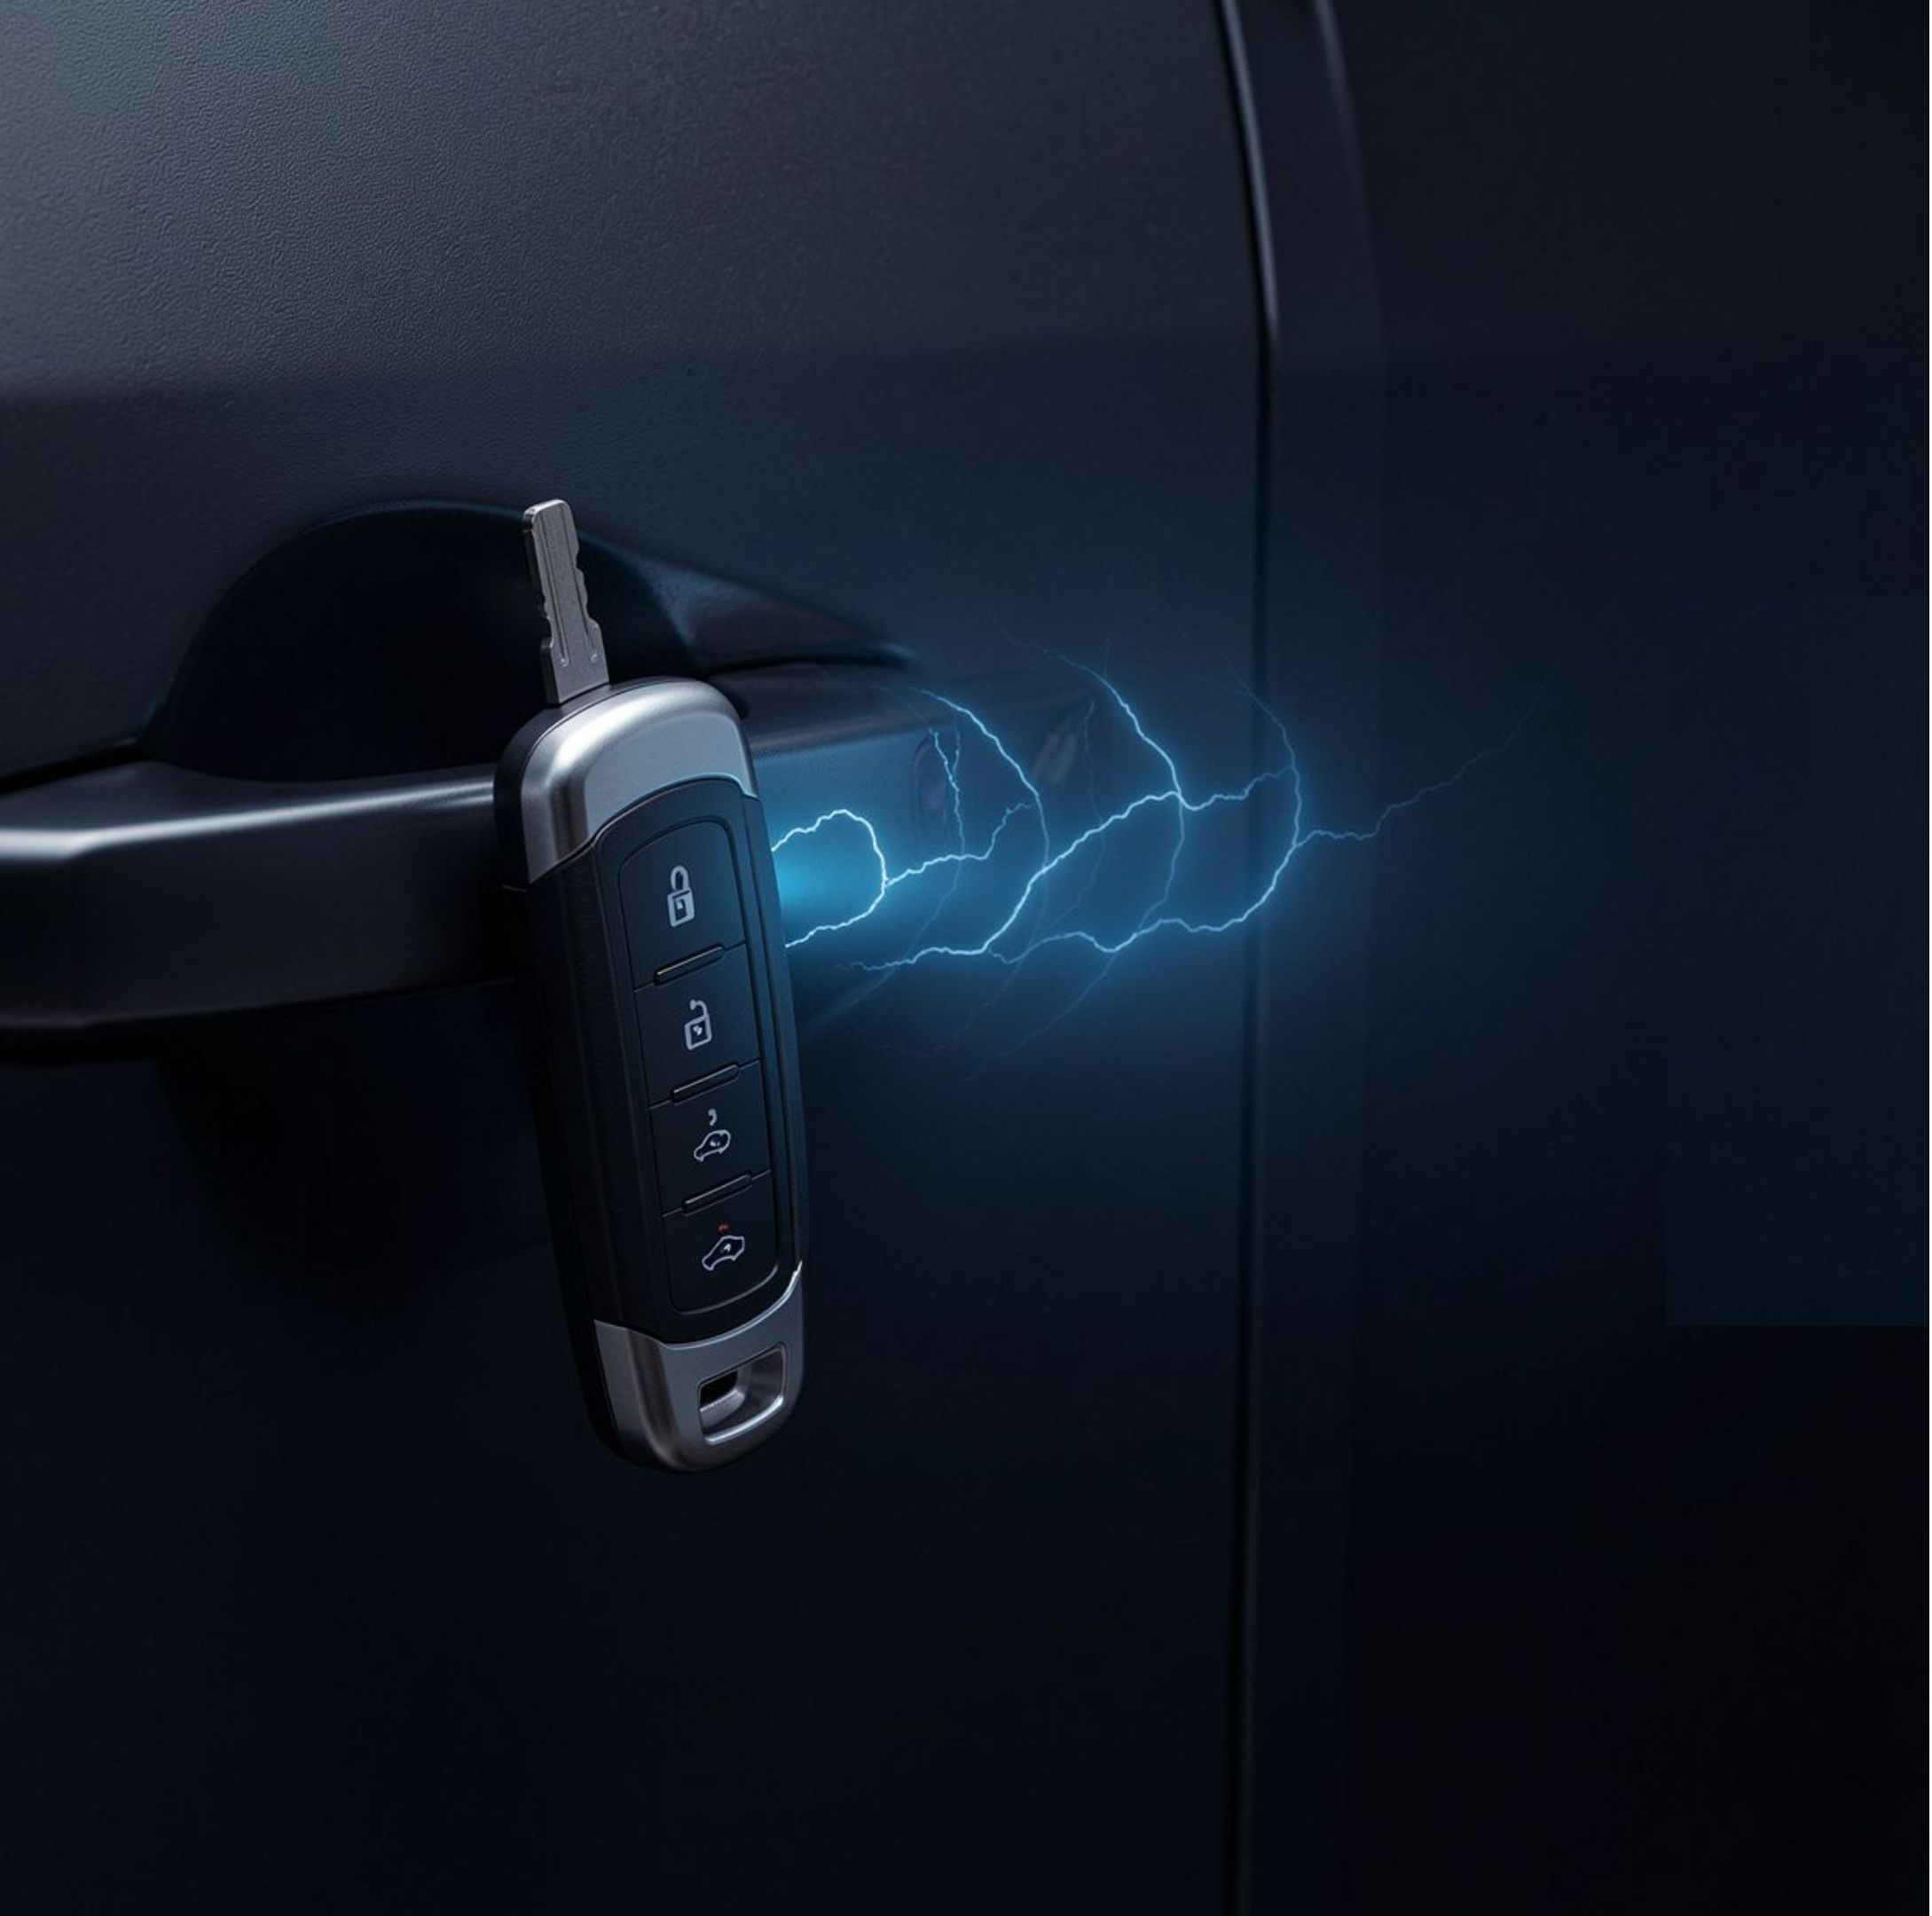

01 · THE EXPOSURE
Keyless entry has a wireless attack surface
Relay and skimming attacks increasingly compromise keyless entry systems.
UWB and biometrics add significant hardware cost, often $20+, while still relying on wireless channels.
Commercial fleets, rental companies, and vehicle owners absorb the resulting theft and disruption.

Slide 3
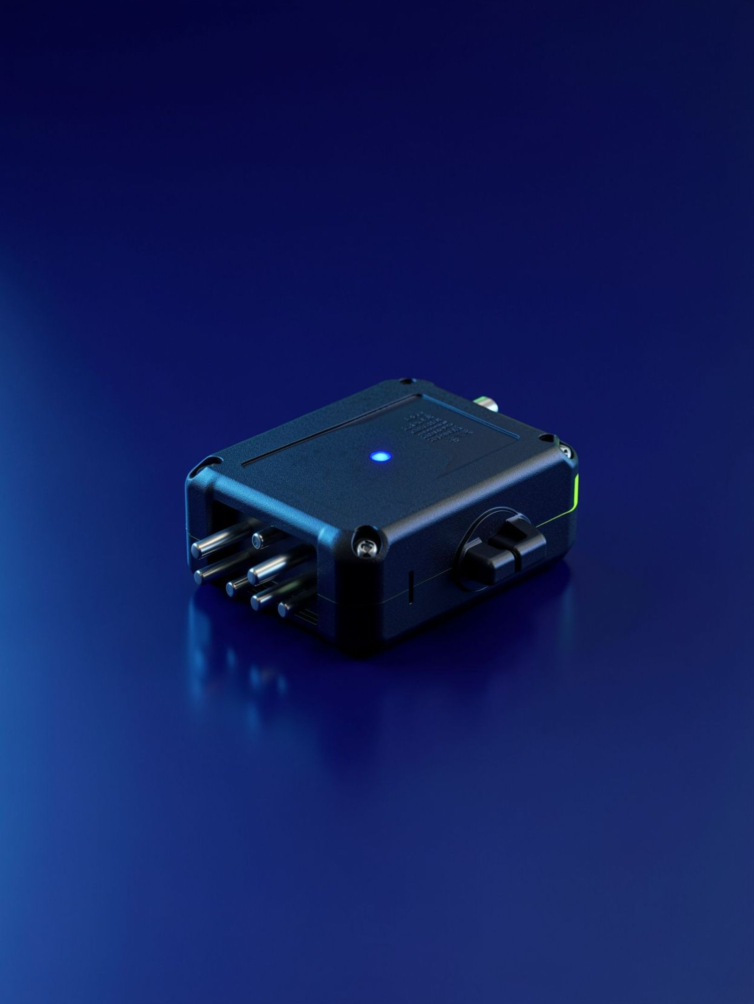

02 · THE MECHANISM
WireLock Architecture
Move authentication from the air to the physical connection.
Zero-RF architecture: removes the wireless attack surface; no radio frequencies means no relay attacks.
Physical handshake: proprietary contact-based authentication.
Advanced cryptography: ASCON and AES-based device authentication.
Dynamic defense: dynamic block permutation helps prevent hardware-level cloning.

Slide 4




03 · THE FIT
Security that fits the vehicle economics
A low-cost security layer for platforms where premium hardware is out of reach.
Ultra-low cost
Seamless integration
Commercial fleets
Rental, EV, and 2-wheelers
Target BOM under $2 at volume production.
Protect shared vehicles without premium hardware.
Standalone master key or high-security backup.
Built for self-drive rental cars, cost-sensitive EV platforms, and 2-wheelers.

Slide 5

04 · PARTNER VALIDATION
Traction is ready for partner validation
PATENT
PENDING
Prototype
Fully functional hardware prototype with 3D-printed enclosure ready.
IP protection
Indian patent filed
App No: 202641101016
Tier-1 automotive partners · technical evaluation · co-development · non-exclusive licensing

