Slide 1

INTRODUCTION TO AGILE
Presented By : JEYARAM A
Project Manager

Slide 2
Discussion Points
What is Agile?
How does it works?
Why we use agile methods?
Scrum Meeting (Daily Huddle Meet/Standup Meeting)
Important terms
Scrum process
Scrum Artifacts

Slide 3

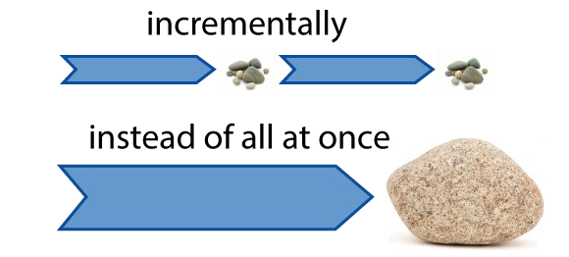
What is Agile?
Agile is a time boxed, iterative approach to software delivery that builds software incrementally from the start of the project, instead of trying to deliver it all at once near the end.
It works by breaking projects down into little bits of user functionality called user stories, prioritizing them, and then continuously delivering them in short two week cycles called iterations.
Final project design is not known in great detail and is continuously developed through a series of incremental iterations over time.
Adjustments are made and a different iterative cycle begins.
Continuous integration, verification, and validation of the evolving product..
Frequent demonstration of progress to increase the likelihood that the end product will satisfy customer needs.
• Early detection of defects and problems.

Slide 4
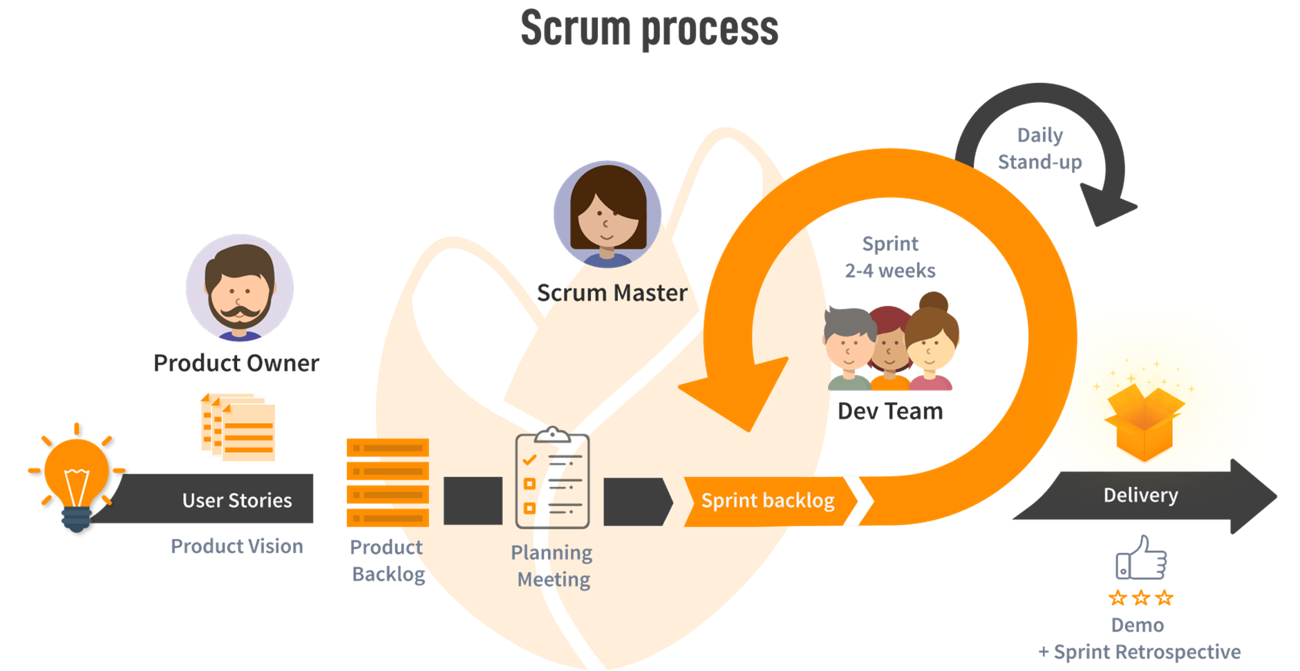
How does it work?

Slide 5
Scrum Meeting (Daily Huddle / Standup Meeting
Sprint Planning Meeting
Sprint Review Meeting
Sprint Retrospective Meeting
Daily Scrum Meeting
Daily Scrum: A short (less than 30 minutes) daily Scrum Meeting allows the team to monitor status and communicate problems.

Slide 6
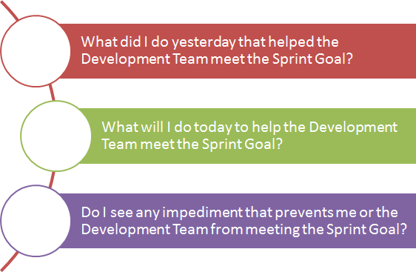
Daily Scrum:
Daily standup is a "brief, daily collaboration meeting in which the team review progress from the previous day, declares intentions for the current day, and highlights any obstacles encountered or anticipated.

Slide 7
Important Term:
Scrum: a definite project management emphasis.
Scrum Master: A Scrum project Is managed by a Scrum Master, who can be considered as much a consultant or coach as a manager.
Sprint. Scrum has a fundamental 30-day development cycle called a Sprint, preceded by
pre-Sprint activities and post-Sprint activities.

Slide 8
How does it work?
You make a list:
Sitting down with your customer you make a list of features they would like to see in their software. We call these things user stories and they become the To Do list for your project.
You size things up:
You size(estimate) your stories relatively to each other, coming up with a guess as to how long you think each user story will take.
You set some priorities:
Like most lists, there always seems to be more to do than time allows. So you ask your customer to prioritize their list so you get the most important stuff done first, and save the least important for last.
You start executing:
Then you start delivering some value. You start at the top. Work your way to the bottom. Building, iterating, and getting feedback from your customer as you go.

Slide 9
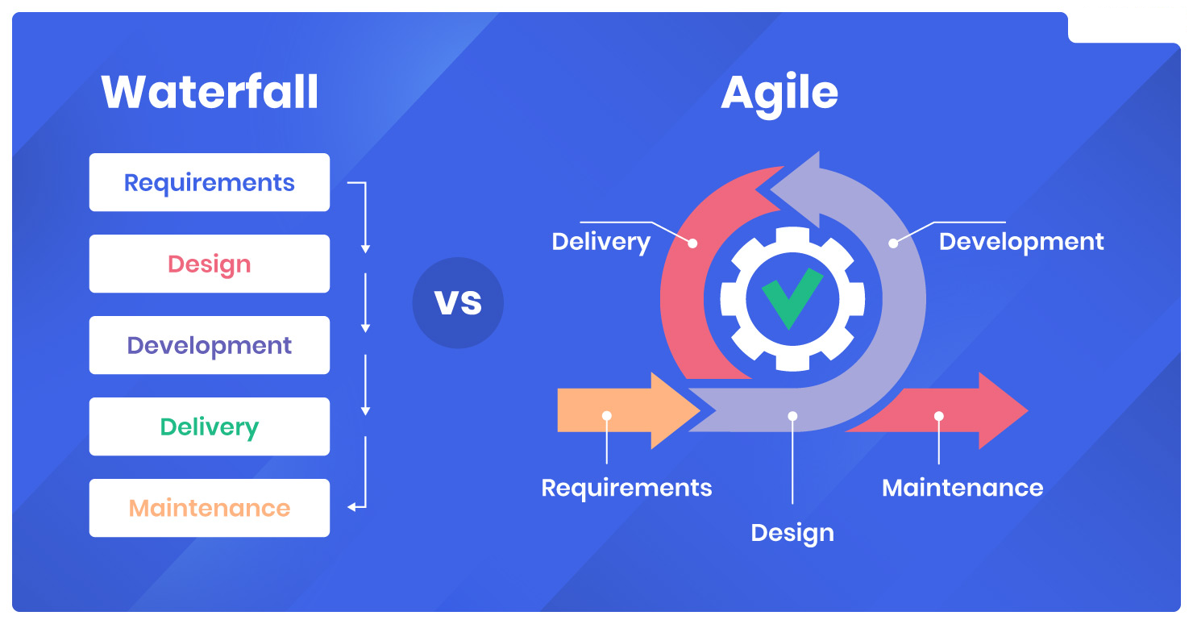
Waterfall vs Agile

Slide 10

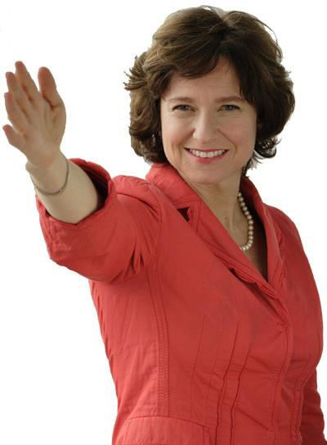






The Product Owner
Sets the Vision
Manages Backlog Elaborates Features Decides Release Dates
Develops the product with high quality.
Reviews Work

Slide 11
Product Owner
Single person responsible for maximizing the return on investment (ROI) of the development effort
Responsible for product vision
Constantly re-prioritizes the Product Backlog, adjusting any longterm expectations such as release plans
Final arbiter of requirements questions Accepts or rejects each product increment
Decides whether to ship
Decides whether to continue development Considers stakeholder interests
May contribute as a team member Has a leadership role

Slide 12
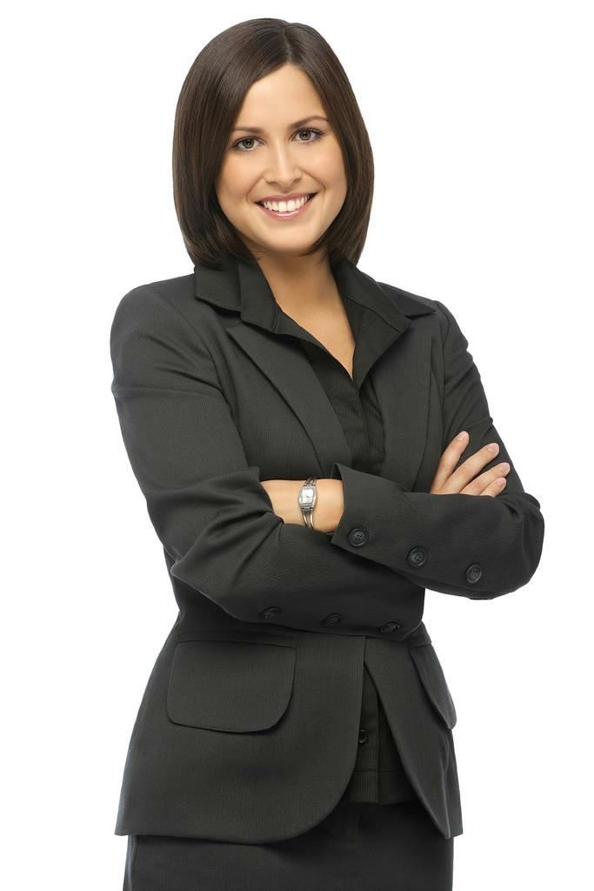






Scrum Master
Helps the Team be awesome!
Facilitates
Protect
Coach Teach
Administer

Slide 13
ScrumMaster
Scrum master is a core of scrum team
Doing scrum planning for a particular sprint
Manage dependencies and impediments
Is a part of scrum team not a manager
Responsible for scrum ceremonies (like daily stand-up ,demo, retrospective)

Slide 14
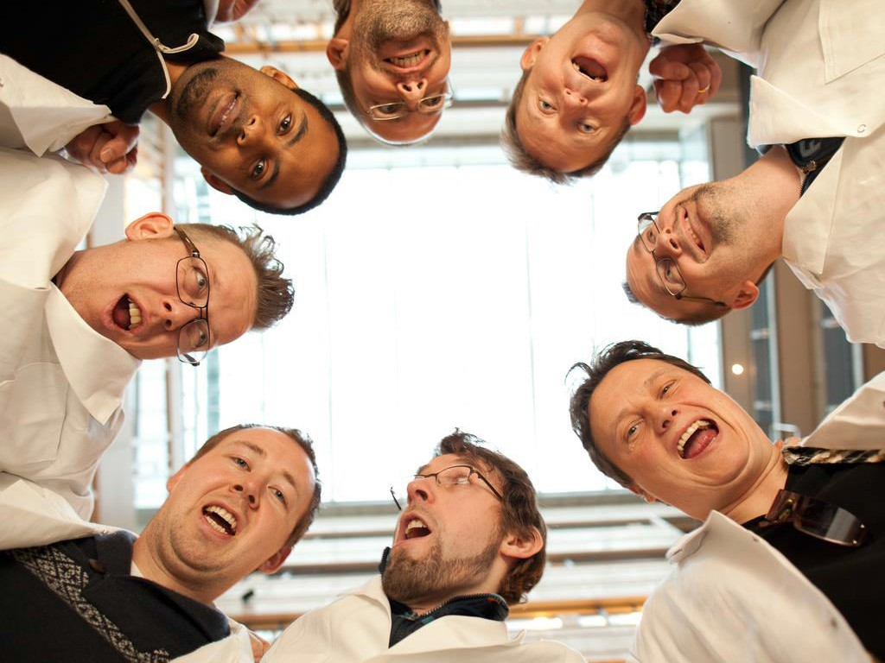

The Team
•7 +/- 2
•Cross functional
•Full time
•Self organizing
•Empowered
•Trust

Slide 15
Scrum Development Team
Scrum Team works towards acheiving goal of the sprint. They work on scrum baklog item and take part in scrum ceremonies.
Scrum team take part in daily standup and discuss 3 things:
What was done yesterday?
What's the plan for today?
Any impediments?

Slide 16
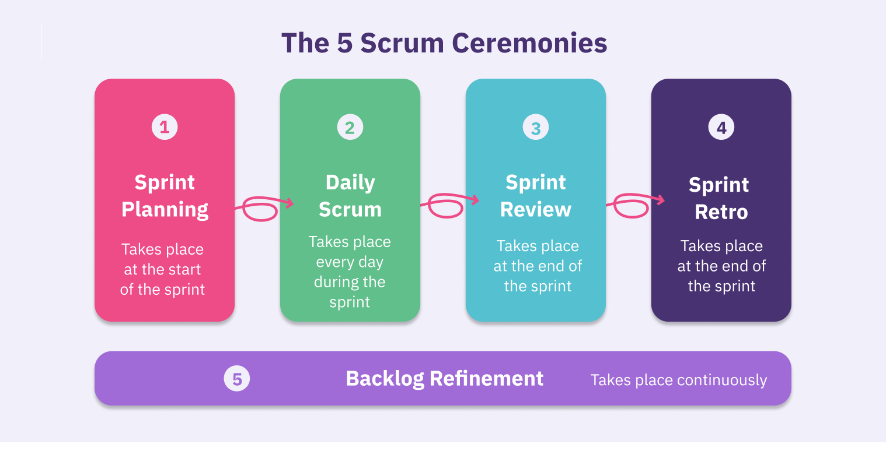
Scrum Ceremonies

Slide 17
Sprint Planning
A collaborative meeting in the beginning of each Sprint between the Product Owner, the Scrum Master and the Team.
Takes 8 hours and consists of 2 parts (“before lunch and after lunch”)
The Product Owner and team negotiate which Product Backlog Items they will attempt to convert to working product during the Sprint. The Product Owner is responsible for declaring which items are the most important to the business.
The team is responsible for selecting the amount of work they feel they can implement without accruing technical debt. The team “pulls” work from the Product Backlog to the Sprint Backlog.

Slide 18
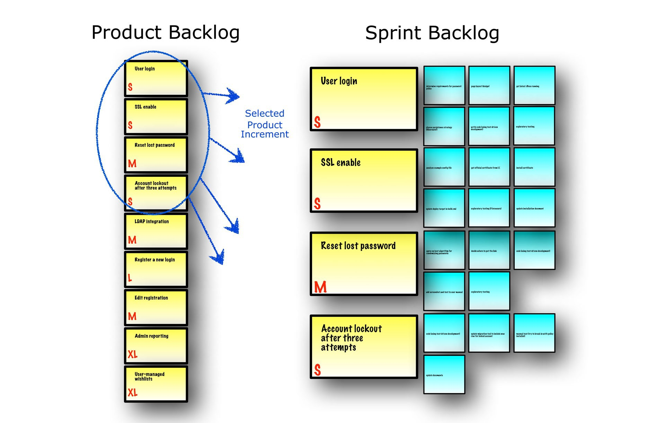
Sprint Planning

Slide 19
Parts of Sprint Planning Meeting
1st Part:
Creating Product Backlog
Determining the Sprint Goal.
Participants: Product Owner, Scrum Master, Scrum Team
2nd Part:
Participants: Scrum Master, Scrum Team
Creating Sprint Backlog

Slide 20
Difference between Product Backlog & Sprint Backlog
Managed by product owner and contains a high-level view of all the work that your team must complete to create the product. Your product owner ranks the user stories in the product backlog and provides sufficient detail during the sprint planning meeting so that your team can estimate and implement each user story.
In contrast, your team creates the sprint backlog, which contains a detailed list of all the tasks that your team must complete to finish the user stories for the sprint. In the product backlog, your team estimates user stories with the relative unit of story points. In the sprint backlog, your team estimates tasks in hours.
Your product owner updates the product backlog every week, but your team updates the sprint backlog at least daily.
Your product owner maintains the same product backlog throughout the project, but your team creates a new sprint backlog for each sprint.

Slide 21
Sprint Review:
Team demonstrates the actual work product increments they have built to the PO & stakeholders.
PO declares which items are done and which items need further work and returned to the product backlog.
The sprint review meeting is an opportunity to examine and adapt the product as it emerges and iteratively refine key requirements.

Slide 22
Sprint Retrospective
The purpose of retrospective is to reflect on how well the previous sprint went and identify specific action that can improve future sprints.
The retrospective reflects Scrum`s commitment to continuous improvement and the value it places on improving not only products but the team interaction.

Slide 23
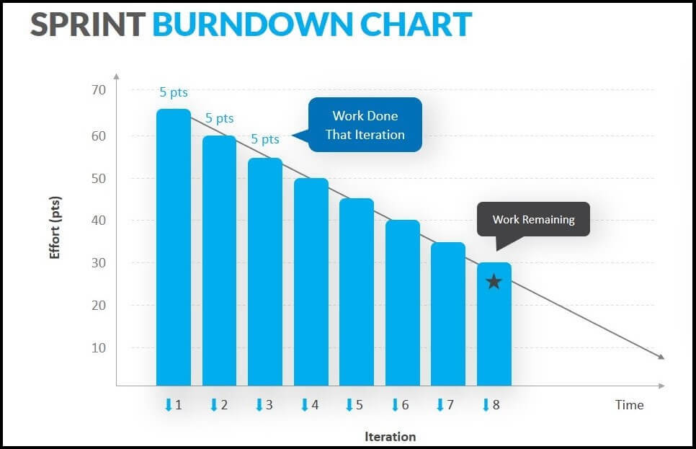
Scrum Artifacts
Product Backlog
Sprint Backlog
Burn down Charts

Slide 24
Product Backlog
Requirements for a system, expressed as a prioritized list of Backlog Items
Is managed and owned by a Product Owner Spreadsheet (typically)
Usually is created during the Sprint Planning Meeting Can be changed and re-prioritized before each PM

Slide 25
Sprint Backlog
No more then 300 tasks in the list
If a task requires more than 16 hours, it should be broken down
Team can add or subtract items from the list. Product Owner is not allowed to do it.

Slide 26
Burn down Charts
Are used to represent “work done”.
Are wonderful Information Radiators 3 Types:
Sprint Burn down Chart (progress of the Sprint)
Release Burn down Chart (progress of release)
Product Burn down chart (progress of the Product)

Slide 27
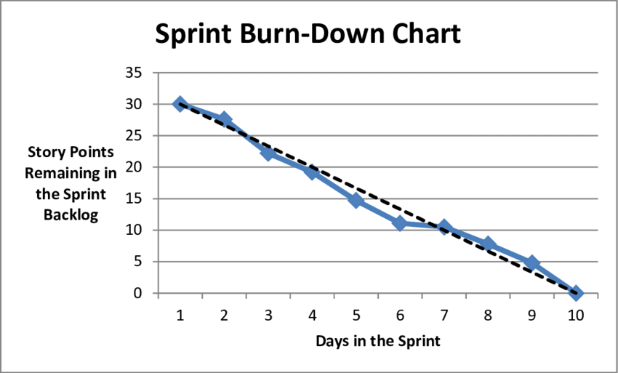
Sprint Burn down Chart

Slide 28
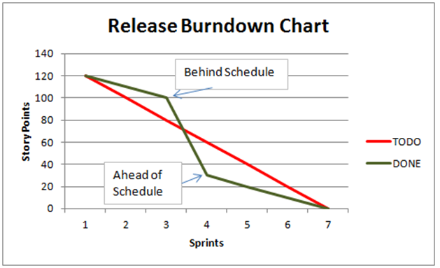
Release Burn down Chart

Slide 29
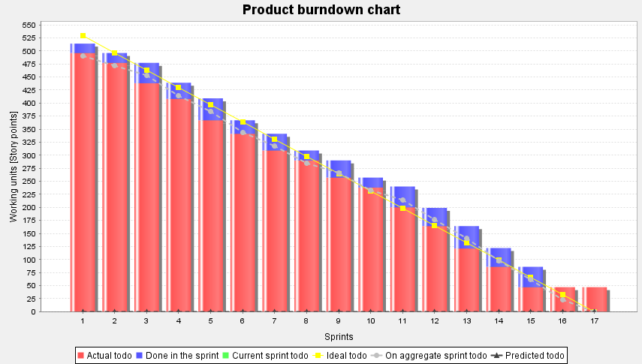
Product Burn down Chart

Slide 30



