Slide 1

KIT - KalaignarKarunanidhi Institute of Technology ( An Autonomous Institution )
Department of Computer Applications
M20CAP302 - OPEN LAB
REVIEW-1
PROJECT TITLE :EMOTION DETECTION IN TEXT DATA USING NLP
PRESENTED BY,
NAME : KISHORE KUMAR J
REG NO : 711522MMC022
CLASS : II-MCA

Slide 2
INTRODUCTION
In the "Emotion Detection in Text Data Using NLP" project the NLP algorithm is used to identify emotions in text. It’s features can user authentication, emotion prediction, and monitoring.
Users can log-in, input text, and analyze emotions instantly.
The project provides confidence scores for predictions, making it useful for sentiment analysis and customer feedback.
It visualizes emotions using emojis and probability distributions in text.

Slide 3
SYSTEM SPECIFICATIONS
HARDWARE SPECIFICATION
Processor : 6 th Gen Intel(R) Core(TM) i5-1235U 1.30 GHz
Ram : 2.0 GB
Hard Disk : 125 Gb
SOFTWARE SPECIFICATION
Operating System : windows 8
IDE : Visual Studio Code
Library : Python Streamlit

Slide 4
DATAFLOW DIAGRAM
USER
Registration
USER-LOGIN
INPUT TEXT
EMOTION DEDECTION
DATASET
OUTPUT EMOTION
TEST DATA
TRAIN DATA

Slide 5
MODULE DESCRIPTION
REGISTRATION
LOGIN
EMOTION DETECTION
MONITOR
ABOUT
LOGOUT

Slide 6
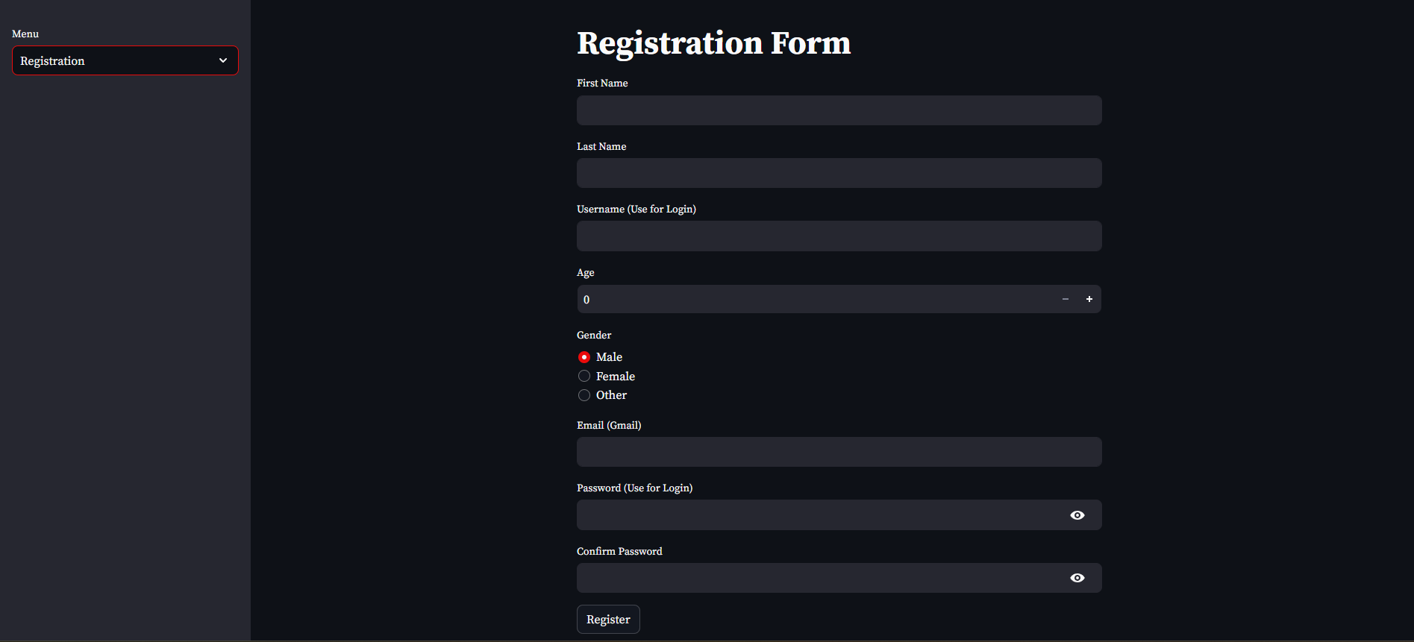
REGISTRATION

Slide 7
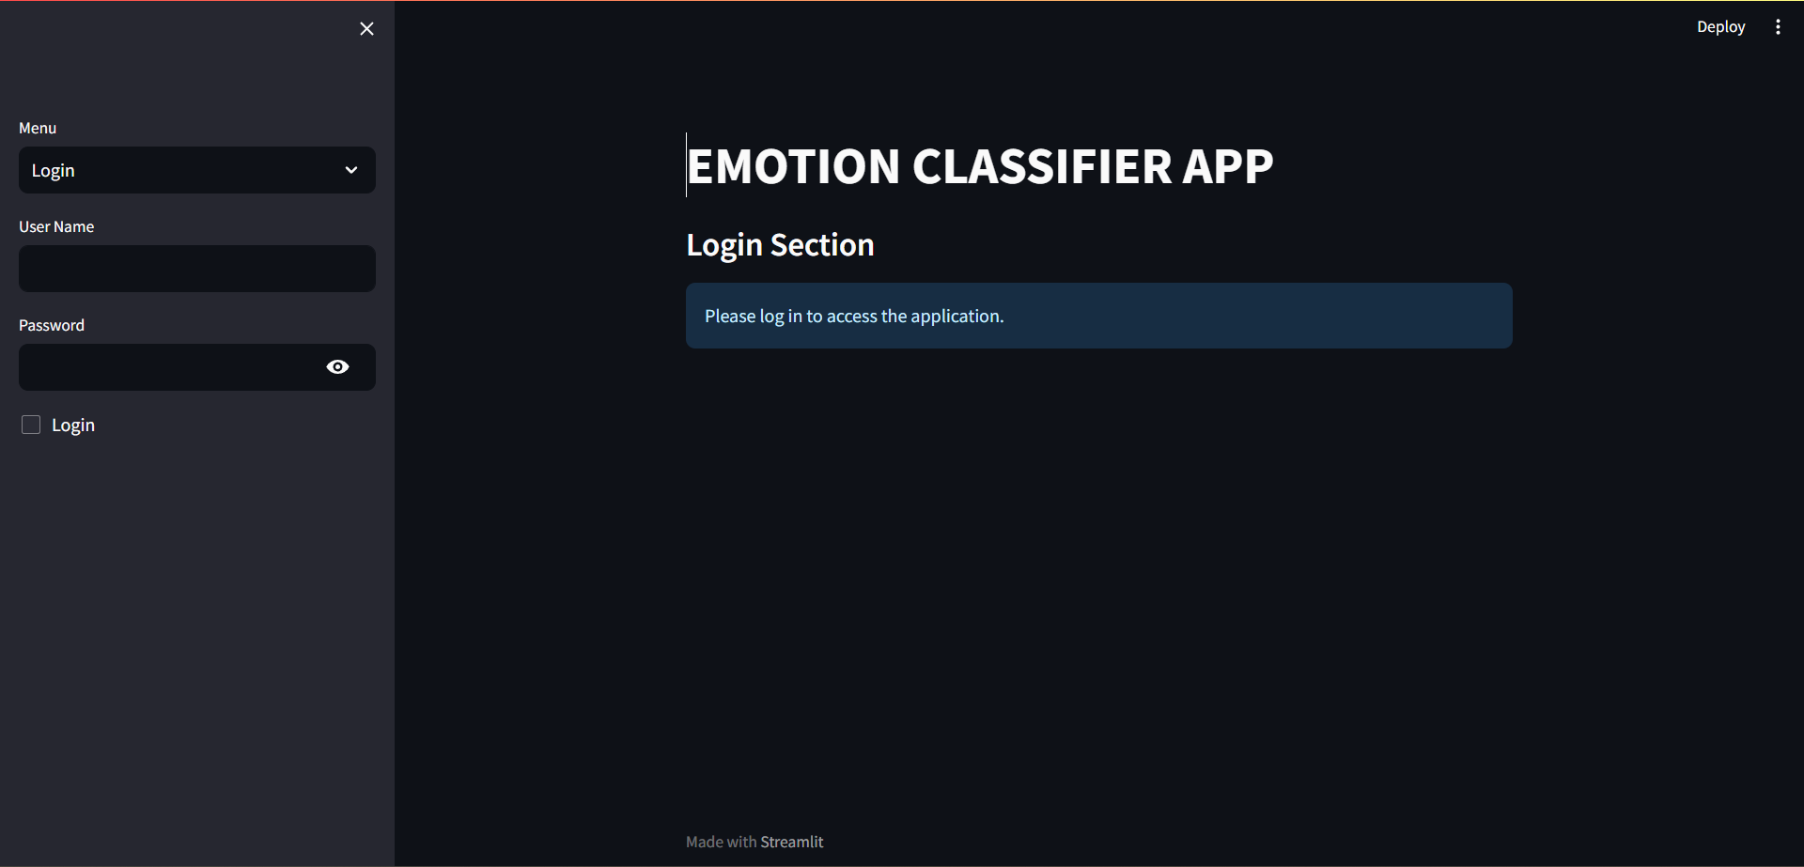
LOGIN

Slide 8
THANK YOU

