Slide 1

KIT - KalaignarKarunanidhi Institute of Technology ( An Autonomous Institution )
Department of Computer Applications
M20CAP302 - OPEN LAB
REVIEW-2
PROJECT TITLE :EMOTION DETECTION IN TEXT DATA USING NLP
PRESENTED BY,
NAME : KISHORE KUMAR J
REG NO : 711522MMC022
CLASS : II-MCA

Slide 2
MODULE DESCRIPTION
EMOTION DETECTION
ABOUT
LOGOUT

Slide 3
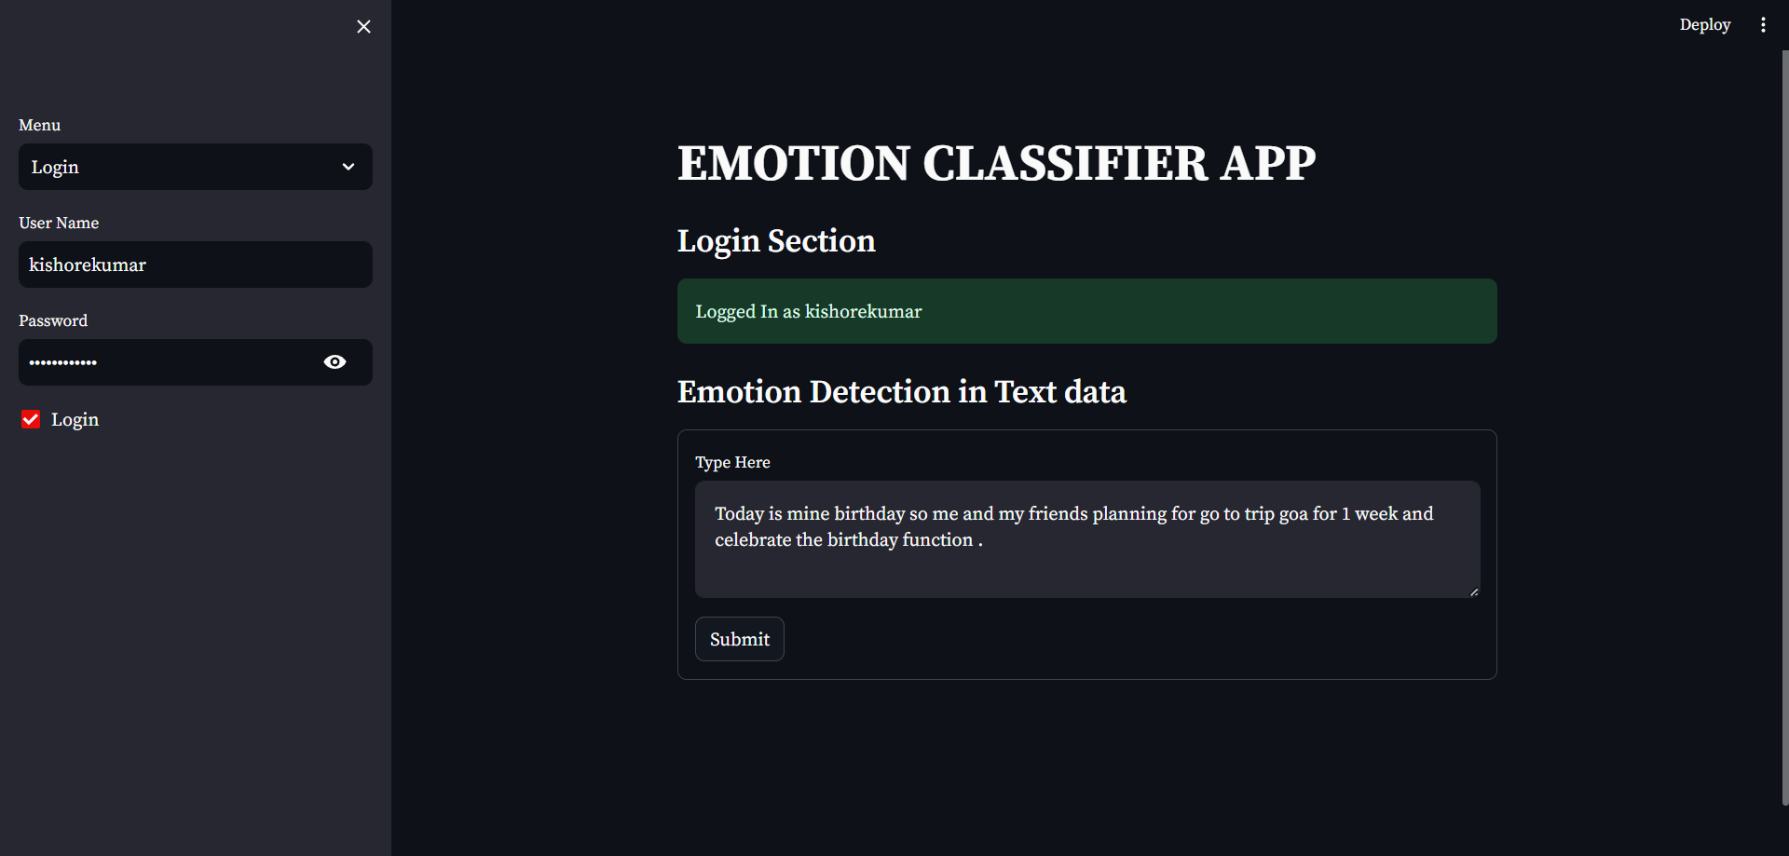
EMOTION DETECTION

Slide 4
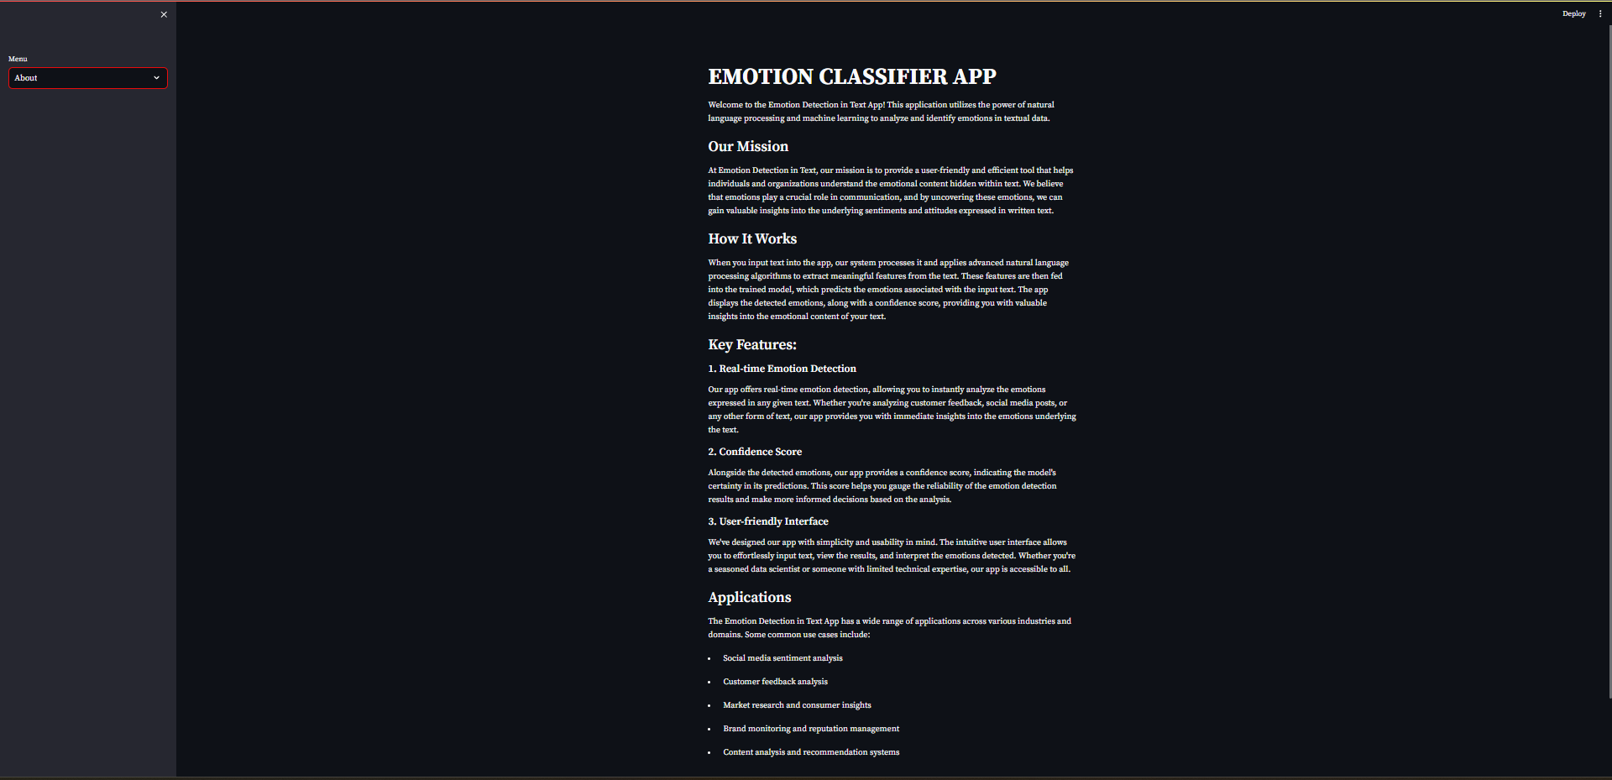
ABOUT

Slide 5
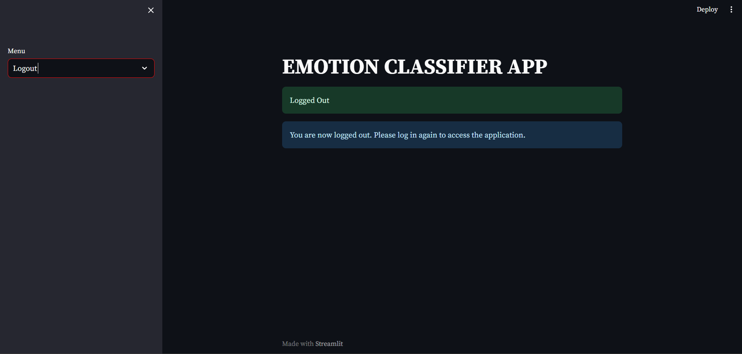
LOGOUT

Slide 6
DATAFLOW DIAGRAM
LEVEL-0

Slide 7
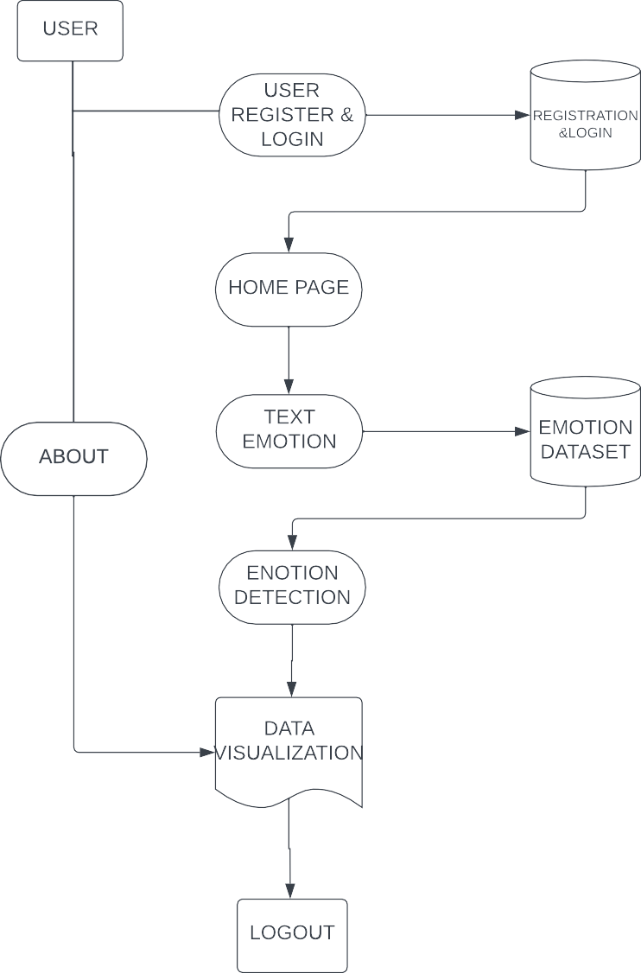
LEVEL-1

Slide 8
THANK YOU

