Slide 1

KIT - KalaignarKarunanidhi Institute of Technology ( An Autonomous Institution )
Department of Computer Applications
M20CAP302 - OPEN LAB
REVIEW-3
PRESENTED BY,
NAME : KISHORE KUMAR J
REG NO : 711522MMC022
CLASS : II-MCA

Slide 2
EMOTION DETECTION IN TEXT DATA USING NLP

Slide 3
ABSTRACT
In the "Emotion Detection in Text Data Using NLP" project the NLP algorithm is used to identify emotions in text. It’s features can user authentication, emotion prediction, and monitoring.
Users can log-in, input text, and analyze emotions instantly.
The project provides confidence scores for predictions, making it useful for sentiment analysis and customer feedback.
It visualizes emotions using emojis and probability distributions in text.

Slide 4
ADVANTAGES OF PROPOSAD SYSTEM
Precision Improvement: Addresses current system limitations, enhancing accuracy in emotion detection.
Multimodal Integration: Incorporates pictures and sounds alongside text for a comprehensive understanding of emotions.
Contextual Recognition: Recognizes emotions in specific contexts like health discussions and social media interactions.
Scalability Enhancement: Aims to overcome scalability issues present in the current system.
Continuous Learning: Focuses on adapting to language and emotion changes for ongoing improvement.

Slide 5
DISADVANTAGES OF EXISTING SYSTEM
Lack of Precision and Nuance: Current systems lack the precision and nuance needed for accurate emotion detection.
Manual and Time-Consuming Analysis: Traditional approaches rely on manual, time-consuming human analysis, impeding efficiency.
Incompatibility with Real-Time Analysis: The method is unsuitable for real-time or large-scale text analysis, limiting its applicability.
Insufficient Integration of NLP and Machine Learning: Without integration, accuracy and efficiency suffer, hindering meaningful insights extraction.
Absence of User Registration and Personalization: The current system lacks user registration and personalization, limiting user engagement and experience

Slide 6
MODULE SPECIFICATION
HOME
REGISTRATION
LOGIN
EMOTION DETECTION
ABOUT
LOGOUT
ADMIN
MONITOR

Slide 7
SYSTEM SPECIFICATIONS
HARDWARE SPECIFICATION
Processor : 6 th Gen Intel(R) Core(TM) i5-1235U 1.30 GHz
Ram : 2.0 GB
Hard Disk : 125 Gb
SOFTWARE SPECIFICATION
Operating System : windows 8
IDE : Visual Studio Code
Library : Python Streamlit

Slide 8
DATABASE TABLE
S.NO | FIELD NAME | DATA TYPE | FIELD DISCRIPTION
1 | User ID | INT | It is used to store the unique id
2 | Username | Varchar | It is used to store the user name
3 | Password | Varchar | It is used to store the password
4 | First_Name | Varchar | It is used to store the first name
5 | Last_Name | Varchar | It is used to store the last name
6 | Age | INT | It is used to store the age name
7 | Gender | Varchar | It is used to store the gender name
8 | Email | Varchar | It is used to store the email name

Slide 9
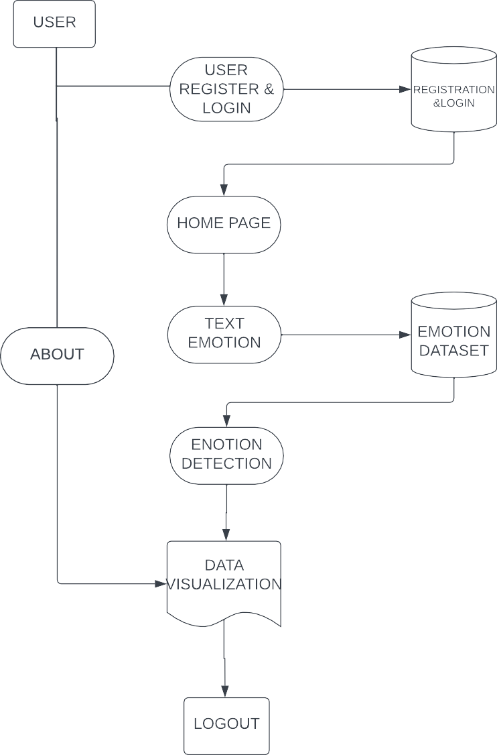
DATAFLOW DIAGRAM
LEVEL-1

Slide 10
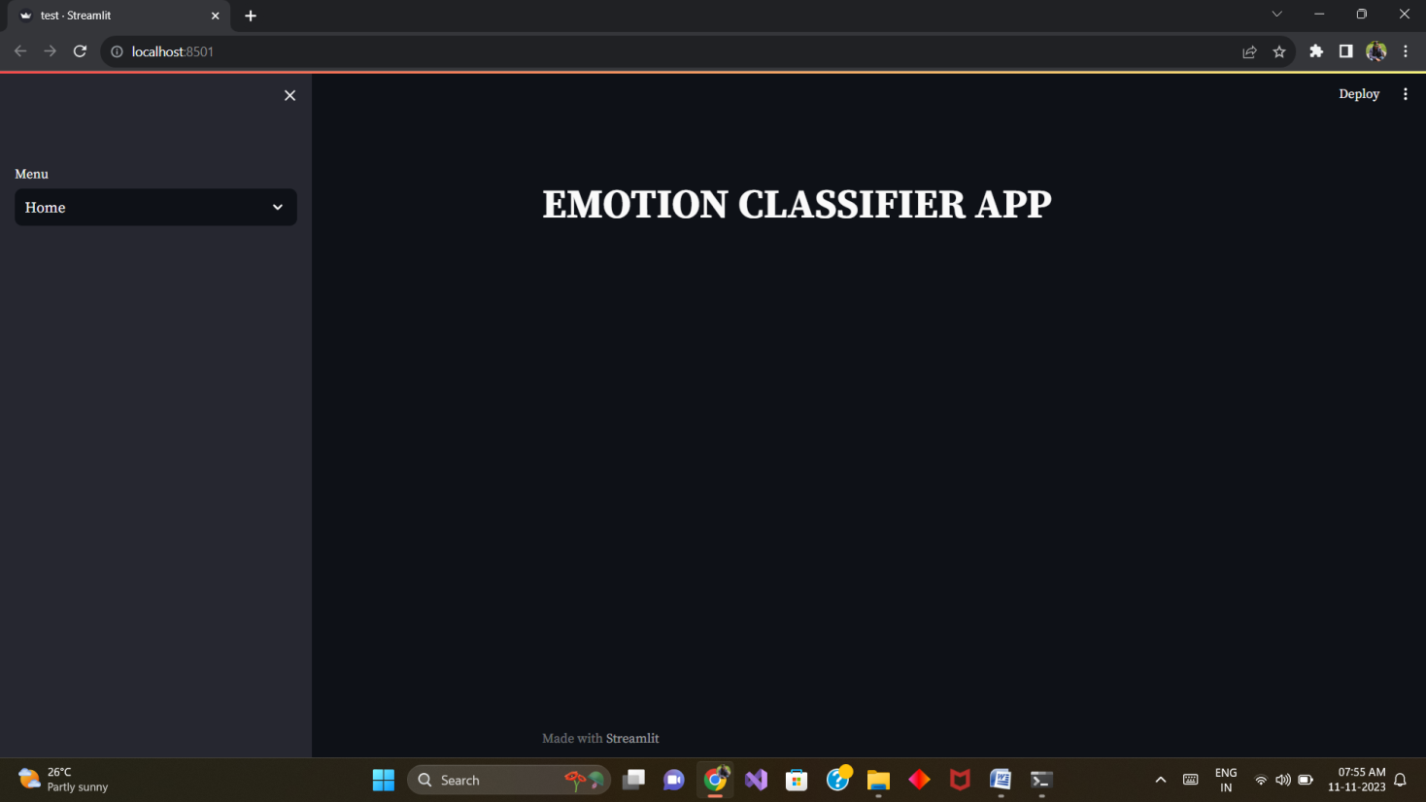
HOME
Figure-1

Slide 11
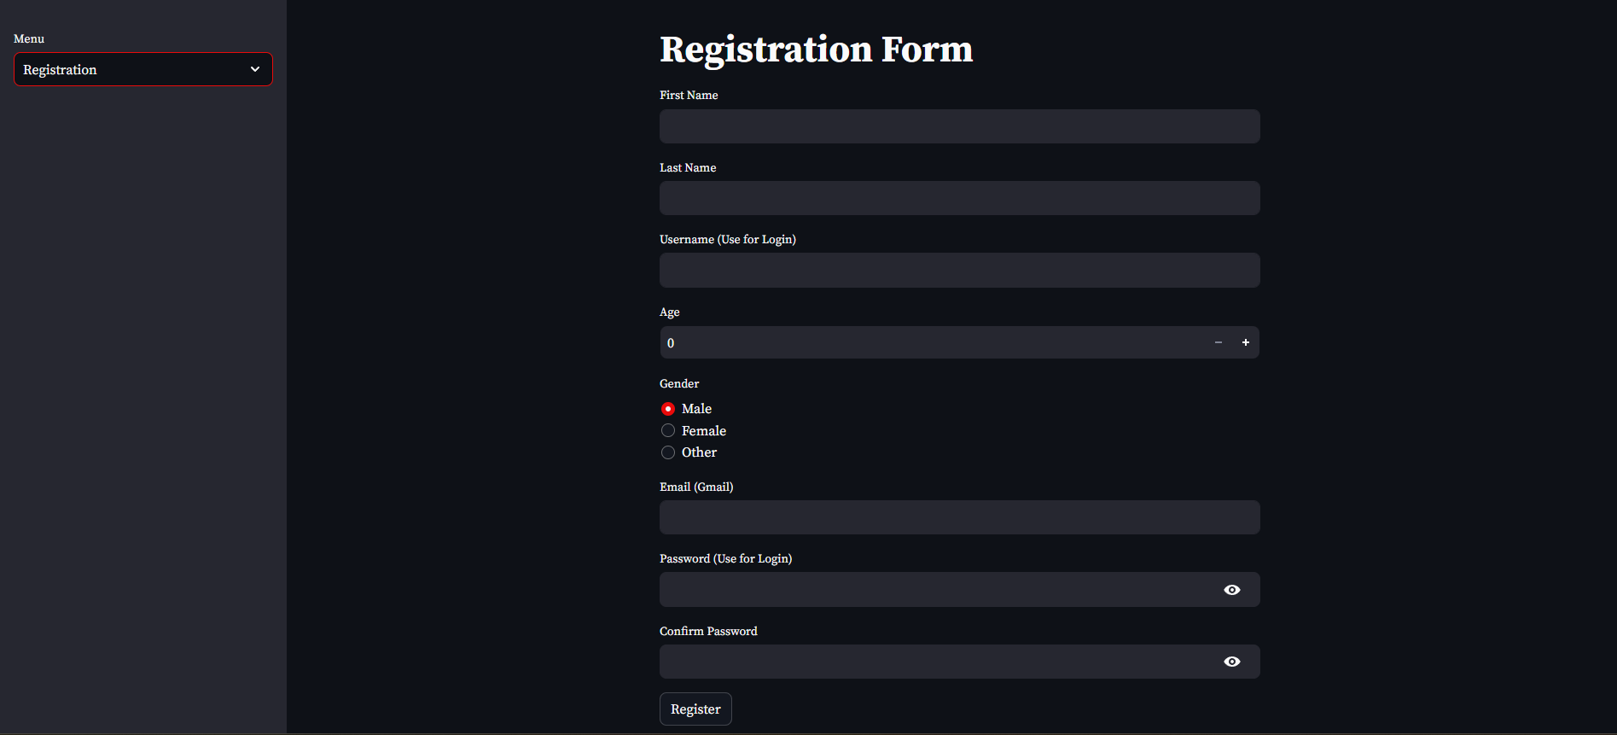
REGISTRATION FORM
Figure-2

Slide 12
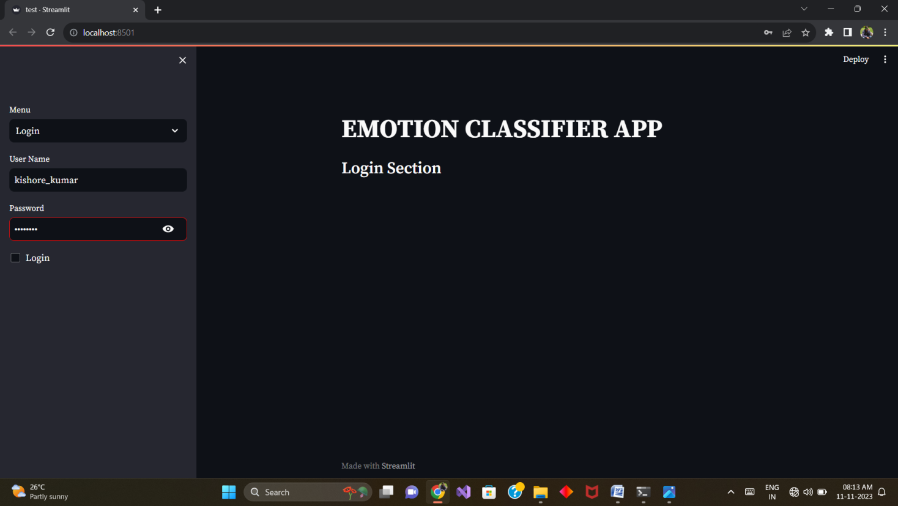
LOGIN
Figure-3

Slide 13
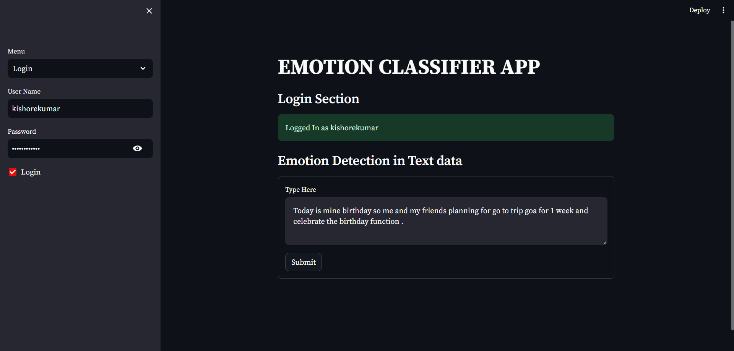
EMOTION DETECTION
Figure-4

Slide 14
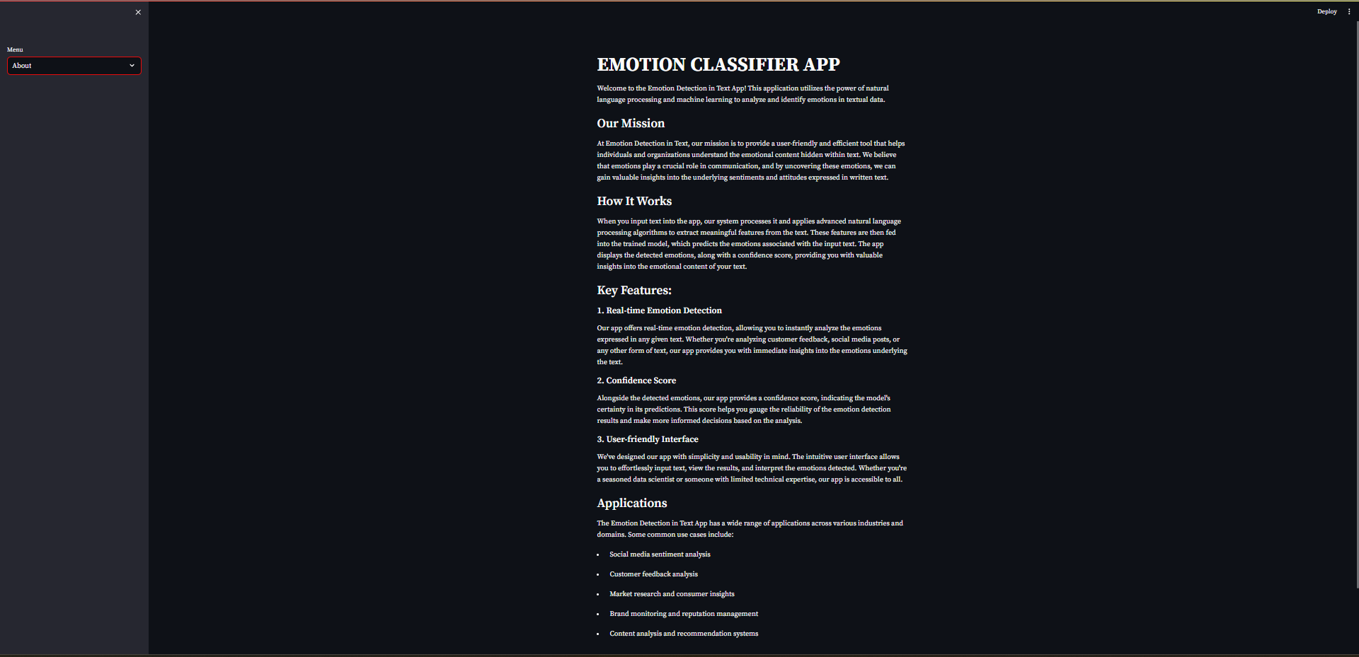
ABOUT
Figure-5

Slide 15
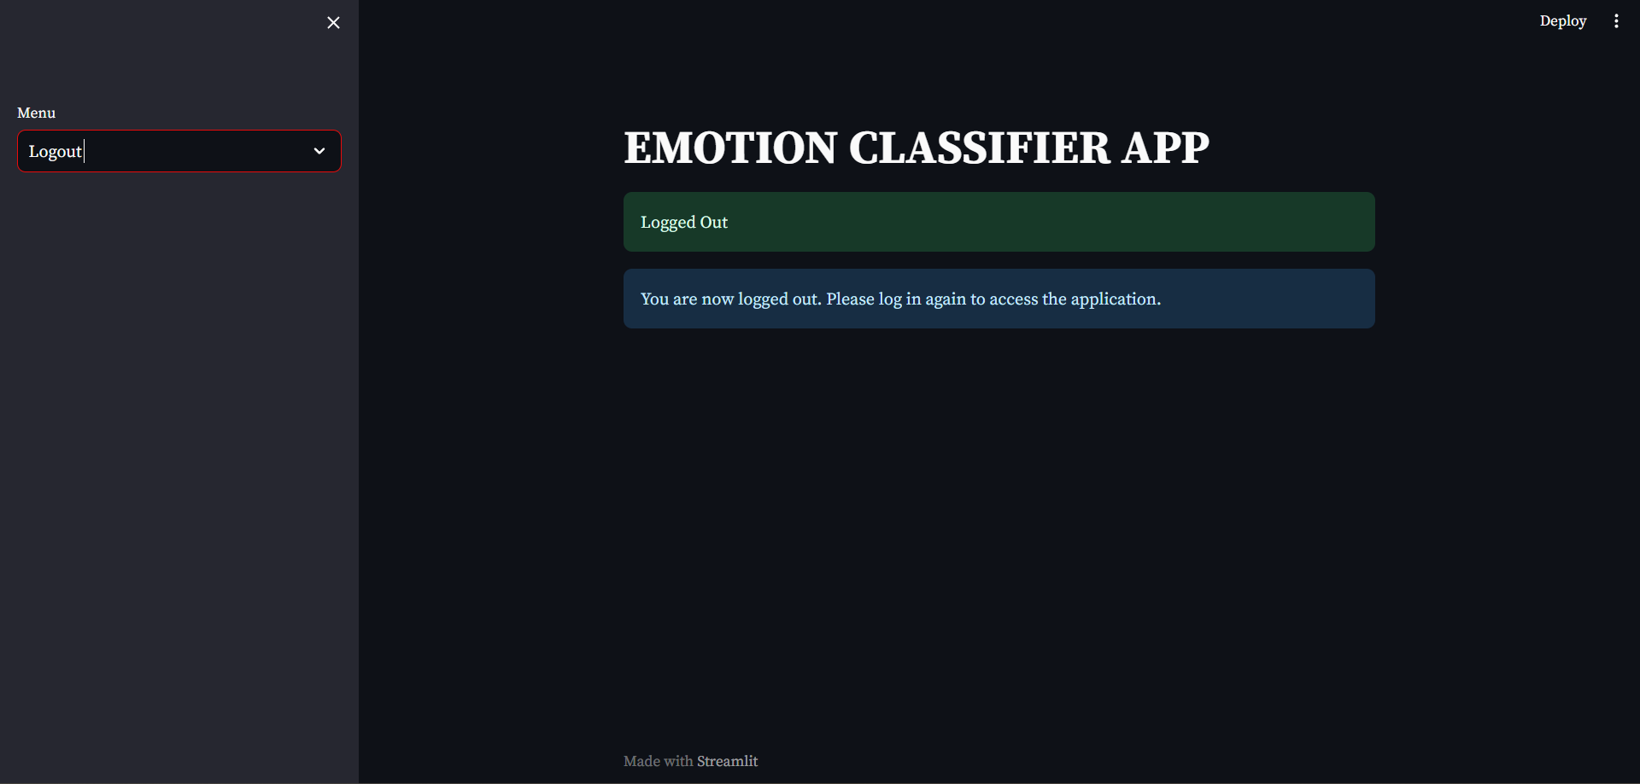
LOGOUT
Figure-6

Slide 16
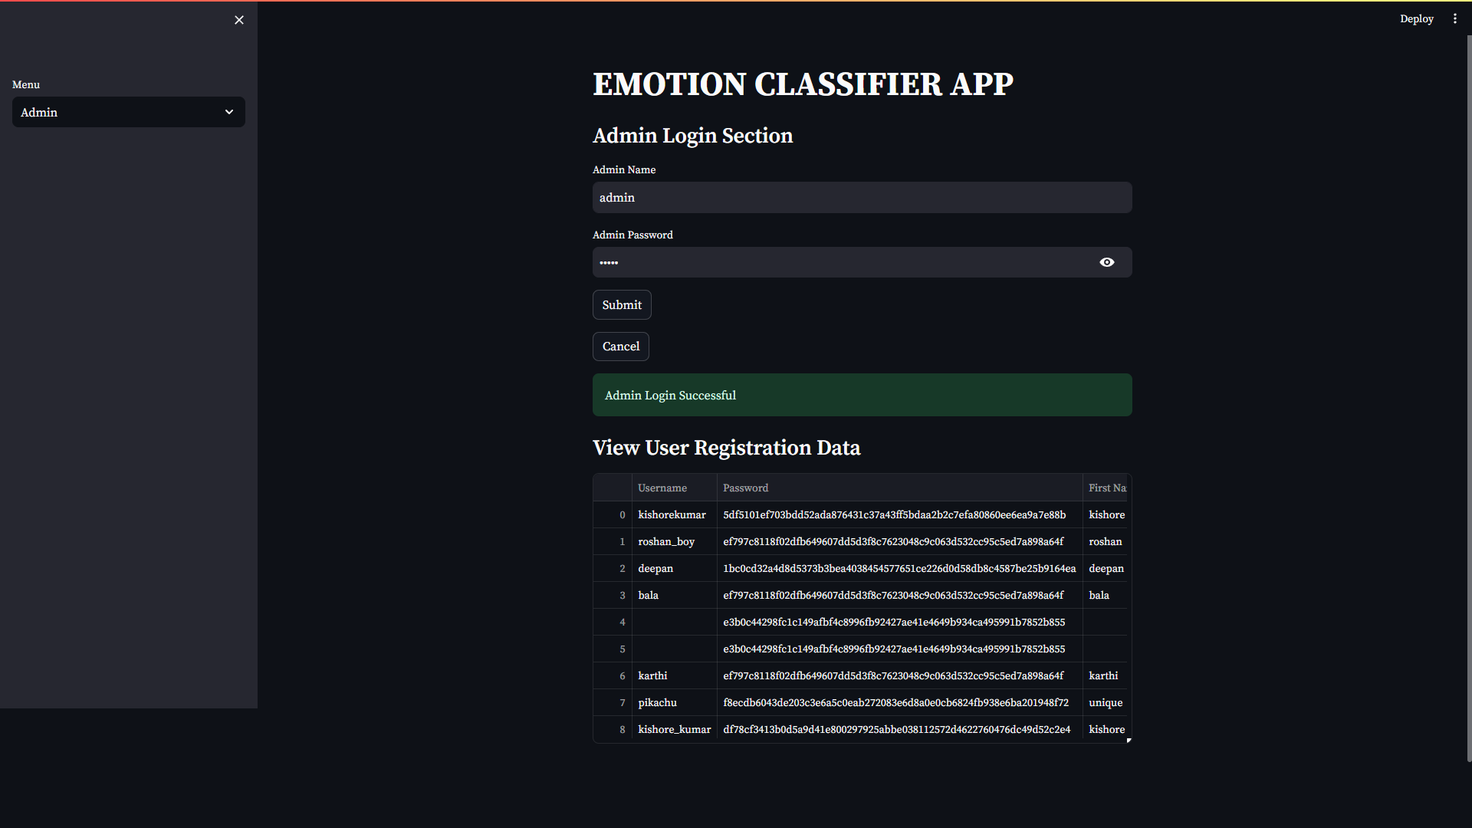
ADMIN
Figure-7

Slide 17
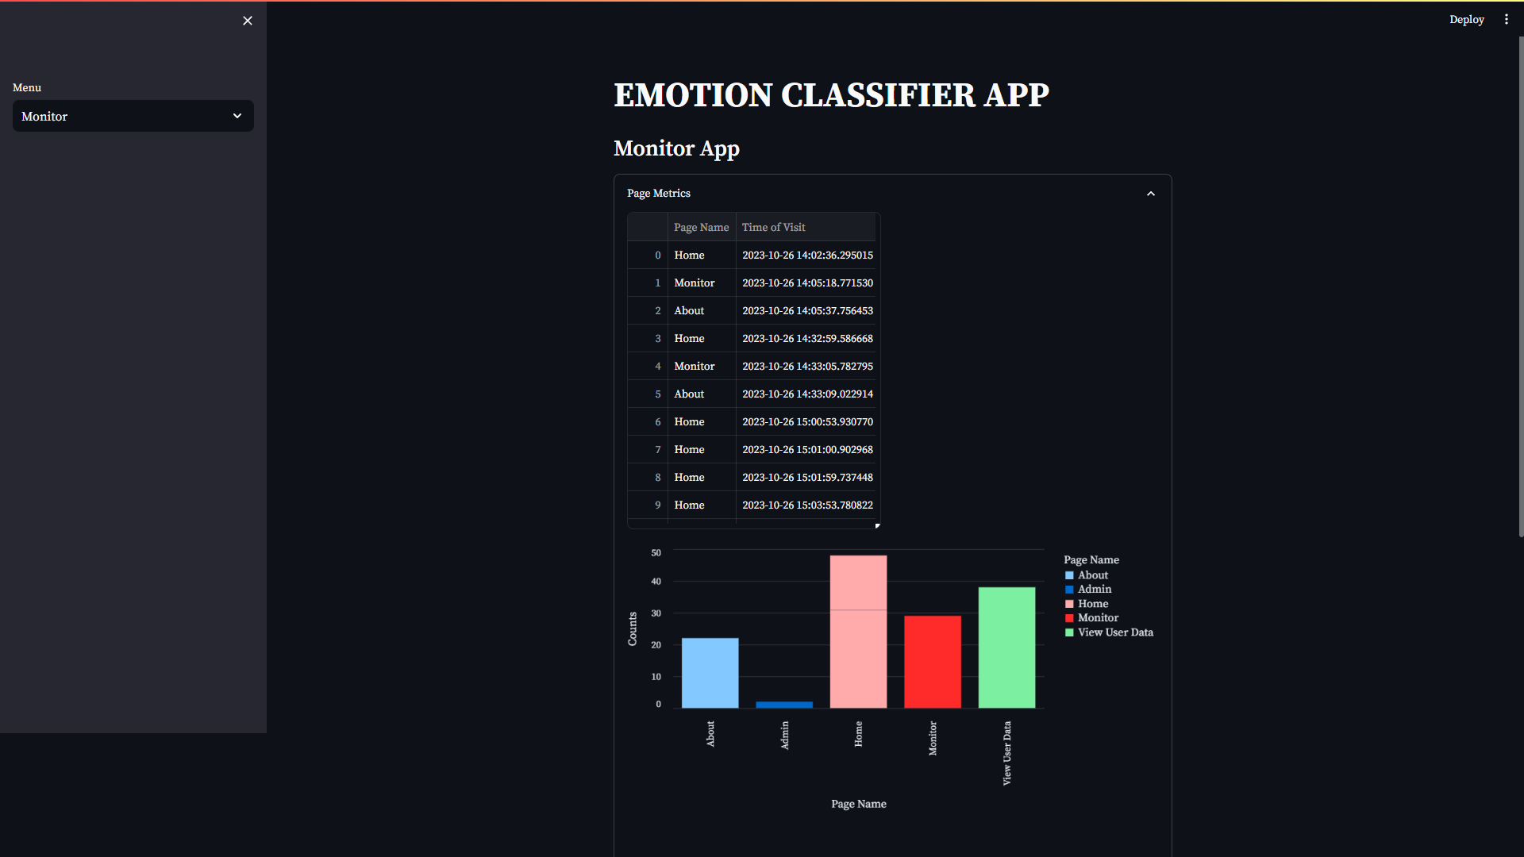
MONITOR
Figure-8

Slide 18
TESTING
UNIT TESTING
INTEGRATION TESTING
USER INTERFACE TESTING
SECURITY TESTING

Slide 19
CONCLUSION
Comprehensive NLP Application: Utilizes NLP for in-depth emotion analysis in textual content.
Diverse Applications: Targets sentiment analysis, customer feedback evaluation, and social media monitoring.
Efficient Data Management: Incorporates core packages for streamlined data handling.
User Registration and Login: Enhances personalization and user engagement.
Real-time Emotion Predictions: Users input text and receive immediate emotion predictions with confidence scores.
Administrative Monitoring: Includes a feature for tracking user activities.
Accessible and User-Friendly: Aims to simplify emotion detection in text for various sectors.
Python Code Implementation: Outlines model loading, database management, and user authentication for versatile use.

Slide 20
FUTURE ENHANCEMENT
Robust Emotion Analysis Platform: Project provides a strong foundation for emotion analysis in textual content.
Multi-language Support: Future enhancement to broaden usability.
Real-time Data Streaming: Implementation for continuous social media and customer feedback analysis.
Domain-Specific Model Fine-Tuning: Improves accuracy in industry contexts.
Advanced Visualization and Sentiment Trend Analysis: Offers deeper insights into emotional patterns.
Integration with External APIs: Enables sentiment comparison against global benchmarks.
Enhanced User Authentication: Measures like two-factor authentication for improved security.
Interactive Dashboard Creation: Enriches user experience and versatility of the application.

Slide 21
THANK YOU

