Slide 1

A survey on Few- shot learning
Presented by
Jeyasri Subramanian
CMPE-297 San Jose State University

Slide 2
Definition
Machine Learning Algorithm began with the idea of “learn from experience”. The machines are feed with more examples (data), then the system learns to perform the task quickly and accurately
Few-Shot learning (FSL) is a type of machine learning problem where the experiences (or data) limited with supervised information for the target task completion.

Slide 3
Note about N * K shot learning
In notation, N-Way K-shot classification refers to N classes each with K examples, D_{train} = K*N examples.
If there is only one sample in supervised information, it is called one-shot learning.
If there is no example in supervision, then the FSL is called zero-shot learning

Slide 4
Why FSL is needed?
We don’t have large dataset for important problems like medical imaging, robotics, personalized learning, translation for rare languages.
Long tail problem
Learning fast and accurate

Slide 5
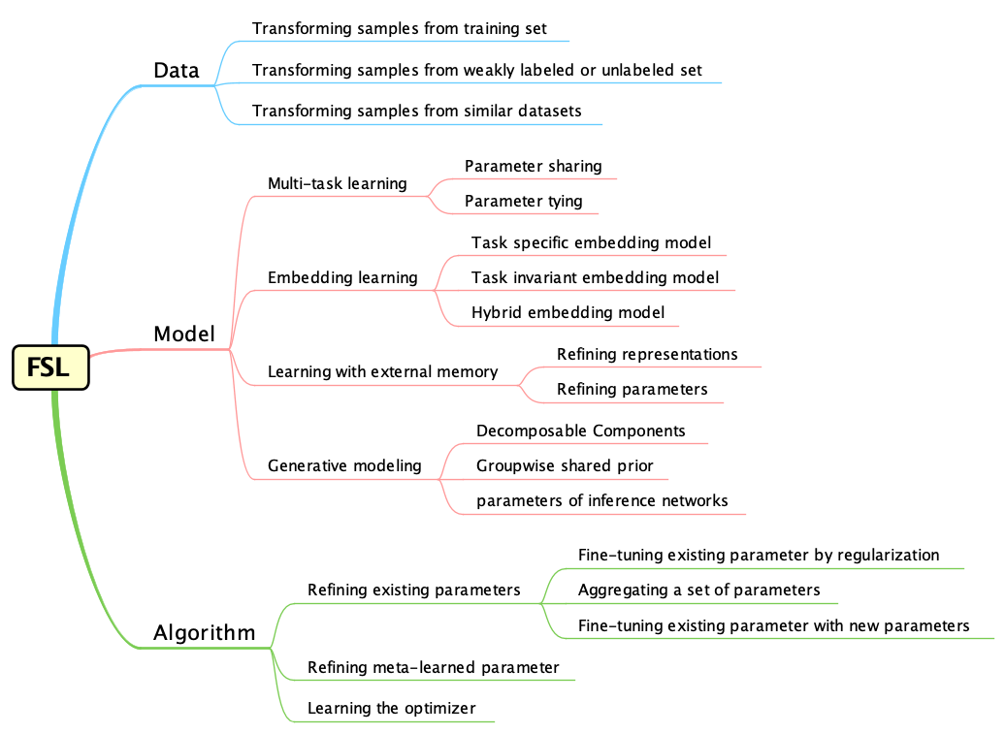
Taxonomy

Slide 6
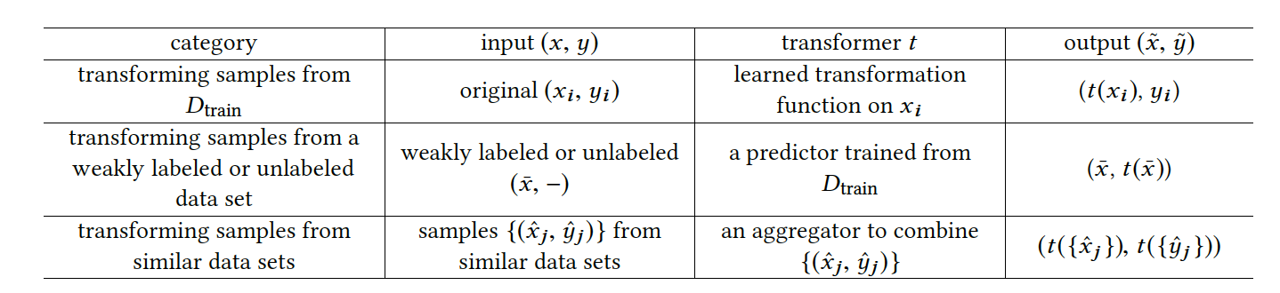
Data based FSL
Data Augmentation to enrich dataset:
Translation
Flipping
Shearing
Scaling
Reflection
Cropping
Rotation

Slide 7
Data based FSL (continued..)
Transforming Samples from training set
01
learnt geometric representations from one class is applied iteratively to similar classes
A set of auto-encoders learns interclass variability from similar classes
Transforming Samples from a Weakly labeled or Unlabeled Data Set
02
Augments target label from large weakly labeled or unlabeled dataset
Transforming Samples from Similar Data Sets
03
Aggregating or adapting input-output pairs from similar dataset

Slide 8
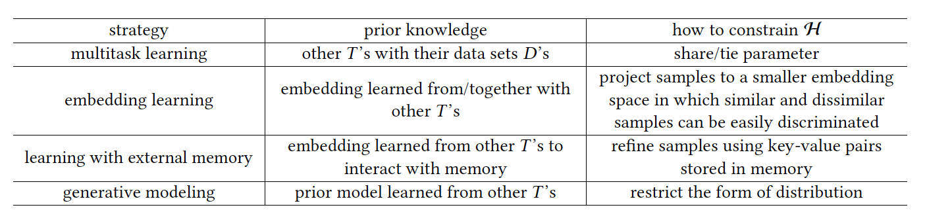
Model based FSL
Learning hypothesis from prior experience

Slide 9
Model based learning (continued ..)
Multitask learning
Learning by exploiting tasks
Task-generic and Task –specific
Embedding Learning
Function which embeds test sample
Function which embeds training sample
A similarity function which measures similarity between these two functions
Learning with external memory
extracts knowledge from training samples and stores it in external memory
Refining Representations
Refining Parameters

Slide 10
Model based learning (continued ..)
Generative modeling:
Estimate Probability distribution from prior knowledge

Slide 11
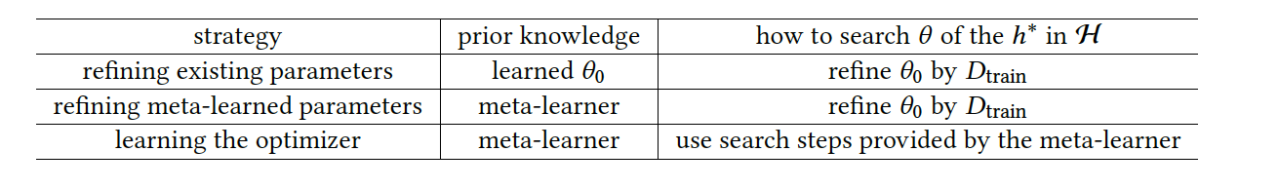
Algorithm based FSL
Using good initial parameter to learn from prior experience
Learning with optimizer

Slide 12
Algorithm based FSL ( continued ..)
Refining existing parameters:
1
Early stopping
Selective updating θ₀ (initial parameter)
updating related parts of θ₀ together
using a model regression network
Refining Meta-Learned Parameter
2
Refine with meta-learner
Model Agnostic Meta learning techniques
Learning the optimizer
3
Instead of gradient descent, use optimizer in tuning step

Slide 13
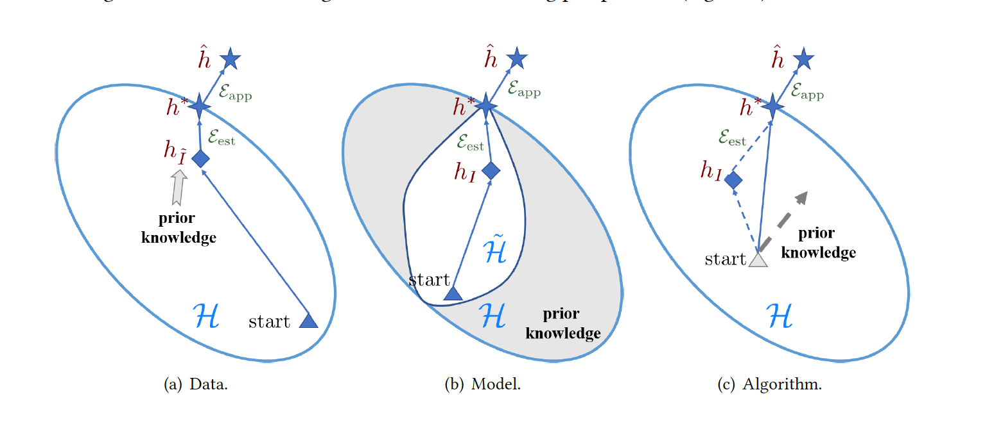
Comparison of all three methods
Data | Model | Algorithm
Cost effective | High inference cost | Lower computation cost
May result in overfitting | More difficult than deterministic models | Failed to get granularizes in meta learning

Slide 14
Future work
Problem setups
Fine-tuning with smaller number of data may lead to overfitting
Exploiting the structured relationships among labels and utilizes a GNN to align the embedding for FSL
Techniques
Extend the AutoML methods to automated feature engineering, model selection and neural architecture search to FSL
Applications
Computer vision, NLP, Robotics, Acoustic signal processing
Theories
Convergence of FSL is not fully understood
General analysis is needed

Slide 15
Conclusion
Few-shot learning bridges the gap between AI and Human
Reduces burden in collecting large labeled data set
This articles explains how learning from prior knowledge is happening in terms of Data, Model and Algorithm

Slide 16
Reference
Y Wang,Q Yao, et.al. “Generalizing from a Few Examples: A Survey on Few-Shot Learning” Revised on 29, March 2020. doi: https://arxiv.org/abs/1904.05046

Slide 17
Thank you

