Slide 1
PA3 : Image Harmonization
11.23.2022

Slide 2
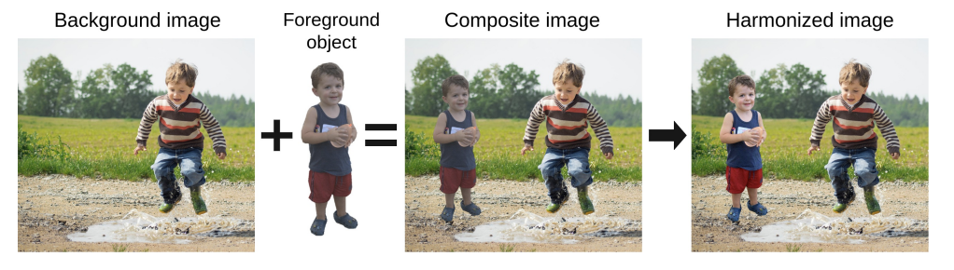
What is Image Harmonization?
Given an input segmentation mask, image harmonization adjusts the color consistency between the foreground object of a reference image and the background region of target images.
Reference: Sofiiuk, Konstantin, Polina Popenova, and Anton Konushin. "Foreground-aware semantic representations for image harmonization." Proceedings of the IEEE/CVF Winter Conference on Applications of Computer Vision. 2021.

Slide 3
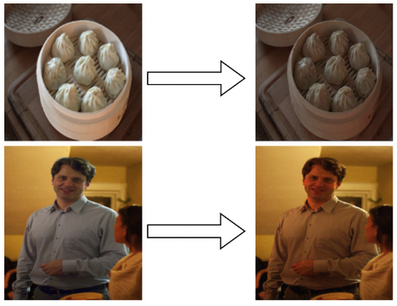

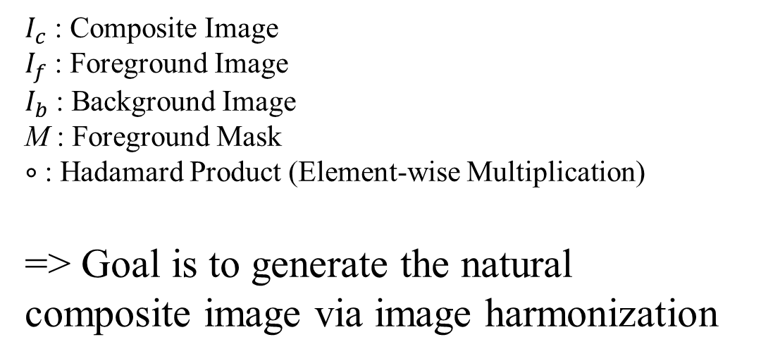
What is Image Harmonization?
$I_{c}=M∘I_{f}+$ $(1−M)∘I_{b}$
$I_{c}$ : Composite Image
$I_{f}$ : Foreground Image
$I_{b}$ : Background Image
M : Foreground Mask
$∘$ : Hadamard Product (Element-wise Multiplication)
=> Goal is to generate the natural composite image via image harmonization
Reference: Ling, Jun, et al. "Region-aware adaptive instance normalization for image harmonization." Proceedings of the IEEE/CVF Conference on Computer Vision and Pattern Recognition. 2021.

Slide 4
What is Image Harmonization?
Traditional Methods : transferring statistics of hand-crafted features between foreground and background regions, such as color
Recent deep learning methods utilize the power of neural network to generate harmonious images
ex) Domain verification discriminator, Region-aware Adaptive Instance Normalization

Slide 5
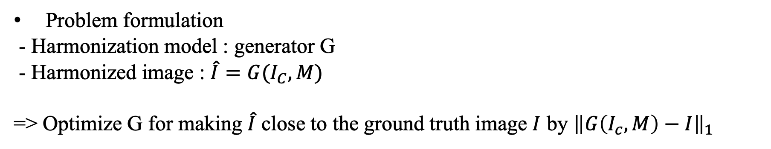
Preliminary : Deep learning based image harmonization Methods
Problem formulation
- Harmonization model : generator G
- Harmonized image : $\hat{I}=G(I_{C}, M)$
=> Optimize G for making $\hat{I}$ close to the ground truth image $I$ by ${\left\|G\left(I_{c}, M\right)−I\right\|}_{1}$
Benchmark dataset : iHarmony4
- Synthesized dataset, consisting of 4 sub-dataset (HCOCO, HAdobe5K, Hflickr and Hday2night)
- 73147 pairs of synthesized composite images and corresponding ground truth images with the foreground mask

Slide 6
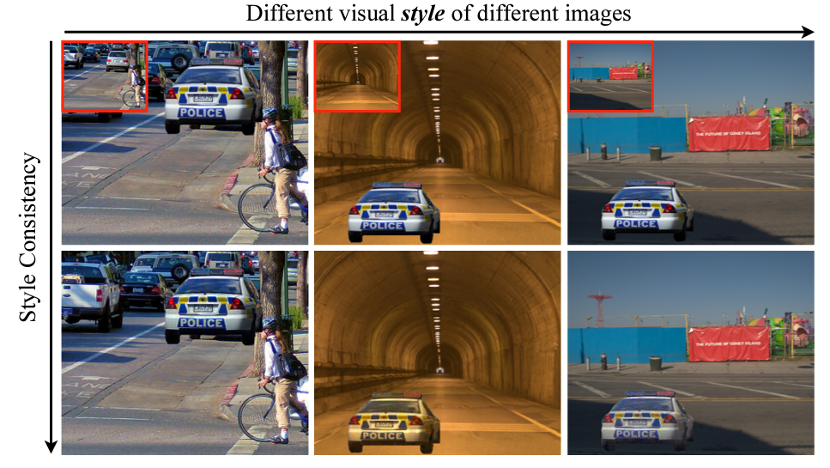
Preliminary : Region-aware Adaptive Instance Normalization for Image Harmonization
Reframe image harmonization as a background-to-foreground style transfer problem => rendering the foreground image to hold similar visual style of the background image
Adaptively learn high-level visual style from different backgrounds and produce harmonious composite images
Introduce Region-aware Adaptive Instance Normalization (RAIN) to improve the performance of the basic network
Reference: Ling, Jun, et al. "Region-aware adaptive instance normalization for image harmonization." Proceedings of the IEEE/CVF Conference on Computer Vision and Pattern Recognition. 2021.

Slide 7
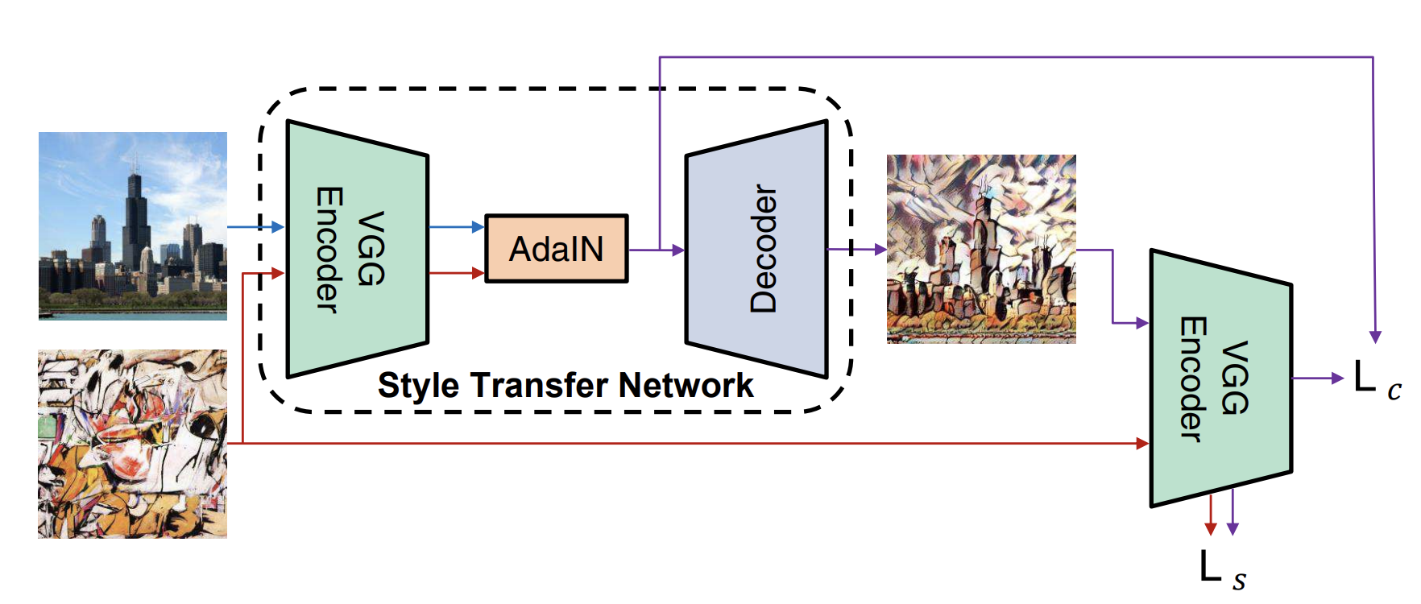
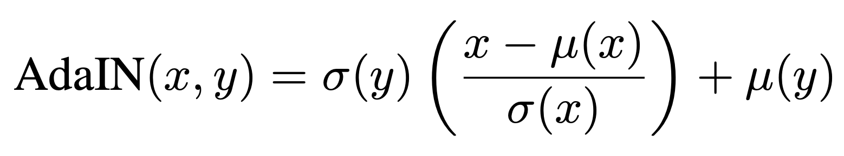
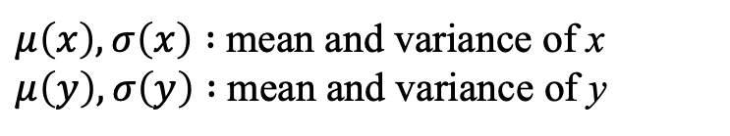
Preliminary : Region-aware Adaptive Instance Normalization for Image Harmonization
But first, what is Adaptive Instance Normalization (AdaIN)?
- A type of normalization which is widely used in style transfer task
- AdaIN receives a content input x and a style input y, and simply aligns the channel-wise mean and variance of x to match those of y
$μ\left(x\right), σ\left(x\right) :$mean and variance of x
$μ\left(y\right), σ\left(y\right) :$mean and variance of y
Reference: Huang, Xun, and Serge Belongie. "Arbitrary style transfer in real-time with adaptive instance normalization." Proceedings of the IEEE international conference on computer vision. 2017

Slide 8
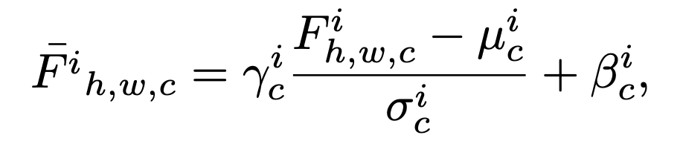
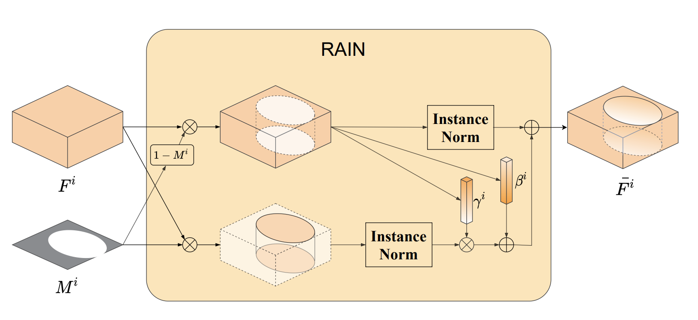
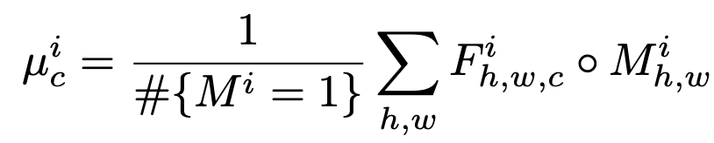
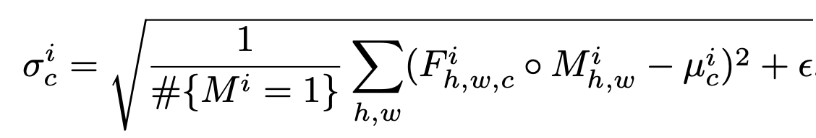
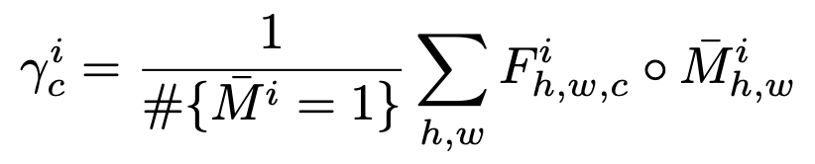

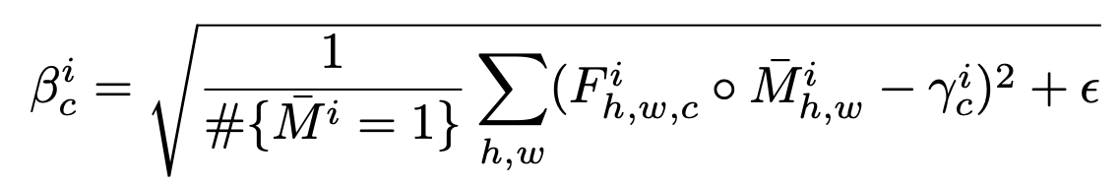

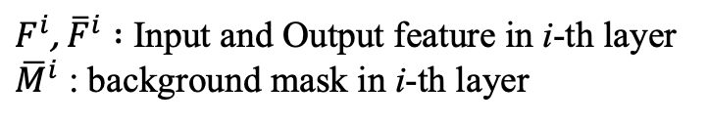
Preliminary : Region-aware Adaptive Instance Normalization for Image Harmonization
Region-aware Adaptive Instance Normalization
- Unlike AdaIN that considers the style of features from another whole external image, it focuses on transferring the visual style from background to foreground only within the same image.
$F^{i}$, ${\overline{F}}^{i} :$ Input and Output feature in i-th layer
${\overline{M}}^{i}$ : background mask in i-th layer
Reference: Ling, Jun, et al. "Region-aware adaptive instance normalization for image harmonization." Proceedings of the IEEE/CVF Conference on Computer Vision and Pattern Recognition. 2021.

Slide 9
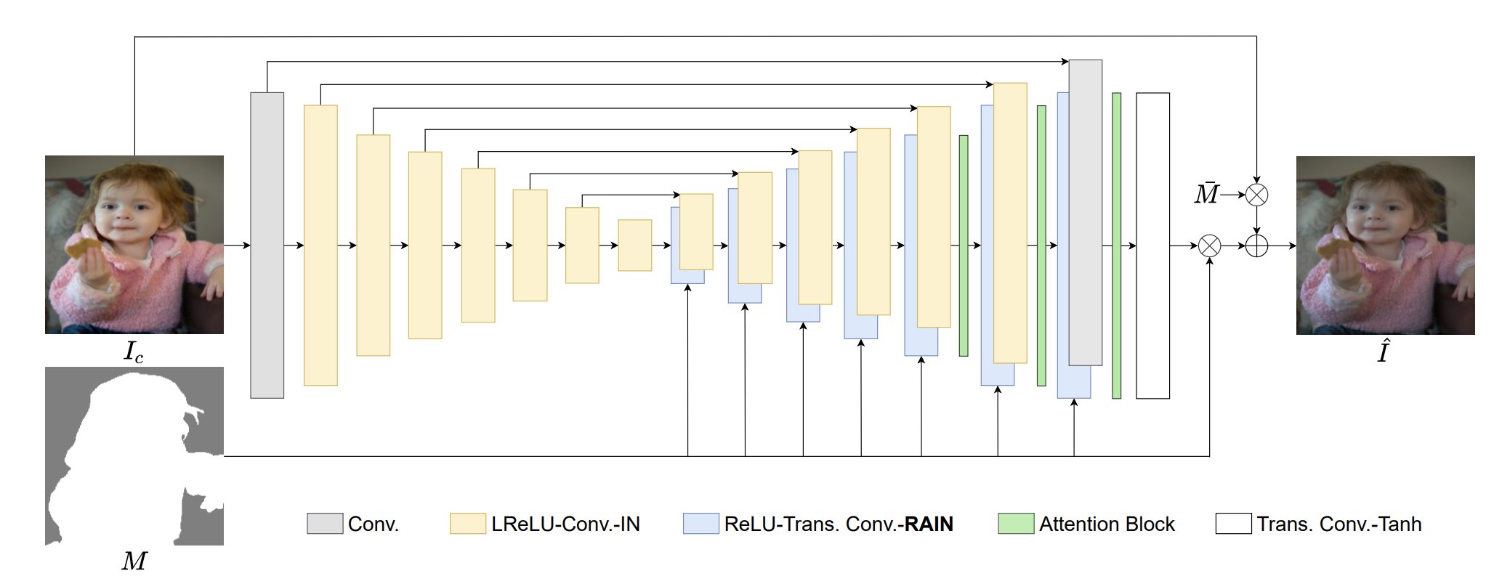
Overview of PA3
Implement the generator G and region-aware adaptive instance normalization for image harmonization
Step 1 (w/o RAIN)
Step 2 (w/ RAIN)
I will provide you the incomplete baseline code modified from official implementation. Please fill the blank and train the model.

Slide 10
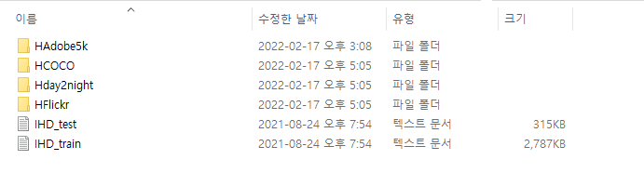
Files/Libraries : Preparation
You can refer the official implementation code : https://github.com/junleen/RainNet
Language : python (Recommend Pycharm for the script editor)
Dataset : iHarmony4 benchmark dataset
Download here: https://cloud.bcmi.sjtu.edu.cn/fsdownload/CCExSuoDA/Image_Harmonization_Dataset
Preprocessing the dataset : https://github.com/junleen/RainNet#3-prepare-the-data
Both 512x512 and 256x256 sizes are acceptable. (You need to download PA3.zip for this step!)
Keep IHD_test.txt and IHD_train.txt on the same directory with the dataset

Slide 11
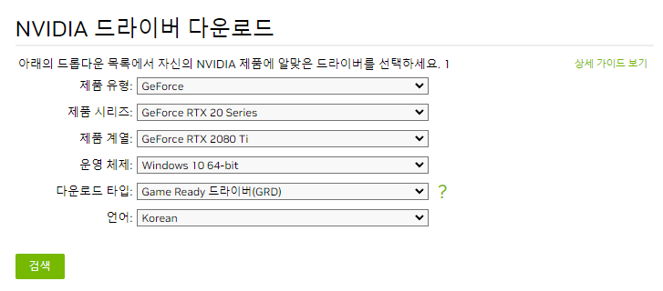
Files/Libraries : Preparation
Install the driver to run your own GPU (You need GPU with at least 10GB memory)
Ex) For RTX 2080 Ti, https://www.nvidia.co.kr/Download/index.aspx?lang=kr
Requirements (libraries) : https://github.com/junleen/RainNet#2-requirements
> conda create –n rainnet python=3.7
> conda install pytorch==1.6.0 torchvision==0.7.0 cudatoolkit=10.1 –c pytorch
> pip install –r requirements.txt

Slide 12
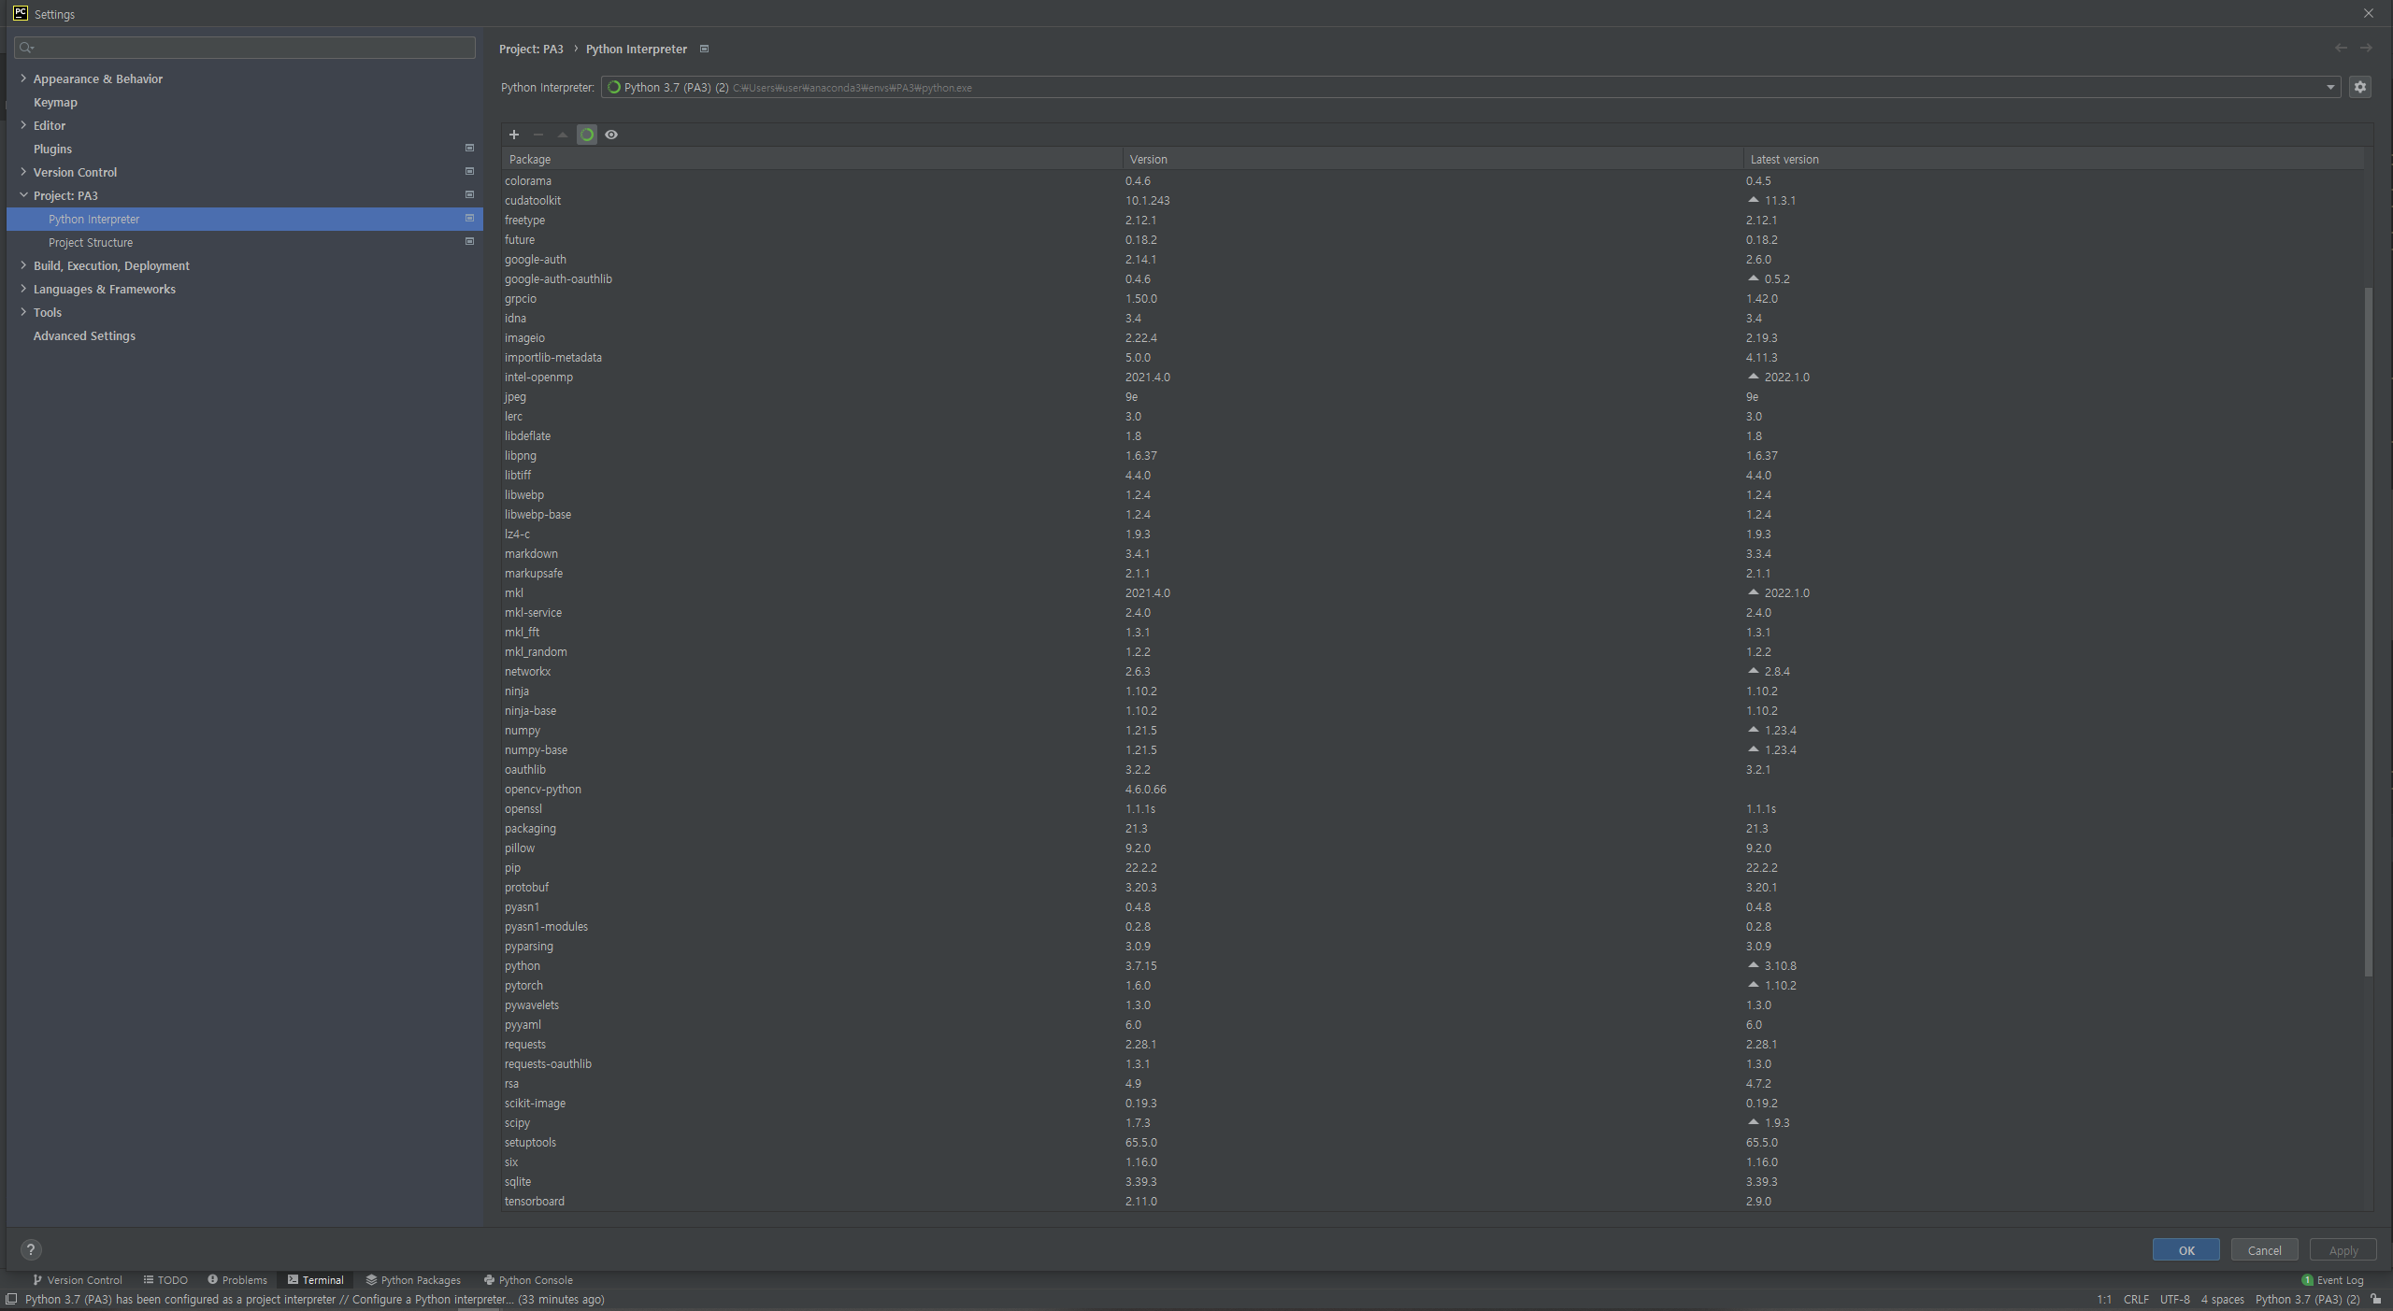
Files/Libraries : Preparation
You can check the installed libraries
Example) Pycharm -> Settings -> Python Interpreter

Slide 13
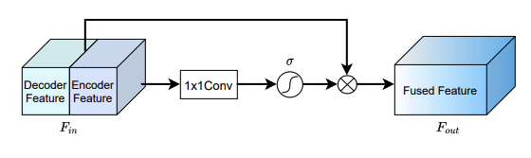
Step 1 : Build a network architecture with IN (10pts)
Build a generator G with instance normalization (without RAIN)
- Instance Normalization is already implemented on the provided code, so you only need to build an architecture as described in the below figure
- In step 2, you will also implement RAIN and replace IN with RAIN on the decoder.
Attention Block
IN (Instance Normalization)

Slide 14
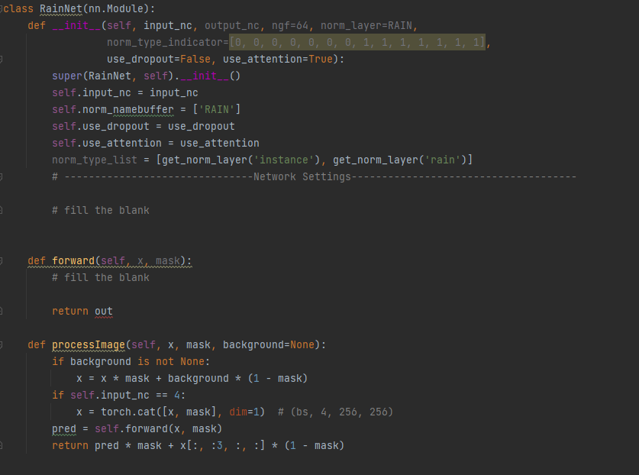
Step 1 : Build a network architecture with IN (10pts)
You can build your own model independent to the official paper.
You only need to prove that your model is well fit to the harmonization task.
Fill the blank in PA3/models/networks.py
Define the convolution blocks
Adjust the normalization layer by modifying norm_type_indicator (4pts)
Implement the generator based on the __init__ (4pts)

Slide 15
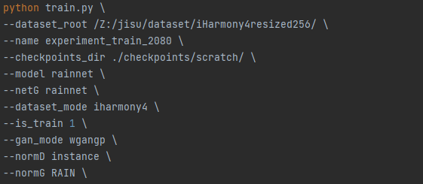
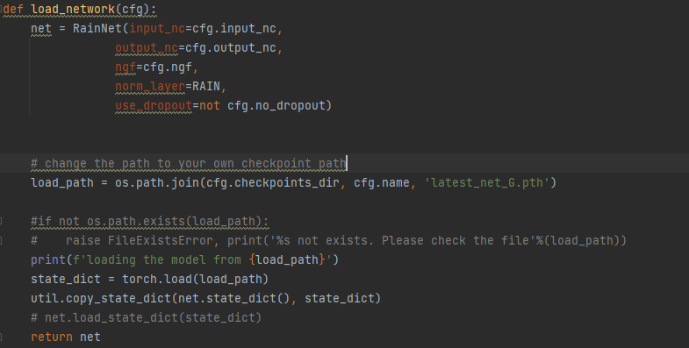
Step 1 : Build a network architecture with IN (10pts)
Training (1pt)
Modify dataset_root, name, checkpoints_dir to your own path.
> bash scripts/train.sh
*You can turn off the training anytime if you think the model is converged. You don’t have to run for all the 200 epoch. Training epoch setting is up to you.
Evaluation (1pt)
Modify the dataset_root to your own path and load_network function in evaluate.py
> python evaluate.py –dataset_root <DATA_DIR> --save_dir evaluated --batch_size 16 --device cuda --store_image
Modify the path to your own checkpoint path name

Slide 16
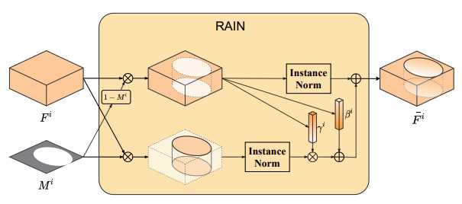
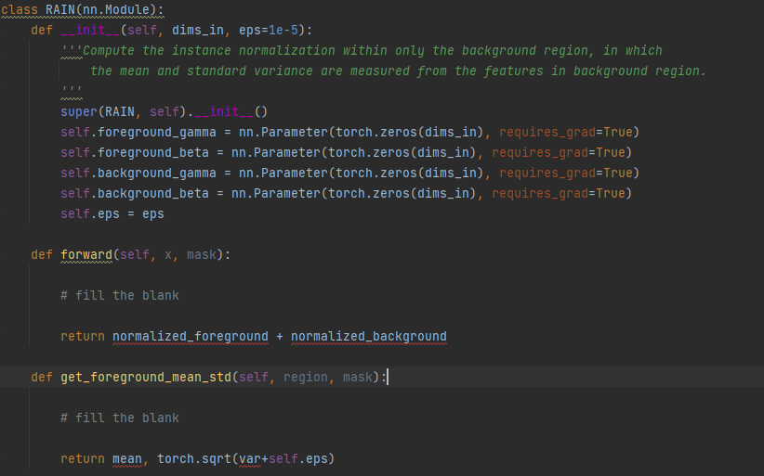
Step 2 : Build a network architecture with RAIN(7pts)
Fill the blank in PA3/models/normalize.py (5pts)
Implement RAIN using get_foreground_mean_std()
Calculate the mean and std

Slide 17
Step 2 : Build a network architecture with RAIN(7pts)
Train & Evaluate : Same with step 1 (2pts)
Modify the norm_type_indicator in the models/neworks.py to replace IN with RAIN
Modify the checkpoint path, result directory… etc. to separate the result from Step 1
For each step, save the evaluated image and csv file with MSE and PSNR for the submission by running evaluation code.

Slide 18
Report(3 pts)
Compare the result from step 1 and step 2 and analyze the result
You must write evaluation metric : MSE, PSNR for both steps
Ex) MSE : 5x.xxx, PSNR : 35.xxx …
You will get bonus credit if you use some skills such as data augmentation to improve the performance of the model

Slide 19
Information
Due Date: Dec. 9 11:55pm
NEVER COPY THE OFFICIAL CODE! I WILL DETECT ALL THE PLAGIARISM! All tricks such as simply changing the name of variables or wrapping into the functions will be regarded to plagiarism.
Please submit codes, results and reports.
Additional credits: up to 5pts ( Best Result 2pts + Ideas for improvement 3pts )
Additional credit can be earned if you submit notable reports, code or results.
If you have any questions about PA3, please contact TA
TA: Jisu Shin (신지수)
E-mail: jsshin98@gm.gist.ac.kr
Office Hour: Mon, Thu 1:30pm~3:00pm
Office Location: Electrical Engineering and Computer Science Building C, Room 405
Call: 062-715-6375

