Slide 1
Vibzcheck: Collaborative Music App
Final Project Presentation
Jabril Jeylani and Prosper Olusegun-Joseph

Slide 2
1. Problem and Objectives
The Problem: The 'Aux Cord Monopoly'
- One person controls the music, leaving others out.
- Lack of democratic queue management in standard apps.
Core Objectives:
- Inputs: User votes, search queries (iTunes API), chat messages.
- Outputs: Live synchronized queue, 30s audio previews, dynamic recommendations.

Slide 3
2. Design and Architecture
Tech Stack: Flutter & Firebase
- Data Model: Firestore for real-time Rooms, Queues, and Chat.
- Architecture: StreamBuilders for reactive UI updates.
- UI Flow: Home -> Open Rooms -> Room Queue/Chat.
- Aesthetics: Custom Neon Cyberpunk Dark Theme.

Slide 4
3. Testing and Validation
End-to-End User Journey Testing
- Tested room creation and joining via 6-character codes.
- Concurrency Testing: Verified Firestore voting transactions.
- Playback Sync: Ensured listeners sync within 3 seconds of the host.
- Bug Fixed: Bypassed Firebase Storage limits using Base64 string compression.

Slide 5
4. Team and Contributions
Prosper Olusegun-Joseph – UI/UX, Itunes API integration, Rooms, FCM, Voting System, Testing
- Jabril Jeylani – UI, Firebase Integration, Voting System, Collaborative Playlist Feature

Slide 6
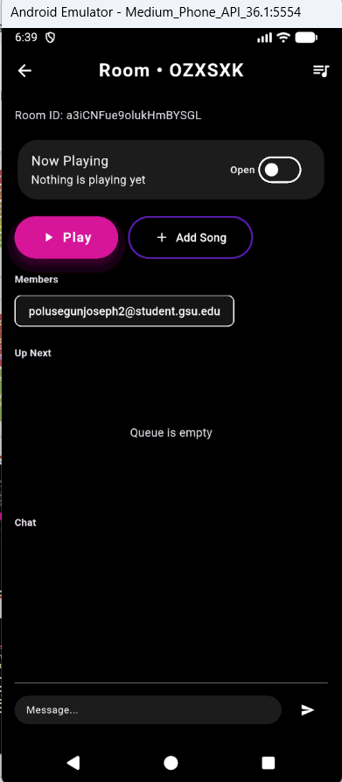
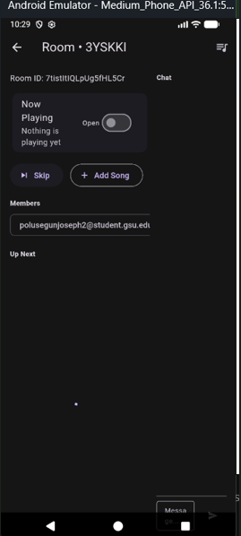
Design Change while
Recording to make APK look
better

Slide 7
6. Code Evidence & Firebase
Firestore Atomic Transactions (Voting):
await db.runTransaction((transaction) async { final songSnap = await transaction.get(songRef); int currentScore = songSnap['voteScore'] ?? 0; currentScore += voteValue; transaction.update(songRef, {'voteScore': currentScore}); });

Slide 8
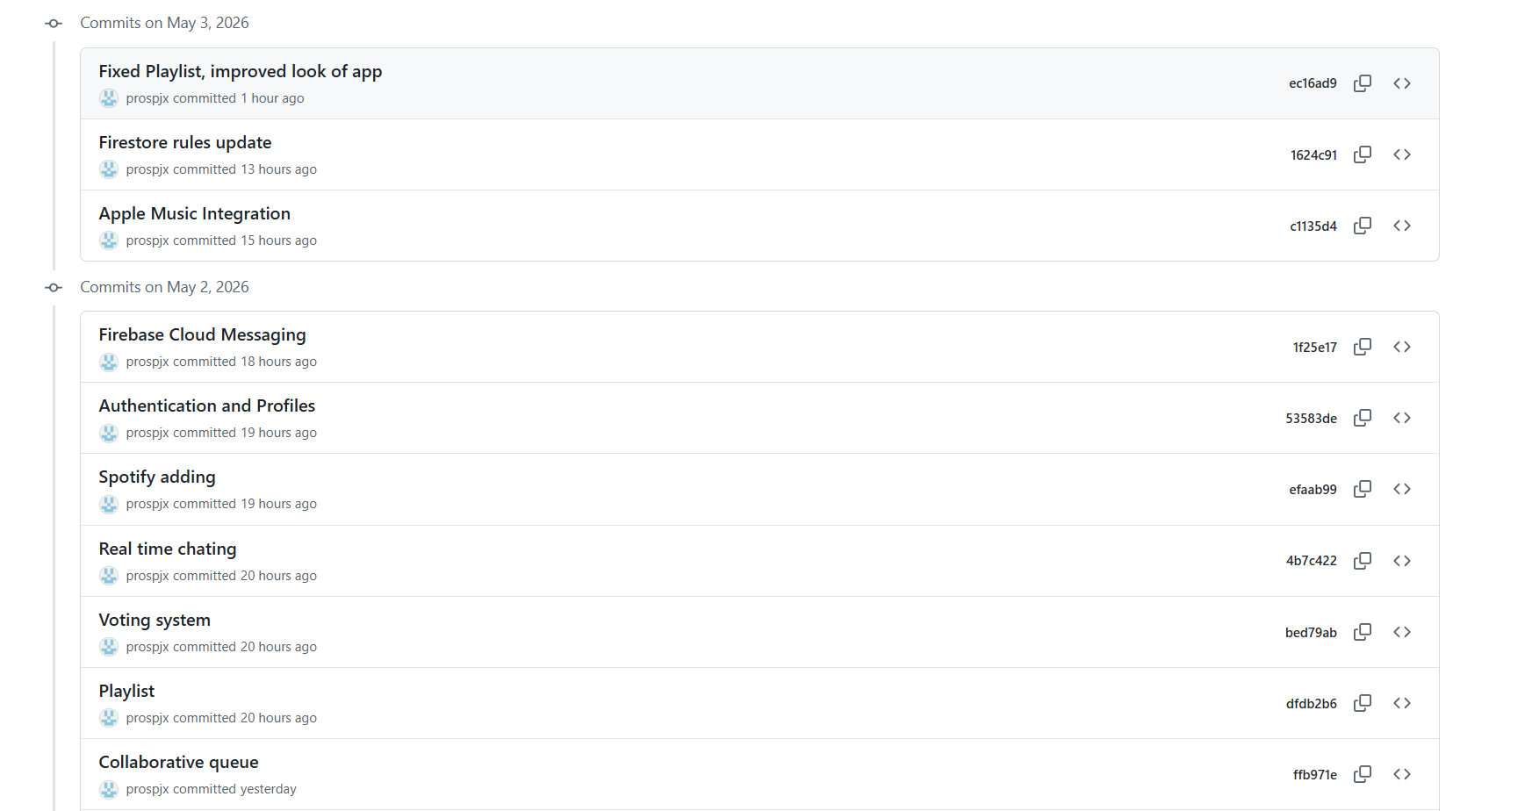
Prosper’s Commits

Slide 9
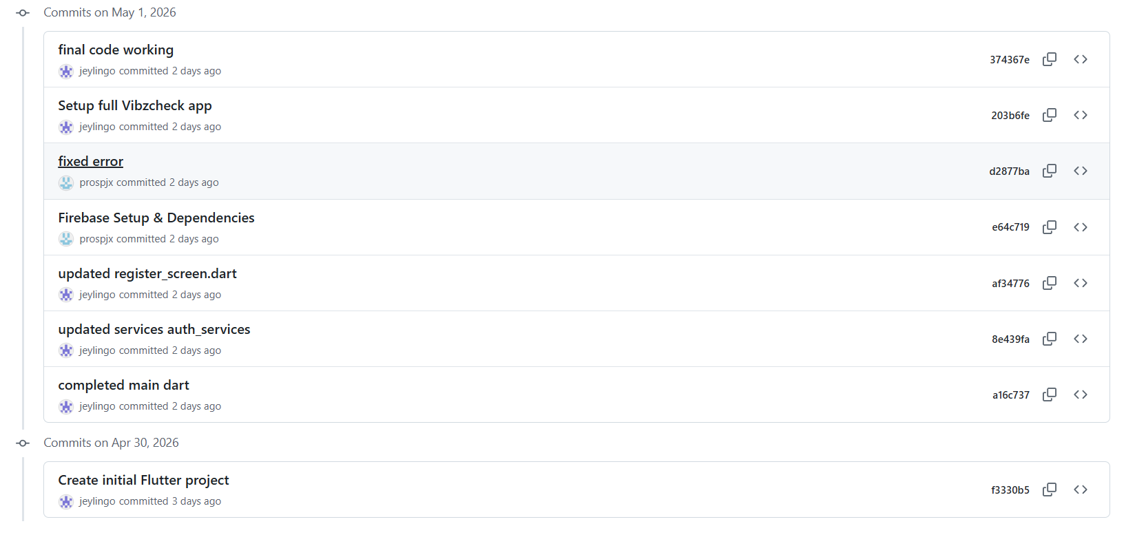
Jabril’s Commits

Slide 10
Question 1
Describe the exact order you implemented your three most complex mobile features and why that order reduced risk.
I implemented authentication first, then Firestore playlists/voting, then recommendations/notifications. This order reduced risk because users needed to log in before saving data, Firestore needed to work before recommendations could use that data, and notifications were added last because they depend on app events already being created.

Slide 11
Question 2
Explain one real synchronization bug you encountered between app state and backend/local data.
One synchronization bug was when the app showed old playlist data after a song was added. Firestore had the new song, but the UI did not update until I refreshed. I fixed it by using StreamBuilder instead of only loading the data once.

Slide 12
Question 3
Which feature was reworked after user-flow testing, and what changed in code and UI behavior?
The playlist flow was reworked after testing. At first, users had to go through too many steps to create and open a playlist. I changed the UI so the playlist list has a simple add button, and after creating a playlist, the app returns back to the playlist screen.

Slide 13
Question 4
How does your current navigation structure support maintainability and future feature additions?
The navigation is separated by feature folders like auth, home, playlists, chat, and recommendations. This makes the app easier to maintain because each feature has its own screen files, and new features can be added without changing the whole project.

Slide 14
Question 5
Which app interaction had noticeable lag, and how did you profile it?
The recommendation screen had noticeable lag because it had to read listening history and songs from Firestore. I profiled it by using console prints and watching how long the screen stayed on the loading indicator. The fix was to keep the recommendation logic simple and only load when the screen opens.

Slide 15
Question 6
If you restarted this app tomorrow, what would you architect differently first?
If I restarted the app, I would architect the services and models first. I would create cleaner model classes for users, songs, playlists, and recommendations before building the UI so the app would be easier to expand.

Slide 16
Question 7
What decision from early planning created technical debt later, and how did your team resolve it?
An early decision that created technical debt was starting with simple manual song entry instead of planning the Spotify API structure earlier. The team resolved it by separating music logic into service files so Spotify integration can be added later without rewriting the UI.

Slide 17
Question 8
How does your app handle notification delivery differently for foreground vs. background vs. terminated app states?
In the foreground state, the app listens for notifications and prints or handles them while the app is open. In the background state, notifications can appear through the system tray. In the terminated state, the user can tap the notification to reopen the app, but deeper routing would need more setup.

Slide 18
Question 9
What code-level optimization gave the biggest user-visible improvement?
The biggest user-visible improvement was switching playlist and chat screens to real-time Firestore streams. This made new songs, votes, and messages appear automatically without needing manual refresh.

Slide 19
Question 10
If AI-assisted features are included, explain how outputs are validated before users rely on them.
If AI-assisted features are included, the output should be validated before users rely on it. For example, recommendation scores should be based on clear data like votes, listening history, and mood tags instead of random suggestions. The app should show the scoring reason so users understand why a song was recommended.

Slide 20
Question 11
Describe the trade-off between strict Firestore rule validation and iterative development speed in your project.
Strict Firestore rules improve security, but they can slow down development because every data write has to match the rule structure exactly. During early development, test rules helped us move faster. Later, stricter rules should be added so only logged-in users can read and write the correct data.

Slide 21
Question 12
How did you test your Security Rules – emulator simulation, live test writes, or rule playground? Show one blocked invalid request.
I tested Security Rules using live test writes in the app and Firebase console. One blocked invalid request would be trying to write data while logged out. Since the rule requires request.auth != null, Firestore blocks unauthenticated users from creating playlists or writing user data.

