Slide 1
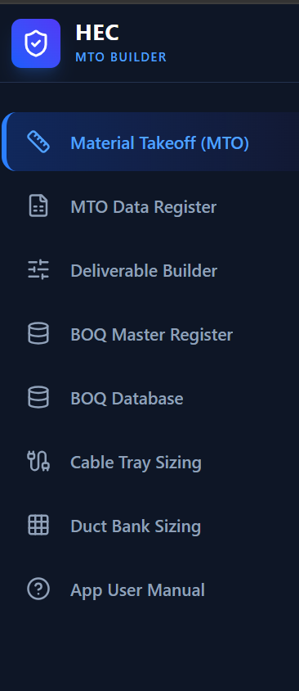
HEC MTO BUILDER
The workflow is deliberately small: takeoff, register, size, hand off.
Telecom MTO Lite
A practical guide from drawing to BOQ-ready data
8 focused pages • offline-friendly • one standalone file
Use this deck as the quick visual companion to the in-app manual.
01
Notes:
Sources: upstream Telecom_MTO README.md and docs/USER_MANUAL.md. Lite page names cross-checked against the standalone app and the supplied HEC MTO Builder navigation image.

Slide 2
START HERE
Follow the pages in this order
Keep the drawing, quantities, sizing checks, and handoff records connected.
1 DRAWING
2 TAKEOFF
3 CHECK
4 REGISTER
5 HANDOFF
Load • calibrate • set datum
Place points • measure runs
Tag • zone • route • size
Filter • reconcile • export
Build deliverable • BOQ review
The safety rule
Do not turn an old revision into a current total. Use Latest per Drawing for project quantities; keep All Saved Instances for audit and recovery.
Source: Telecom_MTO README.md + docs/USER_MANUAL.md (Lite scope)
02
Notes:
Source: Telecom_MTO README.md + docs/USER_MANUAL.md (Lite scope)

Slide 3
01 / DRAWING SETUP
Calibrate before you take off anything
A clean first five minutes prevents every later length from drifting.
✓
Choose Start New Drawing Workspace for a different source.
✓
Load a PDF, image, or DXF and confirm the page is visible.
✓
Click two known endpoints and enter the real distance + unit.
✓
Check a second known dimension before production takeoff.
known distance
✓
Set the drawing coordinate base point for X=0, Y=0, Z=0.
X0 / Y0
Known dimension
Scale check
Source: Telecom_MTO README.md + docs/USER_MANUAL.md (Lite scope)
03
Notes:
Source: Telecom_MTO README.md + docs/USER_MANUAL.md (Lite scope)

Slide 4
02 / TAKEOFF
Keep measured length separate from purchasing allowance
The register is auditable because it preserves the field measurement and the BOQ allowance as different values.
Two takeoff types
The quantity logic
Point / count
Adjusted Length = Actual + route / vertical allowance + sag
Cameras, speakers, cabinets, devices, accessories.
BOQ Length = Adjusted × (1 + waste %) + service loop
Linear measurement
Value | Use it for
Actual | Drawing label / field measurement
Margin | Allowance added above actual
BOQ | Purchasing quantity after allowance
Cable, conduit, tray, duct, and other continuous runs.
Source: Telecom_MTO README.md + docs/USER_MANUAL.md (Lite scope)
04
Notes:
Source: Telecom_MTO README.md + docs/USER_MANUAL.md (Lite scope)

Slide 5
03 / CHECK
Location and route logic must be explicit
Zones assign location; route nodes authorize where a cable may enter, exit, branch, or change elevation.
WBS zone
Route review sequence
✓
Tag source + destination equipment.
✓
Draw corridors along permitted paths.
✓
Place nodes at entry, exit, branch, riser, penetration, pull box, or manhole.
riser
✓
Enter elevations, cable OD, capacity, fill, spare, and allowances.
corridor bend ≠ branch
junction
A corridor bend is geometry only — it is not a branch.
exit
source
destination
Source: Telecom_MTO README.md + docs/USER_MANUAL.md (Lite scope)
05
Notes:
Source: Telecom_MTO README.md + docs/USER_MANUAL.md (Lite scope)

Slide 6
04 / CONTAINMENT
Size from tag-linked inputs, then review the section
Cable Tray Sizing and Duct Bank Sizing are review pages: use them to catch fill, segregation, and envelope issues before handoff.
DUCT BANK
TRAY SECTION
Automatic layouts use two columns and grow vertically.
cable fill
segregation
Reference envelopes
4 ducts • 505 × 445 mm
6 ducts • 505 × 620 mm
8 ducts • 505 × 795 mm
Check: tray tag • cable schedule • fill • segregation • dimensions • supports
red = occupied
white = spare
Edit defaults when the project detail differs. Use 0 to return an input to automatic sizing.
Source: Telecom_MTO README.md + docs/USER_MANUAL.md (Lite scope)
06
Notes:
Source: Telecom_MTO README.md + docs/USER_MANUAL.md (Lite scope)

Slide 7
05 / REGISTER + HANDOFF
Registers turn a drawing into a controlled handoff
Move left to right: filter the right revision, shape the deliverable, then review the BOQ mapping.
MTO Data Register
Deliverable Builder
BOQ Master Register
BOQ Database
Search • filter • edit
Export visible rows
Choose dataset, fields,
headings, order, filters
Review status, units,
remarks, mapping
Maintain purchasing /
construction materials
Scope rule
Use Latest per Drawing for consolidated totals. Keep All Saved Instances for audit only so previous revisions are never counted twice.
Source: Telecom_MTO README.md + docs/USER_MANUAL.md (Lite scope)
07
Notes:
Source: Telecom_MTO README.md + docs/USER_MANUAL.md (Lite scope)

Slide 8
06 / BACKUP
Save revisions as deliberately as you take them off
Lite stores browser workspaces locally. JSON is the portable handoff between browsers, machines, and reviewers.
Current drawing
Save As New Instance
Save Project Session
Load on another device
Latest per Drawing
Keep working
Milestone / revision
Portable JSON backup
Verify records
Use for totals
Browser boundary
file://, another browser, another computer, and an iPhone do not automatically share IndexedDB records.
Source: Telecom_MTO README.md + docs/USER_MANUAL.md (Lite scope)
08
Notes:
Source: Telecom_MTO README.md + docs/USER_MANUAL.md (Lite scope)

Slide 9
07 / FINAL CHECK
Before issue, make the final review visible
A good Lite handoff is not just a file—it is a traceable set of assumptions someone else can review.
Drawing + data
Sizing + handoff
✓
Source drawing + revision are correct.
✓
Nodes cover every branch and vertical transition.
✓
Scale was checked against a second dimension.
✓
Tray / duct-bank fill stays within design criteria.
✓
Datum, elevations, tags, and WBS fields are complete.
✓
Latest per Drawing—not historical duplicates—is used.
✓
Cable From / To tags match the equipment list.
✓
BOQ mapping, units, remarks, and status are reviewed.
✓
Actual, margin, and BOQ values are understood.
✓
JSON backup is saved before issue.
Shortcuts: ? manual • Esc cancel / clear • F8 orthogonal • Ctrl+wheel zoom • Ctrl+B properties • Ctrl+J table
Source: Telecom_MTO README.md + docs/USER_MANUAL.md (Lite scope)
09
Notes:
Sources: upstream Telecom_MTO README.md and docs/USER_MANUAL.md. Final checklist is condensed to the Lite pages and intended as a pre-issue visual aid.

