Slide 1

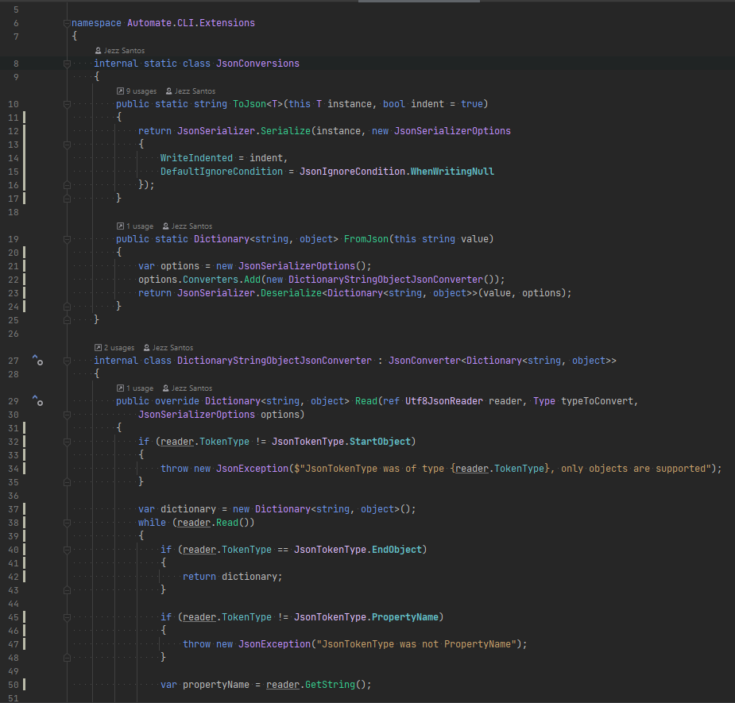






Authoring
Toolkits
Using
Toolkits
A Codebase
Tech Lead
Existing
codebase
New
code
Capture Patterns
Package
Configure
Apply
+ structure
+ snippets
+ templates
+ automation + constraints
toolkit
A draft
A Codebase
Contributor
Use automate to do both

