Slide 1

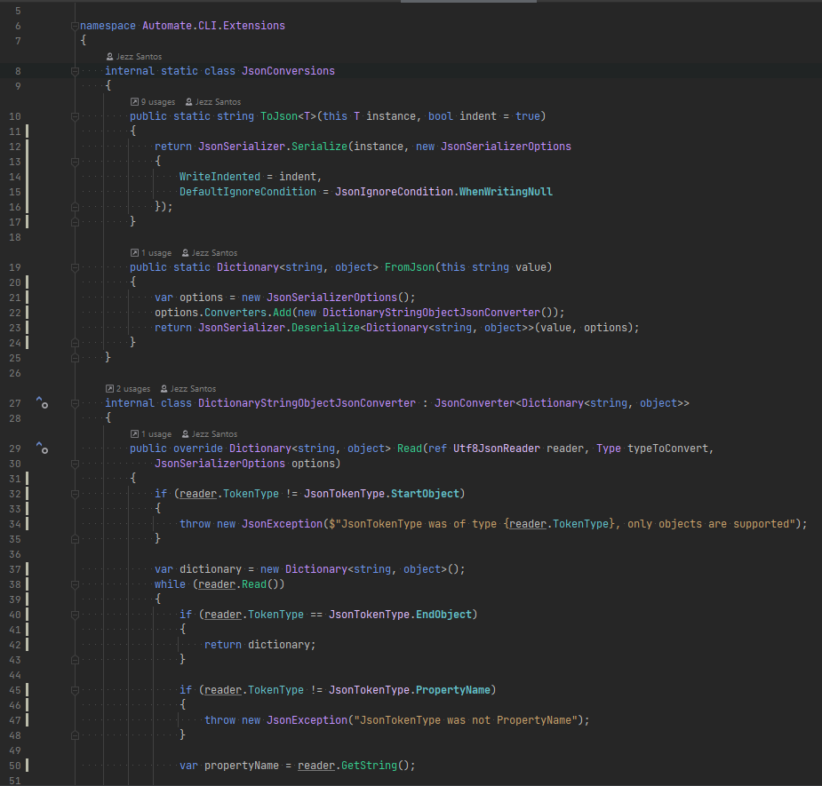






Authoring
Toolkits
Using
Toolkits
A Codebase
Tech Lead
Existing
codebase
New
code
Capture Patterns
Package
Configure
Apply
+ structure
+ snippets
+ templates
+ automation + constraints
toolkit
A draft
A Codebase
Contributor
Use automate to do both

Slide 2
Take code from your own Codebase
Templatize It
Build a Robot that Writes your code
Install the Robot into your Codebase
Tell your Robot to do the Coding!

