Slide 1

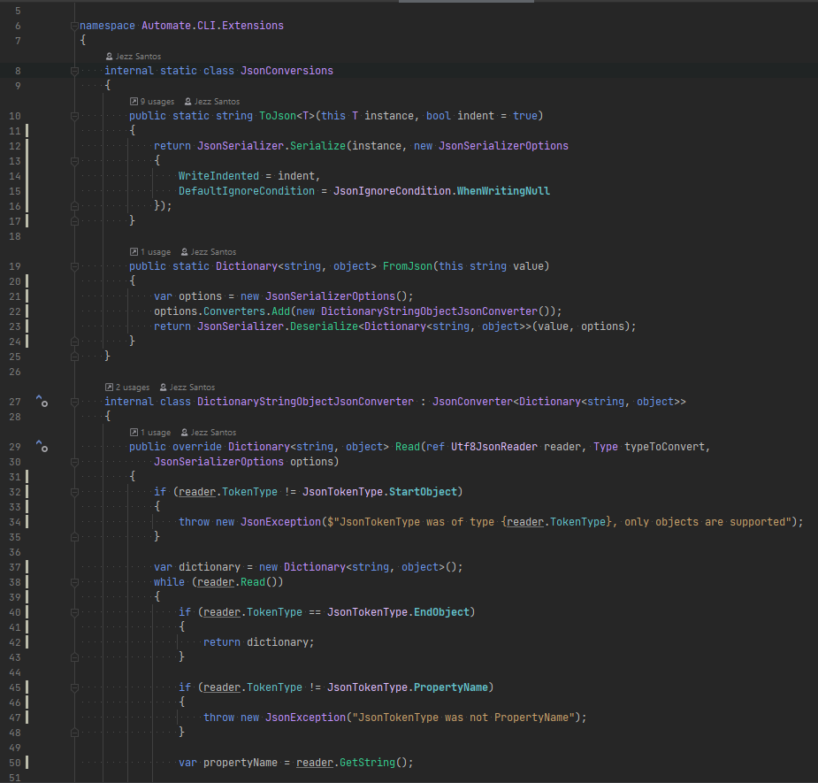






Making
Toolkits
Using
Toolkits
A Codebase
Tech Lead
Existing
codebase
New
code
Capture Patterns
Package
Configure
Apply
+ structure
+ snippets
+ templates
+ automation + constraints
toolkit
A draft
A Codebase
Contributor
Use automate to do both

Slide 2

Extract code from your own Codebase
Templatize it, and make it programmable
We’ll build you the Robot that writes more of that code
Install the Robot into your Codebase
Tell your Robot to do the Coding for you!

Slide 3
Apathetic about effectiveness on their codebase
Asks Creator for more toolkits
Bad experience modifying it
Directed to use a toolkit
Uses Toolkit on codebase
Realises more uses of the toolkit
Decides to modify existing toolkit
Decides to create own toolkits
Downloads Installs CLI/Plugin
Discovery
Consuming
Producing & Sharing
Happens upon automate
Decides to create toolkit
Creates first toolkit
Tries out toolkit on codebase
Improves toolkit
Publishes toolkit to others
Creates another toolkit
Apathetic about applicability to their context
Cannot get started/lack of suitable use-case
Bad experience creating it
Inspired by: https://en.wikipedia.org/wiki/File:Wikipedia_Mobile_User_Journey.pdf

