Slide 1

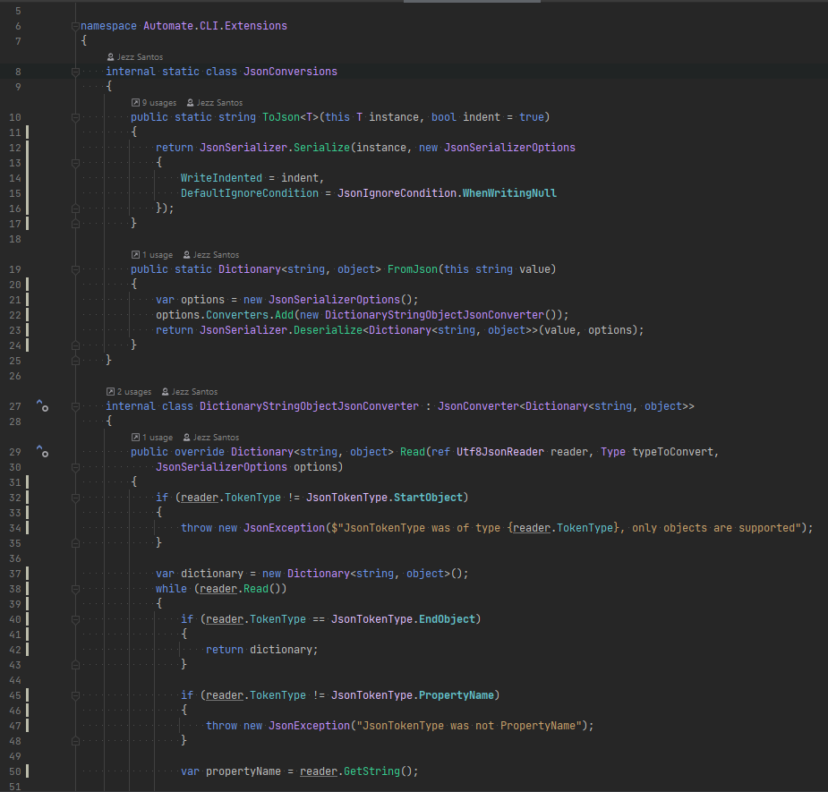






Authoring Toolkits
Using Toolkits
A Codebase
Tech Lead
Existing
codebase
New
code
Capture Patterns
Package
Configure
Apply
Code
Templates
A Model of
+ Templates
+ Automation
A Toolkit
A Draft
A Codebase
Contributor
Use automate to do both

