Slide 1
Ozarks Technical Community College Shipping & Receiving Management Tool
Developed by:
Kalin Bowden
&
Jesse Fender

Slide 2
Why a new tool to manage shipping and receiving?

Slide 3
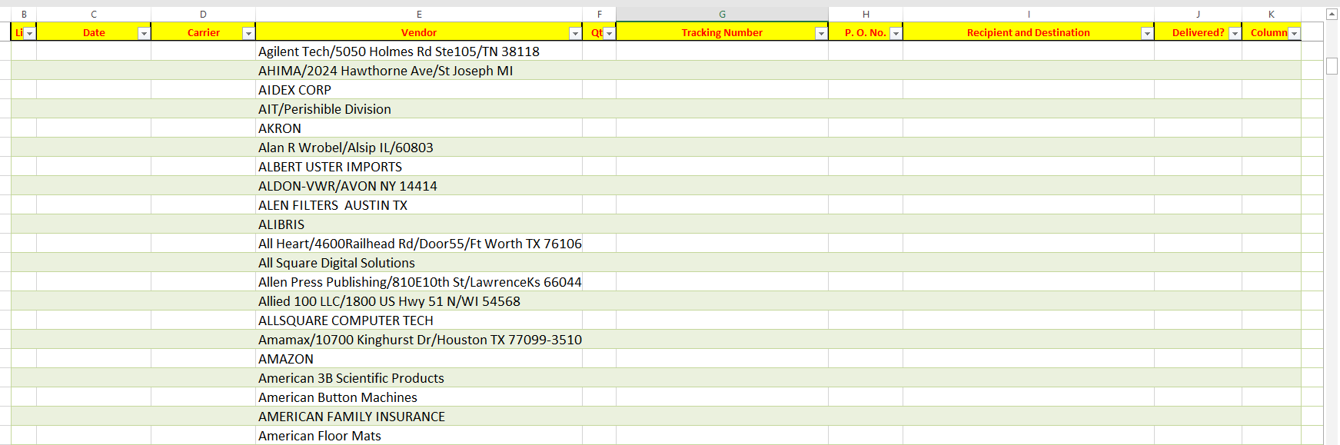
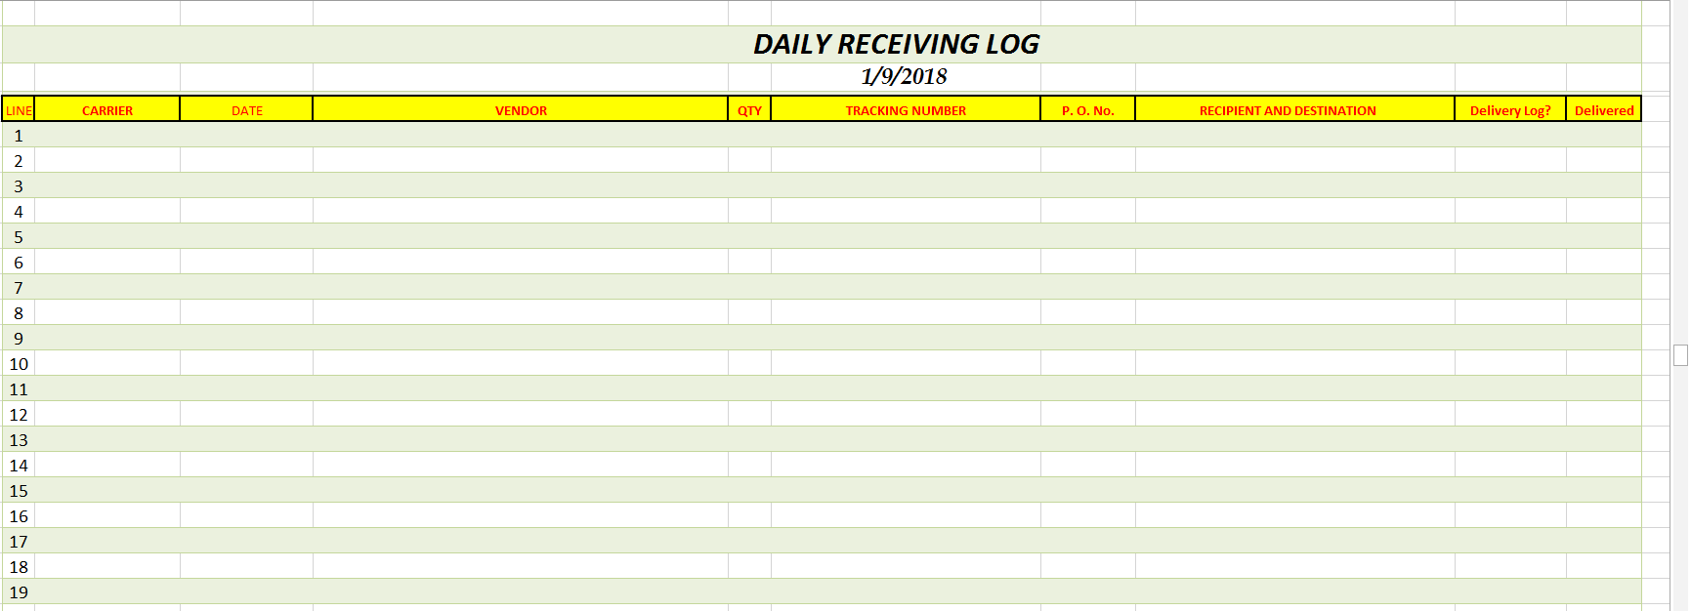
Currently uses Excel to store vendor information
Has to manually input each line of items from a PO or Invoice
Cannot track more than 80 items per page, if more than that receiving must manually create a second log and save it as a separate file

Slide 4
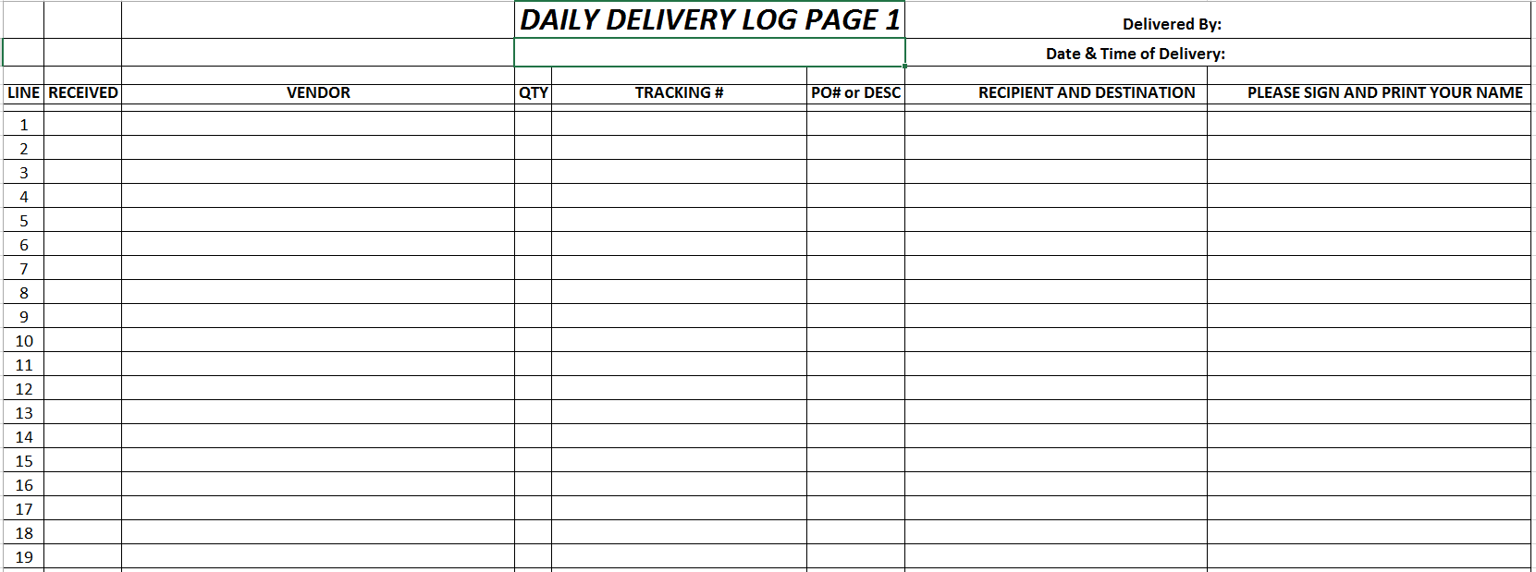
Currently manually generates the delivery log, prints that and that is used to print, this is a ton of repetitive work that could be limited to a minimum.

Slide 5
What the client needs?
MUST HAVES:
NICE TO HAVES:
User log in
Easy to use and train GUI
Better delivery management
Track the status of deliveries
Automatically generate reports
Create delivery log automatically
Easily Manage the database using a simple GUI.
PO PDF scrapped for information
Storing PDF documents in DB as a blob

Slide 6
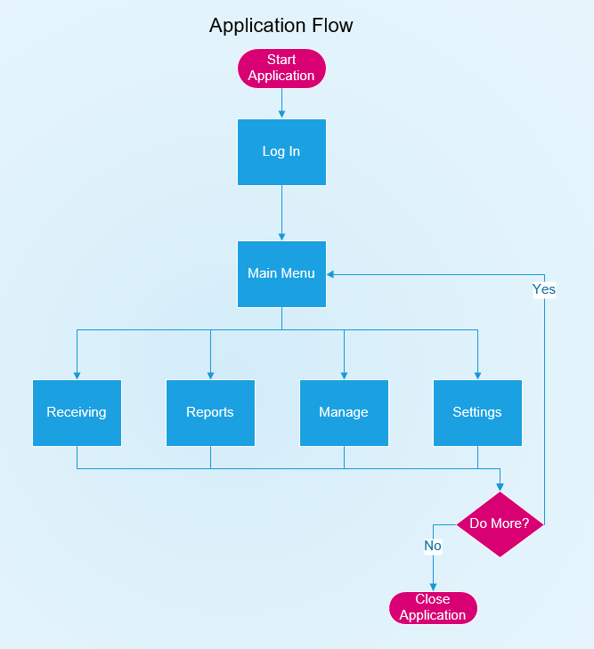
How we plan to resolve the customers problem
A whole new User Interface

Slide 7
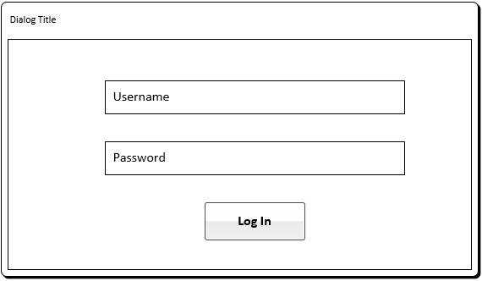

Slide 8
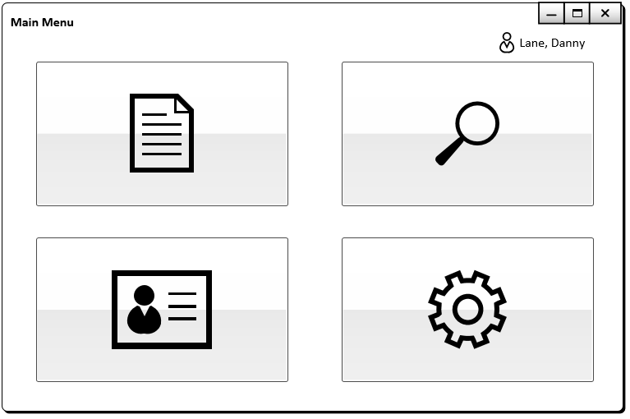

Slide 9
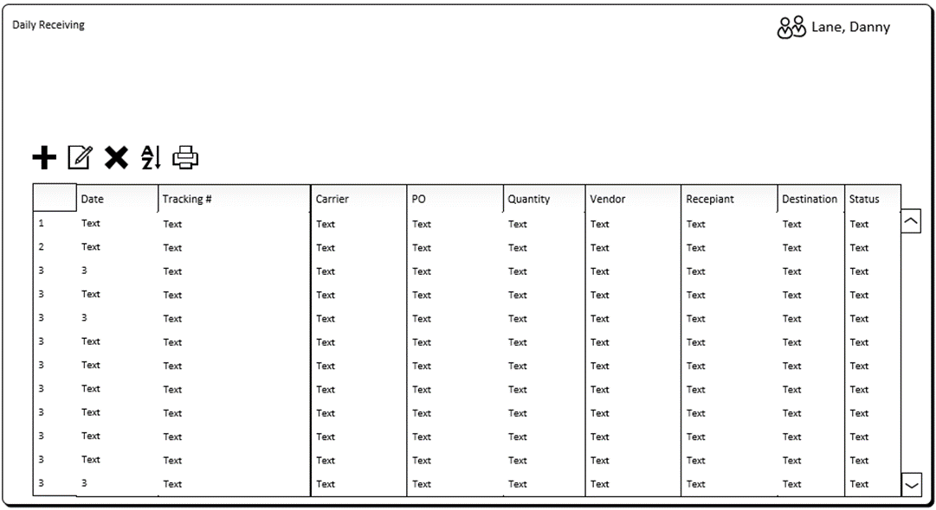
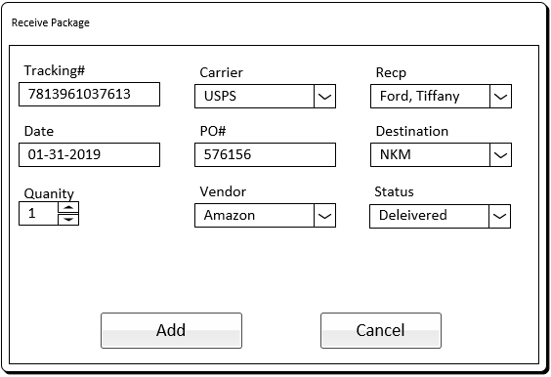

Slide 10
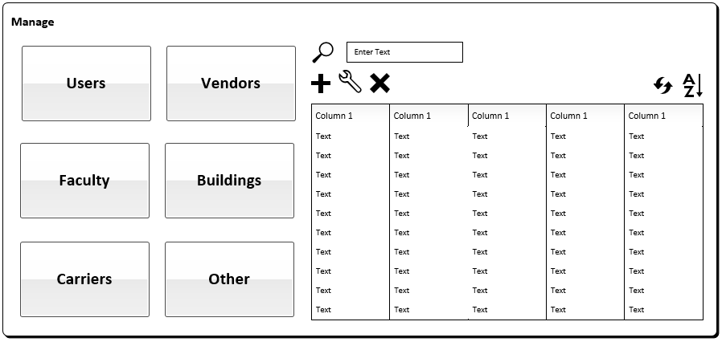

Slide 11
What about the data side???

Slide 12
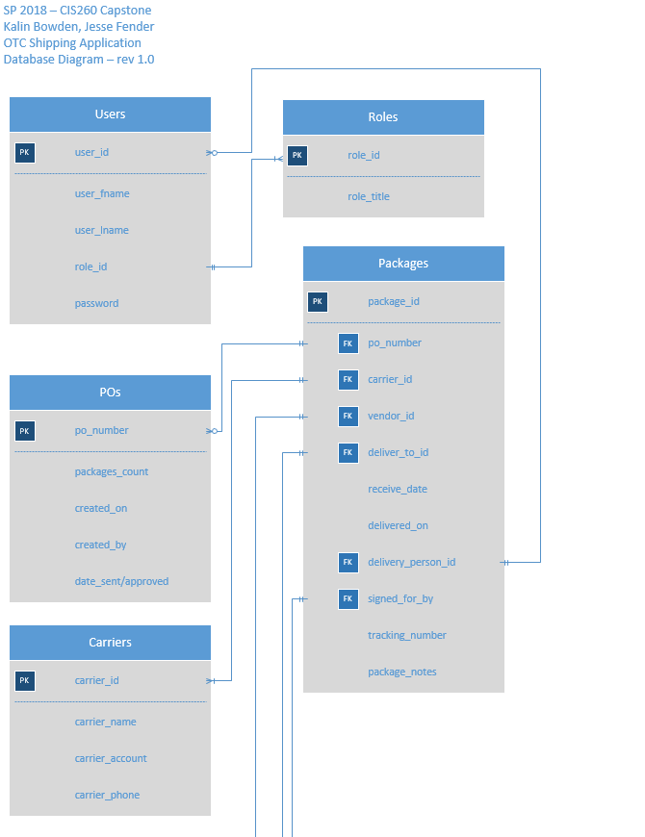

Slide 13
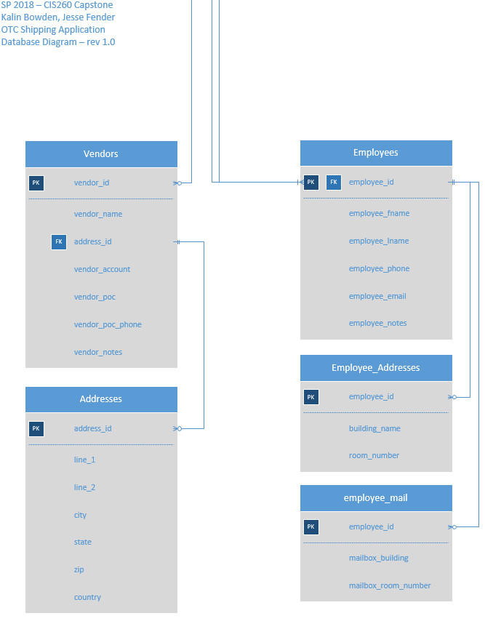

Slide 14
Security Concerns ? ? ?

Slide 15
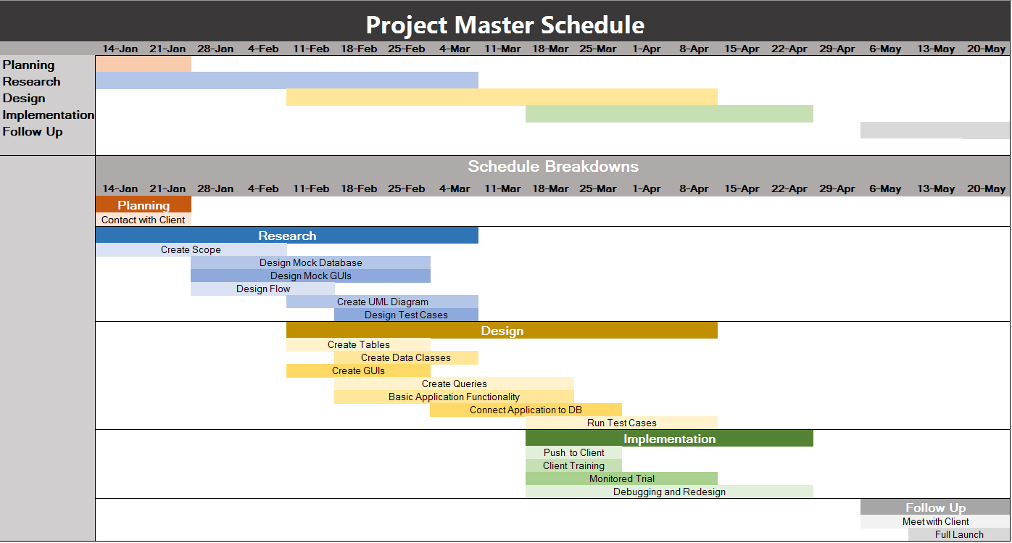
Our Plan Of attack.

