Slide 1
Georgia Primary Runoff 2020 Elections
Case study for future Mail or Email vote direction
Jasmin Fernandez Castillo
August 17th, 2020

Slide 2
Georgia Runoff Primaries
Finalized August 11th
Data last updated August 12th 2020
Notes:
https://elections.sos.ga.gov/Elections/voterabsenteefile.do

Slide 3

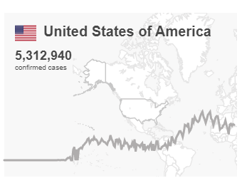
Why its important to Polish up Vote By Mail Now?
Dead people don’t vote
Long term planning for future pandemics
Long term COVID-19 ( might last as long as 2 years)
Notes:
https://covid19.who.int/
https://www.cidrap.umn.edu/sites/default/files/public/downloads/cidrap-covid19-viewpoint-part1_0.pdf

Slide 4
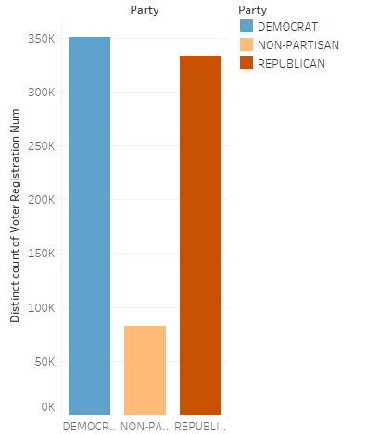
Who were our Absentee Voters?
-Mostly democrats

Slide 5
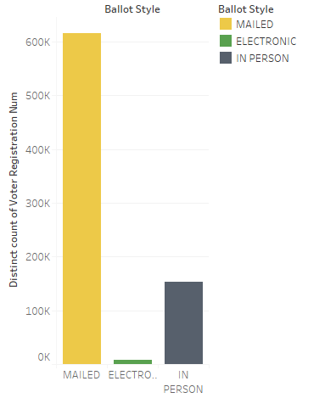
How did all Absentee voters vote?
Most of them voted by mail

Slide 6
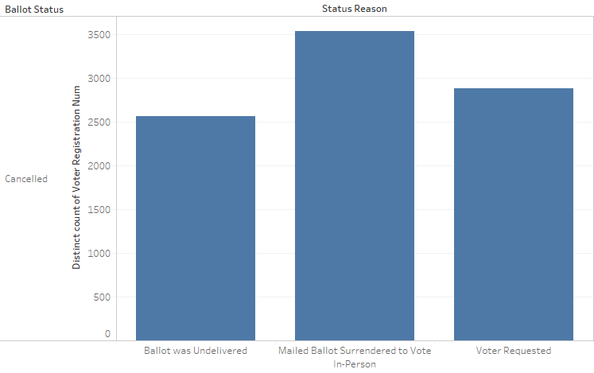
Absentee Ballot Cancelled
These were of the status reasons with 2k and up

Slide 7
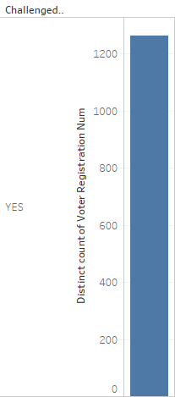
After submission, Challenged Provisional?
Very few
Notes:
Approx 1200 of them--

Slide 8
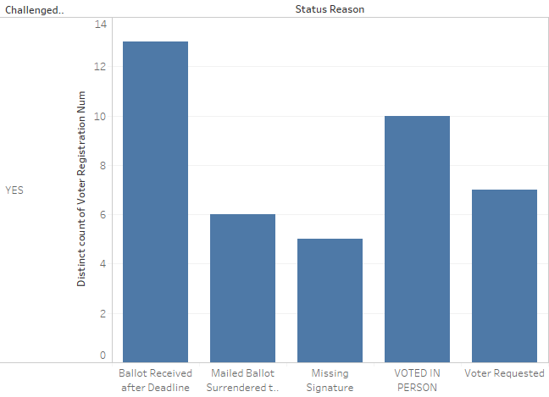
Why did this very few get challenged?
Each of these had at least 5 subjects
Variations of the status reasons exist
Notes:
There are 918 levels to this variable, so this is just recording the frequencies for these levels and not the verbal variations of such

Slide 9
Goals
No one opts out of their absentee vote to vote by mail
No ones absentee vote gets challenged
How?
- script info on what are the most likely reasons for cancellation and how to avoid said cancellations
- Give potential voters resources of rules for voting by mail

Slide 10
Data Set Limitations
there is no data dictionary
not enough details as to why ballots were challenged

Slide 11
If i had more time
potentially get an email back from the source of the data set
look into zip code racial composition as a proxy for race and class and note whether there was a discrepancy between ballot challenges amongst marginalized subpopulations in comparison to privileged subpopulations
Conduct a chi square analysis to note which party group was more likely to have their ballot challenged -- ( see if there is reason to believe bias was in play)

