Slide 1
THIS IS YOUR PRESENTATION TITLE

Slide 2
Instructions for use
EDIT IN GOOGLE SLIDES
Click on the button under the presentation preview that says "Use as Google Slides Theme".
You will get a copy of this document on your Google Drive and will be able to edit, add or delete slides.
You have to be signed in to your Google account.
EDIT IN POWERPOINT®
Click on the button under the presentation preview that says "Download as PowerPoint template". You will get a .pptx file that you can edit in PowerPoint.
Remember to download and install the fonts used in this presentation (you’ll find the links to the font files needed in the Presentation design slide)
More info on how to use this template at www.slidescarnival.com/help-use-presentation-template
This template is free to use under Creative Commons Attribution license. You can keep the Credits slide or mention SlidesCarnival and other resources used in a slide footer.

Slide 3
1.
TRANSITION HEADLINE
Let’s start with the first set of slides

Slide 4
This is a slide title
Here you have a list of items
And some text
But remember not to overload your slides with content
Your audience will listen to you or read the content, but won’t do both.

Slide 5
BIG CONCEPT
Bring the attention of your audience over a key concept using icons or illustrations

Slide 6
You can also split your content
White
Is the color of milk and fresh snow, the color produced by the combination of all the colors of the visible spectrum.
Black
Is the color of coal, ebony, and of outer space. It is the darkest color, the result of the absence of or complete absorption of light.

Slide 7
In two or three columns
Yellow
Is the color of gold, butter and ripe lemons. In the spectrum of visible light, yellow is found between green and orange.
Blue
Is the colour of the clear sky and the deep sea. It is located between violet and green on the optical spectrum.
Red
Is the color of blood, and because of this it has historically been associated with sacrifice, danger and courage.

Slide 8
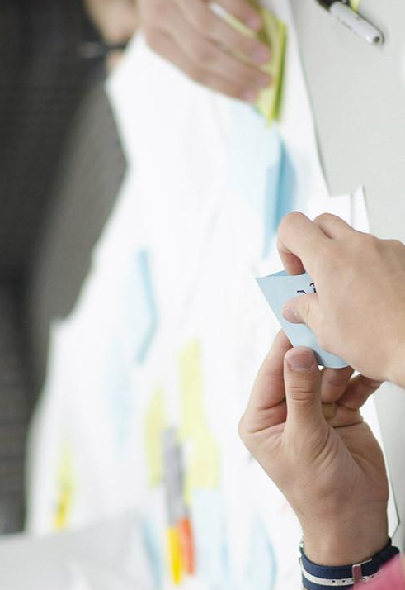
A picture is worth a thousand words
A complex idea can be conveyed with just a single still image, namely making it possible to absorb large amounts of data quickly.

Slide 9
Use charts to explain your ideas
Darknet
OpenCV
Our Logic

Slide 10
Statistiche su video
 | A | B | C
Yellow | 10 | 20 | 7
Blue | 30 | 15 | 10
Orange | 5 | 24 | 16

Slide 11
89,526,124
Whoa! That’s a big number, aren’t you proud?

Slide 12
Our process is easy
FIRST
SECOND
LAST

Slide 13
Let’s review some concepts
Yellow
Is the color of gold, butter and ripe lemons. In the spectrum of visible light, yellow is found between green and orange.
Blue
Is the colour of the clear sky and the deep sea. It is located between violet and green on the optical spectrum.
Red
Is the color of blood, and because of this it has historically been associated with sacrifice, danger and courage.
Yellow
Is the color of gold, butter and ripe lemons. In the spectrum of visible light, yellow is found between green and orange.
Blue
Is the colour of the clear sky and the deep sea. It is located between violet and green on the optical spectrum.
Red
Is the color of blood, and because of this it has historically been associated with sacrifice, danger and courage.

Slide 14
THANKS!
Any questions?
You can find me at:
@username · user@mail.me

Slide 15
Credits
Special thanks to all the people who made and released these awesome resources for free:
Presentation template by SlidesCarnival
Photographs by Startupstockphotos

