Slide 1
ISUZU SERVICE TECHNICIAN
EDUCATION PROGRAM
ISTEP – 1
PERIODIC MAINTENANCE SERVICE

Slide 2
Table of Contents
Periodic Maintenance Service
  Introduction
  Benefits of PMS
  Purpose of PMS
  Difference Between Periodic, Predictive and Corrective Maintenance Service
  1. Periodic Maintenance
  2. Predictive Maintenance
  3. Corrective Maintenance
  Categories of Vehicle Maintenance
  1. General Maintenance Service
  2. Periodic Maintenance Service
  Maintenance in Severe Driving Condition
  New Isuzu Periodic Maintenance Service Menu
2

Slide 3
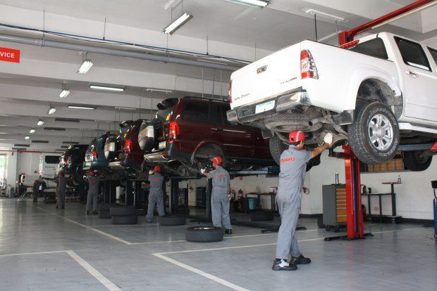
INTRODUCTION
• A periodic maintenance describes the act of inspecting or testing the condition of car sub-systems (engine, transmission, underchassis, etc.) and servicing or replacing parts and fluids. Regular maintenance is critical to ensure the safety, reliability, drivability and comfort.
• Recommended the so-called extreme or the ideal service schedule based on impact parameters such as;
    Number of trips and distance travelled per trip per day
    Extreme hot or cold climate conditions
    Normal paved, mountainous, dusty roads
    Heavy stop-and-go as against long distance cruising
    Towing a trailer or other heavy loads

Slide 4
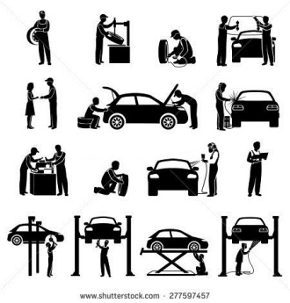



BENEFITS OF PERIODIC MAINTENANCE SERVICE
  • Lowers the utility costs by keeping your vehicle running at peak efficiency.
  • Add years to the life of your vehicle, greatly reduce costly breakdowns, and ensure
  on-going efficiency.
  • Minimizes emergency and unplanned repair costs.
  • To maintain the vehicle performance to the best possible condition.
  • Prevent small problems from becoming bigger.
  • Ensure the vehicle safety.

Slide 5
  PURPOSE OF PERIODIC MAINTENANCE SERVICE
  • Periodic Maintenance Service (PMS) involves performing certain services to
  a vehicle on regularly scheduled basis before there is any sign of trouble.
  • A typical Periodic Maintenance Service recommends particular service based on
  mileage or time intervals.
  • Maintenance, including tests, measurements, adjustments, and parts
  replacement, performed specifically to prevent faults from occurring.
DIFFERENCE BETWEEN PERIODIC, PREDICTIVE and CORRECTIVE
MAINTENANCE SERVICE
1. Periodic Maintenance Service
    • Preventive maintenance tasks are completed when the machines are shut
    down .
    • Designed to preserve and restore equipment reliability by replacing worn
    components before they actually fail.
Example:
      Changing the engine oil in every 5,000 or 6 months.
      Changing transmission and differential oils every 20,000 km or 24 months.
Notes:
5

Slide 6
2. Predictive Maintenance
• Designed to help determine the condition of in-service vehicle in order to
predict when maintenance should be performed. This approach promises cost
savings over routine or time- based preventive maintenance, because tasks are
performed only when necessary.
• The main assurance of predictive maintenance is to allow convenient
scheduling of corrective maintenance.
Example:
    Clutches
    Transmission
    Axle and Differential
    Engine
3. Corrective Maintenance
• It Is a maintenance task or operation done in order to identify or find, isolate or
separate and rectify a particular fault. This is performed in order to restore the
failed machine, equipment or system to an operational condition.
Example:
    Engine overhauling and repair
    Pull down transmission and replace clutch
Function and operation

Slide 7
Important Facts about Periodic Maintenance Service
• Trained, qualified mechanic with the expertise and equipment to do the job
correctly should perform most of the maintenance on vehicle.
• Save hundreds of pesos a year by keeping an auto maintenance schedule
comprised of simple checks and procedures.
• Warranty Booklet of a vehicle will provide a maintenance schedule for specific
make and model.
• If, for any reason, your maintenance history does not meet or exceed the
recommended minimums, warranty claims will be denied by the manufacturer.
If this happens, the customer may have to pay for costly repairs.
• Some car buyers are fanatical about maintenance, periodic maintenance is
preserving the resale value of your vehicle.
• Maintenance items and service intervals are studied and determined from an
engineering point of view based on the following method:
    Climate
    Condition of usage

Slide 8
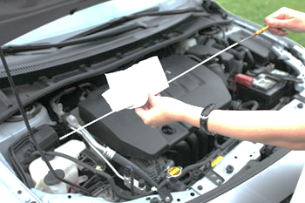
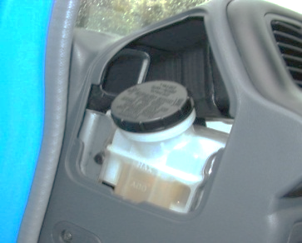
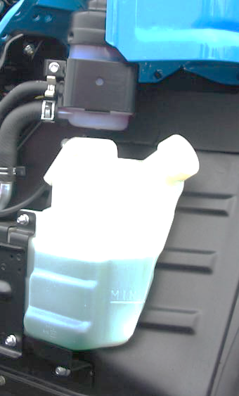
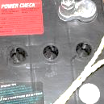
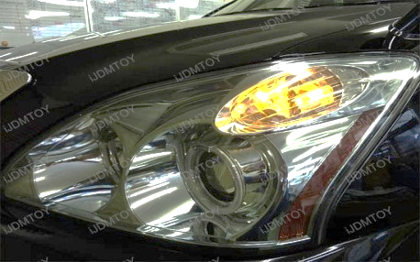
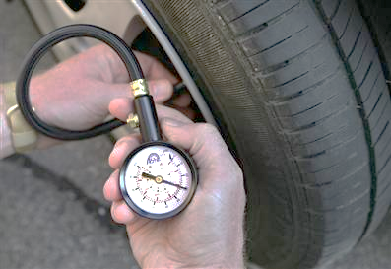
CATEGORIES OF VEHICLE MAINTENANCE
1. General Maintenance
  • Also known as the “Do-It-Yourself Maintenance”
  • The following items generally included as “Do-it-yourself” items;
Oil level checking
Check brake and clutch fluid level
Coolant level
Battery electrolyte level
Turn signal and lighting check
Tire check

Slide 9
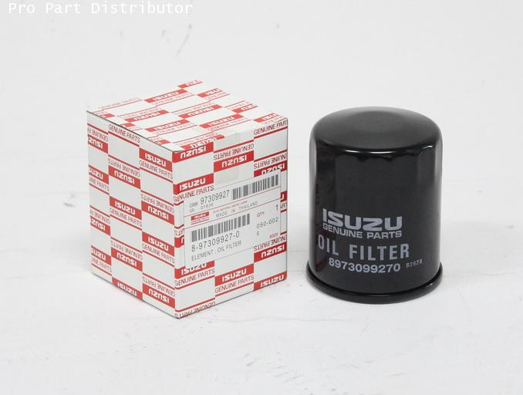
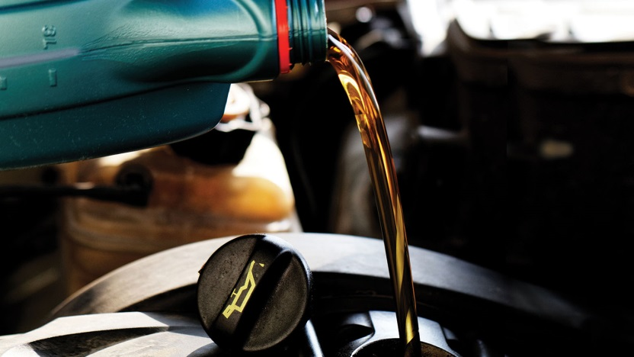
CATEGORIES OF VEHICLE MAINTENANCE
2. Periodic Maintenance Service (PMS)
  • Includes items required to be serviced at regular intervals in any
  authorized Isuzu dealership.
  • Replacement parts are those which cannot avoid material deterioration
  due to aging and need to be replaced at a certain period of time.
  The following items are generally included as periodic maintenance items:
Engine Filter and Oil Replacement

Slide 10
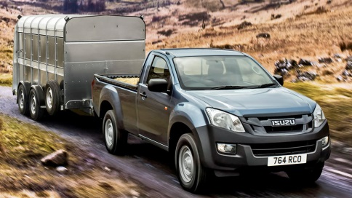
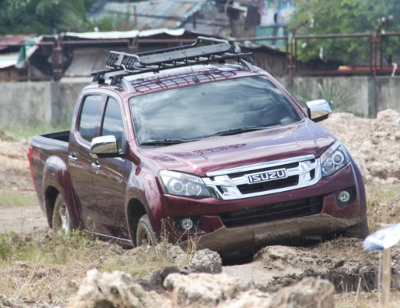

MAINTENANCE IN SEVERE DRIVING CONDITION
1. More frequent service interval are advised for vehicle that are used or operated in severe condition such as;
    • Towing a trailer
    • Dusty road
    • Driving in sand, mud or deep water (as deep as wheel hub).
2. Items for maintenance are:
    • Brake pads, linings, discs and drums
    • Brake lines and hoses
    • Wheel bearing grease and free- running hub grease
    • Differential, transmission and transfer oil
    • Air cleaner filter
    • Clutch housing (check water entry)

Slide 11
ISUZU PERIODIC MAINTENANCE SERVICE MENU
ISUZU CROSSWIND / D-MAX / mu-X / ALTERRA / N-SERIES / F-SERIES
Legend:
I : Inspect and correct or replace as necessary A : Adjust
T : Tighten to the specified torque R : Replace
C : Clean / Check D : Drain
L : Lubricate P : Perform
S/N | SERVICE ITEM | every 5K | every 10K | every 20K
1 | Engine oil | R | R | R
2 | Engine oil filter | R | R | R
3 | Engine oil leakage and contamination | I | I | I
4 | Engine Idling speed and acceleration | I | I | I
5 | Fan belt tension and damage | I / A | I / A | I / A
6 | All hoses and pipes in engine compartment for leak of damage | I | I | I
7 | Valve clearance (Common Rail Engine) |  |  | I / A
8 | Valve clearance (Non-Common Rail Engine) |  | I / A | I / A
9 | Air cleaner element | I / C | I / C | R
10 | Fuel filter |  | R | R
11 | Drain fuel sedimentor | D / C | D / C | D / C
12 | Engine coolant | I | I | R
13 | Cooling system for water leakage | I | I | I

Slide 12
ISUZU PERIODIC MAINTENANCE SERVICE MENU
ISUZU CROSSWIND / D-MAX / mu-X / ALTERRA / N-SERIES / F-SERIES
S/N | SERVICE ITEM | every 5K | every 10K | every 20K
14 | Clutch fluid | I | I | R
15 | Clutch pedal travel and free play | I | I | I
16 | Clutch system | I | I | I
17 | [M/T] Manual transmission oil |  |  | R
18 | [4WD M/T] Transfer case oil |  |  | R
19 | [4WD M/T] Manual transmission and transfer case oil leakage | I | I | I
20 | [A/T] Automatic transmission fluid | I | I | R
21 | [A/T] Automatic transmission fluid filter (*every 60K) for (D-Max RT 50 and mu-X) |  |  | *C
22 | [4WD A/T] Transfer case oil |  |  | R
23 | [4WD A/T] Automatic transmission and transfer case oil leakage | I | I | I
24 | Propeller shaft loose connections |  | I | I
25 | Propeller shaft universal joints and splines for wear |  | I | I
26 | [4WD] Propeller shaft universal joints and sliding sleeve |  | L | L
27 | Differential gear oil (Front and rear) |  |  | R
28 | Front and rear axle oil leakage | I | I | I
29 | [4WD] Shift on the fly system operation |  | I | I
30 | [4WD] Front axle shaft rubber boot for damage | I | I | I

Slide 13
ISUZU PERIODIC MAINTENANCE SERVICE MENU
ISUZU CROSSWIND / D-MAX / mu-X / ALTERRA / N-SERIES / F-SERIES
S/N | SERVICE ITEM | every 5K | every 10K | every 20K
31 | Power steering fluid | I | I | R
32 | Power steering oil leakage | I | I | I
33 | Steering Column bolts for looseness or damage | I | I | I
34 | Power steering hose | I | I | I
35 | Steering wheel play | I | I | I
36 | Steering function | I | I | I
37 | Right and left turning radius | I | I | I
38 | Steering joint ball for oil leakage or damage |  | I | I
39 | Brake fluid | I | I | R
40 | Brake system for fluid leakage | I | I | I
41 | Brake function | I | I | I
42 | Front disc brake pads and discs wear / lining and drum wear | I | I | I
43 | Rear brake lining and drum wear | I | I | I
44 | Brake pedal travel and play | I | I | I
45 | Brake pipes and hoses for loose connections or damage | I | I | I
46 | Parking brake function & cables for looseness or damage | I | I | I
47 | Leaf/coil springs for damage |  | I | I
48 | Suspension mount for looseness or damage |  | I | I
49 | Shock absorbers for oil leakage |  | I | I

Slide 14
ISUZU PERIODIC MAINTENANCE SERVICE MENU
ISUZU CROSSWIND / D-MAX / mu-X / ALTERRA / N-SERIES / F-SERIES
S/N | SERVICE ITEM | every 5K | every 10K | every 20K
50 | Shock absorbers mount for looseness |  | I | I
51 | Rubber bushes of suspension wear or damage |  | I | I
52 | Grease, Hub Bearing |  |  | R
53 | Tire air pressure and damage | C | C | C
54 | Tire rotation |  | P | P
55 | Bolts and Nuts on chassis and body | T | T | T
56 | [F Series] Front brake lining and drum wear |  | I | I
57 | [F Series] Rear brake lining and drum wear |  | I | I
58 | [F Series] King Pin | L | L | L
59 | [F Series] Center Bearing, Propeller Shaft | L | L | L
60 | [F Series] Bushing, Leaf Spring | L | L | L
61 | [F Series] Water Pump | L | L | L
62 | [F Series ] Brake Lining Adjust /Thickness | I | I | I

Slide 15
ISUZU PERIODIC MAINTENANCE SERVICE MENU
ISUZU HEAVY DUTY TRUCKS (C & E SERIES)
Legend:
I : Inspect and correct or replace as necessary A : Adjust
T : Tighten to the specified torque R : Replace
C : Clean / Check D : Drain
L : Lubricate P : Perform
S/N | SERVICE ITEM | every 5K | every 10K | every 20K
1 | Engine oil |  | R | R
2 | Engine oil filter - Main |  | R | R
3 | Engine oil filter - Partial |  | R | R
4 | Engine oil leakage and contamination | I | I | I
5 | Engine idling speed and acceleration | I | I | I
6 | Fan belt tension and damage | I / A | I / A | I / A
7 | All hoses and pipes in engine compartment for leak and damage | I | I | I
8 | Valve clearance (Common Rail Engine) |  |  | I / A
9 | Air cleaner element | I / C | I / C | R
10 | Main fuel filter |  |  | R
11 | Pre-fuel filter element |  |  | R
12 | Engine coolant (Replace every two yrs) | I | I | R (@2yrs)
13 | Cooling system for water leakage | I | I | I

Slide 16
ISUZU PERIODIC MAINTENANCE SERVICE MENU
S/N | SERVICE ITEM | every 5K | every 10K | every 20K
14 | Clutch fluid |  |  | R
15 | Clutch pedal travel and free play | I | I | I
16 | Clutch system | I | I | I
17 | Transmission gear oil |  |  | R
18 | Propeller shaft loose connections | I | I | I
19 | Propeller shaft universal joints and spline for wear |  |  | I
20 | Propeller shaft universal joints and sliding sleeve | L | L | L
21 | Differential gear oil |  |  | R
22 | Front and rear axle oil leakage |  |  | R
23 | Power steering fluid |  |  | R
24 | Power steering oil leakage | I | I | I
25 | Steering column bolts for looseness or damage | I | I | I
26 | Power steering hose | I | I | I
27 | Steering wheel free-play | I | I | I
28 | Steering function |  | I | I
29 | Right and left turning radius | I | I | I
30 | Steering ball joint for oil leakage or damage |  | I | I

Slide 17
ISUZU PERIODIC MAINTENANCE SERVICE MENU
S/N | SERVICE ITEM | every 5K | every 10K | every 20K
31 | Brake fluid | n/a
32 | Brake system for fluid leakage | I | I | I
33 | Brake function | I | I | I
34 | Brake pedal travel and free-play | I | I | I
35 | Brake pipes and hoses for loose connections or damage | I | I | I
36 | Parking brake function & cables for looseness or damage | I | I | I
37 | Leaf / coil springs for damage |  | I | I
38 | Suspension mount for looseness or damage |  | I | I
39 | Shock absorbers for oil leakage |  | I | I
40 | Shock absorbers mount for looseness |  | I | I
41 | Rubber bushing of suspension wear or damage |  | I | I
42 | Grease, hub bearing (* every 40K) |  |  | *R
43 | Tire air pressure and damage | C | C | C
44 | Bolts and nuts on chassis / body | T | T | T
45 | Front and rear brake lining wear | I | I | I
46 | Front and rear drum wear |  |  | I
47 | King pin | L | L | L
48 | Center bearing, propeller shaft | L | L | L
49 | Bushing, leaf spring | L | L | L

Slide 18
ISUZU PERIODIC MAINTENANCE SERVICE MENU
S/N | SERVICE ITEM | every 5K | every 10K | every 20K
50 | Brake lining adjustment / thickness | I | I | I
51 | Water pump (6WF1) | L | L | L
52 | Air dryer | R – every two yrs
53 | Power steering fluid filter (* Every 50K) | *I
54 | Function of brake chamber | I | I | I
55 | Brake chamber boots and diaphragm | *R- every two yrs
56 | Tierod end greasing (*every 25K) | *L- every 25K
57 | Function of brake valve | I | I | I
58 | ABS Modulator | *R – every two yrs
59 | Electro-hydraulic cab tilt pump oil | *R – every two yrs
60 | Intake and exhaust manifold (*every 40K) | *T- every 40K
61 | Air compressor, governor and unloader valve functions (*every 40 K) | *T- every 40K
62 | Leaf spring U-bolt and nut |  |  | T

Slide 19
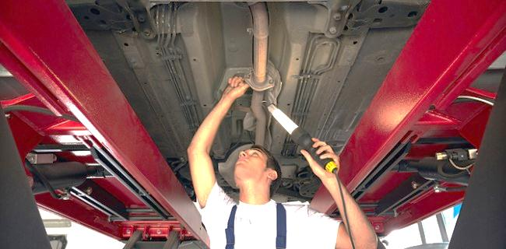
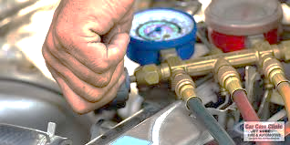
ISUZU PERIODIC MAINTENANCE SERVICE MENU
ADD ON SERVICE ITEMS | Remarks
1 | Air-con General Service | Every 25K or 1 year, whichever comes first
2 | Wheel Alignment | As needed
3 | Injection timing (4JA1 / 4JB1 / 4HF1 / 4HG1) | As needed
4 | Injector Nozzle Spray Pattern (4JA1 / 4JB1 / 4HF1 / 4HG1) | As needed
5 | [F Series] Tire Rotation | As needed

Slide 20
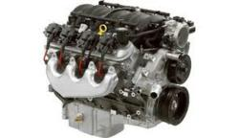
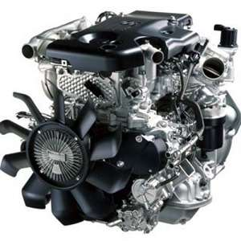
Engine
Automobile Engines – engines designed to produce power and propel automobiles to be able to go from point a to point b.
Gasoline Engines
- Engines which uses gasoline fuels. Small-sized, high speed, high powered and light weight and are widely used for passenger cars, commercial vehicles and small trucks.
Diesel Engines
- Engines which uses light oil called diesel as fuel. Used in commercial vehicles like trucks and buses due to fuel economy and high thermal efficiency compared to gasoline engines.
20

Slide 21
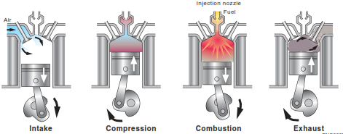
Engine
Fundamentals of Diesel Engines
Designed by Rudolf Diesel in 1897, provides advantages of low fuel consumption and long durability.
Features of Diesel Engines
- It draws only air during intake stroke.
- There is no ignition system
Diesel Engine Operation
Intake Stroke - Air enters the engine as the piston goes down to BDC and Intake Valves open.
Compression Stroke – Air is being compressed as the piston goes up to TDC. Temperature and pressure of air increases as the volume of the cylinder decreases.
Combustion Stroke – fuel is injected into the combustion chamber and ignites as it mixes with the compressed and heated air, increases further its pressure and forces the piston to go down and rotates the crankshaft, providing power.
Exhaust Stroke – as the piston goes up again, exhaust valves open and exhaust gas exits the cylinder and out to exhaust pipe.
21

Slide 22
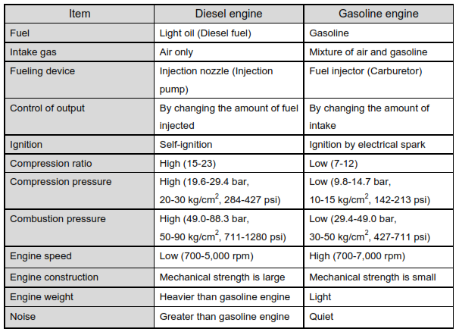
Engine
Comparison between Diesel and Gasoline Engines
22

Slide 23
Chassis
Outline of Drivetrain Systems
Description
  Drivetrain systems transmit torque and power to rotate the wheels which consists of the following:
  Clutch – Transmits or cuts engine torque to the transmission.
  Propeller Shaft & Universal Joint – Transmits engine torque from the transmission to the final drive.
  Final Gear – Torque from the propeller shaft is being transferred to the axle shaft and enables final speed reduction and increase tractability.
  Differential Carrier – Creates rotation variation between left and right wheels to allow for smooth travel on rough roads and when making turns.
  Drive Shaft – transmits torque from final drive to the wheels.
23

Slide 24


Chassis
Types of Drivetrain Configuration.
Front Engine Rear Drive
- Engine, clutch and transmission are placed as integrated unit in front of the vehicle while differential is placed at the rear.
  Front Engine 4 Wheel Drive (4WD)
  - Drive torque is distributed to each of the wheels using transfer assembly.
24

Slide 25
Chassis
Types of Drivetrain Configuration.
Front Engine Rear Drive
- Engine, clutch and transmission are placed as integrated unit in front of the vehicle while differential is placed at the rear.
  Front Engine 4 Wheel Drive (4WD)
  - Drive torque is distributed to each of the wheels using transfer assembly.
25

