Slide 1
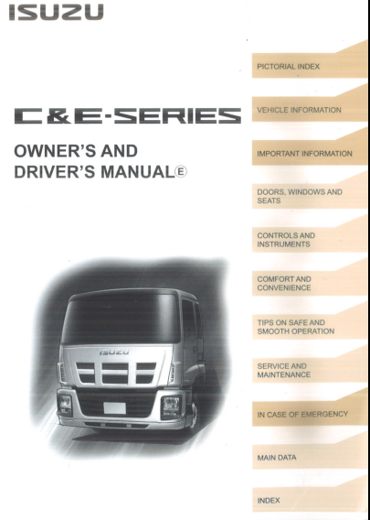

Slide 2
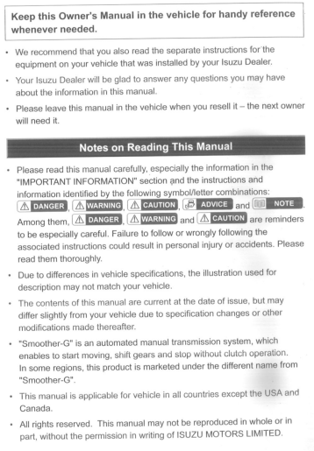
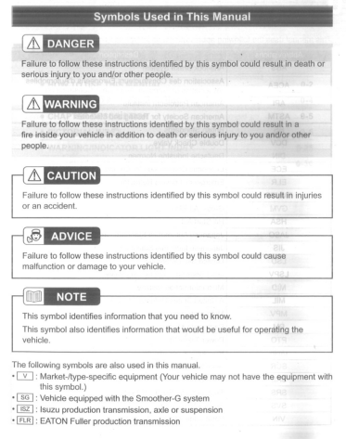
C&E-SERIES
OWNER’S AND
DRIVER’S MANUAL
Notes:
2

Slide 3
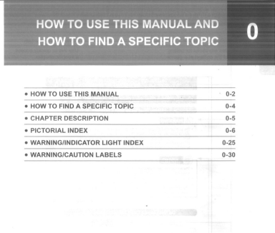
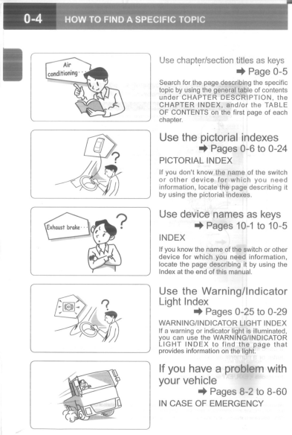
C&E-SERIES
OWNER’S AND
DRIVER’S MANUAL

Slide 4
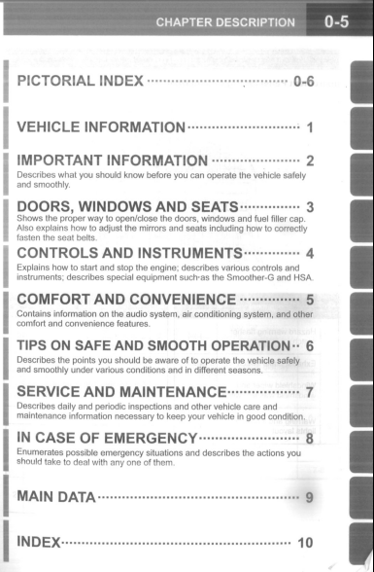
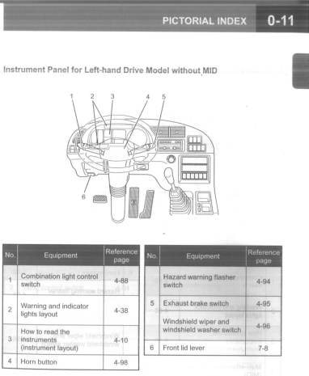
C&E-SERIES
OWNER’S AND
DRIVER’S MANUAL

Slide 5
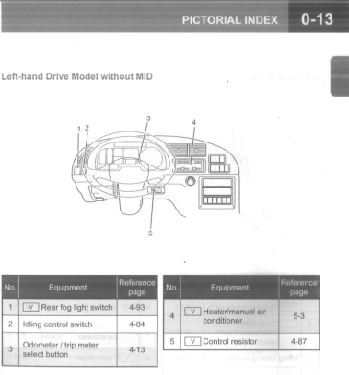
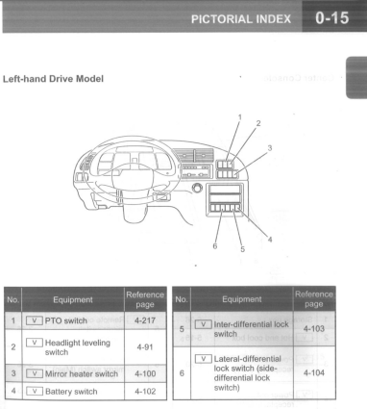
C&E-SERIES
OWNER’S AND
DRIVER’S MANUAL

Slide 6
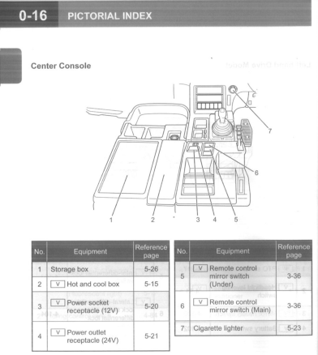
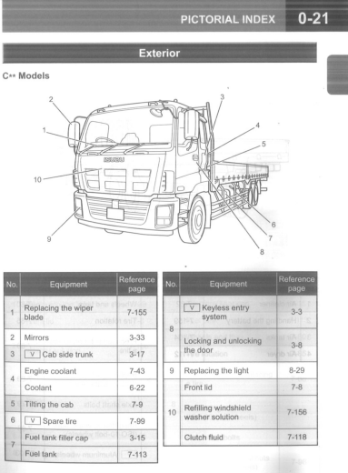
C&E-SERIES
OWNER’S AND
DRIVER’S MANUAL

Slide 7
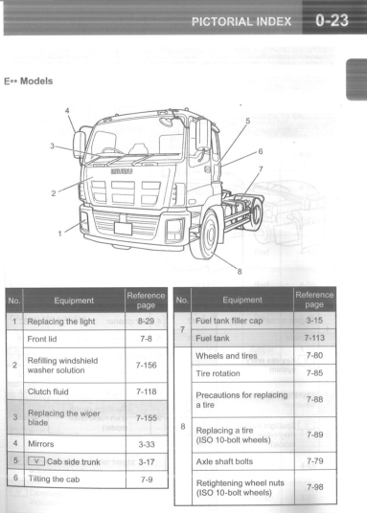
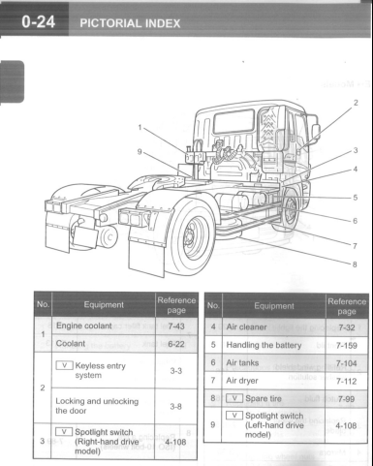
C&E-SERIES
OWNER’S AND
DRIVER’S MANUAL

Slide 8
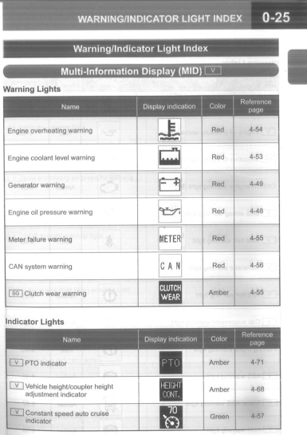
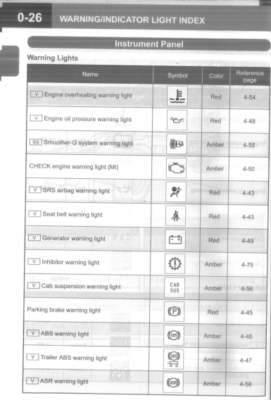
C&E-SERIES
OWNER’S AND
DRIVER’S MANUAL

Slide 9
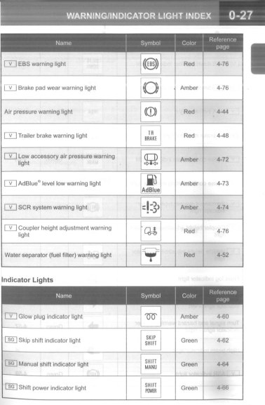
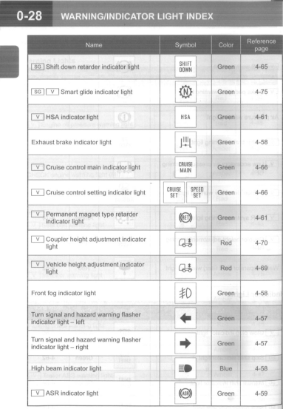
C&E-SERIES
OWNER’S AND
DRIVER’S MANUAL

Slide 10
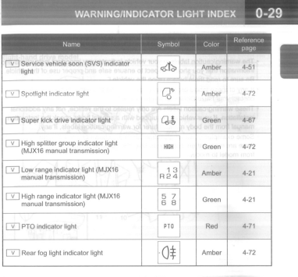
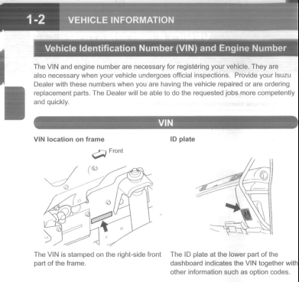
C&E-SERIES
OWNER’S AND
DRIVER’S MANUAL

Slide 11
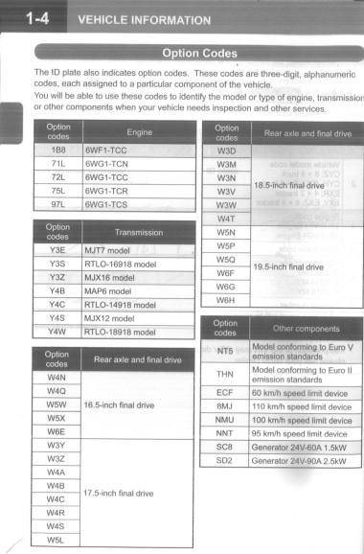
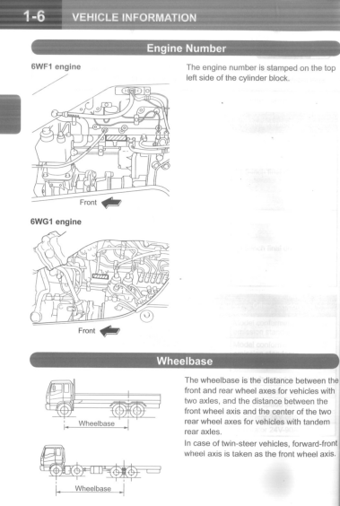
C&E-SERIES
OWNER’S AND
DRIVER’S MANUAL

Slide 12
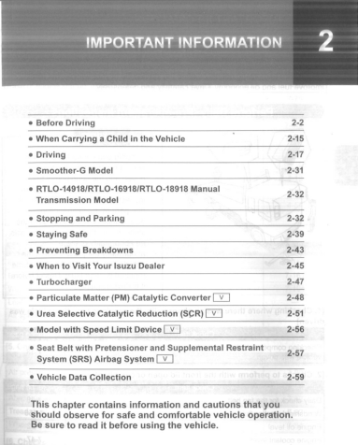
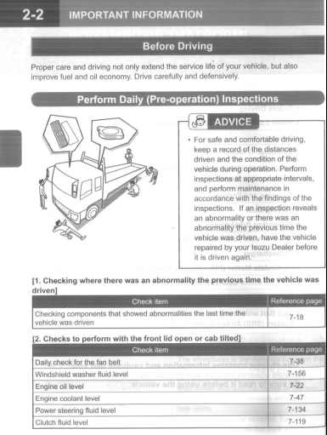
C&E-SERIES
OWNER’S AND
DRIVER’S MANUAL

Slide 13
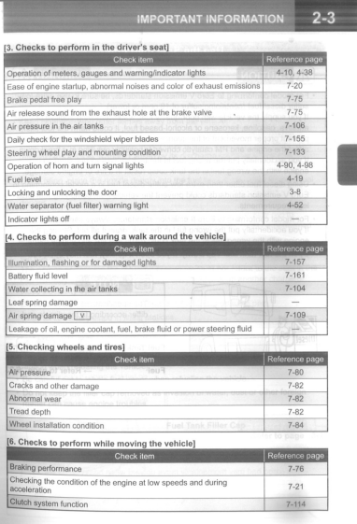
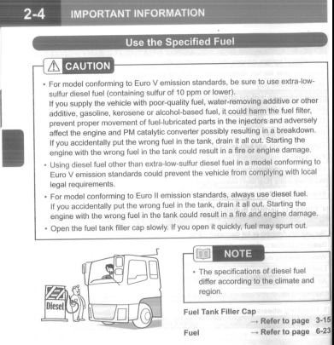
C&E-SERIES
OWNER’S AND
DRIVER’S MANUAL

Slide 14
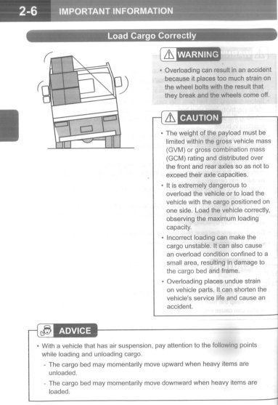
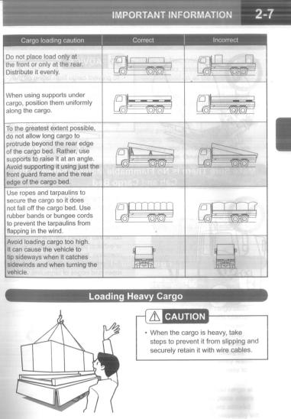
C&E-SERIES
OWNER’S AND
DRIVER’S MANUAL

Slide 15
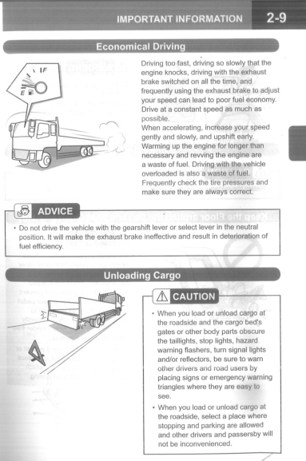
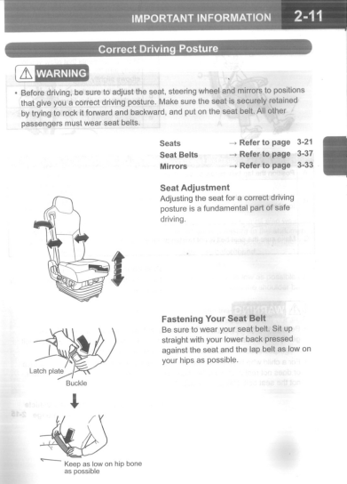
C&E-SERIES
OWNER’S AND
DRIVER’S MANUAL

Slide 16
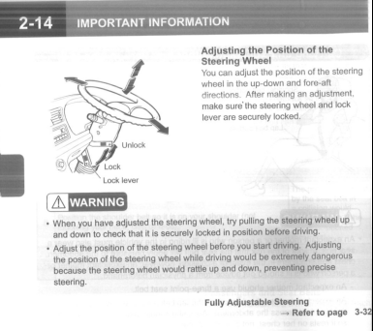
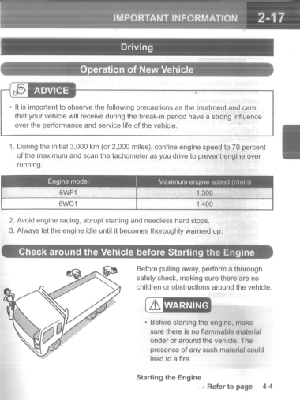
C&E-SERIES
OWNER’S AND
DRIVER’S MANUAL

Slide 17
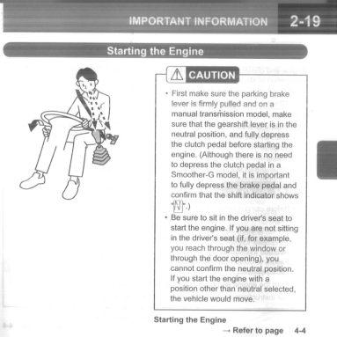
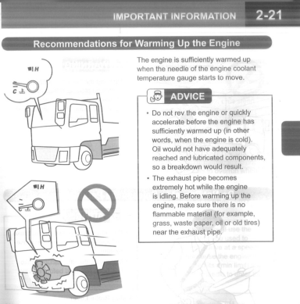
C&E-SERIES
OWNER’S AND
DRIVER’S MANUAL

Slide 18
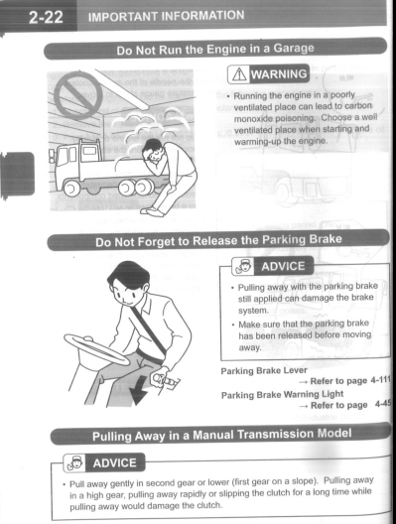
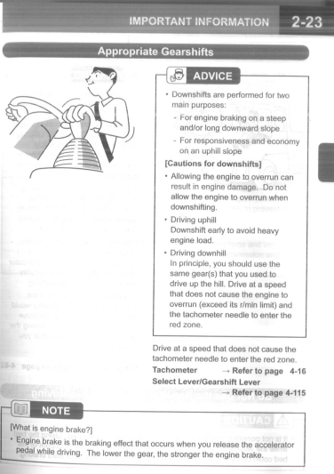
C&E-SERIES
OWNER’S AND
DRIVER’S MANUAL

Slide 19
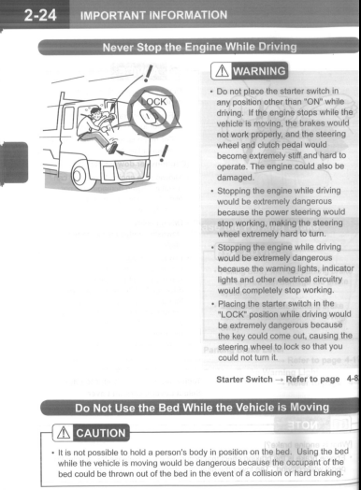
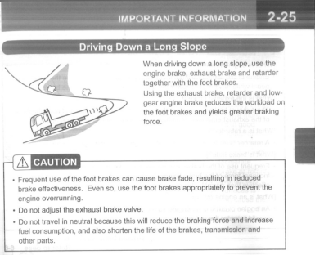
C&E-SERIES
OWNER’S AND
DRIVER’S MANUAL

Slide 20
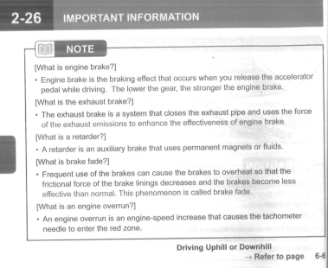
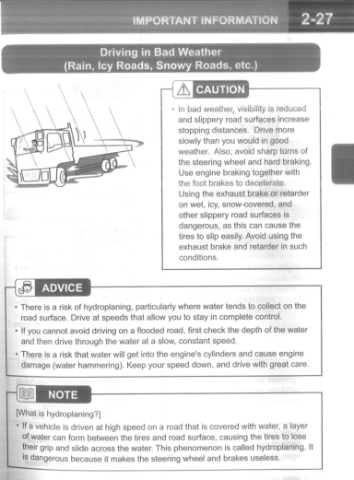
C&E-SERIES
OWNER’S AND
DRIVER’S MANUAL

Slide 21
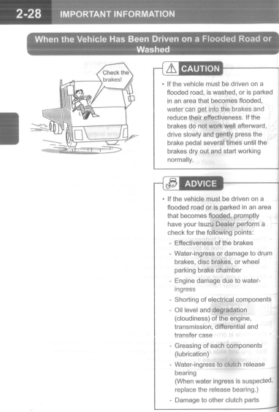
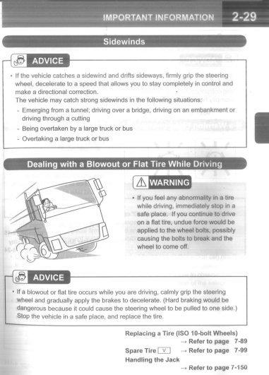
C&E-SERIES
OWNER’S AND
DRIVER’S MANUAL

Slide 22
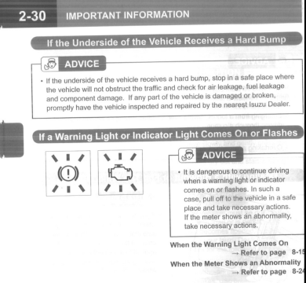
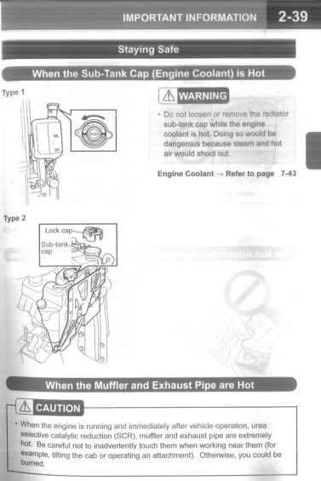
C&E-SERIES
OWNER’S AND
DRIVER’S MANUAL

Slide 23
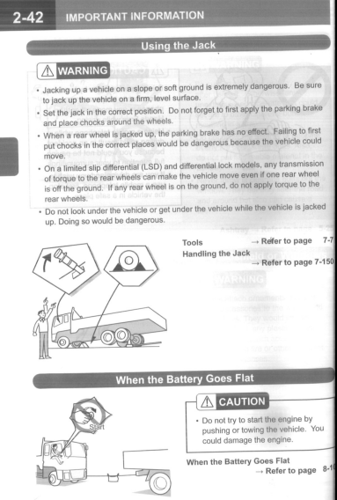
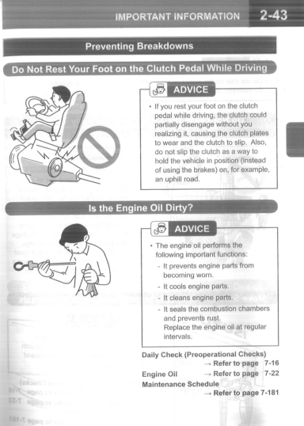
C&E-SERIES
OWNER’S AND
DRIVER’S MANUAL

Slide 24
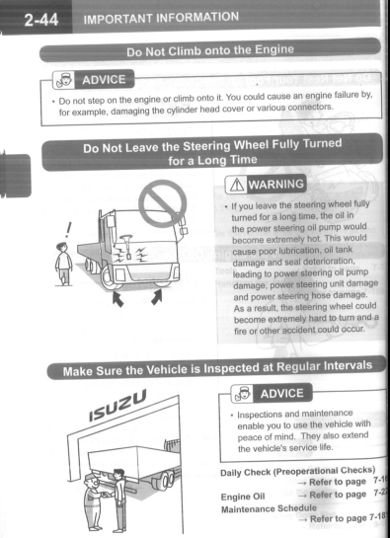
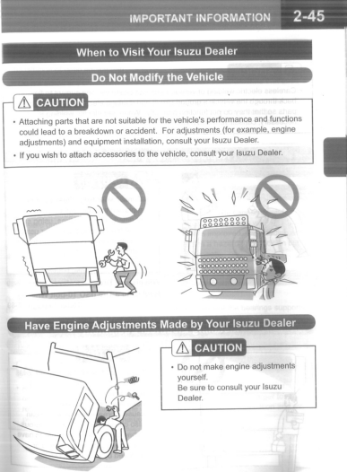
C&E-SERIES
OWNER’S AND
DRIVER’S MANUAL

Slide 25
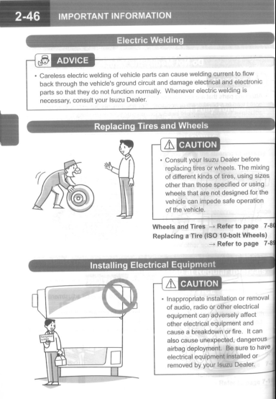
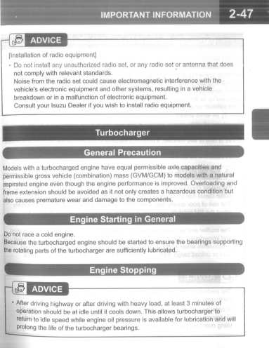
C&E-SERIES
OWNER’S AND
DRIVER’S MANUAL

Slide 26
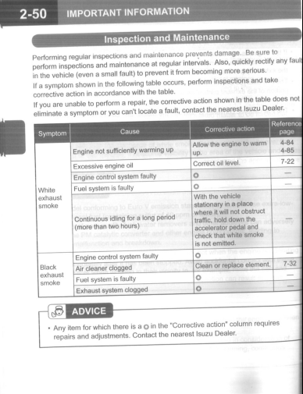

C&E-SERIES
OWNER’S AND
DRIVER’S MANUAL

Slide 27


C&E-SERIES
OWNER’S AND
DRIVER’S MANUAL

Slide 28


C&E-SERIES
OWNER’S AND
DRIVER’S MANUAL

Slide 29


C&E-SERIES
OWNER’S AND
DRIVER’S MANUAL

Slide 30


C&E-SERIES
OWNER’S AND
DRIVER’S MANUAL

Slide 31


C&E-SERIES
OWNER’S AND
DRIVER’S MANUAL

Slide 32


C&E-SERIES
OWNER’S AND
DRIVER’S MANUAL

Slide 33


C&E-SERIES
OWNER’S AND
DRIVER’S MANUAL

Slide 34


C&E-SERIES
OWNER’S AND
DRIVER’S MANUAL

Slide 35


C&E-SERIES
OWNER’S AND
DRIVER’S MANUAL

Slide 36


C&E-SERIES
OWNER’S AND
DRIVER’S MANUAL

Slide 37


C&E-SERIES
OWNER’S AND
DRIVER’S MANUAL

Slide 38


C&E-SERIES
OWNER’S AND
DRIVER’S MANUAL

Slide 39


C&E-SERIES
OWNER’S AND
DRIVER’S MANUAL

Slide 40


C&E-SERIES
OWNER’S AND
DRIVER’S MANUAL

Slide 41


C&E-SERIES
OWNER’S AND
DRIVER’S MANUAL

Slide 42


C&E-SERIES
OWNER’S AND
DRIVER’S MANUAL

Slide 43


C&E-SERIES
OWNER’S AND
DRIVER’S MANUAL

Slide 44


C&E-SERIES
OWNER’S AND
DRIVER’S MANUAL

Slide 45


C&E-SERIES
OWNER’S AND
DRIVER’S MANUAL

Slide 46


C&E-SERIES
OWNER’S AND
DRIVER’S MANUAL

Slide 47


C&E-SERIES
OWNER’S AND
DRIVER’S MANUAL

Slide 48


C&E-SERIES
OWNER’S AND
DRIVER’S MANUAL

Slide 49


C&E-SERIES
OWNER’S AND
DRIVER’S MANUAL

Slide 50


C&E-SERIES
OWNER’S AND
DRIVER’S MANUAL

Slide 51


C&E-SERIES
OWNER’S AND
DRIVER’S MANUAL

Slide 52


C&E-SERIES
OWNER’S AND
DRIVER’S MANUAL

Slide 53


C&E-SERIES
OWNER’S AND
DRIVER’S MANUAL

Slide 54


C&E-SERIES
OWNER’S AND
DRIVER’S MANUAL

Slide 55


C&E-SERIES
OWNER’S AND
DRIVER’S MANUAL

Slide 56


C&E-SERIES
OWNER’S AND
DRIVER’S MANUAL

Slide 57


C&E-SERIES
OWNER’S AND
DRIVER’S MANUAL

Slide 58


C&E-SERIES
OWNER’S AND
DRIVER’S MANUAL

Slide 59


C&E-SERIES
OWNER’S AND
DRIVER’S MANUAL

Slide 60


C&E-SERIES
OWNER’S AND
DRIVER’S MANUAL

Slide 61


C&E-SERIES
OWNER’S AND
DRIVER’S MANUAL

Slide 62


C&E-SERIES
OWNER’S AND
DRIVER’S MANUAL

Slide 63


C&E-SERIES
OWNER’S AND
DRIVER’S MANUAL

Slide 64


C&E-SERIES
OWNER’S AND
DRIVER’S MANUAL

Slide 65


C&E-SERIES
OWNER’S AND
DRIVER’S MANUAL

Slide 66


C&E-SERIES
OWNER’S AND
DRIVER’S MANUAL

Slide 67


C&E-SERIES
OWNER’S AND
DRIVER’S MANUAL

Slide 68


C&E-SERIES
OWNER’S AND
DRIVER’S MANUAL

Slide 69


C&E-SERIES
OWNER’S AND
DRIVER’S MANUAL

Slide 70


C&E-SERIES
OWNER’S AND
DRIVER’S MANUAL

Slide 71


C&E-SERIES
OWNER’S AND
DRIVER’S MANUAL

Slide 72


C&E-SERIES
OWNER’S AND
DRIVER’S MANUAL

Slide 73


C&E-SERIES
OWNER’S AND
DRIVER’S MANUAL

Slide 74


C&E-SERIES
OWNER’S AND
DRIVER’S MANUAL

Slide 75


C&E-SERIES
OWNER’S AND
DRIVER’S MANUAL

Slide 76


C&E-SERIES
OWNER’S AND
DRIVER’S MANUAL

Slide 77


C&E-SERIES
OWNER’S AND
DRIVER’S MANUAL

Slide 78


C&E-SERIES
OWNER’S AND
DRIVER’S MANUAL

Slide 79


C&E-SERIES
OWNER’S AND
DRIVER’S MANUAL

Slide 80


C&E-SERIES
OWNER’S AND
DRIVER’S MANUAL

Slide 81


C&E-SERIES
OWNER’S AND
DRIVER’S MANUAL

Slide 82


C&E-SERIES
OWNER’S AND
DRIVER’S MANUAL

Slide 83


C&E-SERIES
OWNER’S AND
DRIVER’S MANUAL

Slide 84


C&E-SERIES
OWNER’S AND
DRIVER’S MANUAL

Slide 85


C&E-SERIES
OWNER’S AND
DRIVER’S MANUAL

Slide 86


C&E-SERIES
OWNER’S AND
DRIVER’S MANUAL

Slide 87


C&E-SERIES
OWNER’S AND
DRIVER’S MANUAL

Slide 88


C&E-SERIES
OWNER’S AND
DRIVER’S MANUAL

Slide 89


C&E-SERIES
OWNER’S AND
DRIVER’S MANUAL

Slide 90


C&E-SERIES
OWNER’S AND
DRIVER’S MANUAL

Slide 91


C&E-SERIES
OWNER’S AND
DRIVER’S MANUAL

Slide 92


C&E-SERIES
OWNER’S AND
DRIVER’S MANUAL

Slide 93


C&E-SERIES
OWNER’S AND
DRIVER’S MANUAL

Slide 94


C&E-SERIES
OWNER’S AND
DRIVER’S MANUAL

Slide 95


C&E-SERIES
OWNER’S AND
DRIVER’S MANUAL

Slide 96


C&E-SERIES
OWNER’S AND
DRIVER’S MANUAL

Slide 97


C&E-SERIES
OWNER’S AND
DRIVER’S MANUAL

Slide 98


C&E-SERIES
OWNER’S AND
DRIVER’S MANUAL

Slide 99


C&E-SERIES
OWNER’S AND
DRIVER’S MANUAL

Slide 100


C&E-SERIES
OWNER’S AND
DRIVER’S MANUAL

Slide 101


C&E-SERIES
OWNER’S AND
DRIVER’S MANUAL

Slide 102


C&E-SERIES
OWNER’S AND
DRIVER’S MANUAL

Slide 103


C&E-SERIES
OWNER’S AND
DRIVER’S MANUAL

Slide 104


C&E-SERIES
OWNER’S AND
DRIVER’S MANUAL

Slide 105


C&E-SERIES
OWNER’S AND
DRIVER’S MANUAL

Slide 106


C&E-SERIES
OWNER’S AND
DRIVER’S MANUAL

Slide 107


C&E-SERIES
OWNER’S AND
DRIVER’S MANUAL

Slide 108


C&E-SERIES
OWNER’S AND
DRIVER’S MANUAL

Slide 109


C&E-SERIES
OWNER’S AND
DRIVER’S MANUAL

Slide 110


C&E-SERIES
OWNER’S AND
DRIVER’S MANUAL

Slide 111


C&E-SERIES
OWNER’S AND
DRIVER’S MANUAL

Slide 112


C&E-SERIES
OWNER’S AND
DRIVER’S MANUAL

Slide 113


C&E-SERIES
OWNER’S AND
DRIVER’S MANUAL

Slide 114


C&E-SERIES
OWNER’S AND
DRIVER’S MANUAL

Slide 115


C&E-SERIES
OWNER’S AND
DRIVER’S MANUAL

Slide 116


C&E-SERIES
OWNER’S AND
DRIVER’S MANUAL

Slide 117


C&E-SERIES
OWNER’S AND
DRIVER’S MANUAL

Slide 118


C&E-SERIES
OWNER’S AND
DRIVER’S MANUAL

Slide 119


C&E-SERIES
OWNER’S AND
DRIVER’S MANUAL

Slide 120


C&E-SERIES
OWNER’S AND
DRIVER’S MANUAL

Slide 121


C&E-SERIES
OWNER’S AND
DRIVER’S MANUAL

Slide 122


C&E-SERIES
OWNER’S AND
DRIVER’S MANUAL

Slide 123


C&E-SERIES
OWNER’S AND
DRIVER’S MANUAL

Slide 124
C&E-SERIES
OWNER’S AND
DRIVER’S MANUAL

Slide 125


C&E-SERIES
OWNER’S AND
DRIVER’S MANUAL

Slide 126


C&E-SERIES
OWNER’S AND
DRIVER’S MANUAL

Slide 127


C&E-SERIES
OWNER’S AND
DRIVER’S MANUAL

Slide 128


C&E-SERIES
OWNER’S AND
DRIVER’S MANUAL

Slide 129


C&E-SERIES
OWNER’S AND
DRIVER’S MANUAL

Slide 130

C&E-SERIES
OWNER’S AND
DRIVER’S MANUAL

Slide 131


