Slide 1
Interpreter Pattern:
Joshua Mathews and Richard Sterling

Slide 2
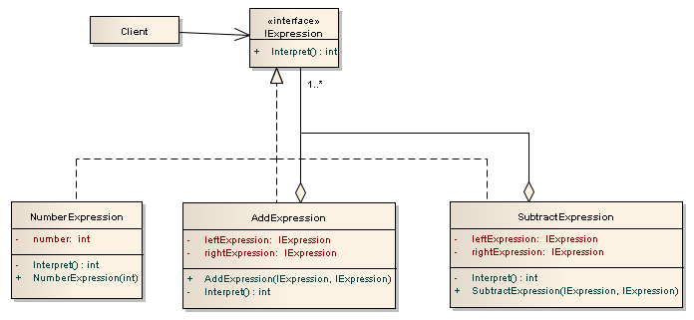
Interpreter Pattern:

Slide 3
When to use?
You can make a language to solve a particular problem. The client sends to the interpreter pattern a series of organized commands. Then, the interpreter pattern translates those commands into machine functionality.

