Slide 1
APP
S.O
DRIVERS
HAL
H.W
Free RTOS
LIB_MCU_LPC 43XX_M4
LPC 4367 (ARM Cortex M4 @ 204 MHz)
…
…
…
…
MEMORY W25Q80DB
SENSOR LIS3DML
GPIO
UART
…

Slide 2
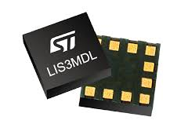
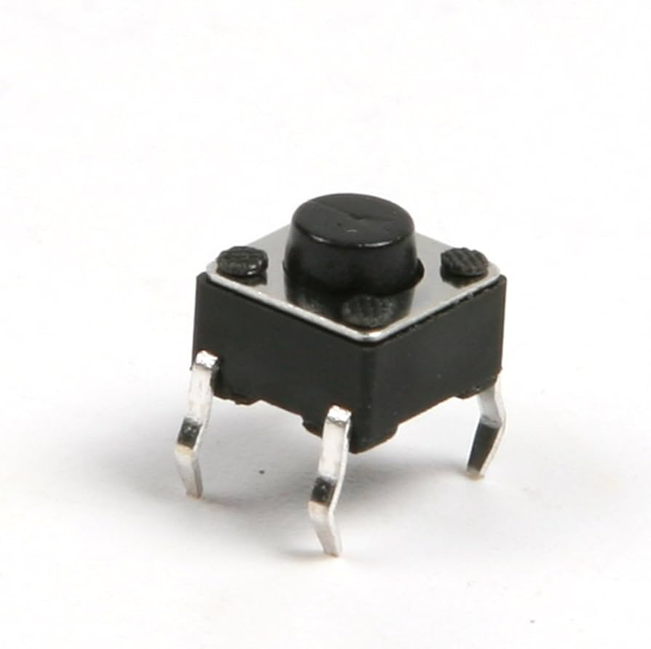
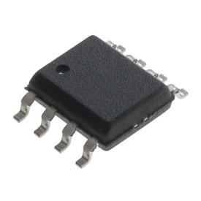
DRIVER
@ 1 seg
VAL+ID
vTaskSensorAdqData()
xSensorDataQueue
xIdRequestQueue
vTaskUartReqManager()
20
UART_TX
xUartRequestSemaphore
vTaskMemoryWriter()
vTaskMemoryReaderr()
xIdResponseQueue
vTaskUartRespManager()
5
10
20
UART
UART_TX
xUartTxMutex
xMemoryAccessMutex
vTaskButtonReqManager()
25
DRIVER
xButtonRequestBufferSemaphore
W25Q80DB
GPIO Driver

Slide 3
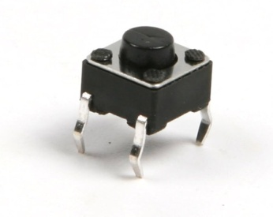
LPC 4367 (Cortex M4 @ 200 MHZ)
UART
W25Q80DB

