Slide 1
Module 1
What Is a Chip?

Slide 2
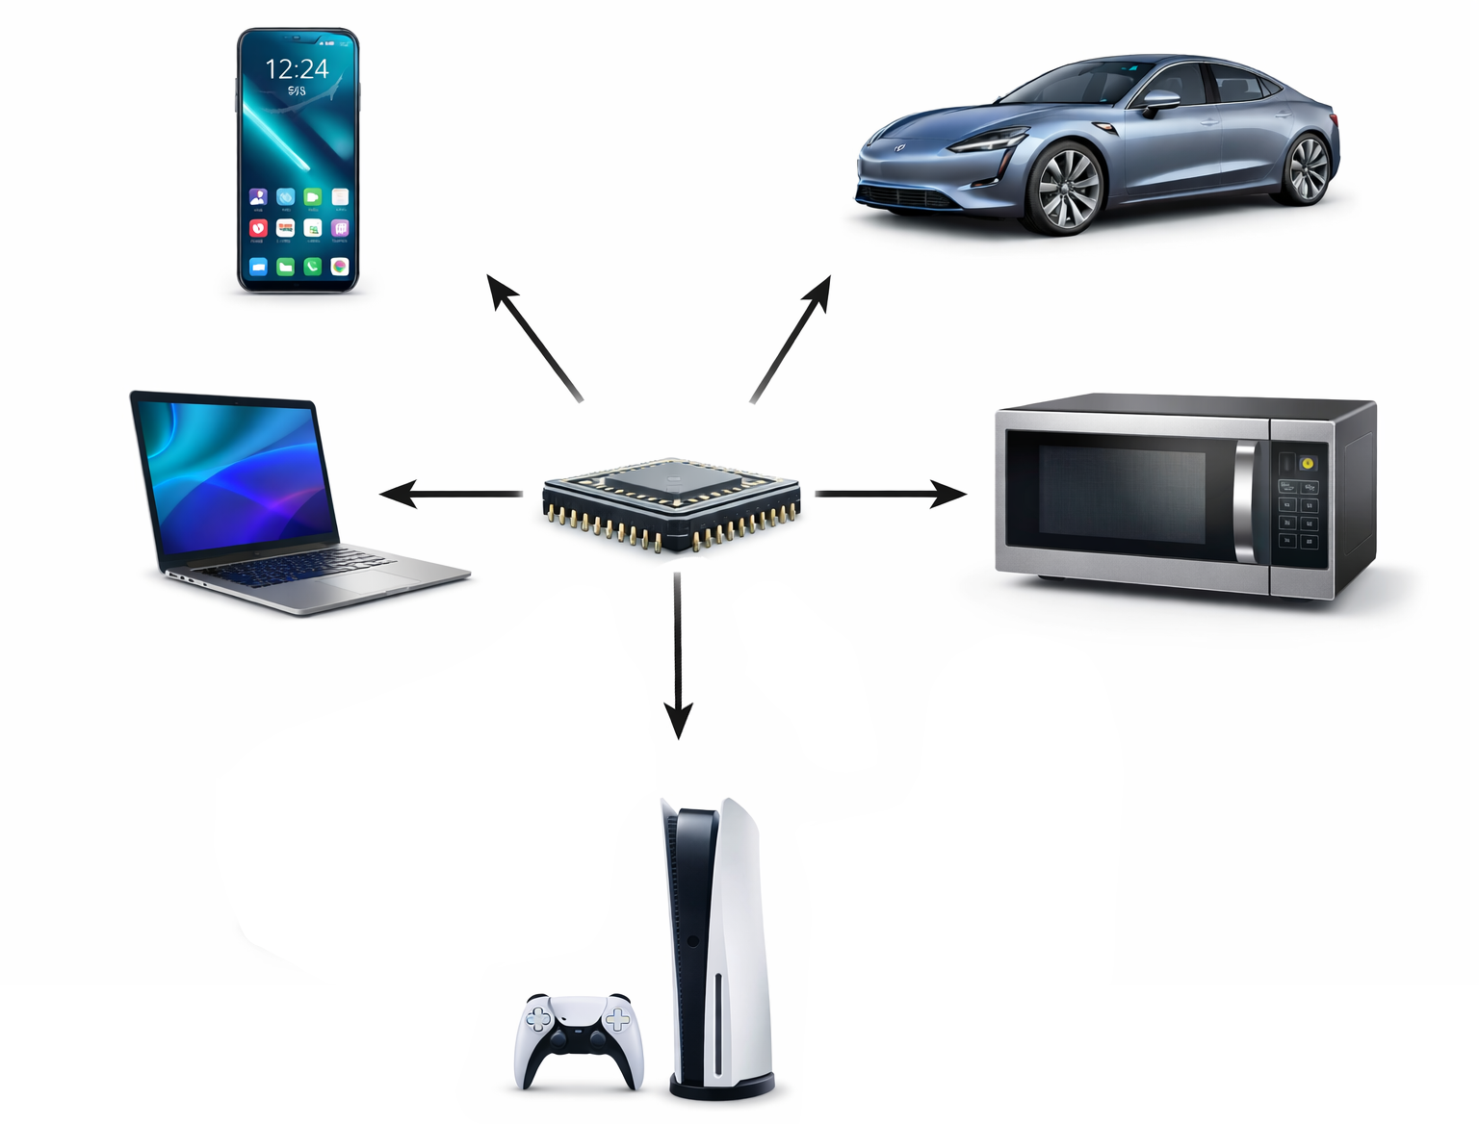
What Is a Chip?
What Is a Chip?
A tiny physical device built from billions of transistors
An electronic system that processes electrical signals
A rule-following machine that implements logic and algorithms
Every Chip Follows the Same Pattern:
Inputs → Rules → Outputs
Why You Use Hundreds Every Day
They are the hidden “brains” inside:
Smartphones
Laptops
Cars
WiFi routers
Game consoles
Medical devices

Slide 3
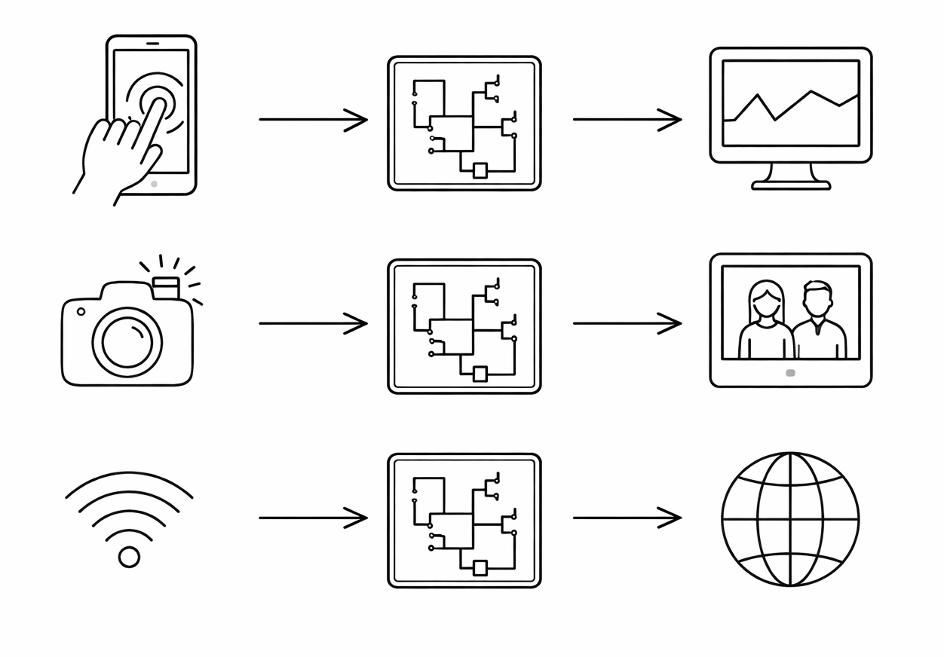
What Does a Chip Actually Do?
At the highest level, every chip:
Receives electrical inputs
Applies physical and logical rules
Produces electrical outputs
Think of It Like a System:
Sensors / Data → Processing → Action
Examples:
Touch screen → Signal processing → Display updates
Camera light → Image processing → Photo
WiFi signal → RF processing → Internet data

Slide 4
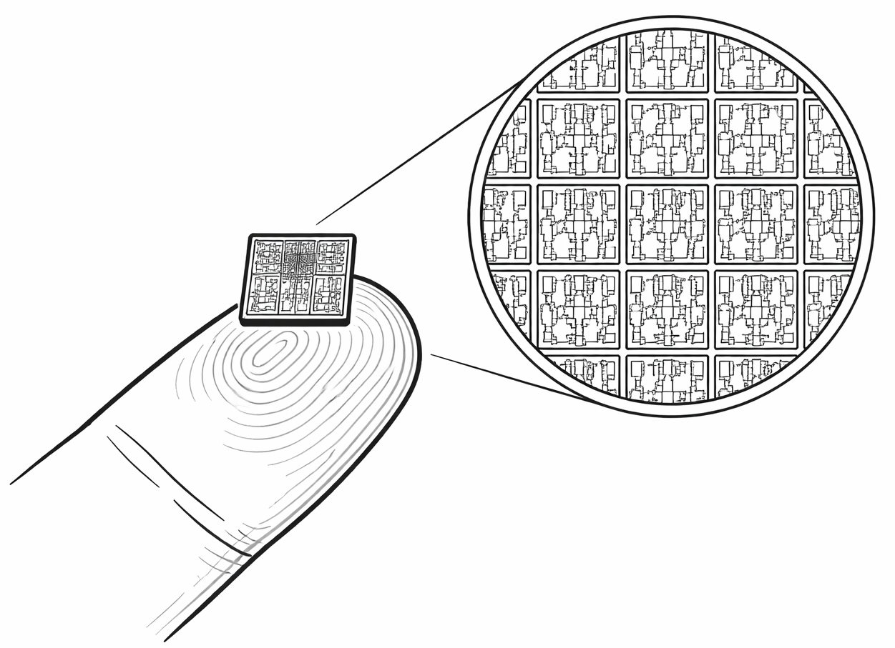
What Is a Chip Made Of?
At the Physical Level
Chips are built from semiconductor material (silicon)
They contain billions of tiny electronic switches called transistors
Transistors control the flow of electrical current
What Does a Transistor Do?
Acts like an electronic switch
ON → current flows (1)
OFF → no current (0)
Why This Matters
Billions of simple switches working together
Create logic, memory, communication, and computation
Complex systems emerge from simple physical rules

Slide 5
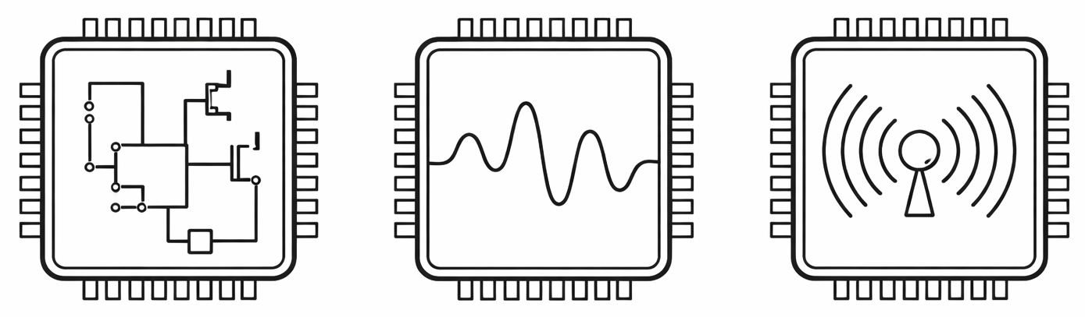
Not All Chips Are the Same
Digital Chips
Work with discrete values (0 and 1)
Perform logic and computation
Examples:
CPUs
Microcontrollers
GPUs
Analog Chips
Work with continuous voltages and currents
Amplify and condition real-world signals
Examples:
Audio amplifiers
Power management ICs
Sensor interfaces
RF (Radio Frequency) Chips
Process high-frequency wireless signals
Enable communication
Examples:
WiFi chips
Bluetooth chips
Cellular transceivers

Slide 6
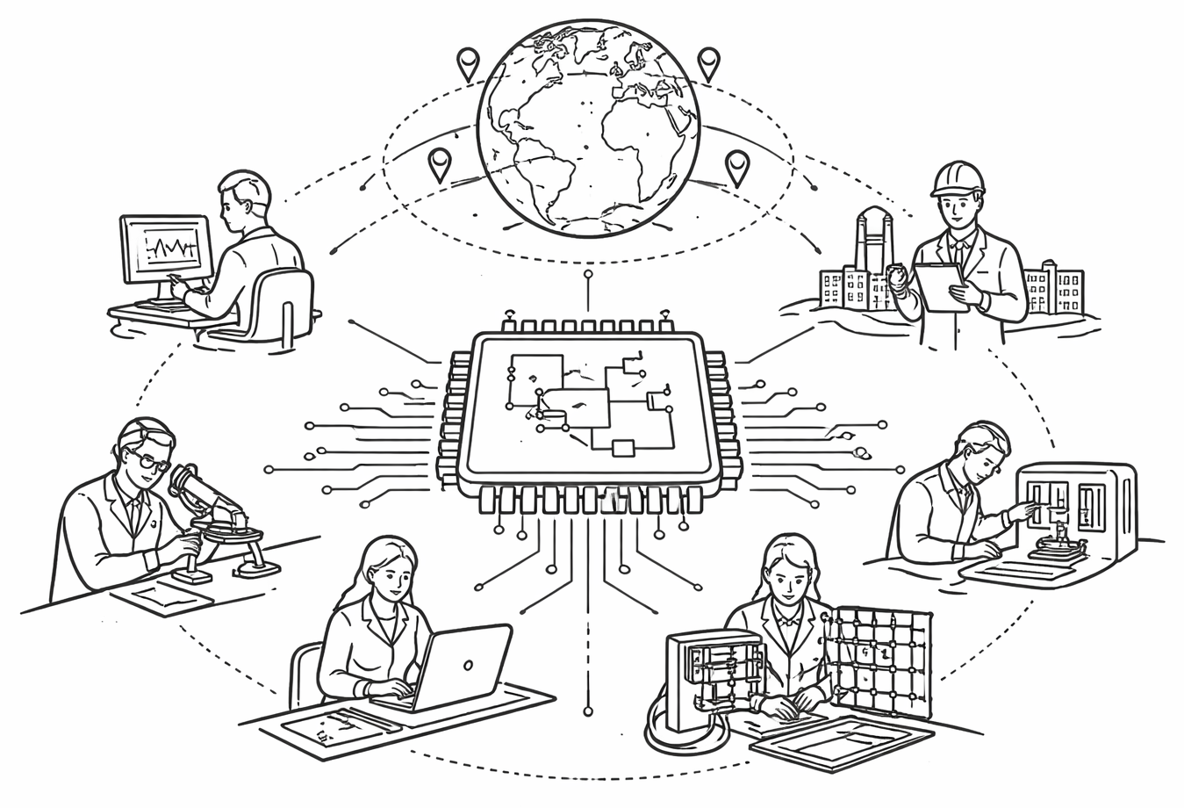
The Semiconductor Ecosystem
Designing a Chip Requires Many Roles
Digital designers - create logic and RTL
Analog/RF engineers - design signal circuits
Verification engineers - test and debug designs
Physical design engineers - convert logic into layout
Manufacturing the Chip
Foundries fabricate chips in silicon
e.g., TSMC, Samsung, Intel
Chips are built in multi-billion-dollar fabrication facilities (“fabs”)
After Fabrication
Packaging engineers connect the chip to the outside world
Test engineers ensure chips work correctly
Chips are integrated into products

Slide 7
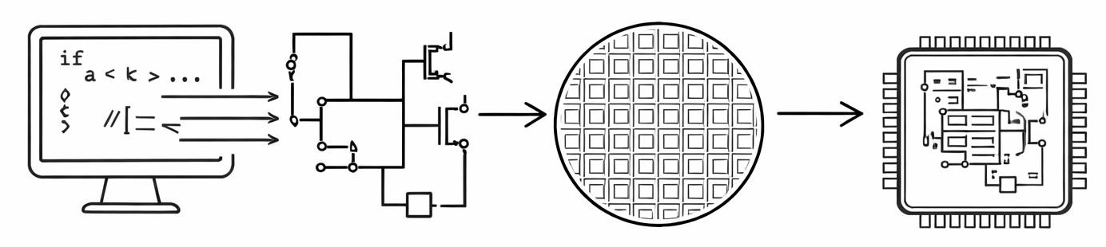
From Idea to Silicon: How Is a Chip Created?
Step 1: Define the Problem
What should the chip do?
What are the inputs and outputs?
What performance is required?
Step 2: Design the System
Create architecture and block diagrams
Design digital logic and analog circuits
Simulate and verify functionality
Step 3: Fabricate the Chip
Convert design into physical layout
Manufacture in a semiconductor fab
Test for defects and performance
Step 4: Package and Deploy
Connect chip to pins and package
Integrate into a product
Ship to customers

Slide 8
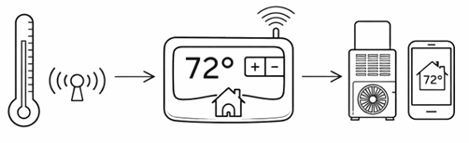
System Thinking Example
Smart Thermostat
Inputs
Room temperature sensor
User-set temperature
Time of day
Occupancy sensor
Rules / Processing
Compare current temperature to setpoint
If temp < setpoint → turn heat on
If temp > setpoint → turn cooling on
Schedule-based control logic
Energy optimization algorithms
Outputs
Control signal to HVAC system
Display updates
WiFi communication to phone app

Slide 9
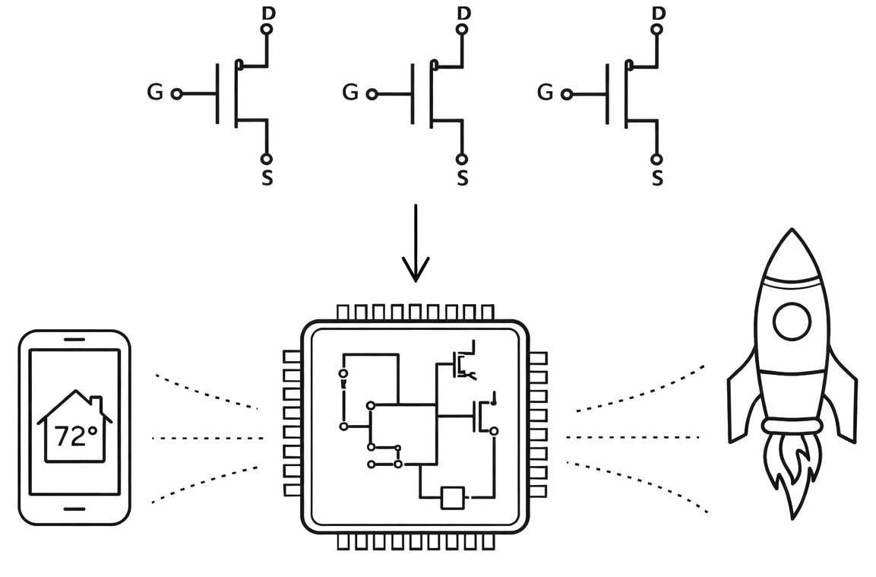
Key Takeaways: What Is a Chip?
A Semiconductor Chip Is:
A physical device built from billions of transistors
A system that processes electrical signals
A rule-following machine designed by engineers
Every Chip Follows the Same Pattern:
Inputs → Rules → Outputs
Sensors and data come in
Logic and physics process the signals
Actions or information come out
Modern Products Contain Many Chips
Digital chips for logic and computation
Analog chips for real-world signals
RF chips for wireless communication
Power chips for energy control

Slide 10
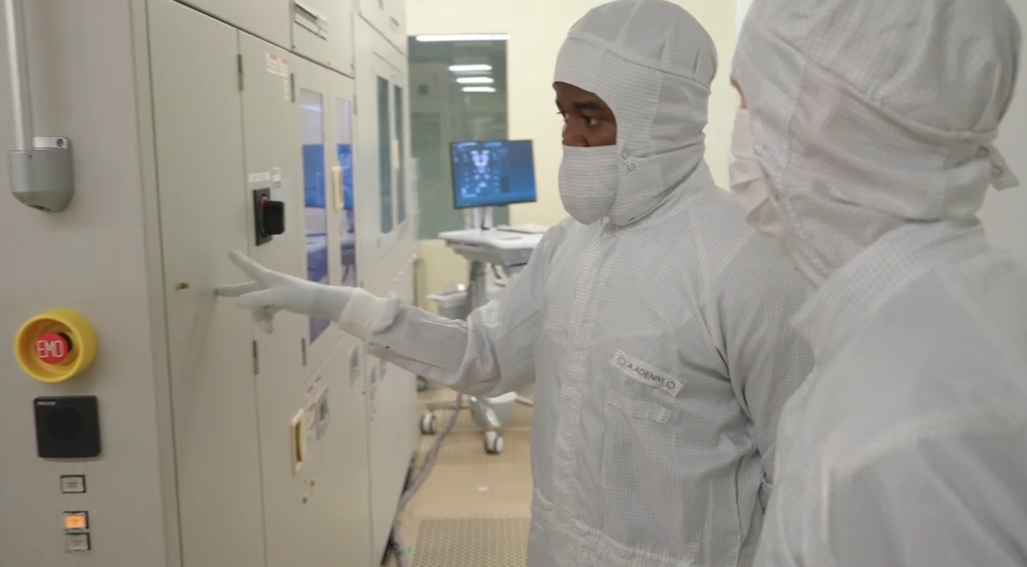
Video: Inside the Cleanroom How Chips Get Made
Source: Tiny Tapeout

Slide 11
This Week
HS: Identify systems, draw diagrams
CSUF: Explore chip types and systems

