Slide 1
Module 2
From If-Then Logic to System Design

Slide 2
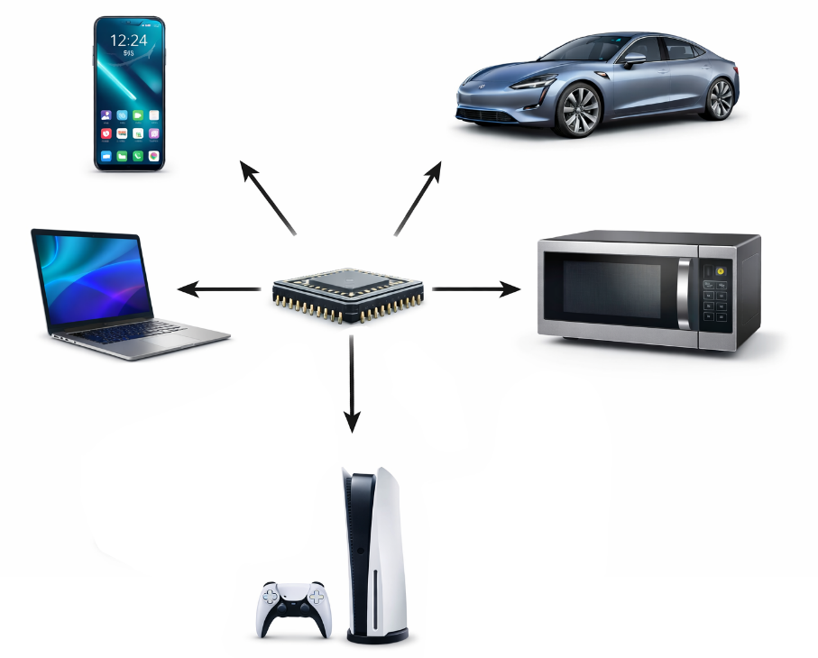
What We Learned Last Week
What a chip is
Chips as systems:
inputs → rules → outputs
Chips are everywhere

Slide 3
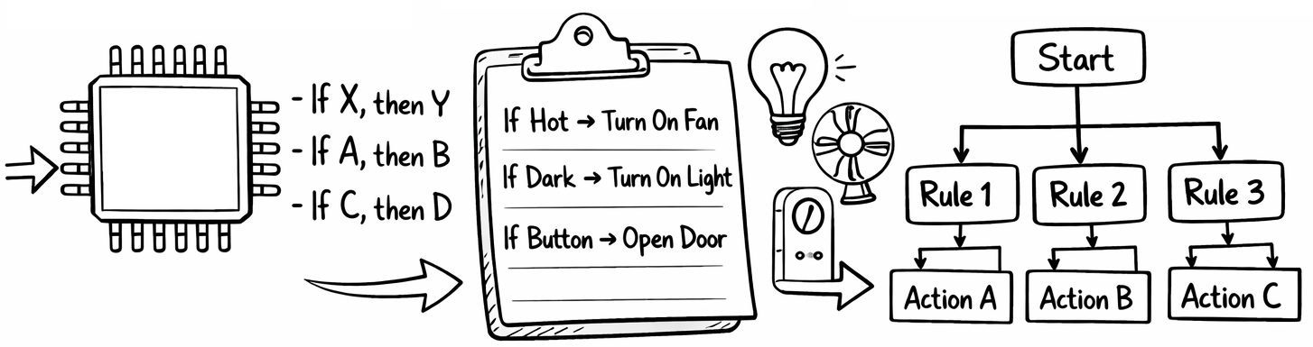
This Week
Chips make decisions using rules
We can describe these rules simply
Then organize them into systems

Slide 4
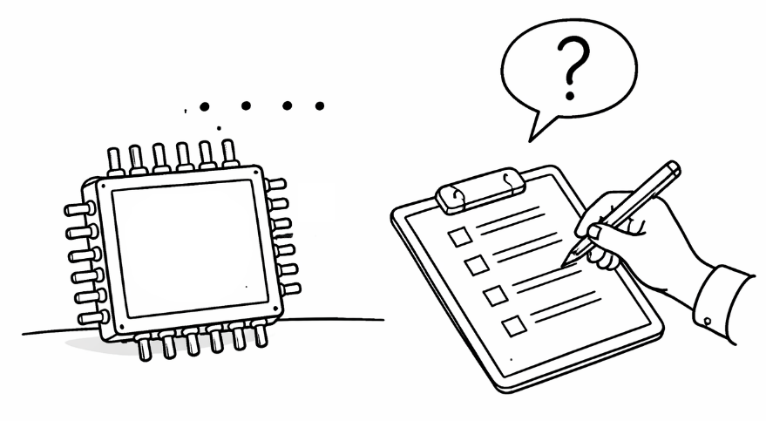
Chips Follow Rules
Chips don’t “think”
They follow defined rules
Many rules look like:
If something happens → do something

Slide 5
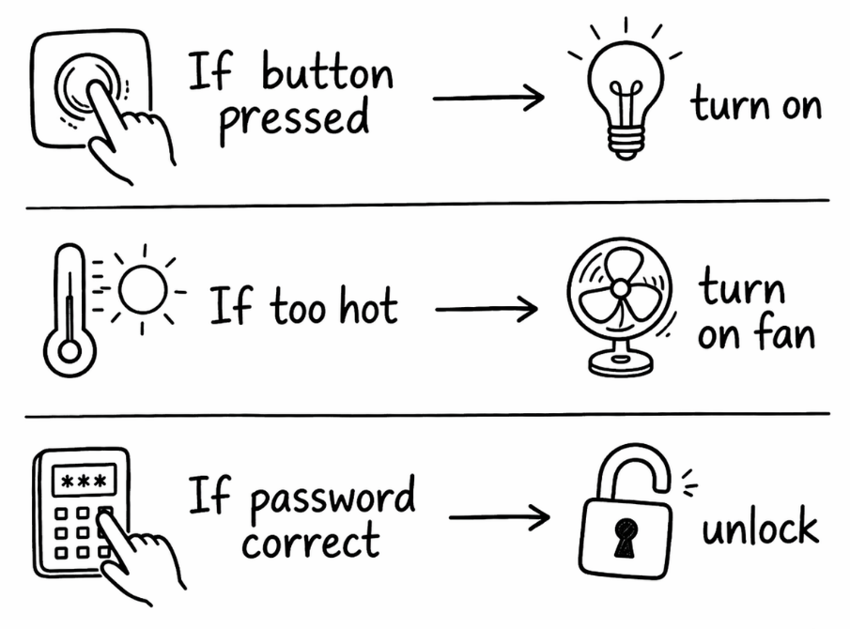
Everyday Examples
If button pressed → turn on
If too hot → turn on fan
If password correct → unlock

Slide 6
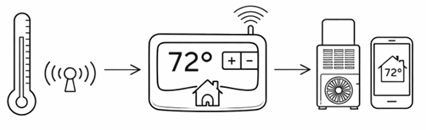
Example: Smart Thermostat
If temp > target → AC ON
If temp ≤ target → AC OFF

Slide 7
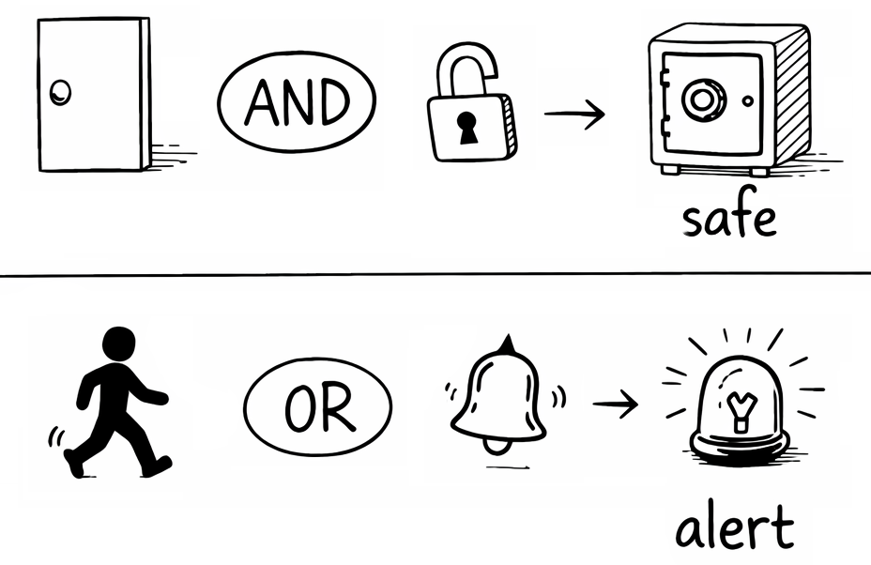
Multiple Inputs
Real systems use multiple signals
Example:
If door closed AND locked → safe
If motion detected OR alarm triggered → alert

Slide 8
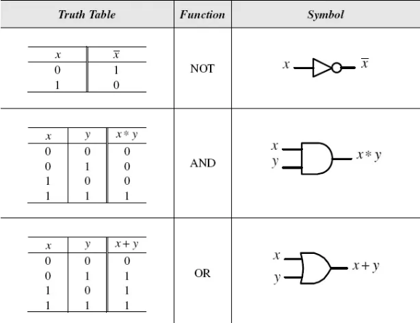
Combining Rules
NOT
Reverse a condition
AND
Both conditions must be true
OR
One condition is enough
Image Source:
M. Ferdjallah, Introduction to Digital Systems: Modeling, Synthesis, and Simulation Using VHDL. Hoboken, NJ, USA: John Wiley & Sons, 2011.

Slide 9
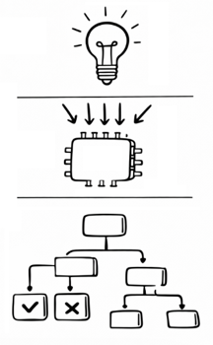
From Rules to Systems
One rule = simple behavior
Many rules = a system
Systems need structure

Slide 10
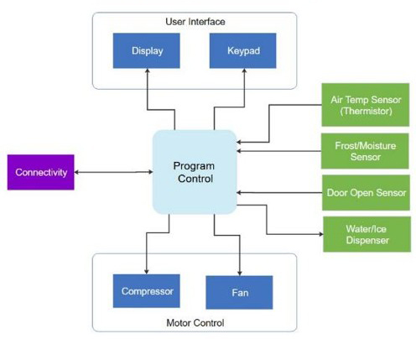
What Is a Block Diagram?
A simple picture of a system
Shows major parts and connections
Hides low-level details
Image Source:
J. Freeman, “Block Diagram - Complete Guide with Examples,” EdrawSoft
https://www.edrawsoft.com/block-diagram.html
Accessed: Mar. 30, 2026

Slide 11
Why Block Diagrams Matter
Helps organize complex ideas
Helps teams communicate
First step toward real design
Image Source:
J. Freeman, “Block Diagram - Complete Guide with Examples,” EdrawSoft
https://www.edrawsoft.com/block-diagram.html
Accessed: Mar. 30, 2026

Slide 12
Example Block Diagram (Refrigerator)
Sensor → Control → Output
Show flow of information
Image Source:
J. Freeman, “Block Diagram - Complete Guide with Examples,” EdrawSoft
https://www.edrawsoft.com/block-diagram.html
Accessed: Mar. 30, 2026

Slide 13
Refrigerator Block Diagram Overview
User Interface
Display Unit (shows information)
Keypad (user input)
Program Control
Processor (CPU/MCU)
Manages and coordinates all system functions
Motor Control
Contains subcomponents related to motor operation
Controls refrigerator motor behavior
Connectivity Block
Enables communication with external systems (e.g., Wi-Fi)
Allows features such as remote monitoring (via smartphone apps)
Role in the System
Interfaces directly with Program Control
Sends/Receives data between the refrigerator and the outside world
Image Source:
J. Freeman, “Block Diagram - Complete Guide with Examples,” EdrawSoft
https://www.edrawsoft.com/block-diagram.html
Accessed: Mar. 30, 2026

Slide 14
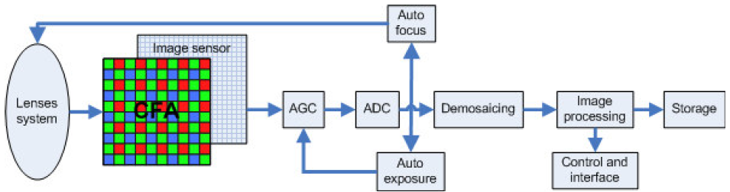
Example Camera Block Diagram
Optical Stage: Lenses focus light onto the sensor
Sensing Stage: Image sensor converts light → electrical signal
Analog Front-End: AGC adjusts gain, ADC digitizes signal
Control Systems: Auto-focus & auto-exposure optimize capture
Image Processing: image correction stage
Output: Image stored or displayed via interface
Image Source: H. Phelippeau, et al., “Bayer bilateral denoising on TriMedia 3270,” Proc. SPIE (Int. Soc. Opt. Eng.), Feb. 2009

Slide 15
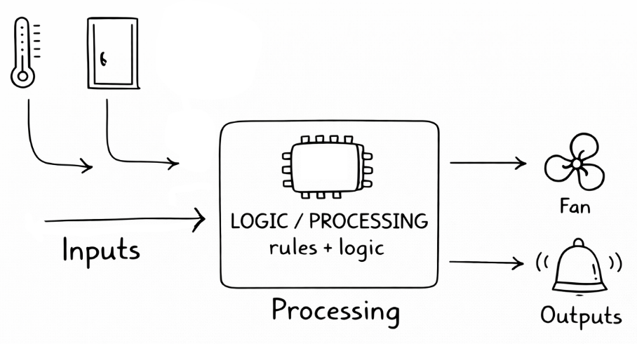
Inputs, Processing, Outputs
Inputs: Data/Signals In
Processing: Rules + Logic
Outputs: Actions

Slide 16
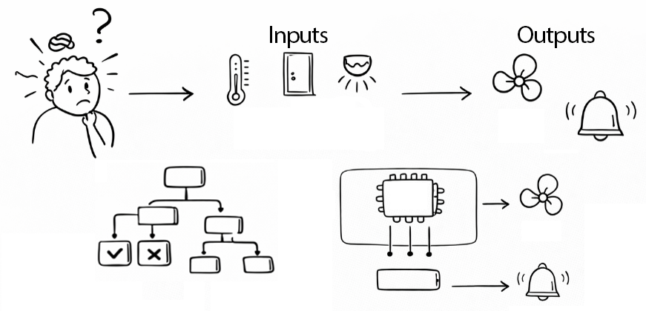
From Idea to Chip
Start with a problem
Define inputs/outputs
Create block diagram
Build the system

Slide 17
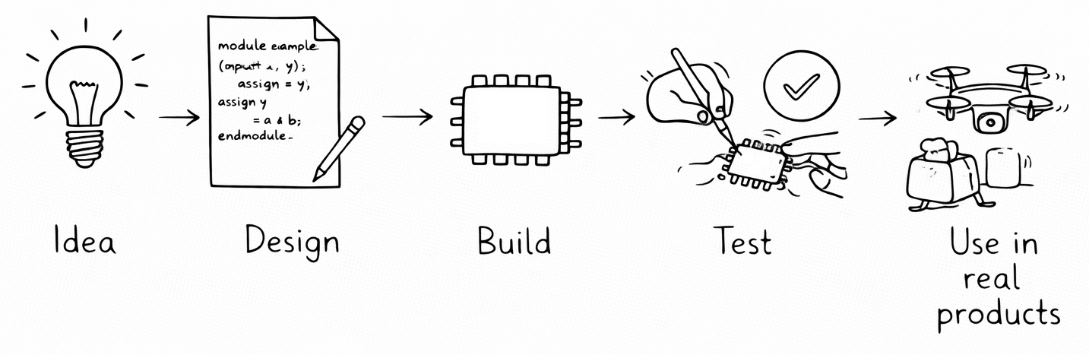
The Chip Design Journey

Slide 18
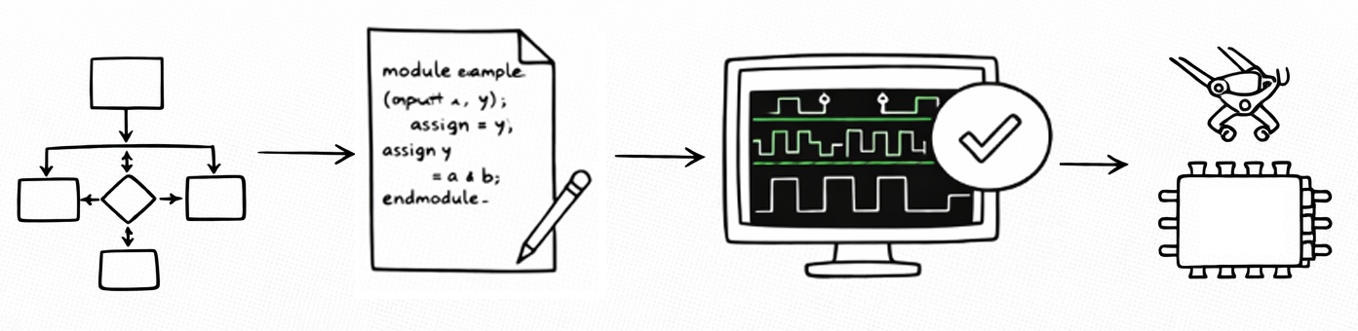
Real Engineering Flow (Simplified)
Define problem
Design system
Check it works (simulation)
Build it (fabrication)

Slide 19
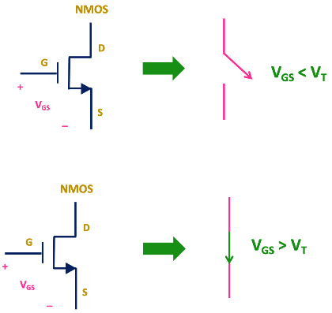
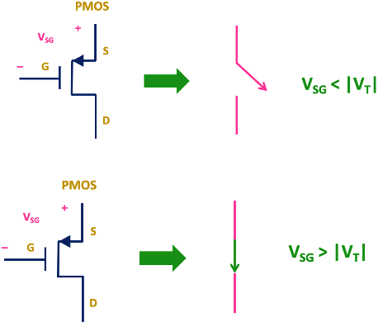
What Is CMOS? (Very High Level)
A way to build digital circuits
Uses tiny switches (transistors)
Voltage applied between the gate and source acts as a control voltage
Foundation of modern chips
Image Source:
All About Electronics, “CMOS Logic Gates Explained” https://www.allaboutelectronics.org/cmos-logic-gates-explained
Accessed: Apr. 4, 2026

Slide 20
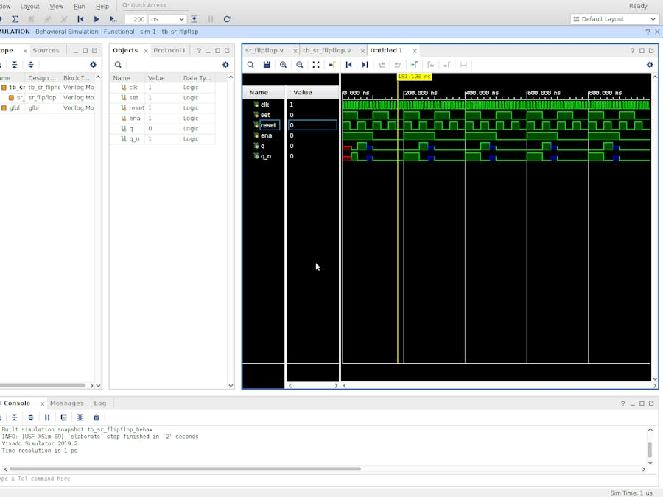
Why Simulation Matters
Test before building
Find mistakes early
Saves time and cost

Slide 21
Key Takeaways
Chips follow if-then rules
Systems combine many rules
Block diagrams organize systems
Chips go through a design process
Real chips are engineered step-by-step

