Slide 1
Module 3
Datapath, Instruction Formats, and System-Level Processor Design
Undergraduate Students
HS Students (Optional)

Slide 2
Learning Objectives
Identify key datapath components (ALU, registers, PC)
Understand common instruction formats
Explain how components integrate into a processor

Slide 3
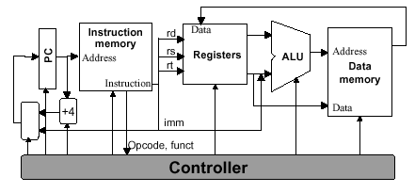
What is a Datapath?
The hardware that moves and processes data inside the CPU
Includes functional units (e.g., ALU, registers, control unit) and connections between them
Works under the control of the control unit
Image Source: https://www.cise.ufl.edu/~mssz/CompOrg/CDA-proc.html

Slide 4
Core Datapath Components
ALU (Arithmetic Logic Unit)
Register File
Program Counter (PC)
Multiplexers (MUXes)
Buses and interconnects
Image Source: https://www.cise.ufl.edu/~mssz/CompOrg/CDA-proc.html

Slide 5
Arithmetic Logic Unit (ALU)
Performs arithmetic and logic operations
Inputs: operands from registers
Output: result back to register or memory
Examples
Add, Subtract, AND, OR, Compare
Image Source: https://www.cise.ufl.edu/~mssz/CompOrg/CDA-proc.html

Slide 6
Program Counter (PC)
Holds address of next instruction
Automatically increments after fetch
Can be updated for branches/jumps
Image Source: https://www.cise.ufl.edu/~mssz/CompOrg/CDA-proc.html

Slide 7
Datapath Operation Example
Instruction
ADD R3, R1, R2
Steps:
Read R1 and R2 from register file
Send operands to ALU
ALU computes sum
Write result to R3

Slide 8
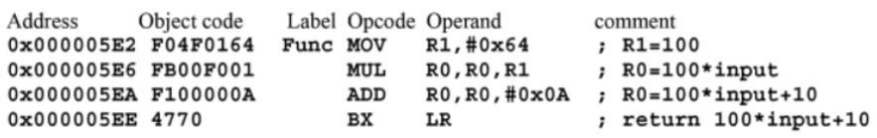
Instruction Formats
Define how instructions are encoded in binary
Specify:
Operation (opcode)
Source operands
Destination operand
Image Source: Valvano, J. W. (2015). Embedded systems: Introduction to the MSP432 microcontroller

Slide 9
Common Instruction Formats
R-type (Register): operations between registers
MOV R0, R1
I-type (Immediate): includes a constant value
MOV R0, #100
J-type (Jump or Branch): for control flow changes
B Label

Slide 10
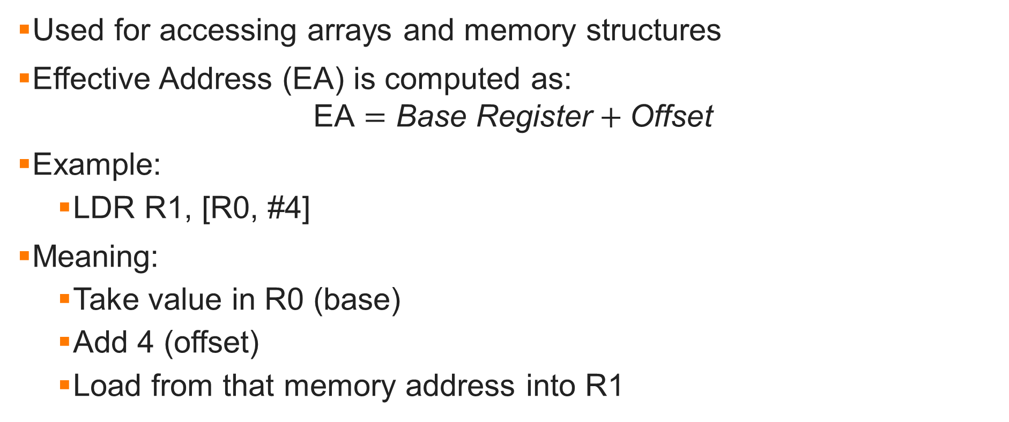
Indexed (Base + Offset) Addressing
Used for accessing arrays and memory structures
Effective Address (EA) is computed as:
$$\text{EA}=\text{Base} \text{Register}+\text{Offset}$$
Example:
LDR R1, [R0, #4]
Meaning:
Take value in R0 (base)
Add 4 (offset)
Load from that memory address into R1

Slide 11
Control Signals
Generated by control unit
Direct datapath behavior
Examples:
ALU operation select
Register write enable
Memory read/write
Image Source: https://www.cise.ufl.edu/~mssz/CompOrg/CDA-proc.html

Slide 12
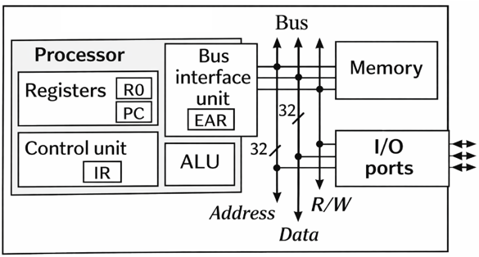
System-Level Processor Design
Combines datapath + control unit
Interfaces with memory and I/O
Key goals:
Performance
Efficiency
Scalability
Image Source: Valvano, J. W. (2015). Embedded systems: Introduction to the MSP432 microcontroller

Slide 13
Putting It Together
Instruction → decoded into control signals
Control signals drive datapath
Datapath executes operation
Result stored or used for next step

Slide 14
Summary
Datapath executes operations using ALU and registers
Instruction formats define how operations are encoded
Processor design integrates datapath and control

Slide 15
Simplified Datapath - Components
Where are the inputs to the ALU coming from?
The ALU inputs come from the register file, specifically from the source registers being read for the instruction
Where does the ALU output go?
The ALU output goes back to the register file, where it is written into the destination register
Register File
(R1, R2, R3)
ALU
Register File
PC → Instruction Memory

Slide 16
Simplified Datapath - Trace an Instruction
Instruction: ADD R3, R1, R2
Operand Flow
R1 and R2 are read from the register file and sent to the ALU as inputs
Result Destination
The ALU computes R1 + R2
The result is written back into R3 in the register file
Full Flow
Read R1
Read R2
Send both values to ALU
ALU adds them
Write result into R3
Register File
(R1, R2, R3)
ALU
Register File
PC → Instruction Memory

Slide 17
Simplified Datapath - Control Signals
3 control signals active during this instruction
ALU operation select = ADD
Tells the ALU to perform addition
Register write enable = 1
Allows the result to be written into the destination register
Register source select/read register select
Selects R1 and R2 as the registers to read
Other acceptable answers:
Destination register select = R3
ALU input enable
PC update/PC increment
Register File
(R1, R2, R3)
ALU
Register File
PC → Instruction Memory

Slide 18
Simplified Datapath - Program Counter Role
The Program Counter (PC) holds the address of the current or next instruction in instruction memory
During execution of this ADD instruction, the PC is used to fetch the instruction, and then it is normally incremented so the processor can move to the next instruction
Register File
(R1, R2, R3)
ALU
Register File
PC → Instruction Memory

Slide 19
Simplified Datapath - Concept Check
Why is the ALU placed between register reads and writes?
The ALU is placed between register reads and writes because it must:
Receive operand values from the registers
Perform the required arithmetic or logic operation
Then send the result back to a register for storage
It acts as the processing unit between input data and output result
Register File
(R1, R2, R3)
ALU
Register File
PC → Instruction Memory

Slide 20
Discussion/Questions
How do different instruction formats affect performance?
What happens during a branch instruction?
How would pipelining change the datapath?

