Slide 1
Module 1
Brief History of Computers

Slide 2
Brief History of Computers
Computers invented over half a century ago
First designed and created as a part of WWII technology effort in the US and Europe
General belief at the time:
  Useful for big institutions and companies
  Not useful for personal use

Slide 3
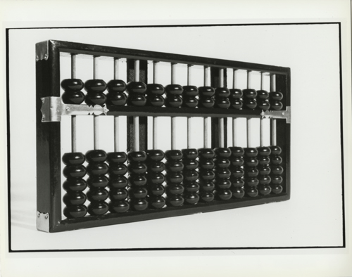
Brief History of Computers
Abacus – invented in China around 500 BC
First device to perform mathematical computation like computers

Slide 4
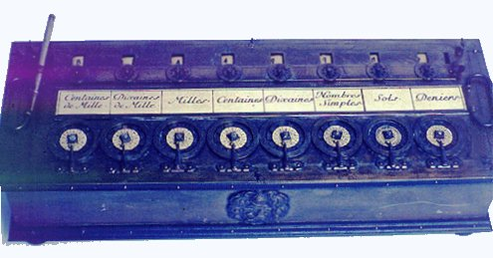
Brief History of Computers
Blaise Pascal
French mathematician and physicist
Created the first adder and subtractor in 1642
Influenced the development of other mechanical computers
Babbage’s mechanical computer
Zuse’s mechanical relay computer

Slide 5
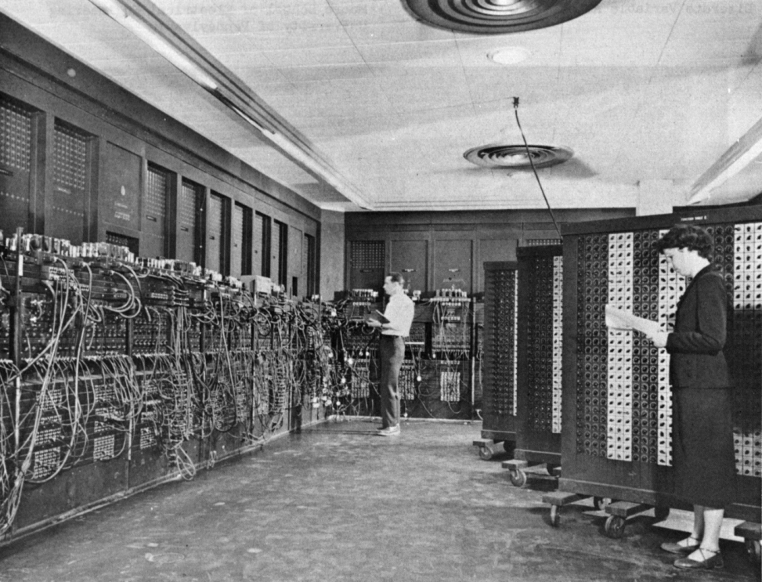
Brief History of Computers
1940s: Relay memories invented
1950s: Electronic Numerical Integrator and Computer (ENIAC)
  Combined relay mems with vacuum tubes
  Enormous: several feet wide x 8 feet high
  No programming language!!!
  Programmed with cables

Slide 6
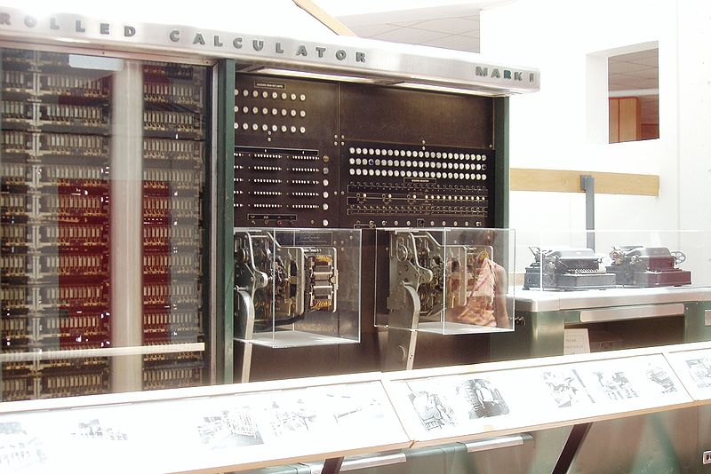
Brief History of Computers
1944: Mark I
  First electromechanical decimal computer
  Designed and created by Howard Aiken of Harvard University
  Sponsored by IBM
  Showed benefits of computers
  Increased interest in computers

Slide 7
Brief History of Computers
1948: Invention of analog transistors at Bell Labs
1950s: Invention of discrete transistors
  Accelerated the start of companies such as IBM, RCA, Honeywell, and UNIVAC
  Mainly used by government and large business firms

Slide 8
Brief History of Computers
1960s: Large-Scale Integrated (LSI) and Very Large-Scale Integrated (VLSI) devices
  Engineers began cramming transistors in a single chip
  Moore’s Law - double the number of transistors on a chip every ~2 years
1970s: advancement of semiconductors and demand spurred two types of computers
  General-Purpose Computers
  Embedded Computers (a.k.a., microcontrollers)

Slide 9
Brief History of Computers
General-Purpose Computers
  Personal Computers (PCs)
  Routers
  Servers
Can accommodate a variety of programs and execute them quickly

Slide 10
Brief History of Computers
Microcontrollers
  In the 1970s, automobile industry began adding computers to cars
  Auto industry heavily influenced the initial design of microcontrollers
  Didn’t require “bells and whistles” or the speed of the general-purpose computers
  Contains all necessary parts of computer on a single chip including memory and I/O
  Sales of microcontrollers far greater than general-purpose computers

