Slide 1
Module 3
Step-by-Step Execution of Simple Programs

Slide 2
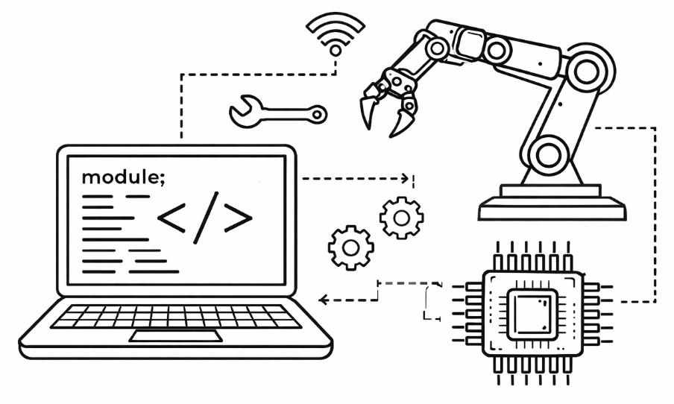
Learning Objectives
Understand how simple programs execute step-by-step
Interpret instruction flow diagrams
Explain the role of registers in computation
Connect instructions to hardware-level actions

Slide 3
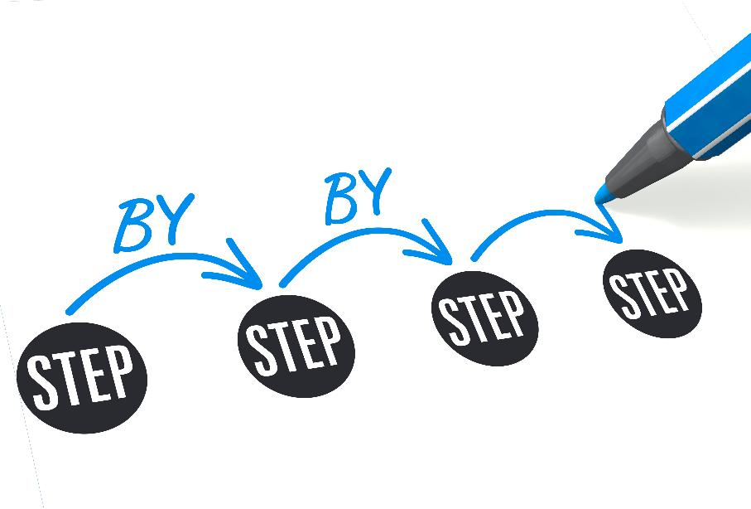
What Is a Program?
A program is a sequence of instructions
Each instruction tells the CPU to perform a specific task
Instructions are executed sequentially (by default)

Slide 4
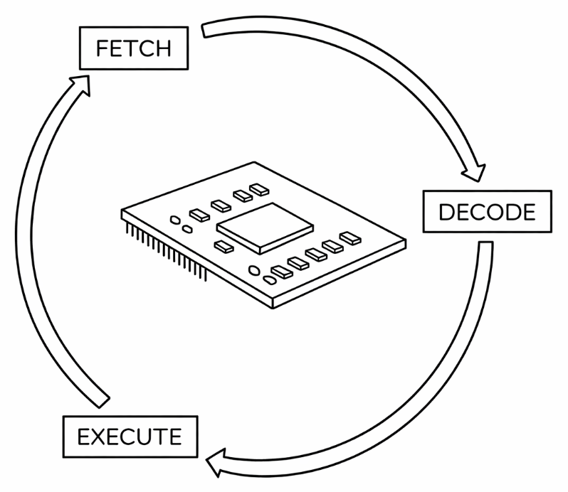
Basic Execution Cycle
Fetch → Decode → Execute
Fetch instruction from memory
Decode instruction
Execute instruction
Move to the next instruction

Slide 5
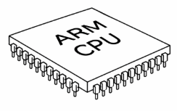
Step-by-Step Execution Example
ARM Assembly Program
MOV R1, #5
MOV R2, #3
ADD R3, R1, R2
Execution
Load 5 into R1
Load 3 into R2
Add R1 + R2 → store in R3

Slide 6
Instruction Flow Diagram
FETCH the instruction and any data from main memory
DECODE the instruction (i.e., convert the instruction into a language the CPU understands)
EXECUTE the instruction (i.e., complete the instruction)
Visual representation of execution steps
Shows control flow and data movement

Slide 7
What are Registers?
Small, fast storage inside the CPU
Hold data temporarily
Used during instruction execution
Examples
R1, R2, R3
Program Counter (PC)
General Purpose Registers | R0
 | R1
 | R2
 | R3
 | R4
 | …
Stack | SP
Program Counter | PC

Slide 8
Types of Registers General and SP
General Purpose Registers
R0 to R12
Contain either data or addresses
Stack Pointer (SP)
R13
Points to the top element of the stack
General Purpose Registers | R0
 | R1
 | R2
 | R3
 | R4
 | …
Stack | SP
Program Counter | PC

Slide 9
Types of Registers PC
Program Counter (PC)
Points to the next instruction to be fetched
The CPU fetches the instruction and then increments PC
General Purpose Registers | R0
 | R1
 | R2
 | R3
 | R4
 | …
Stack | SP
Program Counter | PC

Slide 10
Register Operations
Common operations
Load: move data into register
Store: move data to memory
Add/Subtract: arithmetic operations
Example (ARM Assembly)
ADD R0, R1, R2

Slide 11
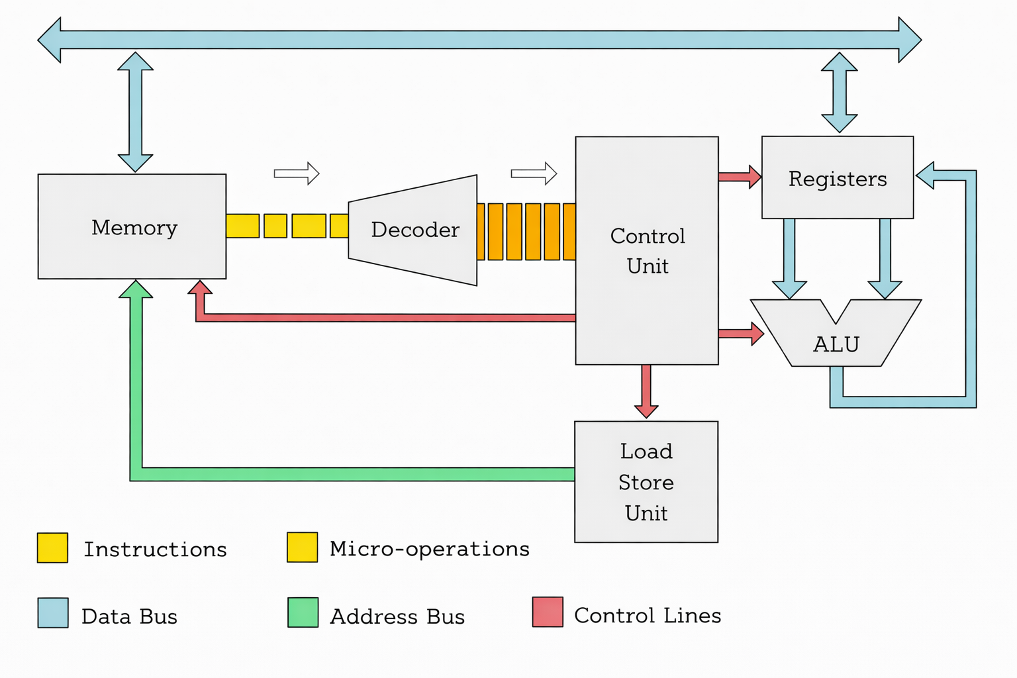
Instruction = Hardware Action
Each instruction triggers hardware-level operations
Data transfer between registers
ALU computation
Memory access
Example
ADD → ALU performs addition
Image Source: https://erik-engheim.medium.com/what-the-heck-is-a-micro-operation-e991f76209e

Slide 12
Micro-Operations
Instructions break into smaller steps
Example (ADD):
Read R1
Read R2
ALU computes sum
Store result in R3
Image Source: https://erik-engheim.medium.com/what-the-heck-is-a-micro-operation-e991f76209e

Slide 13
Control Unit Role
Directs all operations
Generates control signals
Ensures correct sequence of execution
Image Source: https://erik-engheim.medium.com/what-the-heck-is-a-micro-operation-e991f76209e

Slide 14
Putting It All Together
Program Execution:
Instructions → Micro-operations → Hardware actions
Registers store intermediate data
Control unit manages flow
Image Source: https://erik-engheim.medium.com/what-the-heck-is-a-micro-operation-e991f76209e

Slide 15
Summary
Programs execute step-by-step
Instruction flow diagrams visualize execution
Registers are essential for fast computation
Every instruction maps to hardware activity

Slide 16
Discussion/Questions
What happens if registers are limited?
How does branching affect flow?
Can instructions execute in parallel?

