Slide 1
Module 4
Logic Flow and Operations

Slide 2
Learning Objectives
Understand how logic flows through a system using diagrams
Identify basic operations: add, subtract, and logic functions
Connect operations to actual hardware components

Slide 3
What is Logic Flow?
Logic flow describes how signals move through a circuit
Think of it as a “path” that data follows
Inputs
Processing
Outputs

Slide 4
Visualizing Logic Flow
Use block diagrams to represent systems
Each block performs a function
Arrows show direction of signal movement

Slide 5
Example Logic Flow Diagram
Input signals enter system
Signals pass through logic blocks
Output is produced based on processing
Input A
Logic
Output
Input B

Slide 6
Why Diagrams Matter
Simplify complex systems
Help debug circuits
Make design easier to understand and communicate

Slide 7
Introduction to Operations
Operations are actions performed on data
Examples
Addition
Subtraction
Logical operations (AND, OR, NOT)

Slide 8
Arithmetic Operations
Addition (+)
Subtraction (−)
Used in calculators, processors, and DSP systems

Slide 9
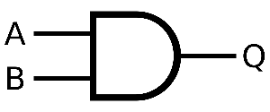
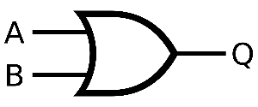
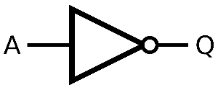
Logic Operations
AND
Output is 1 if both inputs are 1
OR
Output is 1 if at least one input is 1
NOT
Inverts the input
A | B | Q
0 | 0 | 0
0 | 1 | 0
1 | 0 | 0
1 | 1 | 1
A | B | Q
0 | 0 | 0
0 | 1 | 1
1 | 0 | 1
1 | 1 | 1
A | Q
0 | 1
1 | 0

Slide 10
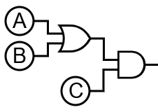
Combining Operations
Systems often use multiple operations together
Example:
(A OR B) AND C
Can also be written as:
(A + B)C
Operations can be chained in logic flow

Slide 11
From Operations to Hardware
Every operation corresponds to a circuit
Addition → Adder circuits
Logic operations → Logic gates

Slide 12
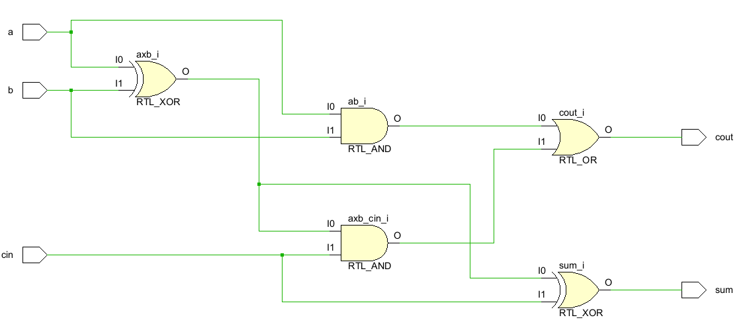
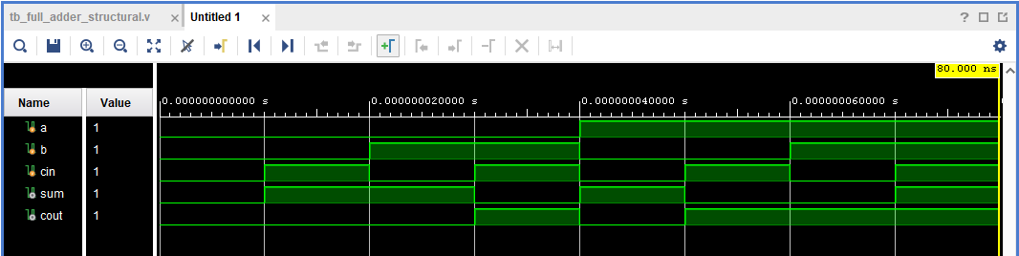
Example: Full-Adder Circuit
Combines two binary numbers
Produces sum and carry
Built using logic gates

Slide 13
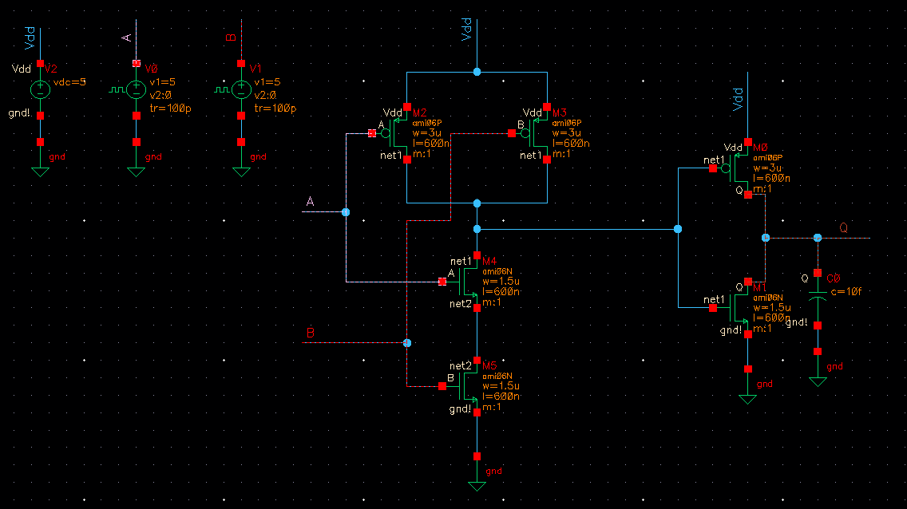
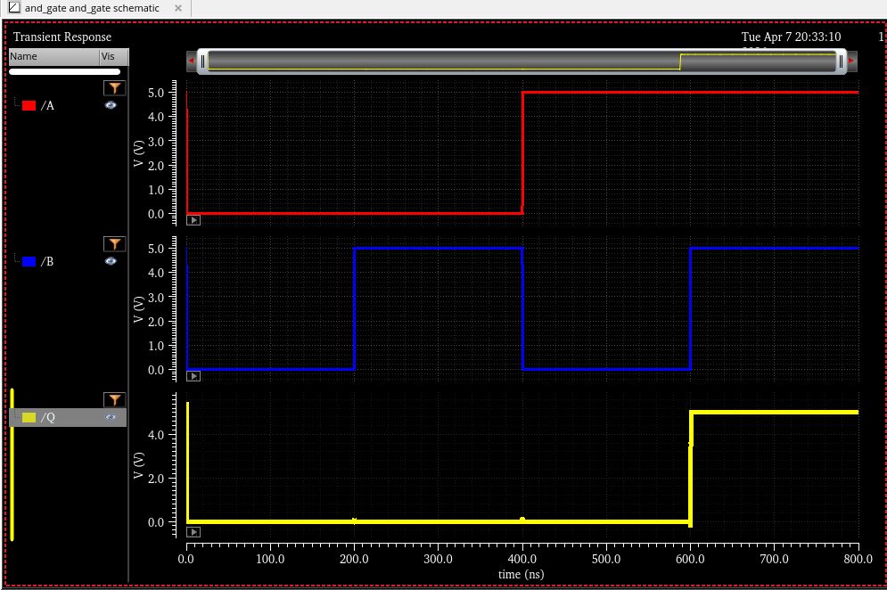
Example: Logic Gates
AND, OR, NOT are implemented using transistors
Fundamental building blocks of digital systems
NAND Inverter

Slide 14
Big Idea
Hardware is designed to perform operations
Software ultimately maps to these operations
Everything reduces to logic flow + operations

Slide 15
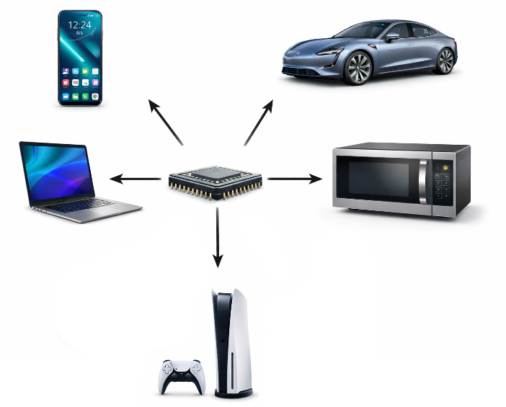
Real-World Connection
Smartphones, computers, and AI chips
All rely on these basic operations
Scaled up to billions of operations per second

Slide 16
Summary
Logic flow shows how signals move
Operations define what is done to data
Hardware is built to execute these operations

Slide 17
Discussion/Questions
What operation do you think is used most in a CPU?
Can you think of a system that uses only logic (no arithmetic)?

