Slide 1
Module 4
Verilog, ALU, and Simulation

Slide 2
Learning Objectives
Understand basic Verilog syntax and module structure
Design and implement a simple ALU
Perform simulation and interpret waveforms

Slide 3
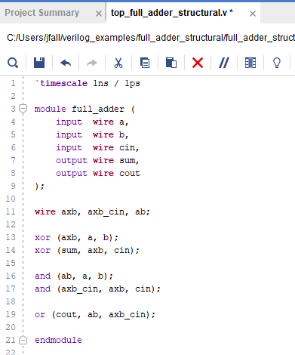
What is Verilog?
Hardware Description Language (HDL)
Used to model digital systems
Describes behavior and structure of hardware

Slide 4

Verilog Module Basics
Fundamental building block
Defines inputs, outputs, and internal logic

Slide 5

Data Types and Signals
Type | Represents | Example | Synthesizable?
Nets (wire) | Physical connections between hardware elements | wire a; | Yes
Variables (e.g., reg) | Storage elements holding values until next assignment | reg q; | Yes (if used properly)
Input/Output Declarations

Slide 6
Continuous vs. Procedural Assignments
assign
Continuous (combinational)
always block
Procedural (sequential or combinational)

Slide 7
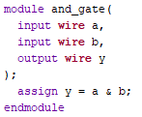
Continuous Assignment (Combinational)
Uses assign
Always active (updates automatically when inputs change)
Only works with wire
Key Idea:
This is like a direct connection
Hardware is always ‘on’ and updating

Slide 8
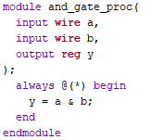
Procedural Assignment
Uses always
Executes when triggered by the sensitivity list
Uses reg type
Key Idea:
This behaves like a block of instructions that runs when inputs change

Slide 9
Continuous vs. Procedural Table
Feature | Continuous (assign) | Procedural (always)
Type | Combinational only | Combinational + Sequential
Signal type | wire | reg
Execution | Always active | Triggered
Example use | Simple logic | ALUs, registers

Slide 10
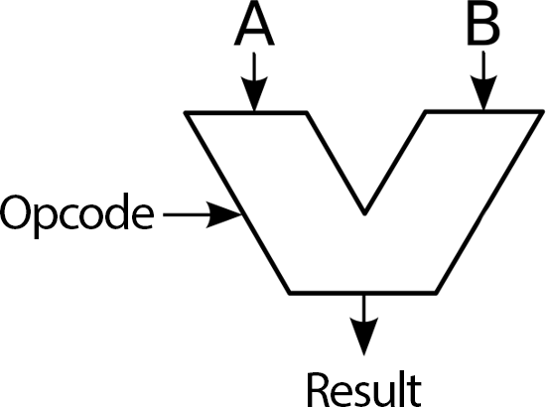
ALU Overview
Arithmetic Logic Unit (ALU)
Performs operations like add, subtract, AND, OR
Core component of CPUs

Slide 11
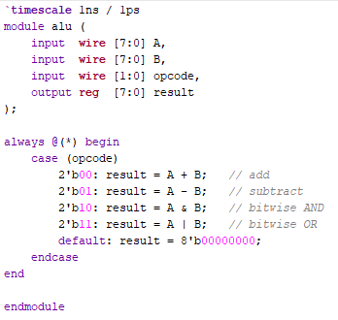
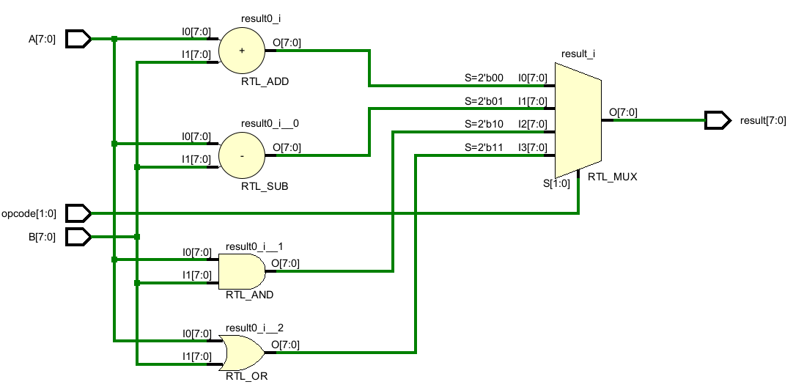
ALU Inputs and Outputs
Inputs: A, B (operands)
Control: opcode (select operation)
Output: result

Slide 12
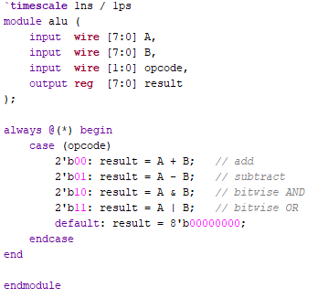
ALU Considerations
Bit width (8-bit vs. 32-bit)
8-bits in this example
Signed vs. unsigned
Overflow and flags
Future extension

Slide 13
Simulation = Testing
Simulation is how we test hardware
Equivalent to unit testing in software
Run before building real hardware

Slide 14
Why Simulation Matters
Catch bugs early
Faster than hardware debugging
No risk of damaging hardware

Slide 15
Introduction to Testbenches
Special Verilog modules for testing
No inputs/outputs
Drive signals into your design

Slide 16
Testbench = Automated Testing
Apply multiple test cases automatically
Repeatable and scalable
Key mindset:
design → test → debug → repeat

Slide 17
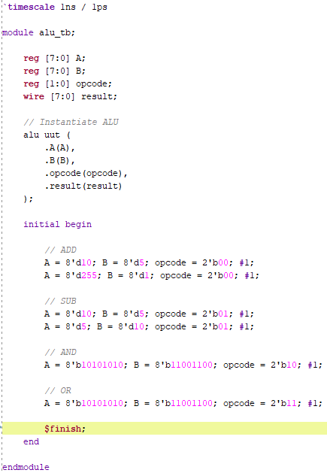
Example Testbench

Slide 18
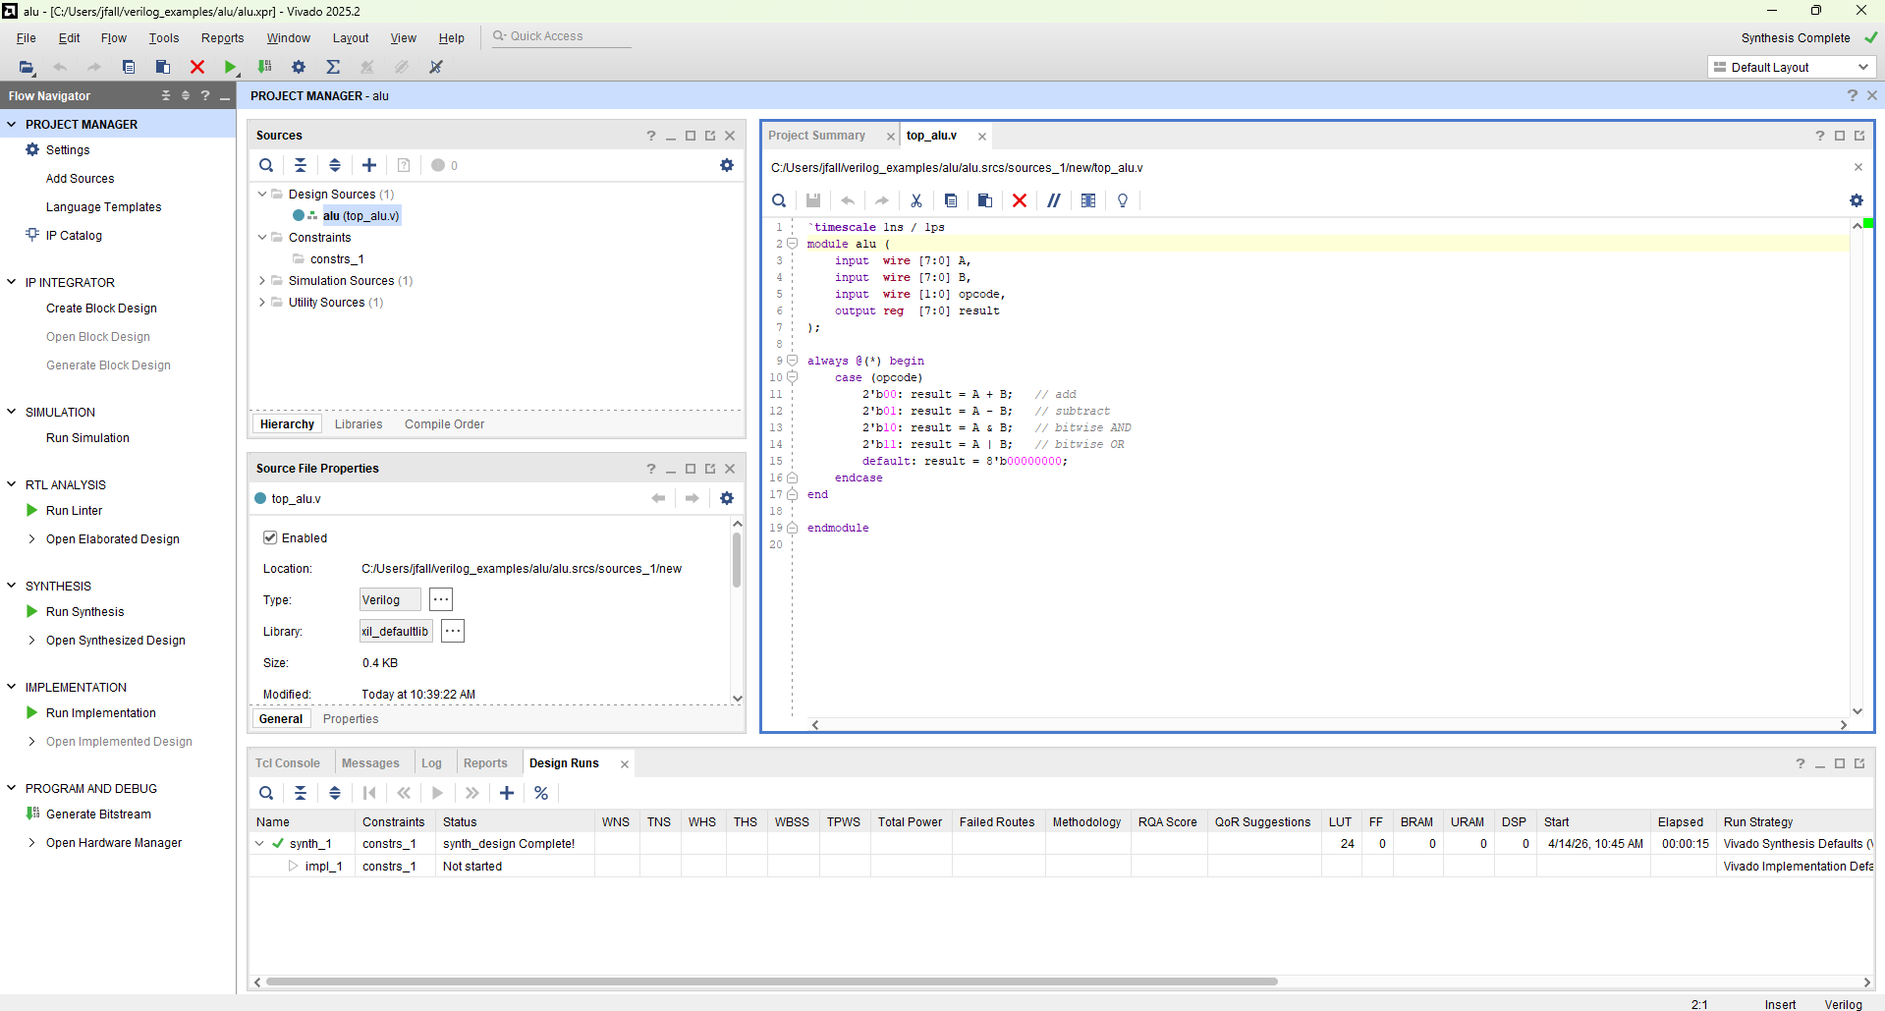
Simulation Tools
ModelSim
Vivado
Icarus Verilog
Workflow
Compile → Run → Analyze

Slide 19
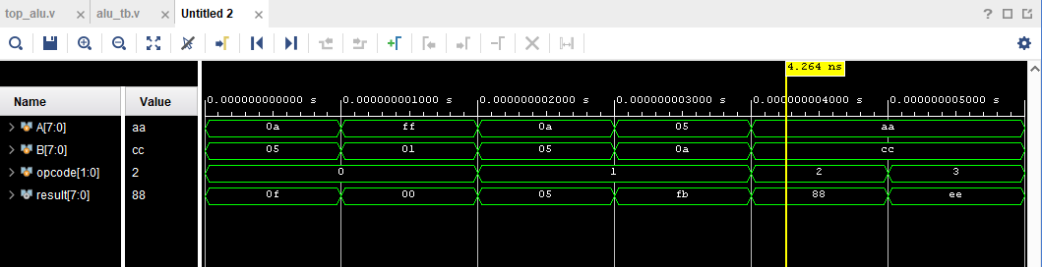
Waveform Analysis
Signals plotted over time
Shows how outputs respond to inputs

Slide 20
What to Look For in Waveforms
Correct output values
Timing alignment
Opcode changes vs. result changes

Slide 21
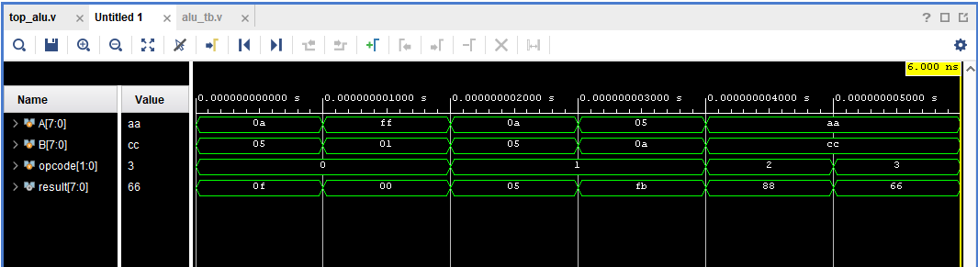
Debugging with Waveforms
Compare expected vs. actual behavior
Identify incorrect logic or timing
Check transitions and glitches

Slide 22
Find the Bug
Assume a version of the previous code was used but there is a bug in this version

Slide 23
The Bug
1010 1010 (0xaa) | 1100 1100 (0xcc) = 1110 1110 (0xee)
But the waveform shows 0x66 (0110 0110) at 5ns
Something must be wrong with the bitwise OR in this case

Slide 24
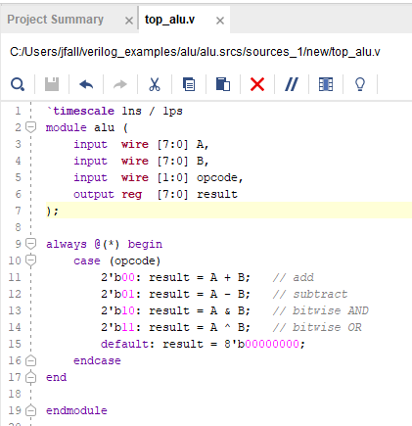
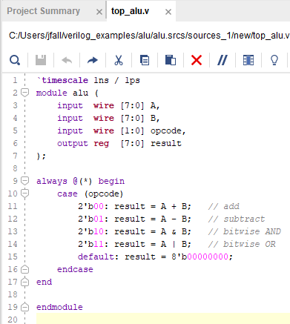
Fixing the code
Code with a Bug
Fixed Code

Slide 25
Re-run Waveform Analysis
Fixed!

Slide 26
Putting It All Together
Write
Write Verilog module (design)
Write
Write testbench (tests)
Run
Run simulation (execute tests)
Analyze
Analyze waveforms (debug)

Slide 27
Big Idea
Hardware design is NOT guess-and-check
It is systematic testing and verification
Simulation is your primary tool

Slide 28
Summary
Verilog defines hardware behavior
ALU performs core operations
Testbenches automate testing
Waveforms help debug and verify designs

Slide 29
Discussion/Questions
How would you add multiplication to the ALU?
What happens if you forget a test case?
Why is simulation critical before hardware?

