Slide 1
IHLT Project: Paraphrase Detection
Josep Famadas Alsamora & Jordi Riu Vicente

Slide 2

Metrics
Phrasal overlap measure
IDF overlap measure
TF-IDF cosine similarity

Slide 3
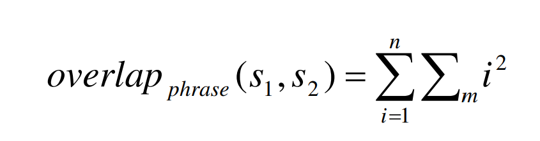
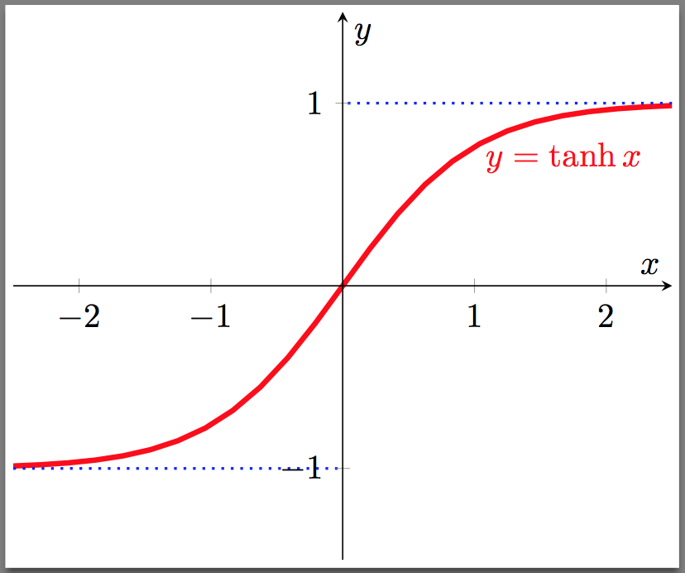

Metrics
Phrasal overlap measure
$$similarity \left(s1,s2\right)=\tanh\left(\frac{overlap_{phrase}\left(s1,s2\right)}{len\left(s1\right)+len\left(s2\right)}\right)$$

Slide 4
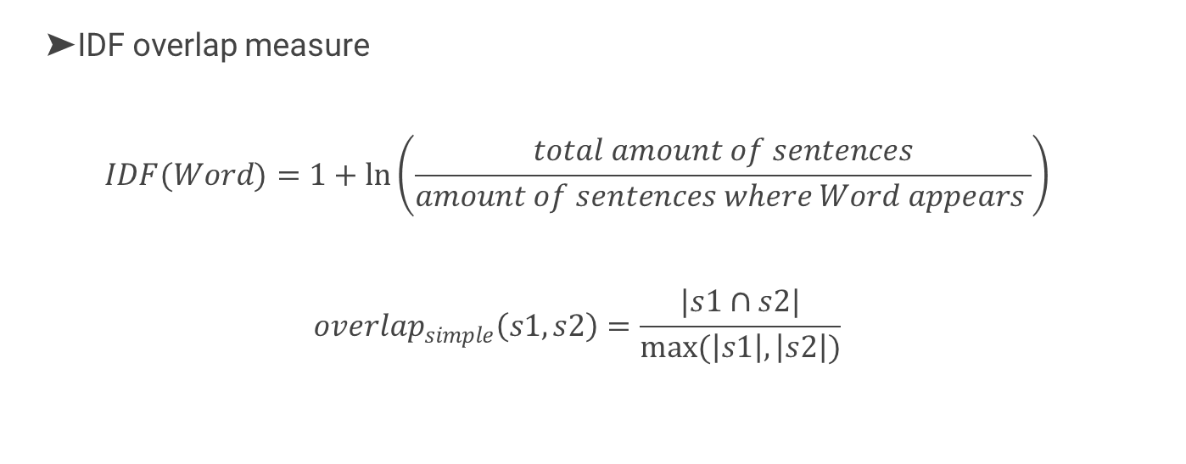
Metrics
IDF overlap measure
$$IDF(Word)=1+\ln\left(\frac{total amount of sentences}{amount of sentences where Word appears }\right)$$
$$overlap_{simple}\left(s1,s2\right)=\frac{|s1∩s2|}{max(\left|s1\right|,\left|s2\right|)}$$

Slide 5
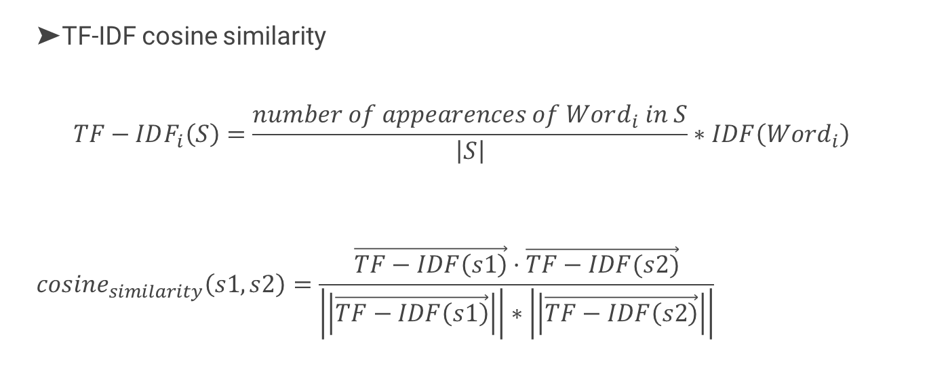
Metrics
TF-IDF cosine similarity
$$TF−IDF_{i}\left(S\right)=\frac{number of appearences of Word_{i} in S}{\left|S\right|}∗IDF\left(Word_{i}\right)$$
$$cosine_{similarity}\left(s1,s2\right)=\frac{\vec{TF−IDF\left(s1\right)}·\vec{TF−IDF(s2)}}{\left|\left|\vec{TF−IDF\left(s1\right)}\right|\right|∗\left|\left|\vec{TF−IDF\left(s2\right)}\right|\right|}$$

Slide 6
Dimensions
Words
Lemmas
Triples
Lexical – Part 1
Syntactic – Part 2

Slide 7
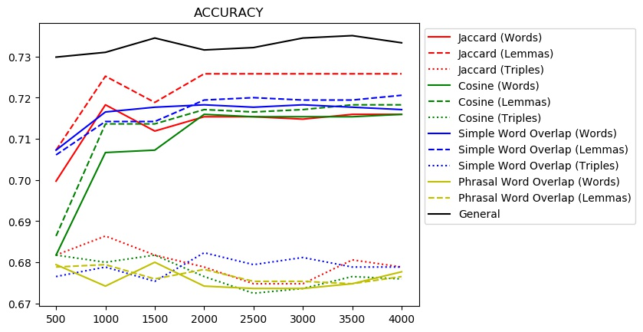
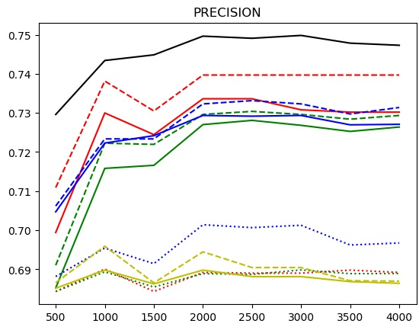
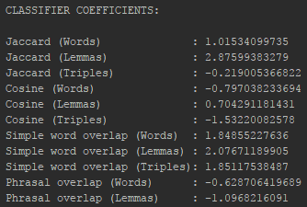
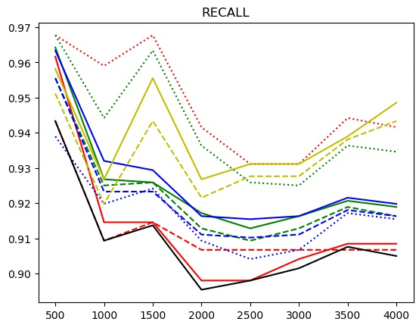
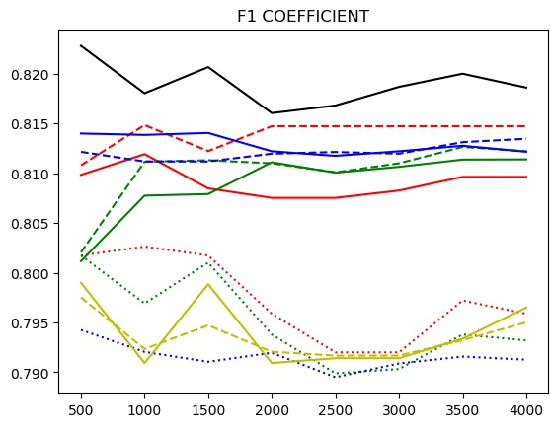
Results

Slide 8
Conclusions
The best result is obtained when combining all metrics.
Generally speaking, the metrics perform better when using lemmas instead of words. This point is accentuated in Jaccard coefficient.
The best metric in our case is the recall, which means that, nearly all paraphrases are detected.

