Slide 1

Artist Who? Artist Identifier Using CNNs
Joyce Fang
May 2021

Slide 2

“Every artist was first an amateur.” – Ralph Waldo Emerson

Slide 3
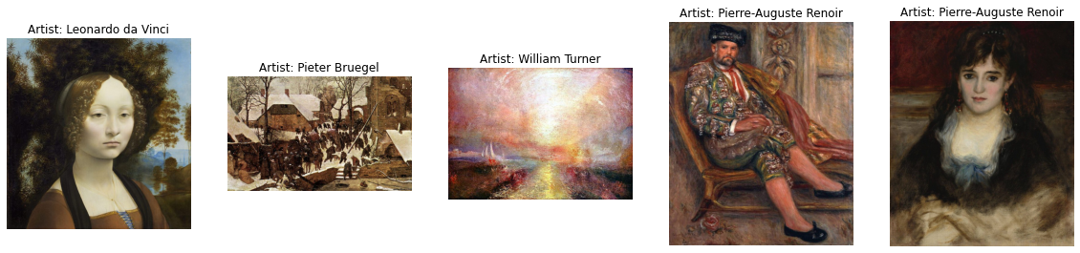
Dataset
50 most influential artists of all time
8,446 total artwork images
Directory/subdirectories format

Slide 4
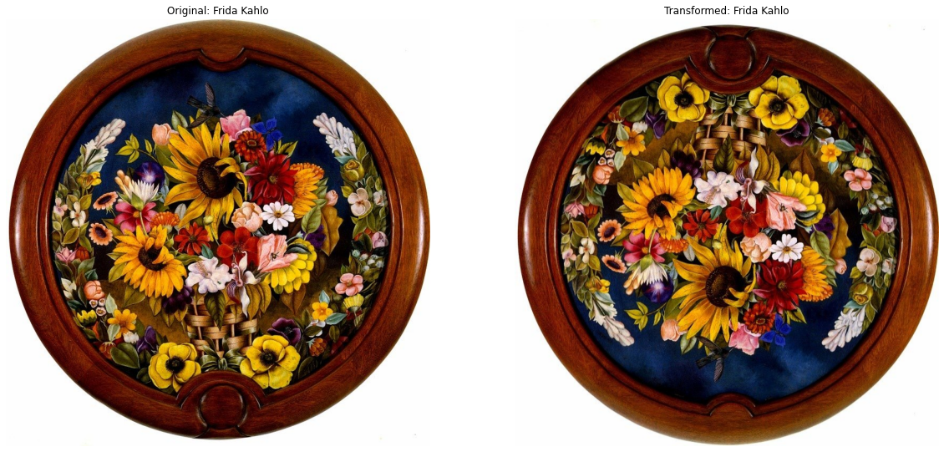
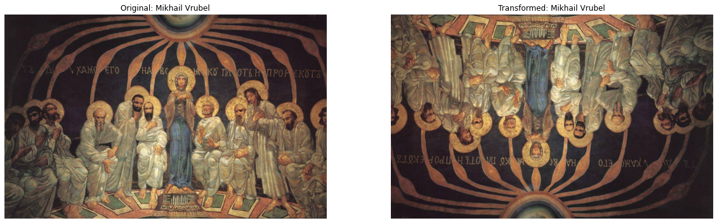
Data Processing
30 artists (classes) with 100 or more artworks
7,091 total artworks
Imbalanced dataset
Vincent Van Gogh: 877, Joan Miro: 102
Total paintings/(30*artist paintings)
Data augmentation
ImageDataGenerator

Slide 5
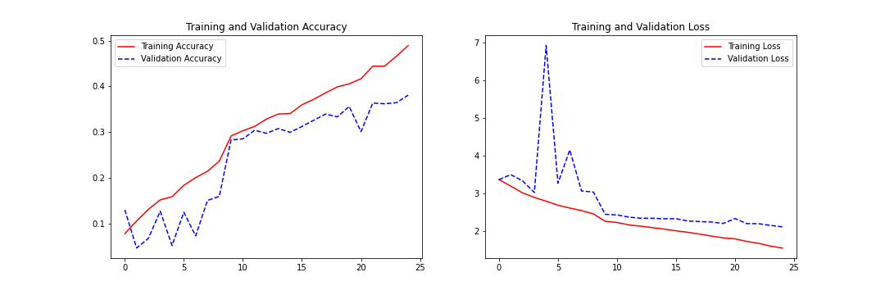
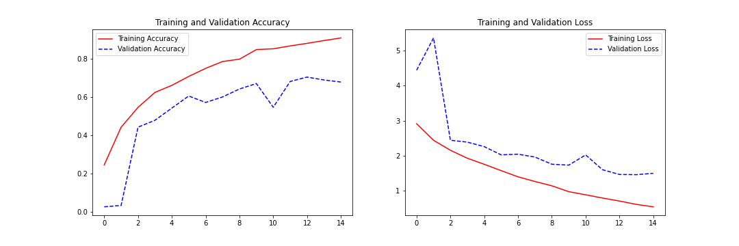
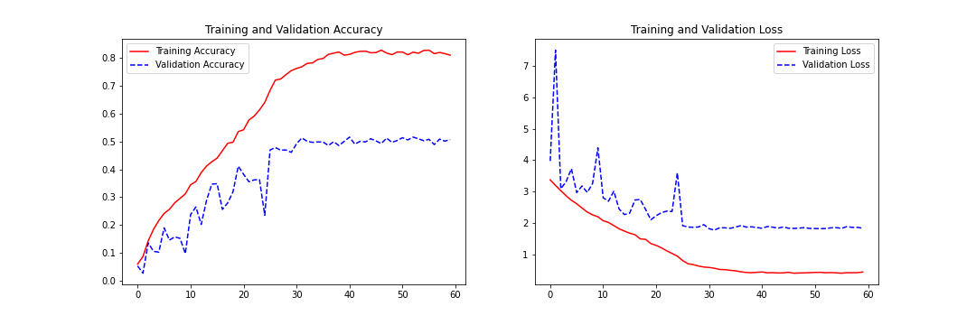
Models
CNN approach
ResNet50 as baseline model

Slide 6
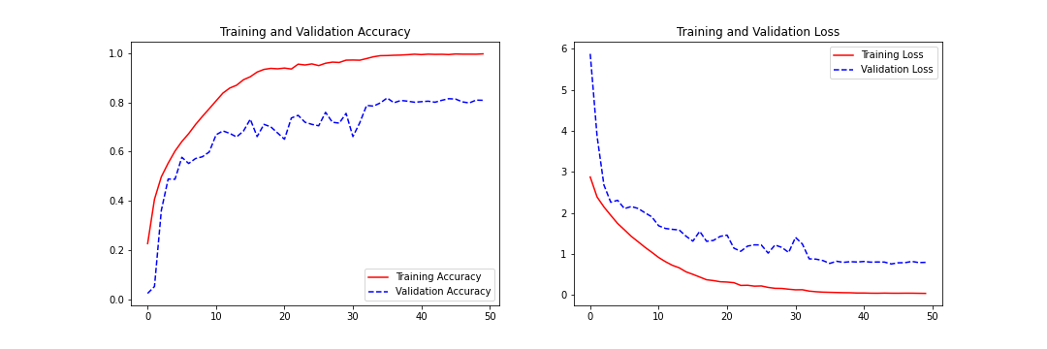
Final Model

Slide 7
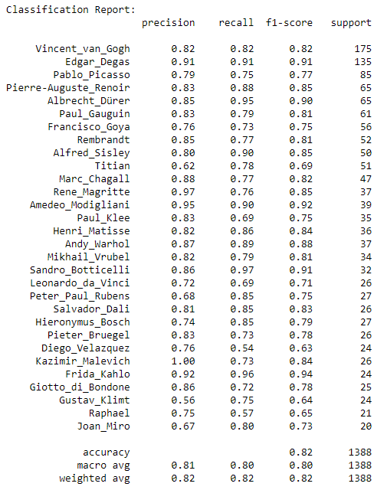
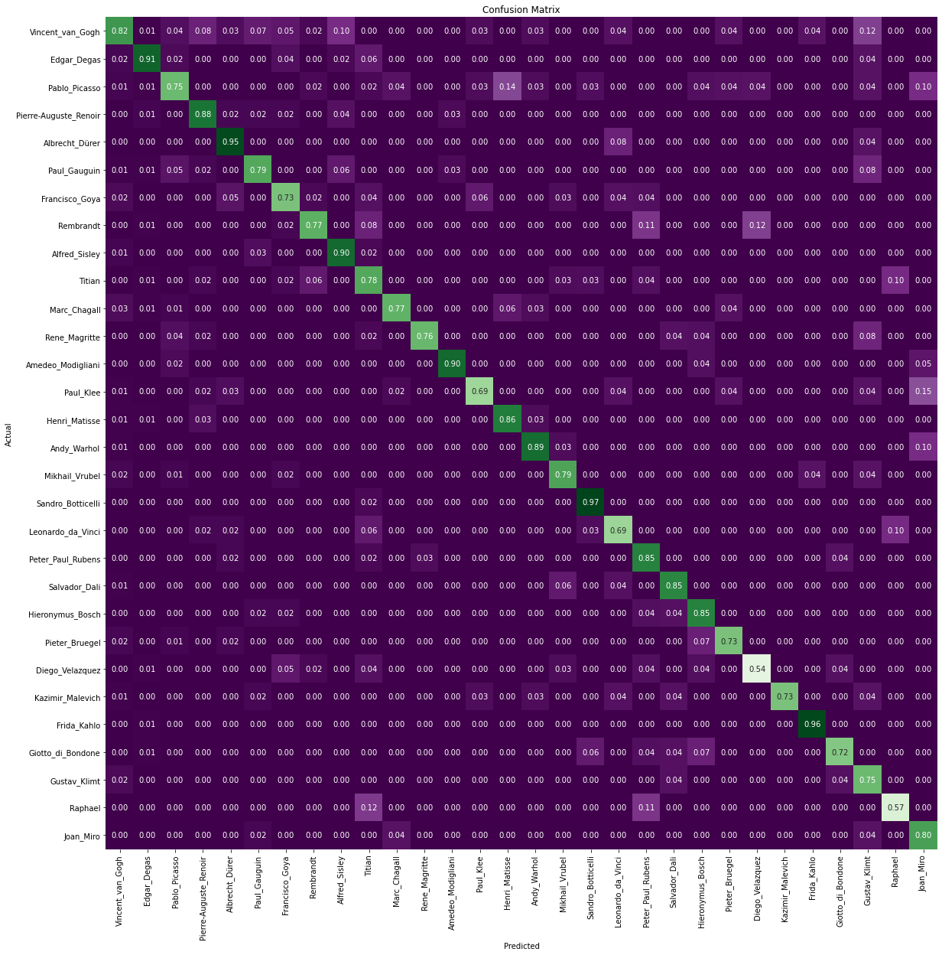
Evaluate

Slide 8
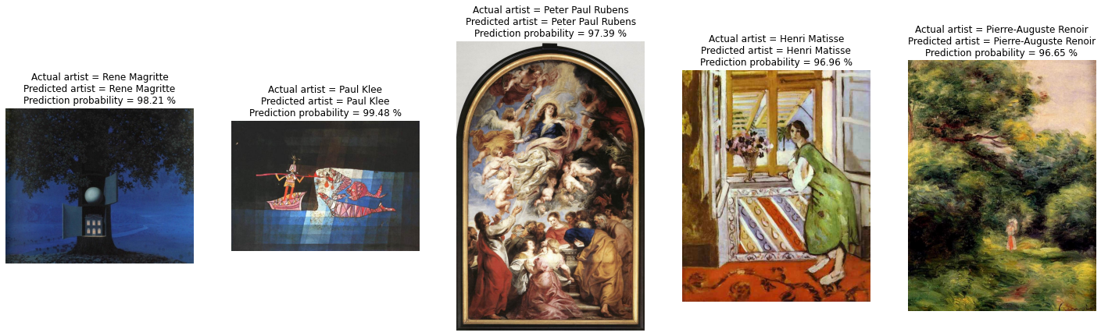
Conclusions/Takeaways
Test additional predefined architecture models as baseline
Set it up to take in any URL image and make predictions
Don’t forget to save models/figures
Hyperparameters!

