Slide 1
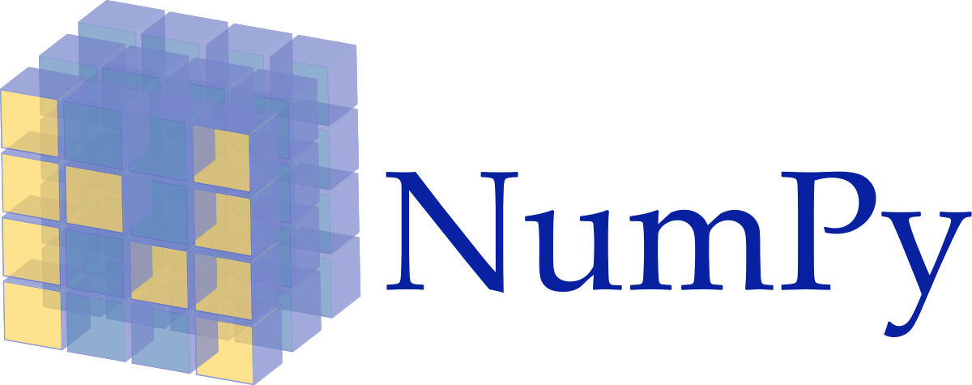



List of Targets
[Arithmetic Mean Ozone, Arithmetic Mean NO2, Arithmetic Mean CO, Arithmetic Mean SO2]
List of Features
[TMIN, TMAX, AWND, SNOW, SNWD]
List of Model Configurations
[LINEAR REGRESSION]
Generate Every Subset of Features
[TMIN], [TMIN, TMAX]…[TMIN, TMAX, AWND, SNOW, SNWD]
For each Target
For each Feature Subset
For each Model Configuration
Partition dataset into train and test set via k-fold Cross Validation
Compute average R² and MSE using all k models
If R² > threshold save Model details for future analysis

