Slide 1
Module 18 – Related Programming Models: MPI
Lecture 18.1 - Introduction to Heterogeneous Supercomputing and MPI

Slide 2
Objective
To learn the basics of an MPI application
Blue Waters, a supercomputer clusters with heterogeneous CPU-GPU nodes
MPI initialization, message passing, and barrier synchronization API functions
Vector addition example

Slide 3
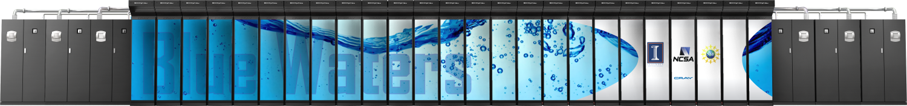

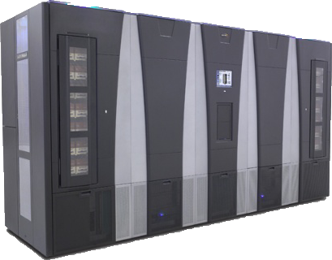
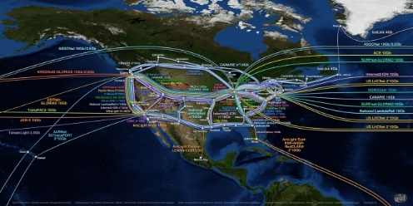
Blue Waters - Operational at Illinois since 3/2013
12.5 PF
1.6 PB DRAM
$250M
IB Switch
>1 TB/sec
10/40/100 Gb
Ethernet Switch
100 GB/sec
120+ Gb/sec
WAN
Spectra Logic: 300 PBs
Sonexion: 26 PBs
Notes:
Note just compute – main memory (1.6PB); Disk (26PB); near line (300PB)

Slide 4








Cray XE6 Dual Socket Nodes
Two AMD Interlagos chips
16 core modules, 64 threads
313 GFs peak performance
64 GBs memory
102 GB/sec memory bandwidth
Gemini Interconnect
Router chip & network interface
Injection Bandwidth (peak)
9.6 GB/sec per direction
HT3
HT3
Blue Waters contains 22,640 Cray XE6 compute nodes.

Slide 5


Cray XK7 Dual Socket Nodes
One AMD Interlagos chip
8 core modules, 32 threads
156.5 GFs peak performance
32 GBs memory
51 GB/s bandwidth
One NVIDIA Kepler chip
1.3 TFs peak performance
6 GBs GDDR5 memory
250 GB/sec bandwidth
Gemini Interconnect
Same as XE6 nodes
PCIe Gen2
HT3
HT3
Blue Waters contains 4,224 Cray XK7 compute nodes.

Slide 6
MPI – Programming and Execution Model
Many processes distributed in a cluster
Each process computes part of the output
Processes communicate with each other
Processes can synchronize
Node
Node
Node
Node

Slide 7
MPI Initialization, Info and Sync
int MPI_Init(int *argc, char ***argv)
Initialize MPI
MPI_COMM_WORLD
MPI group with all allocated nodes
int MPI_Comm_rank (MPI_Comm comm, int *rank)
Rank of the calling process in group of comm
int MPI_Comm_size (MPI_Comm comm, int *size)
Number of processes in the group of comm

Slide 8
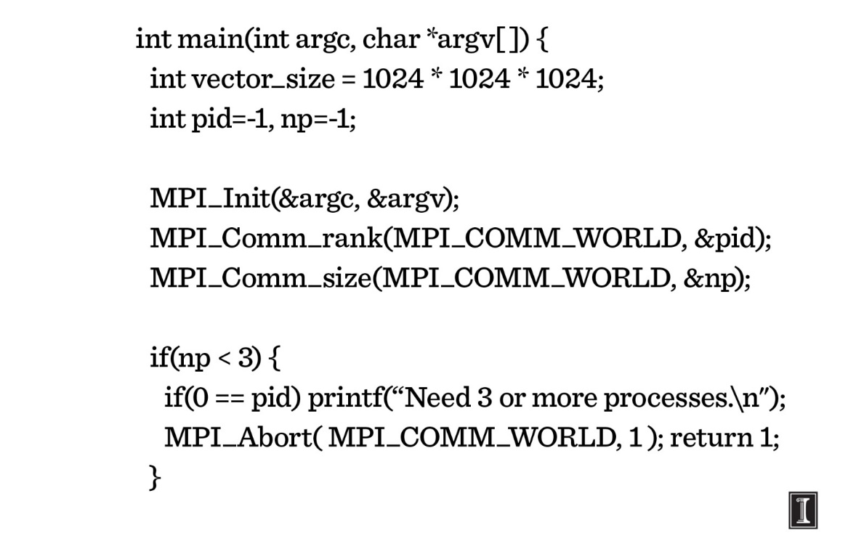
Vector Addition: Main Process

Slide 9
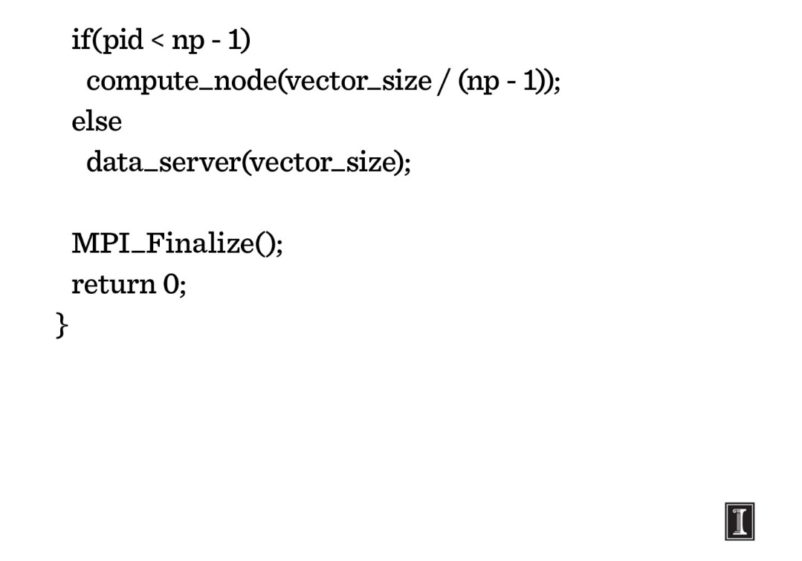
Vector Addition: Main Process

Slide 10
MPI Sending Data
int MPI_Send(void *buf, int count, MPI_Datatype datatype, int dest, int tag, MPI_Comm comm)
Buf: Initial address of send buffer (choice)
Count: Number of elements in send buffer (nonnegative integer)
Datatype: Datatype of each send buffer element (handle)
Dest: Rank of destination (integer)
Tag: Message tag (integer)
Comm: Communicator (handle)

Slide 11
MPI Sending Data
int MPI_Send(void *buf, int count, MPI_Datatype datatype, int dest, int tag, MPI_Comm comm)
Buf: Initial address of send buffer (choice)
Count: Number of elements in send buffer (nonnegative integer)
Datatype: Datatype of each send buffer element (handle)
Dest: Rank of destination (integer)
Tag: Message tag (integer)
Comm: Communicator (handle)
Node
Node
Node
Node

Slide 12
MPI Receiving Data
int MPI_Recv(void *buf, int count, MPI_Datatype datatype, int source, int tag, MPI_Comm comm, MPI_Status *status)
Buf: Initial address of receive buffer (choice)
Count: Maximum number of elements in receive buffer (integer)
Datatype: Datatype of each receive buffer element (handle)
Source: Rank of source (integer)
Tag: Message tag (integer)
Comm: Communicator (handle)
Status: Status object (Status)

Slide 13
MPI Receiving Data
int MPI_Recv(void *buf, int count, MPI_Datatype datatype, int source, int tag, MPI_Comm comm, MPI_Status *status)
Buf: Initial address of receive buffer (choice)
Count: Maximum number of elements in receive buffer (integer)
Datatype: Datatype of each receive buffer element (handle)
Source: Rank of source (integer)
Tag: Message tag (integer)
Comm: Communicator (handle)
Status: Status object (Status)
Node
Node
Node
Node

Slide 14
Vector Addition: Server Process (I)
void data_server(unsigned int vector_size) {
int np, num_nodes = np – 1, first_node = 0, last_node = np - 2;
unsigned int num_bytes = vector_size * sizeof(float);
float *input_a = 0, *input_b = 0, *output = 0;
/* Set MPI Communication Size */
MPI_Comm_size(MPI_COMM_WORLD, &np);
/* Allocate input data */
input_a = (float *)malloc(num_bytes);
input_b = (float *)malloc(num_bytes);
output = (float *)malloc(num_bytes);
if(input_a == NULL || input_b == NULL || output == NULL) {
printf(“Server couldn't allocate memory\n");
MPI_Abort( MPI_COMM_WORLD, 1 );
}
/* Initialize input data */
random_data(input_a, vector_size , 1, 10);
random_data(input_b, vector_size , 1, 10);

Slide 15
Vector Addition: Server Process (II)
/* Send data to compute nodes */
float *ptr_a = input_a;
float *ptr_b = input_b;
for(int process = 1; process < last_node; process++) {
MPI_Send(ptr_a, vector_size / num_nodes, MPI_FLOAT,
process, DATA_DISTRIBUTE, MPI_COMM_WORLD);
ptr_a += vector_size / num_nodes;
MPI_Send(ptr_b, vector_size / num_nodes, MPI_FLOAT,
process, DATA_DISTRIBUTE, MPI_COMM_WORLD);
ptr_b += vector_size / num_nodes;
}
/* Wait for nodes to compute */
MPI_Barrier(MPI_COMM_WORLD);

Slide 16
Vector Addition: Server Process (III)
/* Wait for previous communications */ MPI_Barrier(MPI_COMM_WORLD);
/* Collect output data */
MPI_Status status;
for(int process = 0; process < num_nodes; process++) {
MPI_Recv(output + process * num_points / num_nodes,
num_points / num_comp_nodes, MPI_REAL, process,
DATA_COLLECT, MPI_COMM_WORLD, &status );
}
/* Store output data */
store_output(output, dimx, dimy, dimz);
/* Release resources */
free(input_a);
free(input_b);
free(output);
}

Slide 17
Vector Addition: Compute Process (I)
void compute_node(unsigned int vector_size ) {
int np;
unsigned int num_bytes = vector_size * sizeof(float);
float *input_a, *input_b, *output;
MPI_Status status;
MPI_Comm_size(MPI_COMM_WORLD, &np);
int server_process = np - 1;
/* Alloc host memory */
input_a = (float *)malloc(num_bytes);
input_b = (float *)malloc(num_bytes);
output = (float *)malloc(num_bytes);
/* Get the input data from server process */
MPI_Recv(input_a, vector_size, MPI_FLOAT, server_process,
DATA_DISTRIBUTE, MPI_COMM_WORLD, &status);
MPI_Recv(input_b, vector_size, MPI_FLOAT, server_process,
DATA_DISTRIBUTE, MPI_COMM_WORLD, &status);

Slide 18
MPI Barriers
int MPI_Barrier (MPI_Comm comm)
Comm: Communicator (handle)
Blocks the caller until all group members have called it; the call returns at any process only after all group members have entered the call.

Slide 19
MPI Barriers
Wait until all other processes in the MPI group reach the same barrier
All processes are executing Do_Stuff()
Some processes reach the barrier and the wait in the barrier until all reach the barrier
Example Code
Do_stuff();
MPI_Barrier();
Do_more_stuff();
Node
Node
Node
Node

Slide 20
Vector Addition: Compute Process (II)
/* Compute the partial vector addition */
for(int i = 0; i < vector_size; ++i) {
output[i] = input_a[i] + input_b[i];
}
/* Report to barrier after computation is done*/
MPI_Barrier(MPI_COMM_WORLD);
/* Send the output */
MPI_Send(output, vector_size, MPI_FLOAT,
server_process, DATA_COLLECT, MPI_COMM_WORLD);
/* Release memory */
free(input_a);
free(input_b);
free(output);
}

Slide 21
The GPU Teaching Kit is licensed by NVIDIA and the University of Illinois under the Creative Commons Attribution-NonCommercial 4.0 International License.

