Slide 1
Module 20 – Related Programming Models: OpenCL
Lecture 20.2 - OpenCL Device Architecture

Slide 2
Objective
To Understand the OpenCL device architecture
Foundation to terminology used in the host code
Also needed to understand the memory model for kernels

Slide 3
OpenCL Hardware Abstraction
OpenCL exposes CPUs, GPUs, and other Accelerators as “devices”
Each device contains one or more “compute units”, i.e. cores, Streaming Multicprocessors, etc...
Each compute unit contains one or more SIMD “processing elements”, (i.e. SP in CUDA)
OpenCL Device
Compute Unit
PE
PE
PE
PE
PE
PE
PE
PE
Compute Unit
PE
PE
PE
PE
PE
PE
PE
PE

Slide 4
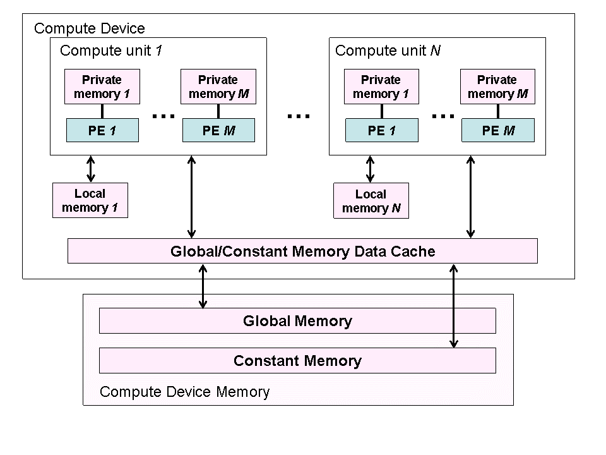
OpenCL Device Architecture

Slide 5
OpenCL Device Memory Types
Memory Type | Host access | Device access | CUDA Equivalent
global memory | Dynamic allocation; Read/write access | No allocation; Read/write access by all work items in all work groups, large and slow but may be cached in some devices. | global memory
constant memory | Dynamic allocation; read/write access | Static allocation; read-only access by all work items. | constant memory
local memory | Dynamic allocation; no access | Static allocation; shared read-write access by all work items in a work group. | shared memory
private memory | No allocation; no access | Static allocation; Read/write access by a single work item. | registers and local memory

Slide 6
OpenCL Context
Contains one or more devices
OpenCL device memory objects are associated with a context, not a specific device
OpenCL Context
OpenCL Device
OpenCL Device

Slide 7

The GPU Teaching Kit is licensed by NVIDIA and the University of Illinois under the Creative Commons Attribution-NonCommercial 4.0 International License.

