Slide 1
Module 8.2 – Parallel Computation Patterns (Stencil)
Tiled Convolution

Slide 2
Objective
To learn about tiled convolution algorithms
Some intricate aspects of tiling algorithms
Output tiles versus input tiles

Slide 3
Tiling Opportunity Convolution
Calculation of adjacent output elements involve shared input elements
E.g., N[2] is used in calculation of P[0], P[1], P[2]. P[3 and P[5] assuming a 1D convolution Mask_Width of width 5
We can load all the input elements required by all threads in a block into the shared memory to reduce global memory accesses
N[0]
N[1]
N[2]
N[3]
N[4]
N[5]
N[6]
1
2
3
4
5
6
7
P[0]
N[0]
N[1]
N[2]
N[3]
N[4]
N[5]
N[6]
1
2
3
4
5
6
7
P[1]
N[0]
N[1]
N[2]
N[3]
N[4]
N[5]
N[6]
1
2
3
4
5
6
7
P[2]
N[0]
N[1]
N[2]
N[3]
N[4]
N[5]
N[6]
1
2
3
4
5
6
7
P[3]
N[0]
N[1]
N[2]
N[3]
N[4]
N[5]
N[6]
1
2
3
4
5
6
7
P[4]

Slide 4
Input Data Needs
Assume that we want to have each block to calculate T output elements
T + Mask_Width -1 input elements are needed to calculate T output elements
T + Mask_Width -1 is usually not a multiple of T, except for small T values
T is usually significantly larger than Mask_Width
N
0
1
2
3
4
5
6
7
8
9
10
11
12
13
14
15
P
0
1
2
3
4
5
6
7
8
9
10
11
12
13
14
15

Slide 5
Definition – output tile
P
0
1
2
3
4
5
6
7
8
9
10
11
12
13
14
15
O_TILE_WIDTH
Each thread block calculates an output tile
Each output tile width is O_TILE_WIDTH
For each thread,
O_TILE_WIDTH is 4 in this example

Slide 6
Definition - Input Tiles
P
0
1
2
3
4
5
6
7
8
9
10
11
12
13
14
15
N
0
1
2
3
4
5
6
7
8
9
10
11
12
13
14
15
Ns
2
3
4
5
6
7
8
9
Each input tile has all values needed to calculate the corresponding output tile.

Slide 7
Two Design Options
Design 1: The size of each thread block matches the size of an output tile
All threads participate in calculating output elements
blockDim.x would be 4 in our example
Some threads need to load more than one input element into the shared memory
Design 2: The size of each thread block matches the size of an input tile
Some threads will not participate in calculating output elements
blockDim.x would be 8 in our example
Each thread loads one input element into the shared memory
We will present Design 2 and leave Design 1 as an exercise.

Slide 8
Thread to Input and Output Data Mapping
P
0
1
2
3
4
5
6
7
8
9
10
11
12
13
14
15
N
0
1
2
3
4
5
6
7
8
9
10
11
12
13
14
15
Thread 0 reads this
Thread 0 writes this
For each thread,
Index_i = index_o – n
were n is Mask_Width /2
n is 2 in this example

Slide 9
All Threads Participate in Loading Input Tiles
float output = 0.0f;
if((index_i >= 0) && (index_i < Width)) {
Ns[tx] = N[index_i];
}
else{
Ns[tx] = 0.0f;
}

Slide 10
Some threads do not participate in calculating output
if (threadIdx.x < O_TILE_WIDTH){
output = 0.0f;
for(j = 0; j < Mask_Width; j++) {
output += M[j] * Ns[j+threadIdx.x];
}
P[index_o] = output;
}
index_o = blockIdx.x*O_TILE_WIDTH + threadIdx.x
Only Threads 0 through O_TILE_WIDTH-1 participate in calculation of output.

Slide 11
Setting Block Size
#define O_TILE_WIDTH 1020
#define BLOCK_WIDTH (O_TILE_WIDTH + 4)
dim3 dimBlock(BLOCK_WIDTH,1, 1);
dim3 dimGrid((Width-1)/O_TILE_WIDTH+1, 1, 1)
The Mask_Width is 5 in this example
In general, block width should be
output tile width + (mask width-1)

Slide 12
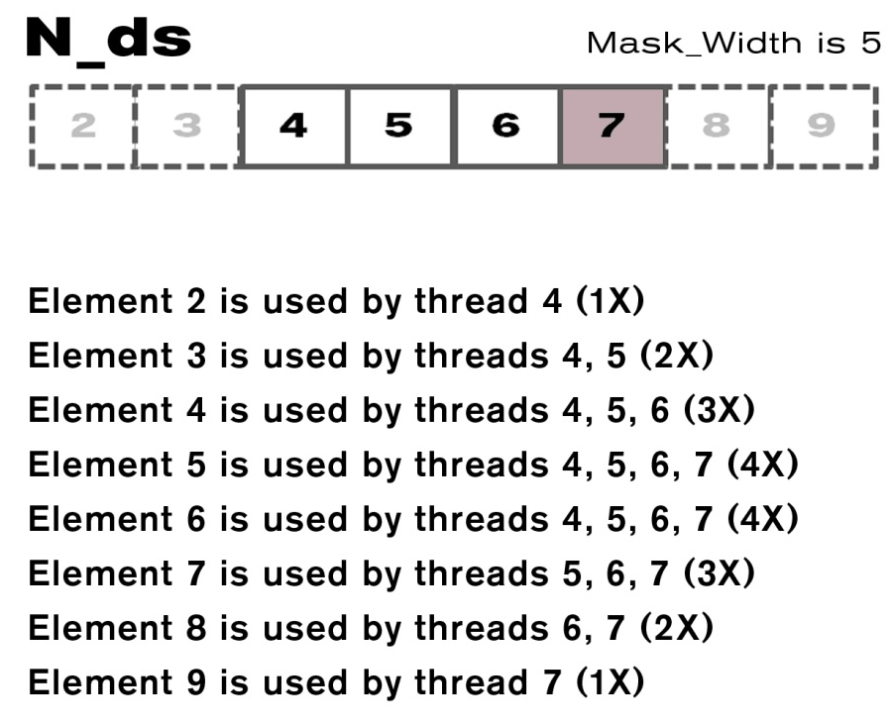
Shared Memory Data Reuse

Slide 13
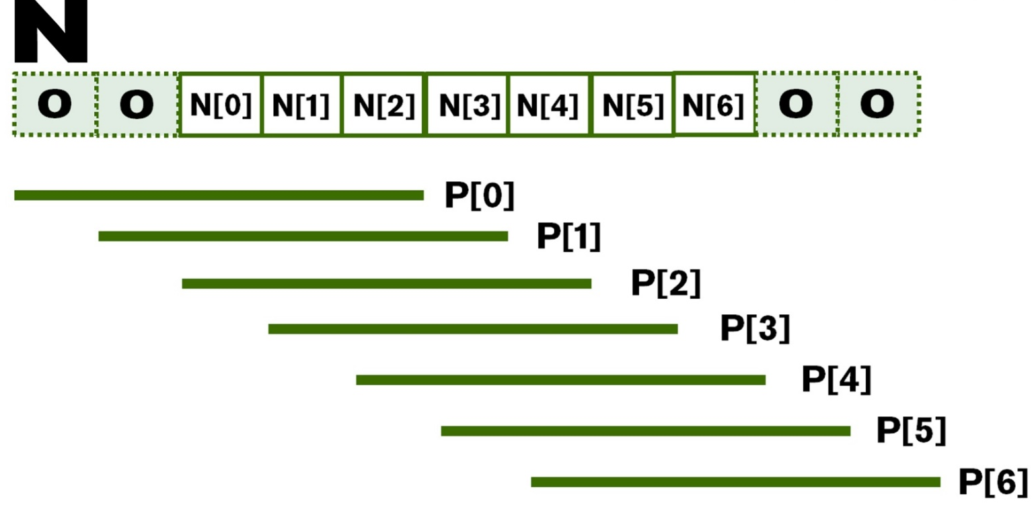
Ghost Cells

Slide 14
The GPU Teaching Kit is licensed by NVIDIA and the University of Illinois under the Creative Commons Attribution-NonCommercial 4.0 International License.

