Slide 1
Module 17 – Computational Thinking
Lecture 17.1 – Introduction to Computational Thinking

Slide 2
Objective
To provide you with a framework for further studies on
Thinking about the problems of parallel programming
Discussing your work with others
Approaching complex parallel programming problems
Using or building useful tools and environments

Slide 3
Fundamentals of Parallel Computing
Parallel computing requires that
The problem can be decomposed into sub-problems that can be safely solved at the same time
The programmer structures the code and data to solve these sub-problems concurrently
The goals of parallel computing are
To solve problems in less time (strong scaling), and/or
To solve bigger problems (weak scaling), and/or
To achieve better solutions (advancing science)
The problems must be large enough to justify parallel computing and to exhibit exploitable concurrency.

Slide 4
Shared Memory vs. Message Passing
We have focused on shared memory parallel programming
This is what CUDA (and OpenMP, OpenCL) is based on
Future massively parallel microprocessors are expected to support shared memory at the chip level
The programming considerations of message passing model is quite different!
However, you will find parallels for almost every technique you learned in this course
Need to be aware of space-time constraints

Slide 5
Data Sharing
Data sharing can be a double-edged sword
Excessive data sharing drastically reduces advantage of parallel execution
Localized sharing can improve memory bandwidth efficiency
Efficient memory bandwidth usage can be achieved by synchronizing the execution of task groups and coordinating their usage of memory data
Efficient use of on-chip, shared storage and datapaths
Read-only sharing can usually be done at much higher efficiency than read-write sharing, which often requires more synchronization
Many:Many, One:Many, Many:One, One:One

Slide 6
Synchronization
Synchronization == Control Sharing
Barriers make threads wait until all threads catch up
Waiting is lost opportunity for work
Atomic operations may reduce waiting
Watch out for serialization
Important: be aware of which items of work are truly independent

Slide 7
Parallel Programming Coding Styles – Program and Data Models
Program Models
Data Models
SPMD
Shared Data
Master/Worker
Shared Queue
Loop Parallelism
Distributed Array
Fork/Join
These are not necessarily mutually exclusive.

Slide 8
Program Models
SPMD (Single Program, Multiple Data)
All PE’s (Processor Elements) execute the same program in parallel, but has its own data
Each PE uses a unique ID to access its portion of data
Different PE can follow different paths through the same code
This is essentially the CUDA Grid model (also OpenCL, MPI)
SIMD is a special case – WARP used for efficiency
Master/Worker
Loop Parallelism
Fork/Join

Slide 9
Program Models
SPMD (Single Program, Multiple Data)
Master/Worker (OpenMP, OpenACC, TBB)
A Master thread sets up a pool of worker threads and a bag of tasks
Workers execute concurrently, removing tasks until done
Loop Parallelism (OpenMP, OpenACC, C++AMP)
Loop iterations execute in parallel
FORTRAN do-all (truly parallel), do-across (with dependence)
Fork/Join (Posix p-threads)
Most general, generic way of creation of threads

Slide 10
Algorithm Structure
Start
Organize
by Task
Organize by
Data
Organize by
Data Flow
Linear
Recursive
Linear
Recursive
Regular
Irregular
Task
Parallelism
Divide and
Conquer
Geometric
Decomposition
Recursive
Data
Pipeline
Event Driven
Mattson, Sanders, Massingill, Patterns for Parallel Programming

Slide 11
More on SPMD
Dominant coding style of scalable parallel computing
MPI code is mostly developed in SPMD style
Many OpenMP code is also in SPMD (next to loop parallelism)
Particularly suitable for algorithms based on task parallelism and geometric decomposition.
Main advantage
Tasks and their interactions visible in one piece of source code, no need to correlated multiple sources
SPMD is by far the most commonly used pattern for structuring massively parallel programs.

Slide 12
Typical SPMD Program Phases
Initialize
Establish localized data structure and communication channels
Obtain a unique identifier
Each thread acquires a unique identifier, typically range from 0 to N-1, where N is the number of threads.
Both OpenMP and CUDA have built-in support for this.
Distribute Data
Decompose global data into chunks and localize them, or
Sharing/replicating major data structure using thread ID to associate subset of the data to threads
Run the core computation
More details in next slide…
Finalize
Reconcile global data structure, prepare for the next major iteration

Slide 13
Core Computation Phase
Thread IDs are used to differentiate behavior of threads
Use thread ID in loop index calculations to split loop iterations among threads
Potential for memory/data divergence
Use thread ID or conditions based on thread ID to branch to their specific actions
Potential for instruction/execution divergence
Both can have very different performance results and code complexity depending on the way they are done.

Slide 14
Making Science Better, not just Faster or… in other words: There will be no Nobel Prizes or Turing Awards awarded for “just recompile” or using more threads

Slide 15
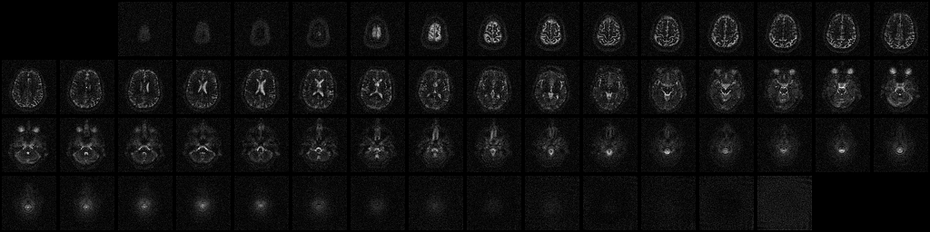
A Revolution - Sodium Map of the Brain
Images of sodium in the brain
Sodium is one of the most regulated substance in human tissues
Any significant shift in sodium concentration signals cell death
Much less abundant than water in human tissues, about 1/2000
Very large number of samples are needed for good SNR
Requires high-quality reconstruction, currently considered impractical
Courtesy of Keith Thulborn and Ian Atkinson, Center for MR Research, University of Illinois at Chicago
Notes:
15

Slide 16
A Revolution - Sodium Map of the Brain
Enables study of brain-cell viability before anatomic changes occur in stroke and cancer treatment.
Drastic improvement of timeliness of treatment decision
Minutes for stroke and days for oncology.
Courtesy of Keith Thulborn and Ian Atkinson, Center for MR Research, University of Illinois at Chicago
Notes:
16

Slide 17
Reconstructing MR Images
Cartesian Scan Data
Spiral Scan Data
Gridding¹
FFT
LS
Spiral scan data + Gridding + FFT:
Fast scan, fast reconstruction, good images
Can become realtime with about 10X speedup.
Notes:
Thus, non-Cartesian trajectories, such as the spiral trajectory shown here, are becoming increasingly popular. These non-Cartesian scans are faster and less susceptible to artifacts than Cartesian scans.
However, the FFT cannot be applied directly to the non-Cartesian scan data. One popular approach is to “grid” the data. That is, the non-Cartesian data (shown in orange) is interpolated onto a uniform grid (shown in blue) using some sort of windowing function. The FFT can then be applied to the interpolated data. This technique introduces inaccuracies and satisfies no statistical optimality criterion, but is very fast, and does produce better images than a Cartesian scan.

Slide 18
Reconstructing MR Images
Cartesian Scan Data
Spiral Scan Data
Gridding
FFT
Least-Squares (LS)
Spiral scan data + LS
Superior images at expense of significantly more computation; several hundred times slower than gridding.
Traditionally considered impractical!
Notes:
Least-squares reconstruction is a superior technique that operates directly on the non-uniform data using the least-squares optimality criterion. The combination of a non-Cartesian scan and the LS reconstruction produces images superior to those obtained via Cartesian scans or gridding. However, these superior images come at the expense of increasing the amount of computation by several orders of magnitude. For the LS reconstruction to be practical in clinical settings, it needs to be accelerated a lot.
Again, this is what we mean when we say that the GPU allows us to change the boundaries of science. The LS reconstruction algorithm isn’t viable on the CPU. It’s the GPU that makes the LS reconstruction practical, so that we don’t have to use approximate techniques like gridding.

Slide 19
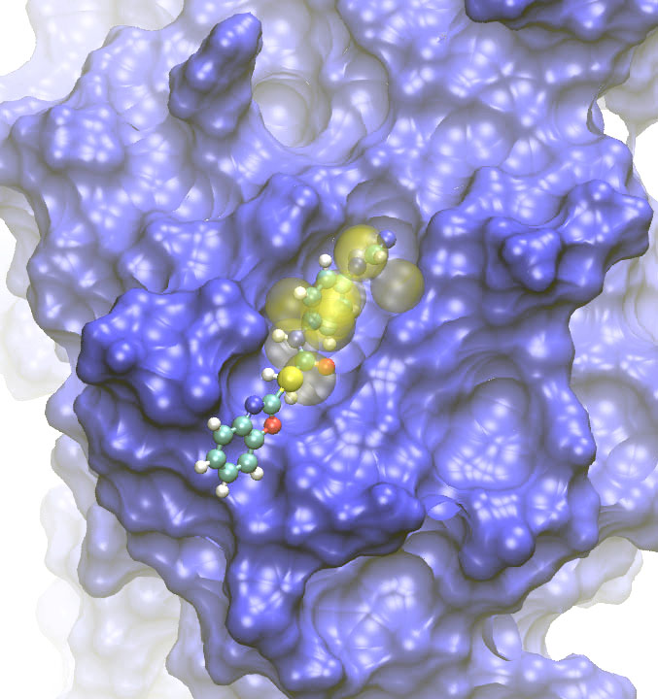
High-Throughput Computing = Futuristic Biology
in-silico screening of drugs
mastering diseases
personalized medicine
Thanks: Lorena Barba
Notes:
Image source:
http://www.psc.edu/science/2008/erks.html/

Slide 20
In-silico Drug Screening
Protein Aggregation
Weed out inactive compounds
Rank “drug candidates” for given targets
Example:
CERN grid — 300,000 potential drugs against avian flu screened
2000 computers, 4 weeks!
4 years cpu-time
a process critical in
some degenerative diseases (e.g., Parkinson’s): aggregates abnormal
drug production: aggregates undesirable
time scale of the process:
in vitro: up to days!
impossible for molecular dynamics
Notes:
In silico screening assists drug discovery, for example, by identifying small molecules that can selectively act on a target protein. The goal is to find drugs to treat cancer, diabetes, and so on.
Hundreds of thousands possible drugs need to be studied, to find those that can dock on the active sites of a virus, say.
Source for CERN example: http://cerncourier.com/cws/article/cern/29686

Slide 21
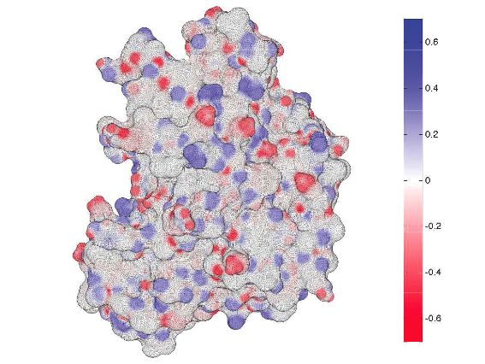
Electrostatic Interactions Play a Crucial Role
Classical molecular dynamics:
very detailed ... but too expensive at large scale!
Alternative: continuum model of surrounding water
don’t care what the H20 molecules do
model as a continuum dielectric
leads to a boundary integral equation (BIE) problem
Fast algorithm, well-suited for GPU:
fast multipole method, solves BIE in O(N) ops
Notes:
The bioelectrostatic interactions play a crucial role in the function of biological molecules.
Classical molecular dynamics methods use all-atom representation of the bio-molecule and solvent ... they are very detailed, but too expensive for large systems.
An alternative formulation of the physics is to use a continuum model of the solvated molecule. The model leads to a boundary integral equation problem on the molecular surface, which then needs to be solved using a fast algorithm (fast multipole method).

Slide 22
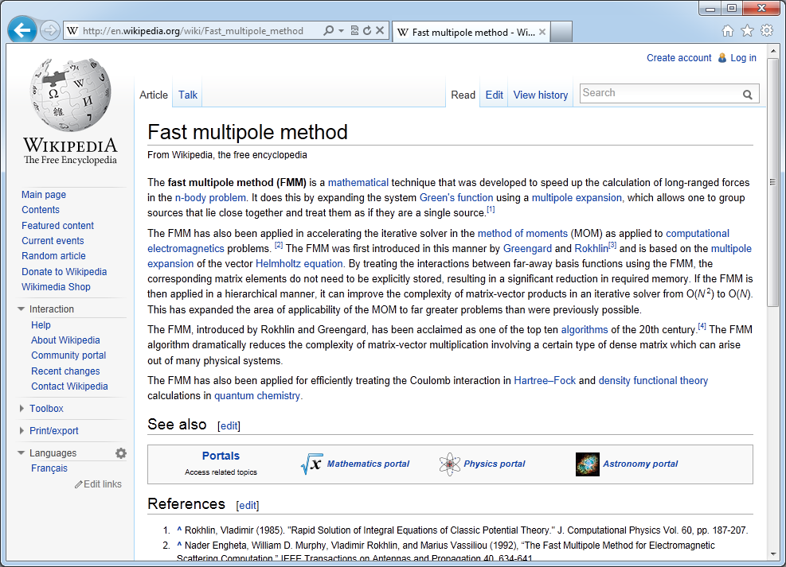

Slide 23
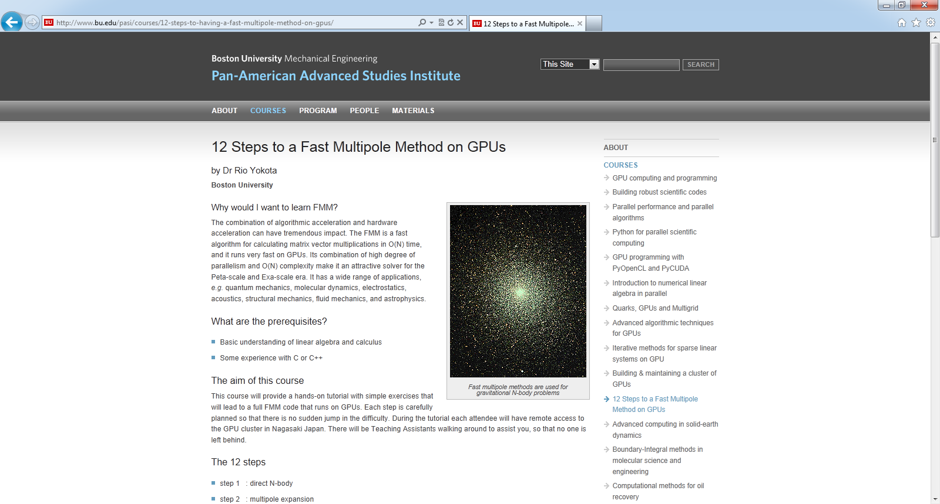

Slide 24
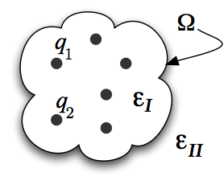
As in Many Computation-hungry Applications
Three-step approach:
Restructure the mathematical formulation
Innovate at the algorithm level
Tune core software for hardware architecture

Slide 25
Conclusion: Three Options
Good: “Accelerate” Legacy Codes
Recompile/Run
Call CUBLAS/CUFFT/thrust/matlab/PGI pragmas/etc.
=> good work for domain scientists (minimal CS required)
Better: Rewrite / Create new codes
Opportunity for clever algorithmic thinking
=> good work for computer scientists (minimal domain knowledge required)
Best: Rethink Numerical Methods & Algorithms
Potential for biggest performance advantage
=> Interdisciplinary: requires CS and domain insight
=> Exciting time to be a computational scientist

Slide 26
Think, Understand… then, Program
Think about the problem you are trying to solve
Understand the structure of the problem
Apply mathematical techniques to find solution
Map the problem to an algorithmic approach
Plan the structure of computation
Be aware of in/dependence, interactions, bottlenecks
Plan the organization of data
Be explicitly aware of locality, and minimize global data
Finally, write some code! (this is the easy part ☺)

Slide 27
Future Studies
More complex data structures
More scalable algorithms and building blocks
More scalable math models
Thread-aware approaches
More available parallelism
Locality-aware approaches
Computing is becoming bigger, and everything is further away

Slide 28

The GPU Teaching Kit is licensed by NVIDIA and the University of Illinois under the Creative Commons Attribution-NonCommercial 4.0 International License.

