Slide 1
Module 18 – Related Programming Models: MPI
Lecture 18.2 – Introduction to MPI-CUDA Programming

Slide 2
Objective
To learn to write an MPI-CUDA application
Vector addition example
Wave propagation stencil example
MPI Barriers

Slide 3
A Typical Wave Propagation Application
Do T = 0, Tmax
Insert Source
(e.g. acoustic wave)
Stencil Computation to compute Laplacian
Time Integration
Absorbing Boundary Conditions
T == Tmax

Slide 4
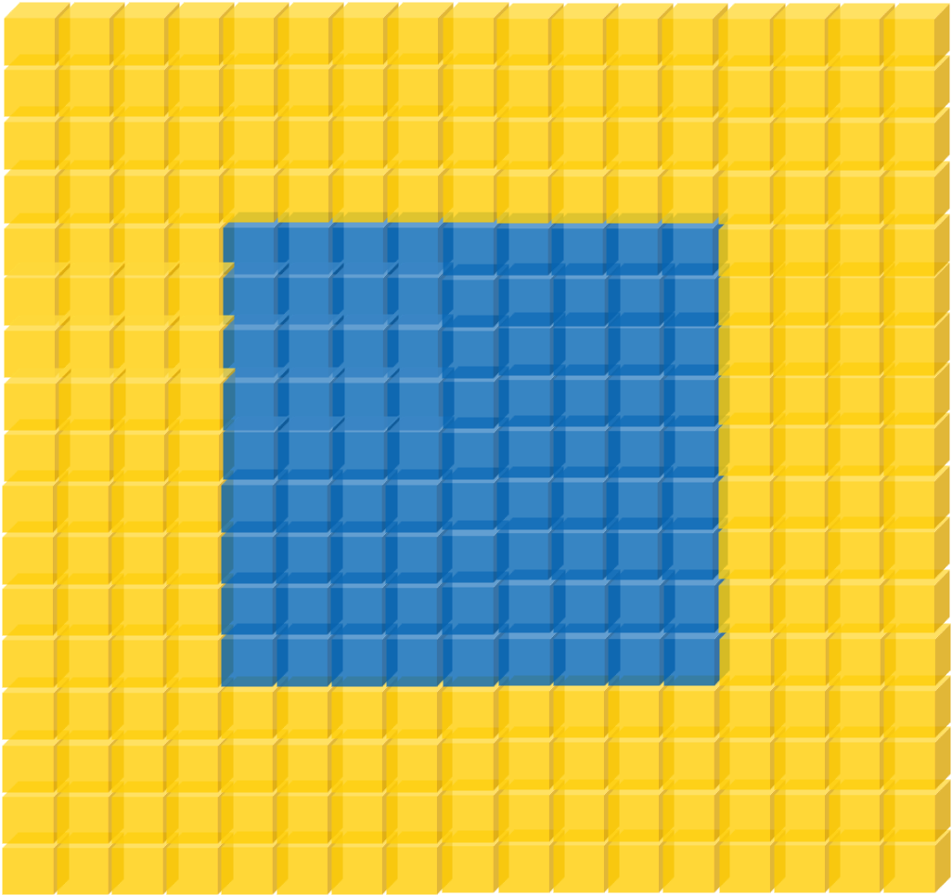

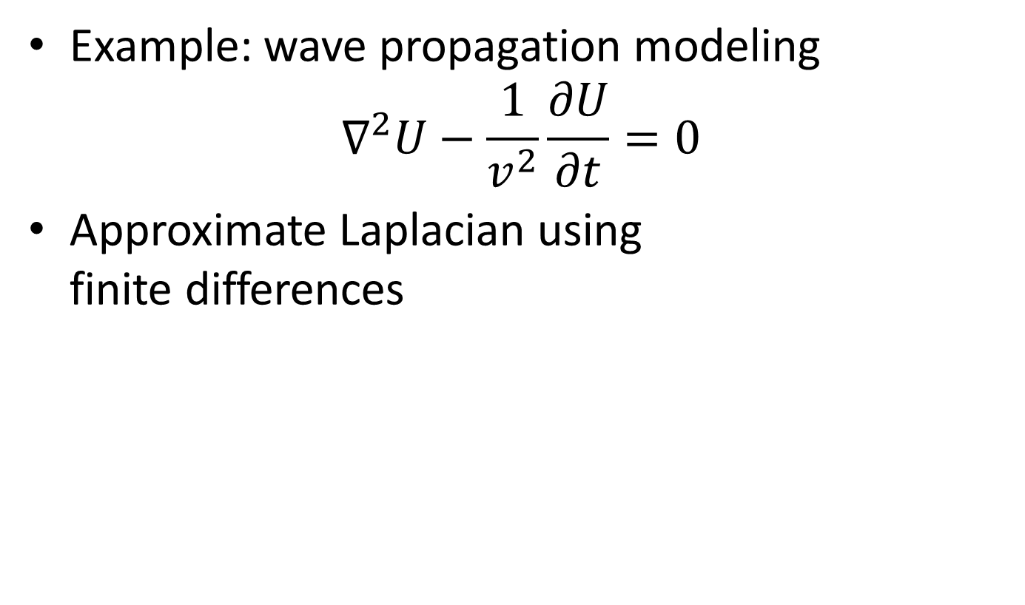
Review of Stencil Computations
Example: wave propagation modeling
$∇^{2}U−\frac{1}{v^{2}}\frac{∂U}{∂t}=0$
Approximate Laplacian using finite differences
Boundary Conditions
Laplacian and Time Integration

Slide 5
Wave Propagation: Kernel Code
/* Coefficients used to calculate the laplacian */
__constant__ float coeff[5];
__global__ void wave_propagation(float *next, float *in,
float *prev, float *velocity, dim3 dim)
{
unsigned x = threadIdx.x + blockIdx.x * blockDim.x;
unsigned y = threadIdx.y + blockIdx.y * blockDim.y;
unsigned z = threadIdx.z + blockIdx.z * blockDim.z;
/* Point index in the input and output matrixes */
unsigned n = x + y * dim.z + z * dim.x * dim.y;
/* Only compute for points within the matrixes */
if(x < dim.x && y < dim.y && z < dim.z) {
/* Calculate the contribution of each point to the laplacian */
float laplacian = coeff[0] + in[n];

Slide 6
Wave Propagation: Kernel Code
for(int i = 1; i < 5; ++i) {
laplacian += coeff[i] *
(in[n – i] + /* Left */
in[n + i] + /* Right */
in[n – i * dim.x] + /* Top */
in[n + I * dim.x] + /* Bottom */
in[n – i * dim.x * dim.y] + /* Behind */
in[n + i * dim.x * dim.y]); /* Front */
}
/* Time integration */
next[n] = velocity[n] * laplacian + 2 * in[n] – prev[n];
}
}

Slide 7
Stencil Domain Decomposition
Volumes are split into tiles (along the Z-axis)
3D-Stencil introduces data dependencies
D2
D4
x
y
z
D1
D3

Slide 8
Wave Propagation: Main Process
int main(int argc, char *argv[]) {
int pad = 0, dimx = 480+pad, dimy = 480, dimz = 400, nreps = 100;
int pid=-1, np=-1;
MPI_Init(&argc, &argv);
MPI_Comm_rank(MPI_COMM_WORLD, &pid);
MPI_Comm_size(MPI_COMM_WORLD, &np);
if(np < 3) {
if(0 == pid) printf(“Nedded 3 or more processes.\n");
MPI_Abort( MPI_COMM_WORLD, 1 ); return 1;
}
if(pid < np - 1)
compute_node(dimx, dimy, dimz / (np - 1), nreps);
else
data_server( dimx,dimy,dimz, nreps );
MPI_Finalize();
return 0;
}

Slide 9
Stencil Code: Server Process (I)
void data_server(int dimx, int dimy, int dimz, int nreps) {
int np, num_comp_nodes = np – 1, first_node = 0, last_node = np - 2;
unsigned int num_points = dimx * dimy * dimz;
unsigned int num_bytes = num_points * sizeof(float);
float *input=0, *output = NULL, *velocity = NULL;
/* Set MPI Communication Size */
MPI_Comm_size(MPI_COMM_WORLD, &np);
/* Allocate input data */
input = (float *)malloc(num_bytes);
output = (float *)malloc(num_bytes);
velocity = (float *)malloc(num_bytes);
if(input == NULL || output == NULL || velocity == NULL) {
printf(“Server couldn't allocate memory\n");
MPI_Abort( MPI_COMM_WORLD, 1 );
}
/* Initialize input data and velocity */
random_data(input, dimx, dimy ,dimz , 1, 10);
random_data(velocity, dimx, dimy ,dimz , 1, 10);

Slide 10
Stencil Code: Server Process (II)
/* Calculate number of shared points */
int edge_num_points = dimx * dimy * (dimz / num_comp_nodes + 4);
int int_num_points = dimx * dimy * (dimz / num_comp_nodes + 8);
float *input_send_address = input;
/* Send input data to the first compute node */
MPI_Send(send_address, edge_num_points, MPI_REAL, first_node,
DATA_DISTRIBUTE, MPI_COMM_WORLD );
send_address += dimx * dimy * (dimz / num_comp_nodes - 4);
/* Send input data to "internal" compute nodes */
for(int process = 1; process < last_node; process++) {
MPI_Send(send_address, int_num_points, MPI_FLOAT, process,
DATA_DISTRIBUTE, MPI_COMM_WORLD);
send_address += dimx * dimy * (dimz / num_comp_nodes);
}
/* Send input data to the last compute node */
MPI_Send(send_address, edge_num_points, MPI_REAL, last_node,
DATA_DISTRIBUTE, MPI_COMM_WORLD);

Slide 11
Stencil Code: Server Process (II)
float *velocity_send_address = velocity;
/* Send velocity data to compute nodes */
for(int process = 0; process < last_node + 1; process++) {
MPI_Send(send_address, edge_num_points, MPI_FLOAT, process,
DATA_DISTRIBUTE, MPI_COMM_WORLD);
send_address += dimx * dimy * (dimz / num_comp_nodes);
}
/* Wait for nodes to compute */
MPI_Barrier(MPI_COMM_WORLD);
/* Collect output data */
MPI_Status status;
for(int process = 0; process < num_comp_nodes; process++)
MPI_Recv(output + process * num_points / num_comp_nodes,
num_points / num_comp_nodes, MPI_FLOAT, process,
DATA_COLLECT, MPI_COMM_WORLD, &status );
}

Slide 12
Stencil Code: Server Process (III)
/* Store output data */
store_output(output, dimx, dimy, dimz);
/* Release resources */
free(input);
free(velocity);
free(output);
}

Slide 13
Stencil Code: Compute Process (I)
void compute_node_stencil(int dimx, int dimy, int dimz, int nreps ) {
int np, pid;
MPI_Comm_rank(MPI_COMM_WORLD, &pid);
MPI_Comm_size(MPI_COMM_WORLD, &np);
unsigned int num_points = dimx * dimy * (dimz + 8);
unsigned int num_bytes = num_points * sizeof(float);
unsigned int num_ghost_points = 4 * dimx * dimy;
unsigned int num_ghost_bytes = num_ghost_points * sizeof(float);
int left_ghost_offset = 0;
int right_ghost_offset = dimx * dimy * (4 + dimz);
float *input = NULL, *output = NULL, *prev = NULL, *v = NULL;
/* Allocate device memory for input and output data */
gmacMalloc((void **)&input, num_bytes);
gmacMalloc((void **)&output, num_bytes);
gmacMalloc((void **)&prev, num_bytes);
gmacMalloc((void **)&v, num_bytes);

Slide 14
Stencil Code: Compute Process (II)
MPI_Status status;
int left_neighbor = (pid > 0) ? (pid - 1) : MPI_PROC_NULL;
int right_neighbor = (pid < np - 2) ? (pid + 1) : MPI_PROC_NULL;
int server_process = np - 1;
/* Get the input data from server process */
float *rcv_address = input + num_ghost_points * (0 == pid);
MPI_Recv(rcv_address, num_points, MPI_FLOAT, server_process,
DATA_DISTRIBUTE, MPI_COMM_WORLD, &status );
/* Get the velocity data from server process */
rcv_address = h_v + num_ghost_points * (0 == pid);
MPI_Recv(rcv_address, num_points, MPI_FLOAT, server_process,
DATA_DISTRIBUTE, MPI_COMM_WORLD, &status );

Slide 15
The GPU Teaching Kit is licensed by NVIDIA and the University of Illinois under the Creative Commons Attribution-NonCommercial 4.0 International License.

