Slide 1
Lecture 20 – Related Programming Models: OpenCL
Lecture 20.1 - OpenCL Data Parallelism Model

Slide 2
Objective
To Understand the OpenCL programming model
basic concepts and data types
Kernel structure
Application programming interface
Simple examples

Slide 3
Background
OpenCL was initiated by Apple and maintained by the Khronos Group (also home of OpenGL) as an industry standard API
For cross-platform parallel programming in CPUs, GPUs, DSPs, FPGAs,…
OpenCL draws heavily on CUDA
Easy to learn for CUDA programmers
OpenCL host code is much more complex and tedious due to desire to maximize portability and to minimize burden on vendors

Slide 4
OpenCL Programs
An OpenCL “program” is a C program that contains one or more “kernels” and any supporting routines that run on a target device
An OpenCL kernel is the basic unit of parallel code that can be executed on a target device
OpenCL Program
Misc support
functions
Kernel A
Kernel B
Kernel C

Slide 5
OpenCL Execution Model
Integrated host+device app C program
Serial or modestly parallel parts in host C code
Highly parallel parts in device SPMD kernel C code
. . .
. . .

Slide 6
Mapping between OpenCL and CUDA data parallelism model concepts.
OpenCL Parallelism Concept | CUDA Equivalent
host | host
device | device
kernel | kernel
host program | host program
NDRange (index space) | grid
work item | thread
work group | block

Slide 7
OpenCL Kernels
Code that executes on target devices
Kernel body is instantiated once for each work item
An OpenCL work item is equivalent to a CUDA thread
Each OpenCL work item gets a unique index
__kernel void vadd(__global const float *a,
__global const float *b,
__global float *result)
{
int id = get_global_id(0);
result[id] = a[id] + b[id];
}

Slide 8
Array of Work Items
An OpenCL kernel is executed by an array of work items
All work items run the same code (SPMD)‏
Each work item can call get_global_id() to get its index for computing memory addresses and make control decisions
work group 0
work group 1
work group 7
work items
0
1
2
3
4
5
6
7
8
9
10
11
12
13
14
15
56
57
58
59
60
61
62
63
…
int id = get_global_id(0);
result[id] = a[id] + b [id];
…
…
int id = get_global_id(0);
result[id] = a[id] + b [id];
…
…
int id = get_global_id(0);
result[id] = a[id] + b [id];
…
…

Slide 9
Work Groups: Scalable Cooperation
Divide monolithic work item array into work groups
Work items within a work group cooperate via shared memory and barrier synchronization
Work items in different work groups cannot cooperate
OpenCL counter part of CUDA Thread Blocks

Slide 10
OpenCL Dimensions and Indices
OpenCL API Call | Explanation | CUDA Equivalent
get_global_id(0); | global index of the work item in the x dimension | blockIdx.x*blockDim.x+threadIdx.x
get_local_id(0) | local index of the work item within the work group in the x dimension | threadIdx.x
get_global_size(0); | size of NDRange in the x dimension | gridDim.x*blockDim.x
get_local_size(0); | Size of each work group in the x dimension | blockDim.x

Slide 11
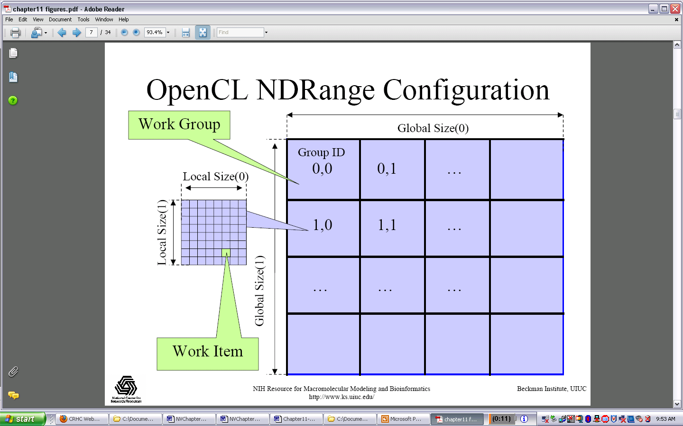
Multidimensional Work Indexing

Slide 12
OpenCL Data Parallel Model Summary
Parallel work is submitted to devices by launching kernels
Kernels run over global dimension index ranges (NDRange), broken up into “work groups”, and “work items”
Work items executing within the same work group can synchronize with each other with barriers or memory fences
Work items in different work groups can’t sync with each other, except by terminating the kernel

Slide 13

The GPU Teaching Kit is licensed by NVIDIA and the University of Illinois under the Creative Commons Attribution-NonCommercial 4.0 International License.

