Slide 1
Module 8.4 – Parallel Computation Patterns (Stencil)
Analyzing Data Reuse in Tiled Convolution

Slide 2
Objective
To learn to analyze the cost and benefit of tiled parallel convolution algorithms
More complex reuse pattern than matrix multiplication
Less uniform access patterns

Slide 3
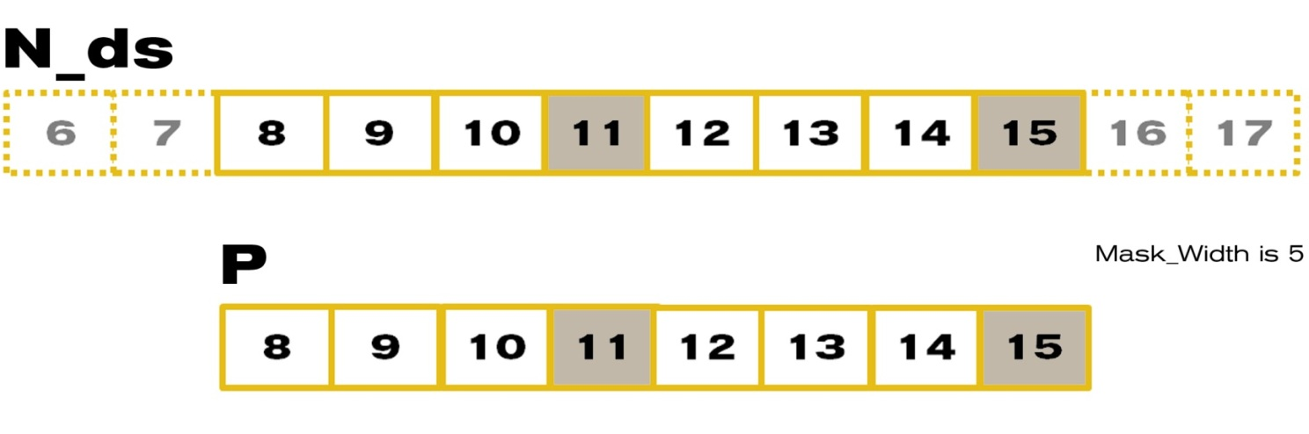
An 8-element Convolution Tile
For Mask_Width=5, we load 8+5-1=12 elements (12 memory loads)

Slide 4
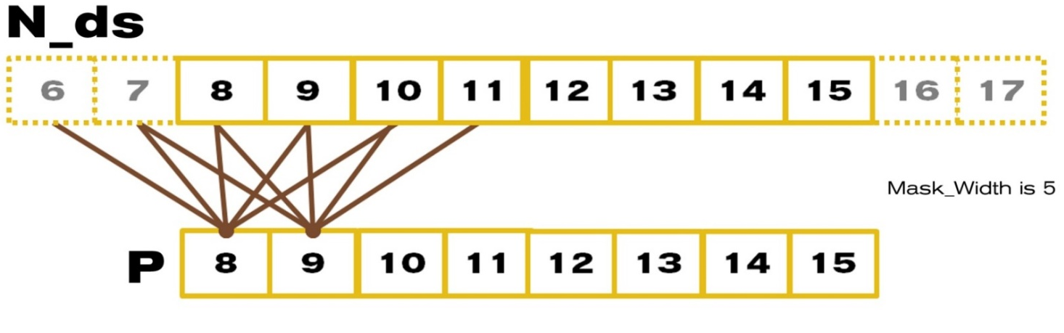
Each output P element uses 5 N elements
P[8] uses N[6], N[7], N[8], N[9], N[10]
P[9] uses N[7], N[8], N[9], N[10], N[11]
P[10] use N[8], N[9], N[10], N[11], N[12]
…
P[14] uses N[12], N[13], N[14], N[15], N[16]
P[15] uses N[13], N[14], N[15], N[16], N[17]

Slide 5
A simple way to calculate tiling benefit
(8+5-1)=12 elements loaded
8*5 global memory accesses replaced by shared memory accesses
This gives a bandwidth reduction of 40/12=3.3

Slide 6
In General, for 1D TILED CONVOLUTION
O_TILE_WIDTH+MASK_WIDTH -1 elements loaded for each input tile
O_TILE_WIDTH*MASK_WIDTH global memory accesses replaced by shared memory accesses
This gives a reduction factor of
(O_TILE_WIDTH*MASK_WIDTH)/(O_TILE_WIDTH+MASK_WIDTH-1)
This ignores ghost elements in edge tiles.

Slide 7
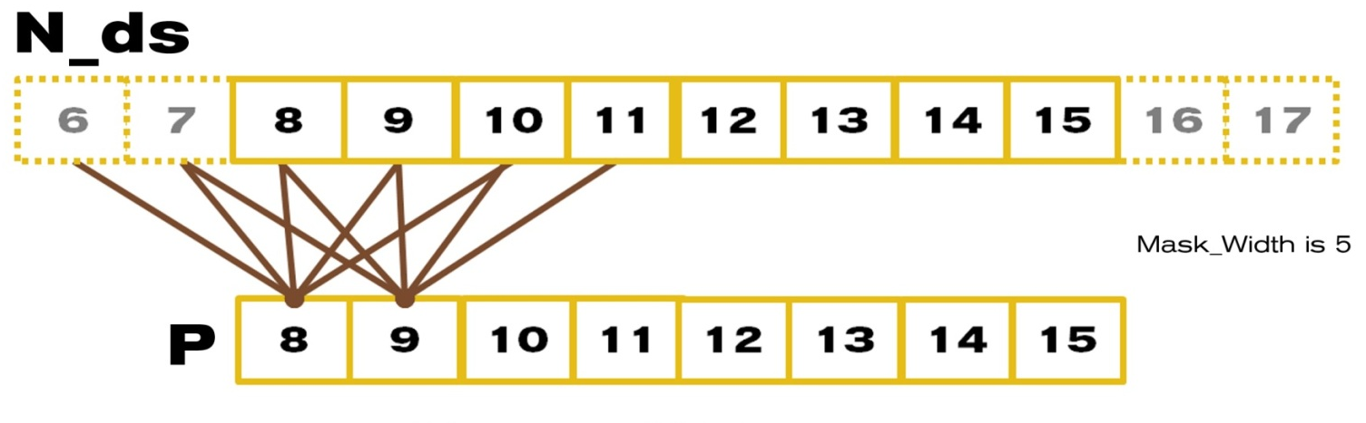
Another Way to Look at Reuse
N[6] is used by P[8] (1X)
N[7] is used by P[8], P[9] (2X)
N[8] is used by P[8], P[9], P[10] (3X)
N[9] is used by P[8], P[9], P[10], P[11] (4X)
N10 is used by P[8], P[9], P[10], P[11], P[12] (5X)
… (5X)
N[14] is used by P[12], P[13], P[14], P[15] (4X)
N[15] is used by P[13], P[14], P[15] (3X)

Slide 8
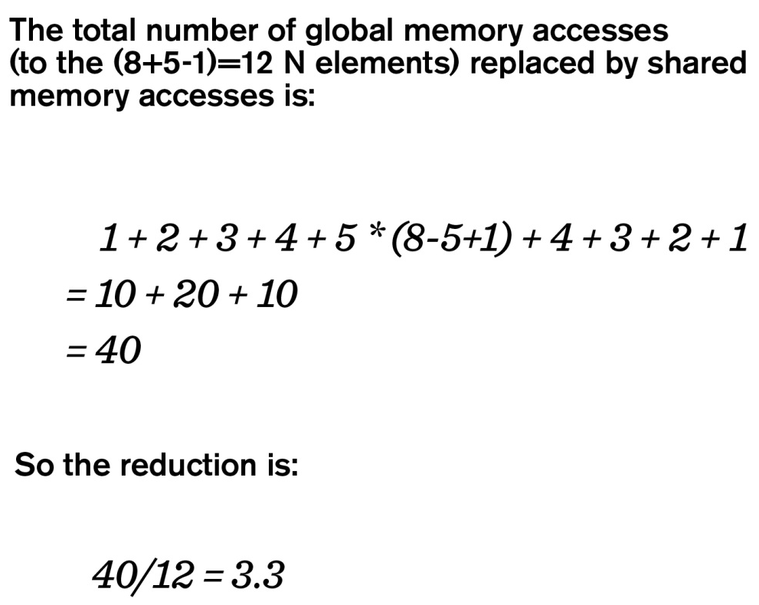
Another Way to Look at Reuse

Slide 9
In General, for 1D
The total number of global memory accesses to the input tile can be calculated as
1 + 2+…+ MASK_WIDTH-1 + MASK_WIDTH*(O_TILE_WIDTH-MASK_WIDTH+1) + MASK_WIDTH-1 + …+ 2 + 1
= MASK_WIDTH * (MASK_WIDTH-1) + MASK_WIDTH *
(O_TILE_WIDTH-MASK_WIDTH+1)
= MASK_WIDTH * O_TILE_WIDTH
For a total of O_TILE_WIDTH + MASK_WIDTH -1 input tile elements

Slide 10
Examples of Bandwidth Reduction for 1D
The reduction ratio is:
MASK_WIDTH * (O_TILE_WIDTH)/(O_TILE_WIDTH+MASK_WIDTH-1)
O_TILE_WIDTH | 16 | 32 | 64 | 128 | 256
MASK_WIDTH= 5 | 4.0 | 4.4 | 4.7 | 4.9 | 4.9
MASK_WIDTH = 9 | 6.0 | 7.2 | 8.0 | 8.5 | 8.7

Slide 11
For 2D Convolution Tiles
(O_TILE_WIDTH+MASK_WIDTH-1)² input elements need to be loaded into shared memory
The calculation of each output element needs to access MASK_WIDTH² input elements
O_TILE_WIDTH² * MASK_WIDTH² global memory accesses are converted into shared memory accesses
The reduction ratio is
O_TILE_WIDTH² * MASK_WIDTH² / (O_TILE_WIDTH+MASK_WIDTH-1)²

Slide 12
Bandwidth Reduction for 2D
The reduction ratio is:
O_TILE_WIDTH² * MASK_WIDTH² / (O_TILE_WIDTH+MASK_WIDTH-1)²
O_TILE_WIDTH | 8 | 16 | 32 | 64
MASK_WIDTH = 5 | 11.1 | 16 | 19.7 | 22.1
MASK_WIDTH = 9 | 20.3 | 36 | 51.8 | 64
Tile size has significant effect on of the memory bandwidth reduction ratio.
This often argues for larger shared memory size.

Slide 13
The GPU Teaching Kit is licensed by NVIDIA and the University of Illinois under the Creative Commons Attribution-NonCommercial 4.0 International License.

