Slide 1
My Password Manager
A password storing application
- By Jon antonopoulos

Slide 2
FEATURES
Created with C#, supports Windows.
Stores credential sources, along with their associated usernames and passwords.
Credentials are stored in a local SQLite file.
Passwords are encrypted via a unique value assigned to Windows users.
Supports adding, editing, and deleting.

Slide 3
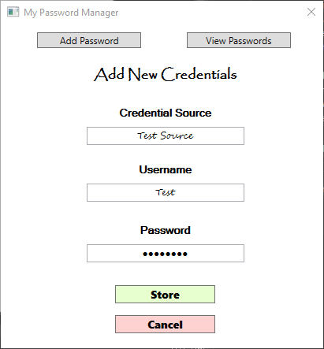
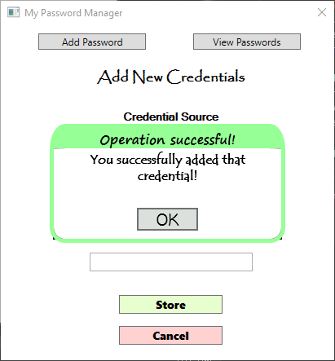
ADDING CREDENTIALS

Slide 4
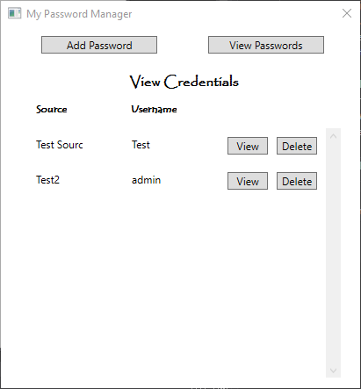
VIEWING CREDENTIALS

Slide 5
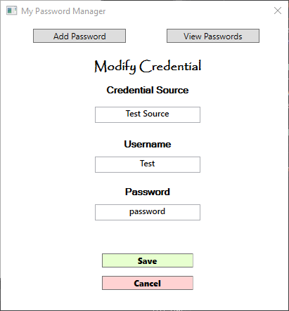
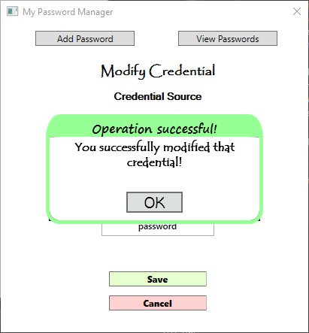
MODIFYING CREDENTIALS

Slide 6
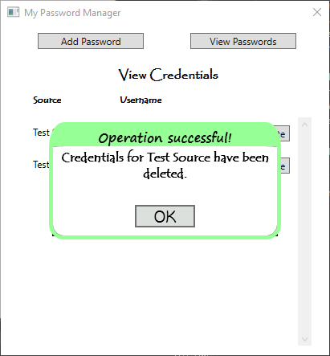
DELETING CREDENTIALS

