Slide 1

BUILDING STRUCTURES FROM SCRATCH
Build a CNT+Water pdb/psf using VMD
Jordi Faraudo
jfaraudo@icmab.es

Slide 2
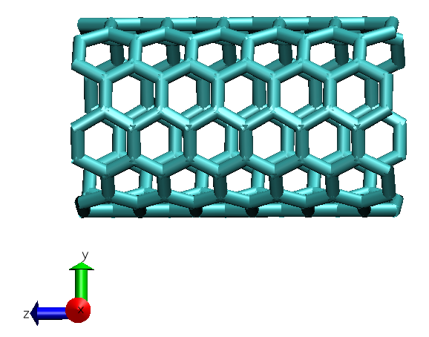
Step 1
Build a (6,6) Nanotube of 1.4 nm length using VMD Nanotube builder.
Using the Tk console, determine min and max coordinates, center the coordinates of the nanotube and save the data in pdb and psf files
(when saving data always check your folder with pwd in the tk console and move to the desired folder with the cd command)

Slide 3
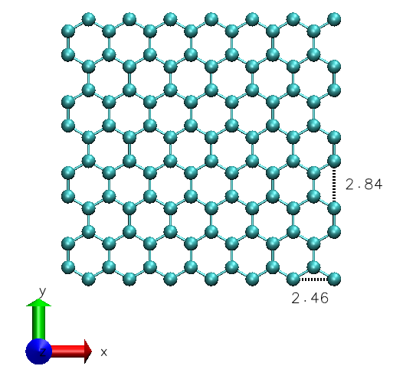
Step 2
Build a 1.5 x 1.5 nm length armchair graphene sheet using VMD Nanotube builder.
Using the Tk console, determine min and max coordinates, center the coordinates of the sheet and save the data in pdb and psf files
15.964 Å
15.598 Å
PERIODIC CELL: a= 17.194, b=17.018

Slide 4
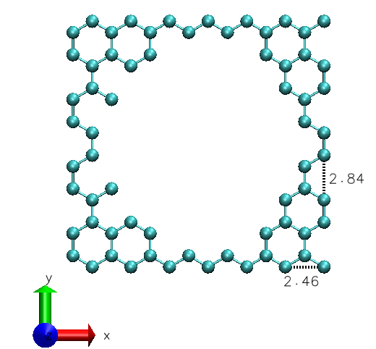
Step 3
Using the Tk console, make a hole in the sheet of the size of the CNT (remove atoms within x*x+y*y<36) and save the data in pdb and psf files
15.964 Å
15.598 Å
PERIODIC CELL: a= 17.194, b=17.018

Slide 5
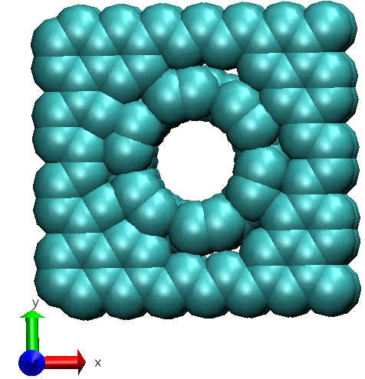
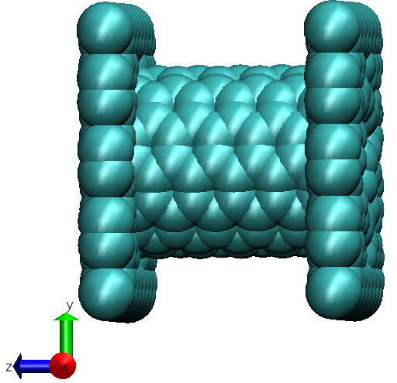
Step 4
Using the Tk console, move the sheet to the position corresponding to one end of the CNT and save pdb and psf files. Repeat again saving another sheet which fits to the other end of the tube.
Merge all pdb/psf files of the tube and the two ends in a single file using the VMD option Modelling – Merge structures
PERIODIC CELL: a= 17.194, b=17.018

Slide 6
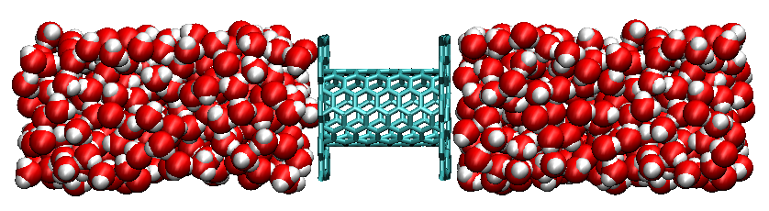
Step 5
Using VMD – Modelling – Add Solvation Box add water from –a/2 to a/2, -b/2 to b/2 and -40 to +40
Obtain a system like the one in the image. To this end, in the Tk console remove undesired water and save pdb and psf files.
PERIODIC CELL: a= 17.194, b=17.018, c=80

