Slide 1
RFIDefence (Group 11)
Jake Mecimore, Fiacre Indagiye, Charles Valdez , Justin Farkas

Slide 2
Summary of the Project
RFID reader that can be used to give access to the house if the user has a registered RFID
Not only will the system allow its users to easily gain access to their house, but it will also notify them is someone that is unauthorized tries to use the system. Using an app that also provides them with a current state of the door
The administrator will have access to logs and the state of the doors. He will also be incharge of registering new users.

Slide 3
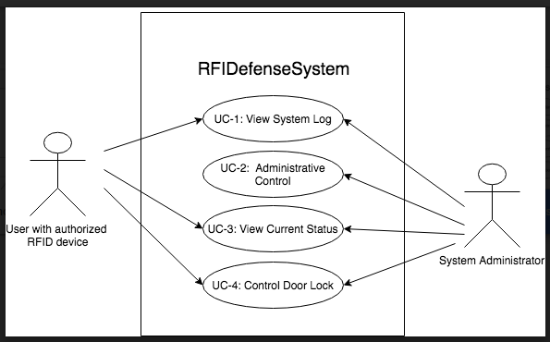
UML

Slide 4
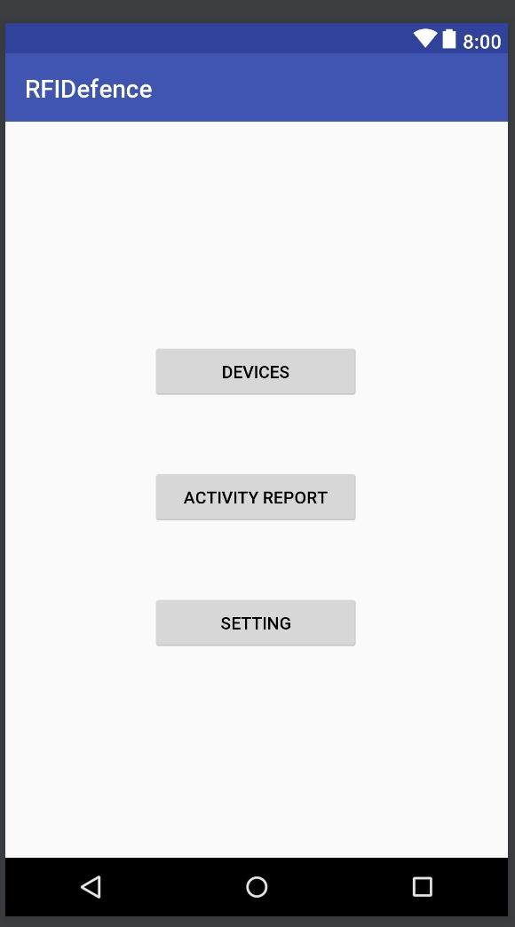
Mobile Application
Once registered on the mobile application, you have the option to devices registered to the system, view the system activity log, or choose custom settings for the system.

Slide 5
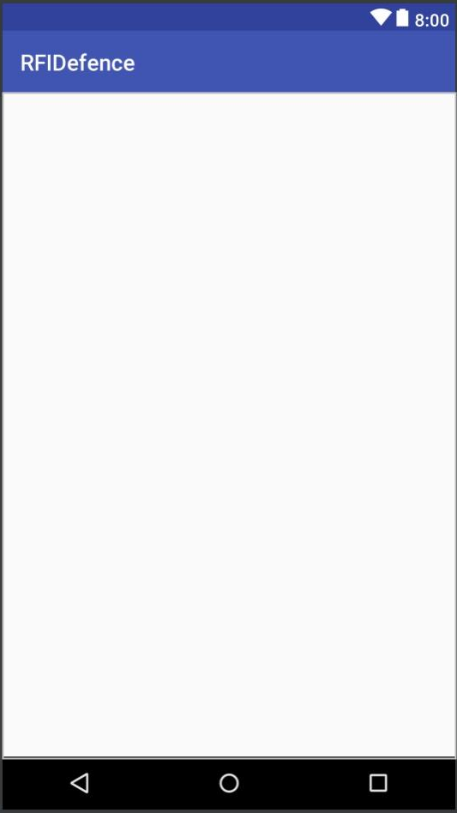
Activity Log
The activity log is where all system activity is stored.
Registered users can look here to review how the system has been used.

Slide 6
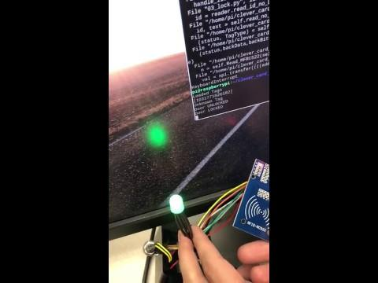
Demo (Unregistered RFID)
Scans unregistered RFID, keeps the door locked and saves the log for the Admin

Slide 7
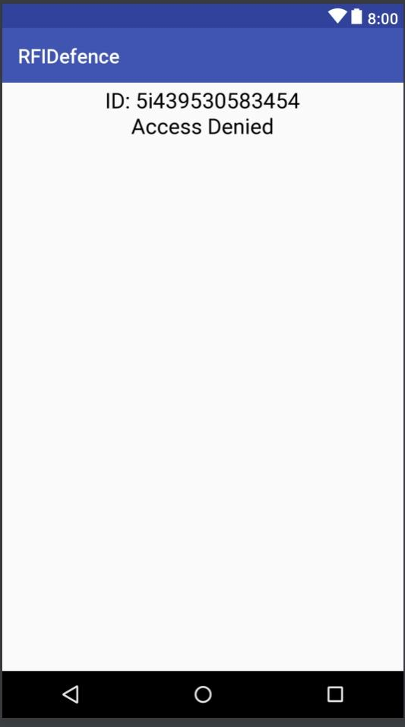
Log After Denied Scan
When an unregistered RFID device is scanned, the door remains locked.
The activity is still logged to the activity log and the system administrator is notified by push notification.

Slide 8
Demo (Registered RFID)
Scans Registered RFID, Unlocks door and saves logs

Slide 9
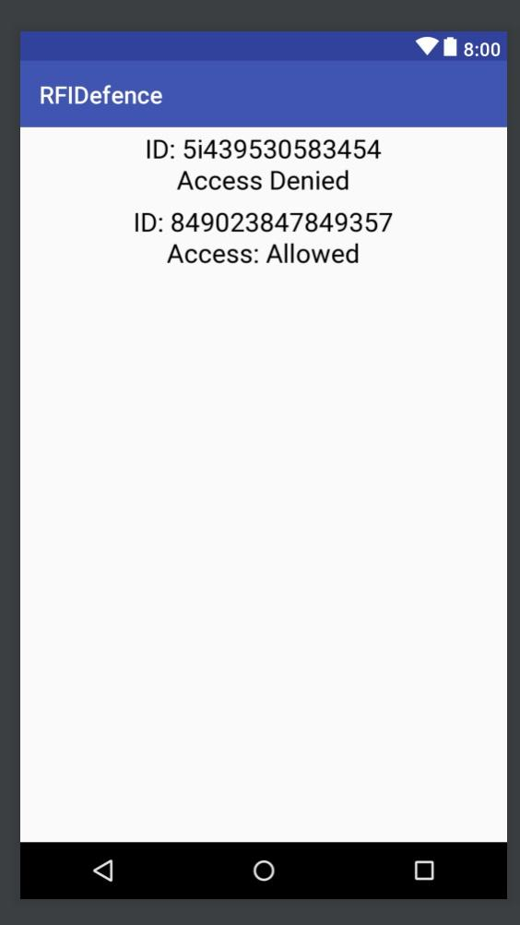
Log After Both Scans
When a registered RFID device is scanned, the door is unlocked. The system waits for 10 seconds, after which it will automatically lock the door.
The authorized activity is added to the log.

Slide 10
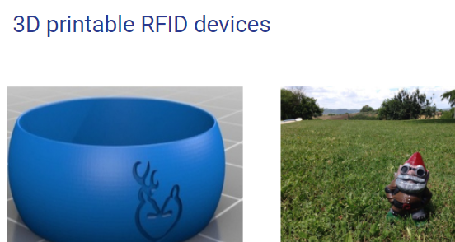
Sprint 1 Screen
3D RFID devices that are used in everydaylife to help the user have an easier time unlocking the door.

Slide 11
Things left to Do
Connect multiple doors to the system
Improve mobile application design
Look into customizable RFID devices

