Slide 1


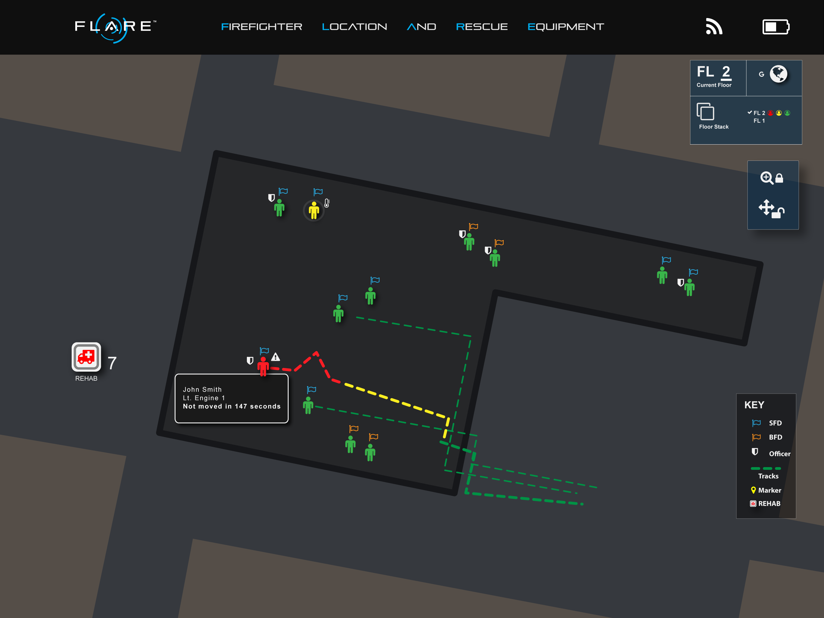
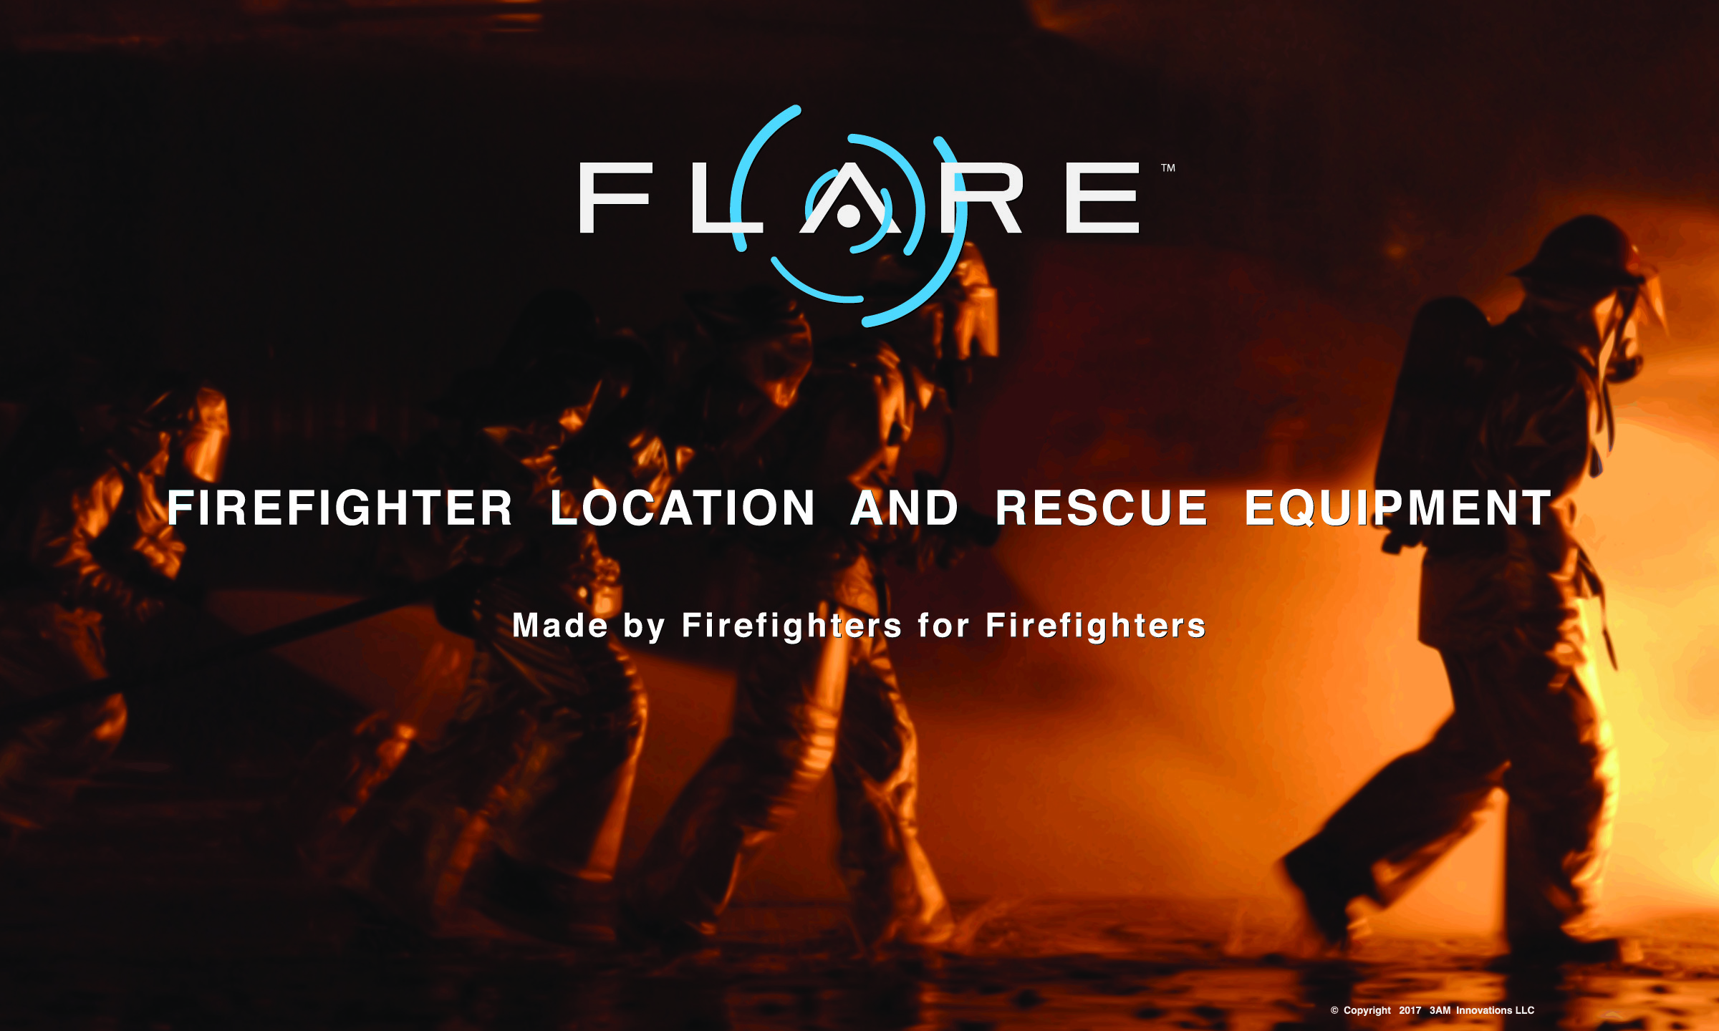
Saving the Brave,
Who Sacrifice for Others!
Patrick@3amInnovations.com | www.3amInnovations.com
Direct: +1.716.909.1956 | 640 Ellicott St, Suite 499 Buffalo, NY 14203

Slide 2


Many people do not realize that the current tech used to track firefighters is inadequate. A pair of dog tags and a white board is not enough to ensure the safety of our brave men and women, who put their lives on the line.
3AM (www.3aminnovations.com) has developed new technology that will not only track the location of firefighters while in the building but provide industry tailored alerts to the commanding officer. Allowing for greater situational awareness and speed in actions taken if rescue efforts are needed.
- Patrick O’Connor, Chairman & CEO
3AM is about to change the fire industry forever with the launch of FLARE – Firefighter Location And Rescue Equipment.

