Slide 1
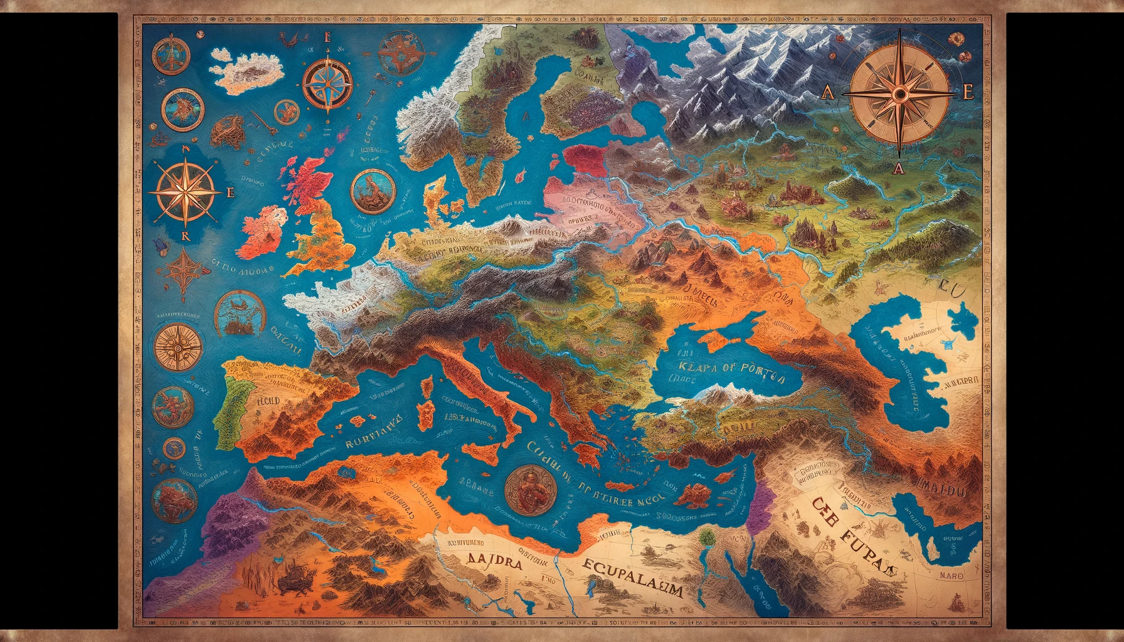
53
52
60
51
63
61
59
54
50
49
62
58
55
48
57
56
47
40
41
42
46
39
43
44
45
24
35
25
22
23
38
37
36
26
21
34
27
33
32
20
31
30
28
19
15
14
29
18
16
12
17
13
11
10
9
8
6
7
5
4
3
2
1
Notes:
2: you have to cross a river skip a turn
7: a friend has a boat you can use, go to 10
11: the Turkish border patrol caught you trying to climb over a fence, pay a fine of €40
13: you tried to climb a mountain but fell down go back to 10
14: you succesfully climbed the mountain but you fell and rolled down go to 17
18: a kind lady gifted you €30
22: the Romanian customs caught you trying to get into the country, you need a visa to move on
26: you took a taxi to your destination but he went the wrong way go back to 24 and pay €20
29: you sneaked into a truck, go to 34
33: you got hit by a car, skip 1 turn
36: you want to get into france but your pasport is not strong enough you need a visa to move on
39: when walking in paris a man robbed you, you managed to keep half your money the other half was stolen
41: the German customs caught you trying to sneak into Germany you need 2 visa’s to move on
45: the police caught you trying to pickpocket someone you go to jail and skip 2 turns
48: a trucker helped you to cross the border go to 51
53: when crossing a river you fell in now you have to buy new clothes you lose €40
59: you ran from the police and you attacked a police officer you got shot go back to start
62: the IND knows your in the country illigally hide! Skip 3 turns
63: you arrived in ter Apel

