Slide 1
Massive 3D Depositor Senior Capstone Design
Josh Booth, Dillon LaBonte, Caleb Coldsmith
Notes:
Talk about niche in the market
Our design requirements
Initial concepts
Some analysis
Caleb

Slide 2
Traditional 3D Printing
Pros
Cons
Rapid production
Low machine cost
Low per-unit cost
Wide availability
Low size footprint
Dimensionally inaccurate
±0.1mm vs ±0.005mm for CNC
Limited object size
Low strength
Low temperature
Notes:
Josh

Slide 3
Market Analysis
 | Max Extruder Temp. | Max Bed Temp. | Max Chamber Temp. | Build Volume | Price
Average Commercial PEEK Printer | 490 | 193 | 165 | 5.01e7 | 61,000
Intamsys Funmat HT | 450 | 160 | 90 | 1.76e7 | 6,000
Aon-M2+ | 450 | 200 | 135 | 1.30e8 | 50,000
M3DD | 450 | 200 | 80 | 1.12e8 | 2,500
Intamsys Funmat HT
Similar Price
10x smaller build volume
Aon-M2+
Similar build volume
10x price
In 2018, the 3D printing industry was worth 1.5 billion. It is predicted to be worth 3.78 billion by 2026
3D printing is expanding into medical, automotive, and oil industries
Notes:
Average of comerically available printers
Intamsys Funmat HT is the most like ours in terms of price, but note the build volume is 10x smaller
Aon-M2+ is most like ours in terms of size, but not the price
Josh

Slide 4
Design Requirements
Functional Requirements
User Experience Requirements
Respond to movement commands in the X, Y, Z, and extruder directions
Heat nozzle to 450 °C, bed to 200 °C, chamber to 80 °C
Print all common filament types without heated chamber
Can print PEEK/PSU object
Print volume of 300x280x1330mm
Operate at maximum chamber temperature for 3 days continuously
User can monitor and control temperature and movement locally through an LCD
Through a web interface, the user can:
Control nozzle, bed, and chamber temp
Control X, Y, Z, and E movement
Send commands
Start, stop, and monitor prints
View print through real-time stream
Usability Requirements
System can operate on a local 20A breaker without heated chamber and with a heated chamber on 3 separate 20A circuits
Will have thermal protection for the nozzle, heated bed, and chamber
System will have fused connections in the event of a short
Notes:
Dillon

Slide 5
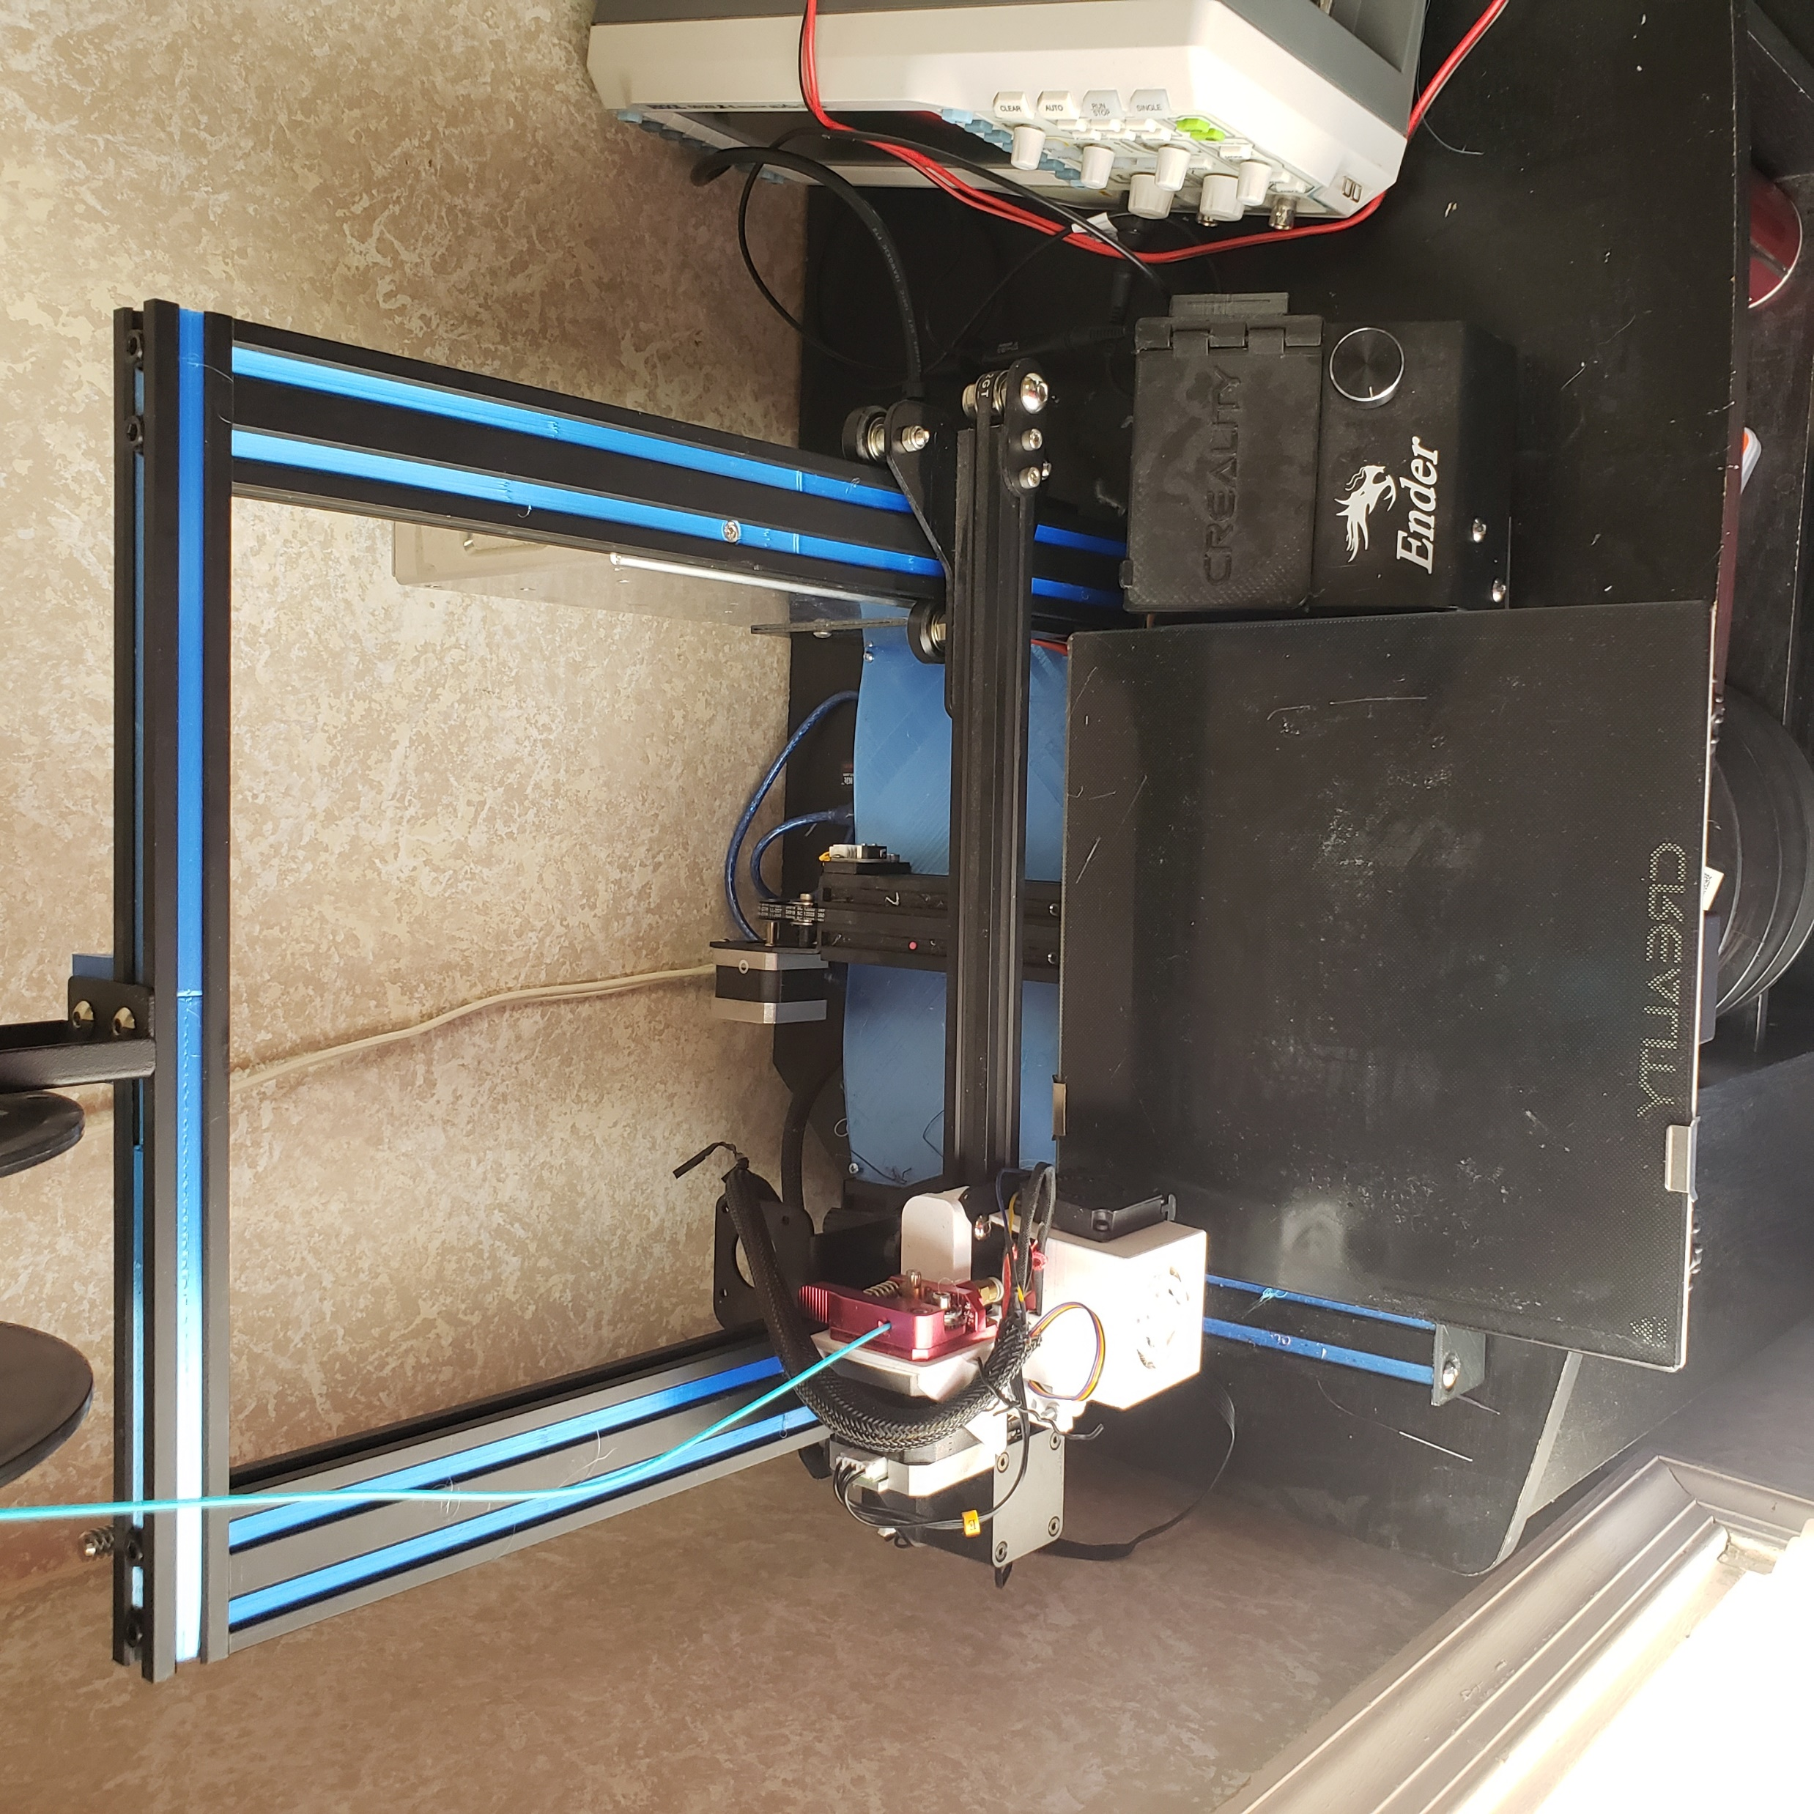
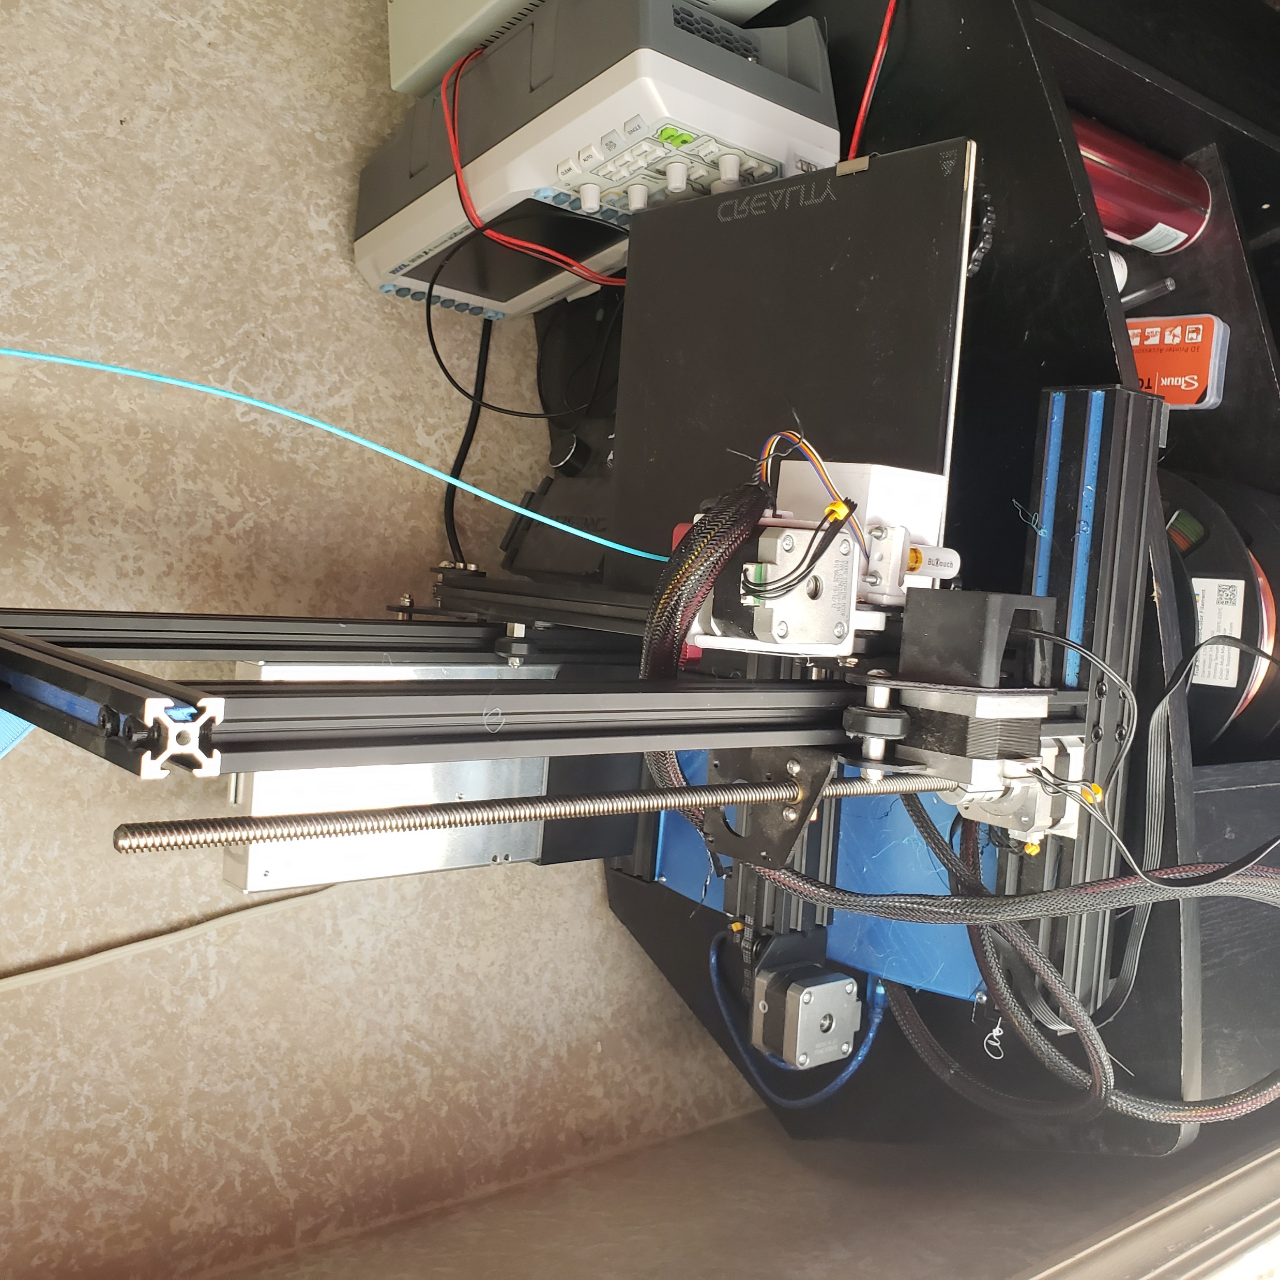
Initial Concept Generation
Cartesian system
Belt/pulley combination with counterweight for Z-axis
Fail-safe latches at top and bottom of printer to prevent bottoming-out
Mount motors outside heated chamber, cool other motors with Peltier Plates
Space heater heating element
Surrounded by insulation
Notes:
Josh

Slide 6
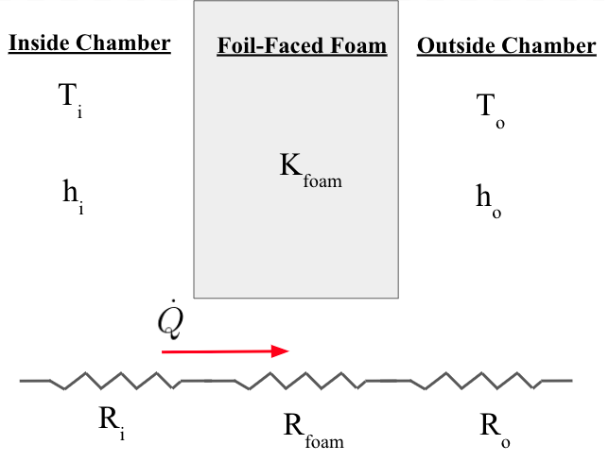
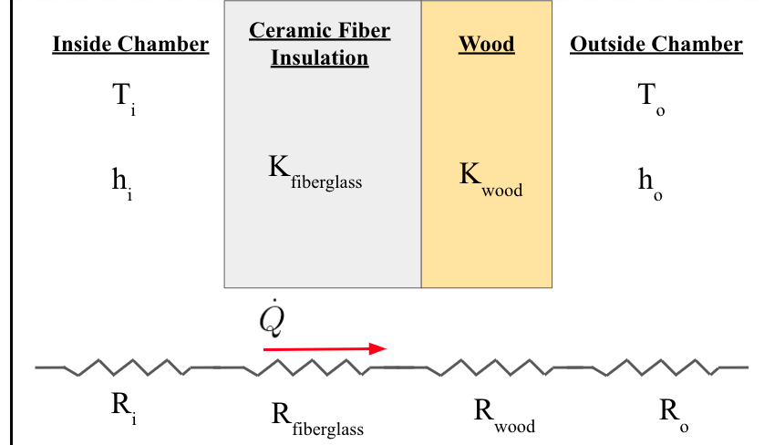
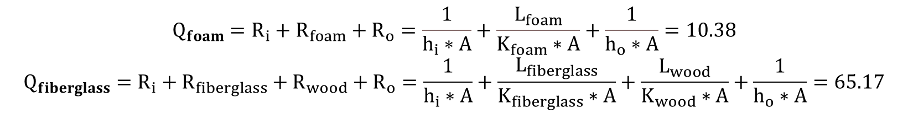
Preliminary Thermal Analysis
Variable | Value | Units | Name
T­_{i} | 80 | C | Temperature inside
T_{­o} | 22.2 | C | Temperature outside
C_{height} | 1.651 | m | Chamber height
C_{width} | 0.535 | m | Chamber width
C_{length} | 0.648 | m | Chamber length
A | 1.069 | m­­² | Cross-sectional area
L_{foam} | 0.1524 | m | Foam depth
L_{fiberglass} | 0.0254 | m | Fiberglass depth
L_{wood} | 0.00635 | m | Wood depth
h_{o} | 12 [9] | W/m²⋅K | Heat transfer coefficient outside
h_{i} | 120 [10] | W/m²⋅K | Heat transfer coefficient inside
K_{foam} | 0.026 [11] | W/m⋅K | Foam thermal conductivity
K_{fiberglass} | 0.0316 [12] | W/m⋅K | Fiberglass thermal conductivity
K_{wood} | 0.12 [13] | W/m⋅K | Wood thermal conductivity
$$Q_{foam}=R_{i}+R_{foam}+R_{o}=\frac{1}{h_{i}∗A}+\frac{L_{foam}}{K_{foam}∗A}+\frac{1}{h_{o}∗A}=10.38$$
$$Q_{fiberglass}=R_{i}+R_{fiberglass}+R_{wood}+R_{o}=\frac{1}{h_{i}∗A}+\frac{L_{fiberglass}}{K_{fiberglass}∗A}+\frac{L_{wood}}{K_{wood}∗A}+\frac{1}{h_{o}∗A}=65.17$$
Notes:
Dillon u can take this slide. Modify it if u think there’s too much/too little information

Slide 7
Next steps
Assemble movement system in frame
Get working 3D printer without build chamber
Perform more complete thermal analysis on heating element
Notes:
Caleb

