Slide 1
HappyTime Restaurant
Group 6
Jiongfeng Chen
Yuanyuan Jia
Xiaotong Wang
Xing Yang
Xingxing Ju
https://docs.google.com/presentation/d/1nL4UbZW2imUe32zwIbwSGSzOir57_Upp8E8tIap6zz4/edit#slide=id.g13e2d754ea_1_0

Slide 2

Techniques
MEAN
MongoDB
Express.js
Angular.js
Node.js
RESTful API between FrontEnd Heroku and Backend AWS.
reference: https://thinkster.io/mean-stack-tutorial
Notes:
MEAN is a free and open-source JavaScript software stack for building dynamic web sites and web applications.^{[1]}
are known to synergize well together.
The major benefit of the MEAN stack is that it's extremely quick to prototype with. Node.js allows you to use Javascript on the backend as well as the frontend which can save you from having to learn a separate language.
In addition, the NoSQL nature of MongoDB allows you to quickly change and alter the data layer without having to worry about migrations, which is a very valuable attribute when you're trying to build a product without clear specifications. Finally, these technologies have a lot of community support behind them so finding answers to questions or hiring help is going to be much easier using these technologies.
The MEAN stack makes use of MongoDB, Express.js, Angular.js, and Node.js. Because all components of the MEAN stack support programs written in JavaScript, MEAN applications can be written in one language for both server-side and client-side execution environments.

Slide 3
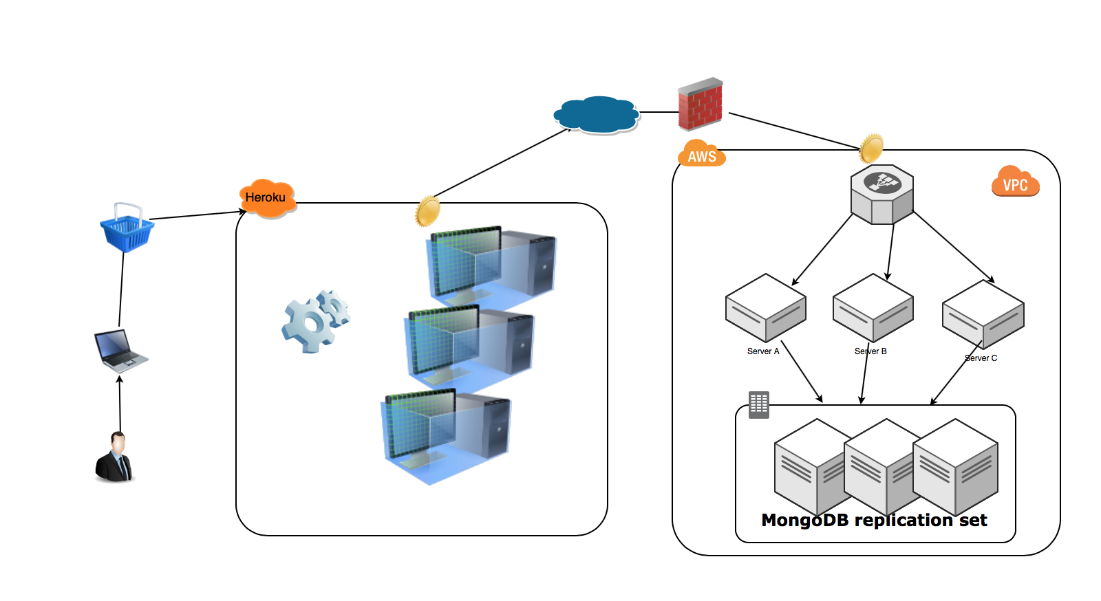
Architecture

Slide 4
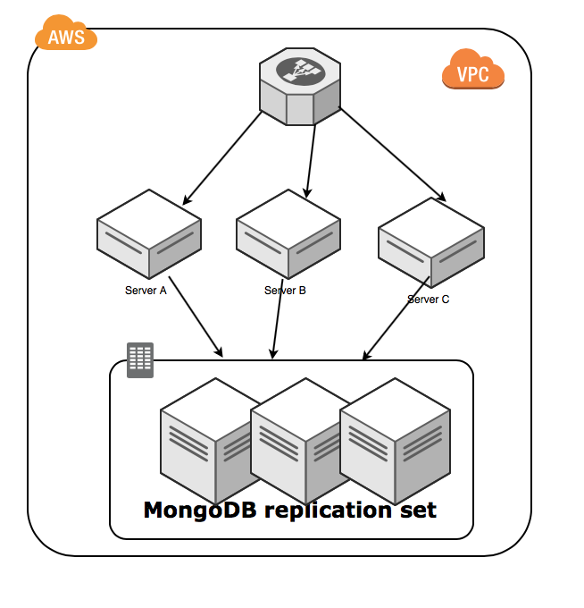
Scaling Strategy
Database Engine Server Replication
through load balancer
MongoDB replication set

Slide 5
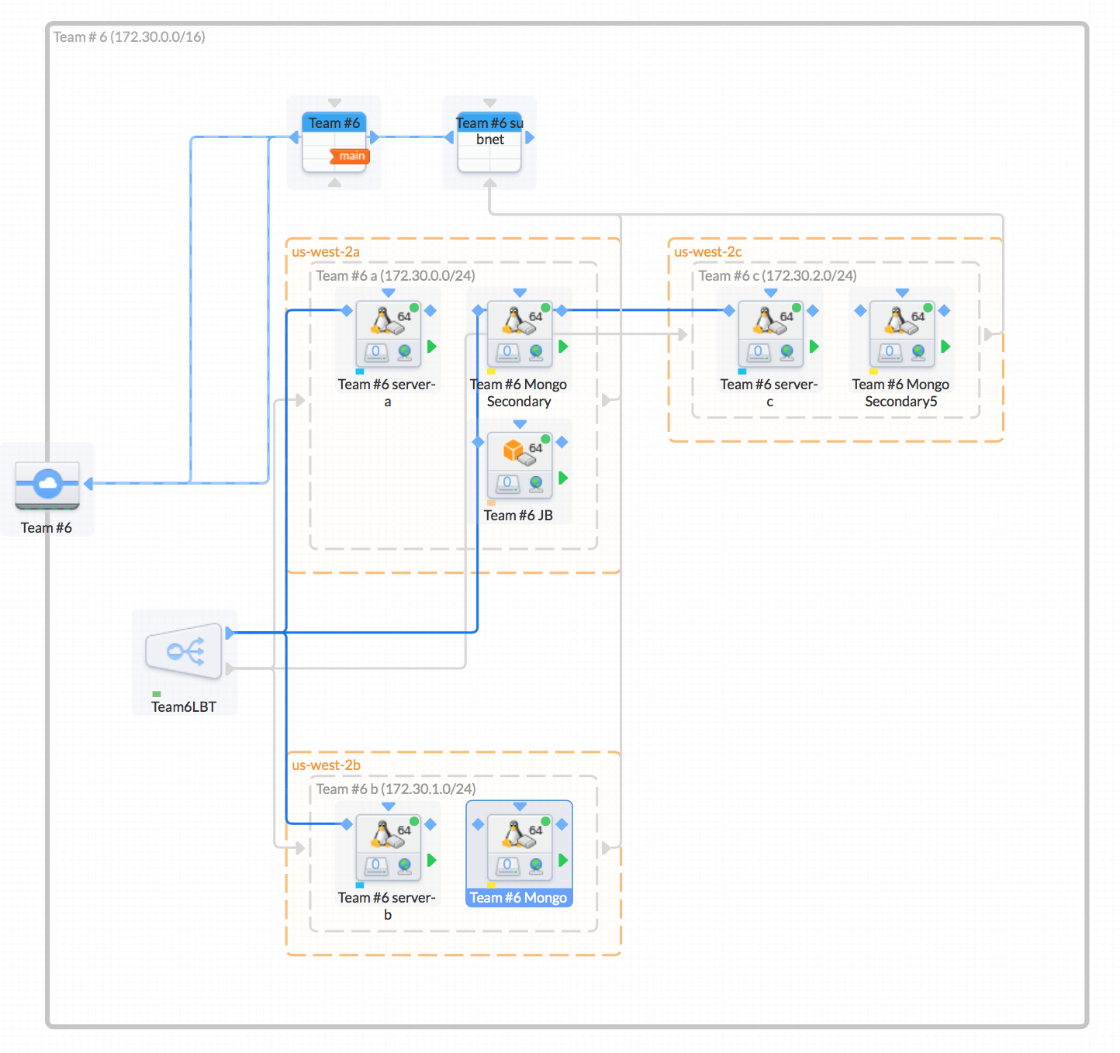
Configuration on AWS
EC2
VPC
Subnet
Load Balancer

Slide 6
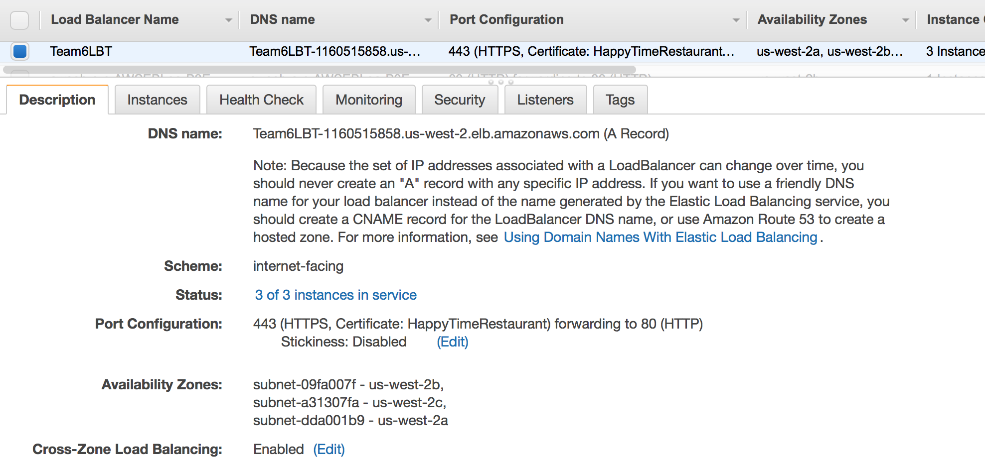
Security
MongoDB Authentication
HTTPS ELB
HTTPS calls
with self-signed
Certification between
Heroku and AWS
Security Group
VPC

Slide 7
Thanks!

