Slide 1
Tariff Prediction Application
Jack Demtshuk
Joscelin Montoya-Rojas
Adam Zorgo

Slide 2
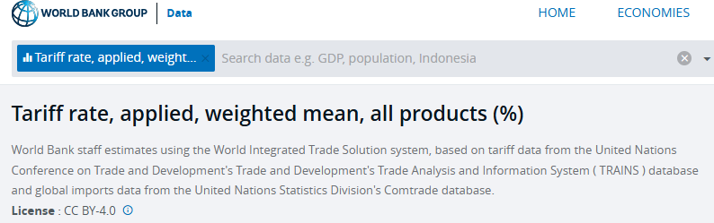
Our Dataset
We retrieved the dataset from World Bank Group. Our dataset details the mean tariff rate of imported goods to the United States from other countries for every year 1960-2024

Slide 3
Preprocessing and Cleaning
Our dataset had many years that were missing data entirely, and other years where certain countries were missing data. We resolved this in this stage of development by:
Removing years that had no, or next to no, data at all
Filling missing country data of certain years with the previous year’s data

Slide 4
Models
We used three different models to predict the next year’s mean tariff rate for each country.
Linear Regression
Gradient Boost
Random Forest

Slide 5
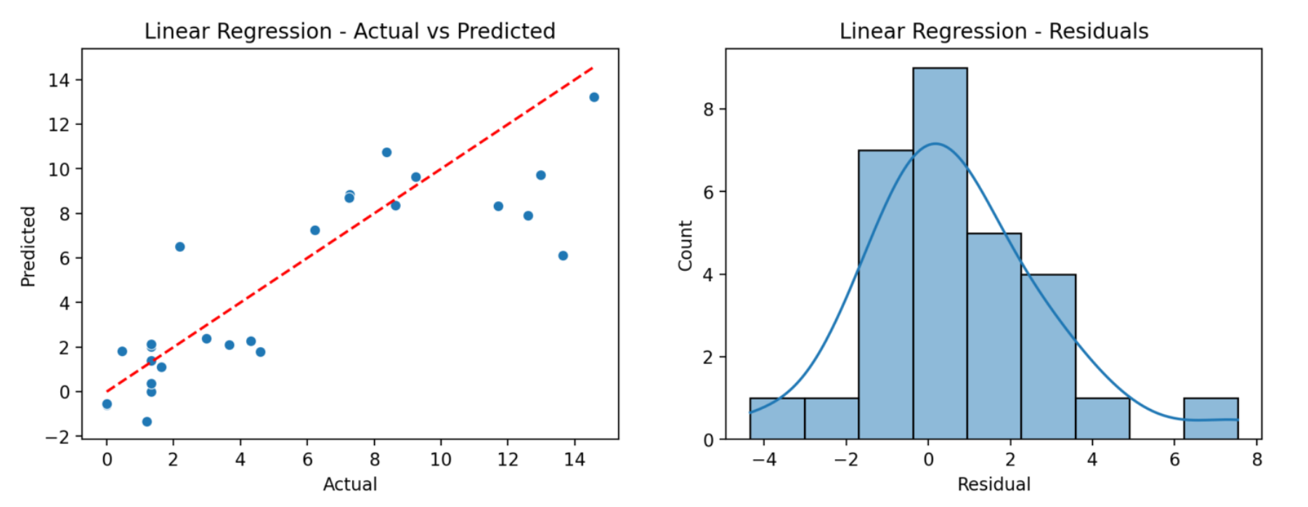
Linear Regression

Slide 6
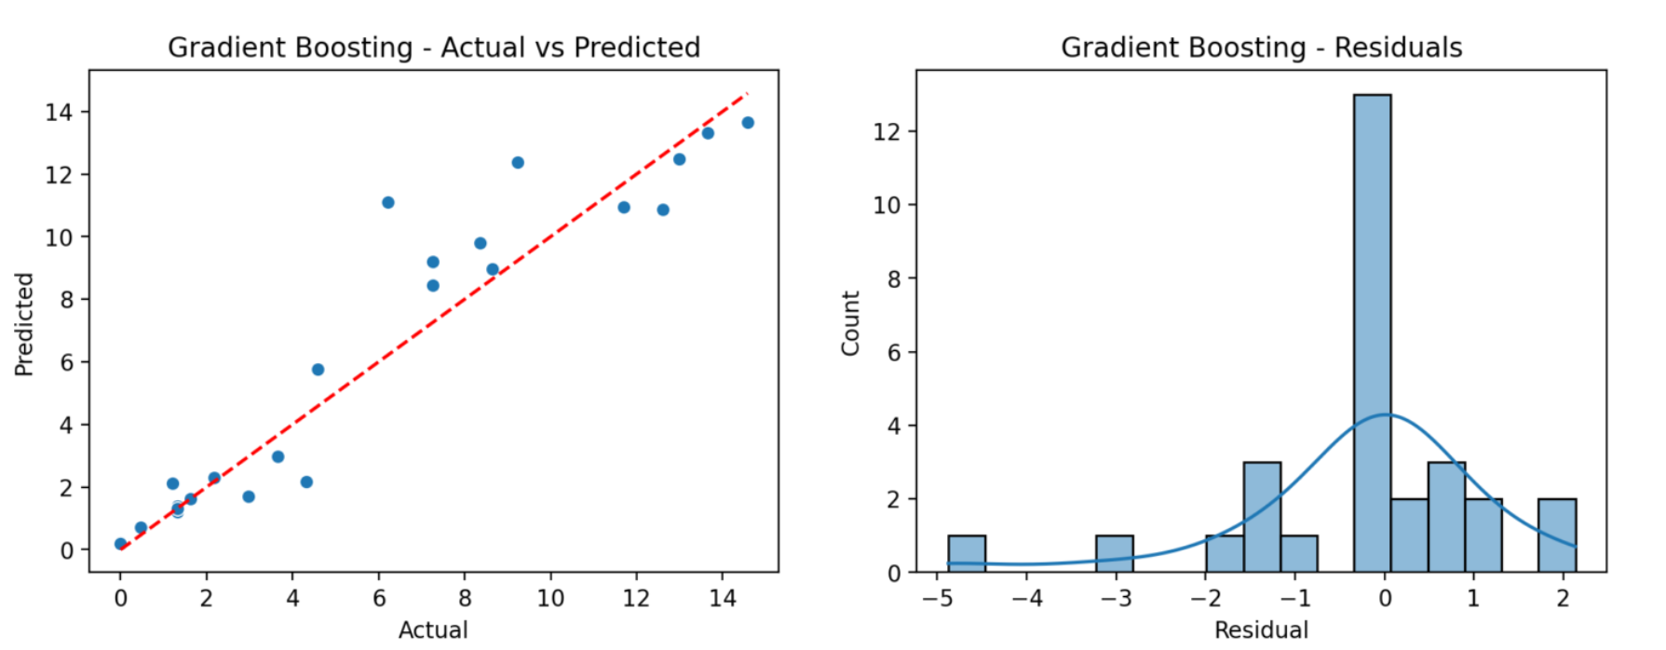
Gradient Boost

Slide 7
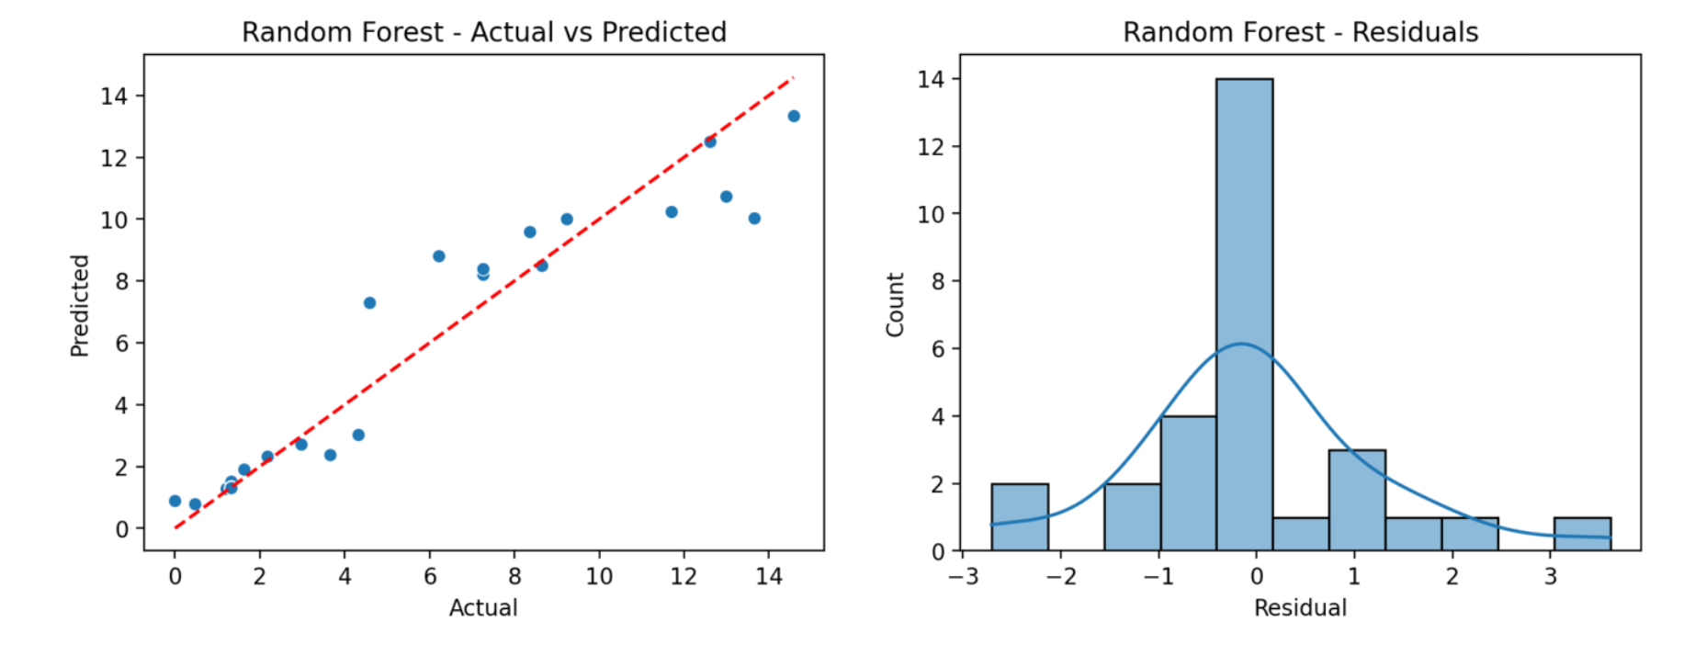
Random Forest

