Slide 1
Executive Summary
Daniel – Khairul - Agus

Slide 2
Have you ever strolled around your neighborhood,
try to enjoy the scenery,
BUT then you saw this ……

Slide 3
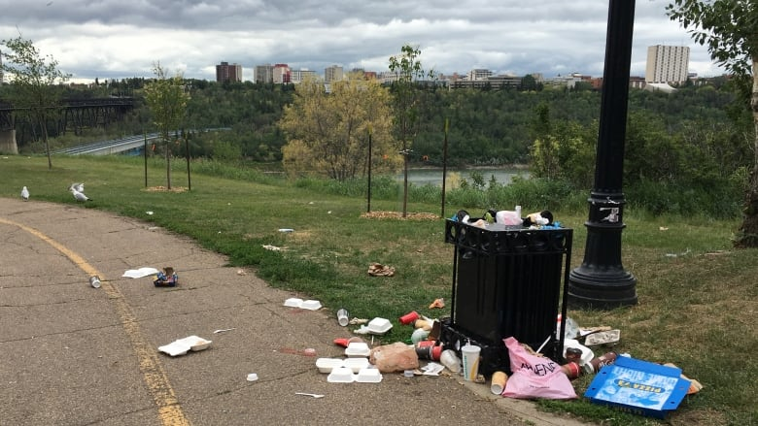

Slide 4
Garbage collection with one schedule fits all has failed,
and leave us with scattered trash

Slide 5
Perhaps you might have also seen
this irony ……

Slide 6
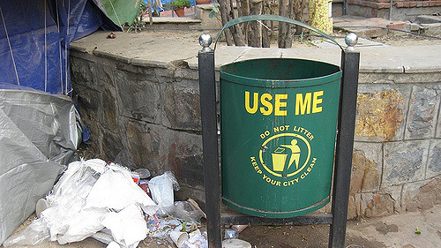

Slide 7
People are not motivated to bin the garbage properly

Slide 8
What should we do ?

Slide 9
Fear Not!
It’s time to meet Billy.

Slide 10
Billy / Bin It Happily
Waste management unlike any other
Notify related parties for garbage collection from lesser collection points
Put a smile on our face with rewards to be a better person everyday in keeping our environment clean

Slide 11
Why waste management ?

Slide 12
Global Waste Management Market / Overview
Expected to grow to $435 billion by 2023. Compound annual growth rate (CAGR) of 6.2 percent from 2017 to 2023
The majority of the growth in the emerging regions of Asia-Pacific
Rise in environmental concerns along with inevitable increases in non-hazardous waste from rapid economic growth

Slide 13
How do we nurture Billy ?

Slide 14

Embryo Billy
Waste Photo
Detect Labels
Store Results
Responsive web application
Basic end-to-end flow within AWS infrastructure
Process flow:
Capture a garbage photo
Post the photo to the backend API together with a random dummy location ID
AWS Rekognition detects labels
The detection result is stored
Return the detection result for statistics display

Slide 15




Embryo Billy / High Level Architecture
Smartphone
AWS Cloud
IoT Things
Camera
Camera
Camera
Billy

Slide 16












Embryo Billy / Detail Architecture
AWS Cloud
Static website
Access Control
Raw Image
S3
Amazon Cognito
S3
AWS Lambda
Amazon Rekognition
Amazon ECS
Amazon CloudFront
Amazon SageMaker
Mobile client
Application Container
Redis
Amazon API Gateway
IoT thing camera

Slide 17
Baby Billy
Responsive web application & IoT devices
Allow general public to register and upload profile photos for Face ID authentication purpose
Process flow:
IoT devices will capture garbage photos
IoT devices will also start recognizing registered users while depositing garbage
Post the photo to the backend API together with a specific location ID configured for each IoT devices
Return the detection result for statistics display
Notify relevant parties based on bin’s volume
Sign Up
IoT Recognize
IoT Capture
Process
Detection Result

Slide 18
Toddler Billy
Mobile application & IoT devices
Locked bin accessible only by registered users
Mechanism to deposit points and redeem rewards
Embrace partnerships for extensive list of rewards
Process flow:
A registered user will be recognized by IoT devices and open the bin
The deposited garbage will be analyzed
Deposit points accordingly
Allow registered users to redeem rewards
Recognize & Open Bin
Analyze Garbage
Points & Rewards Management

Slide 19
Kid Billy
Mobile application, IoT & robotic devices
Recognize unregistered users and offer on-the-spot registration
Able to offer rewards redemption on time-limited offer items
Motorized bin that can move to collection points once reaches its threshold
Embrace opportunities to partner with property management companies or government agencies to optimize garbage collection from lesser collection points
Capture new users
Retain existing users
Optimize adoption
Agility
Optimize collection

Slide 20
Teen Billy
Mobile application, IoT, and robotic devices
Multi compartment bin to support recycling
Recognize recyclable garbage and perform separation
Able to have a chat to offer recycling advice before depositing the garbage
Deposit more points for users who are more aware of recycling the garbage
Notify different parties related to recycling different types of garbage
Recycle
Rewards
Advice
Optimized waste management

Slide 21
Who will nurture Billy ?

Slide 22
Our Team / Overview
Daniel is an AWS Certified Professional with 17 years experiences in software development
Khairul is a developer with 8 years of experience in software development.
Agus is a techno-functional person equipped with 15 years unique combination of technical and management experiences

Slide 23
And first and foremost
we are techie and having fun doing it

Slide 24
The future is bright
and by the way…… Billy says Hi!

