Slide 1
Executive Summary
Daniel – Khairul - Agus

Slide 2
Have you ever strolled around your neighborhood,
try to enjoy the scenery,
BUT then you saw this ……

Slide 3
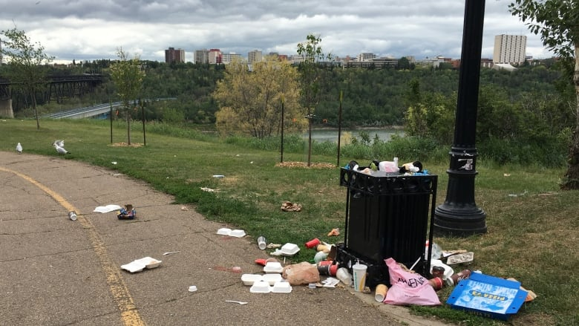

Slide 4
Garbage collection with one schedule fits all has failed,
and leave us with scattered trash

Slide 5
Perhaps you might have also seen
this irony ……

Slide 6
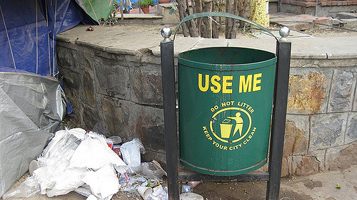

Slide 7
People are not motivated to bin the garbage properly

Slide 8
What should we do ?

Slide 9
Fear Not!
It’s time to meet Billy.

Slide 10
Billy / Bin It Happily
Waste management unlike any other
Notify related parties for garbage collection from lesser collection points
Put a smile on our face with rewards to be a better person everyday in keeping our environment clean

Slide 11
Global Waste Management Market / Overview
Expected to grow to $435 billion by 2023. Compound annual growth rate (CAGR) of 6.2 percent from 2017 to 2023
The majority of the growth in the emerging regions of Asia-Pacific
Rise in environmental concerns along with inevitable increases in non-hazardous waste from rapid economic growth

Slide 12
It is all started with Embryo Billy

Slide 13

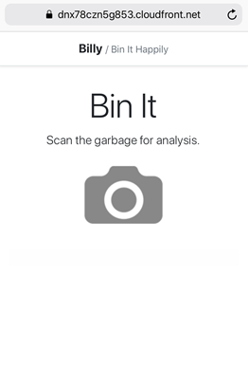
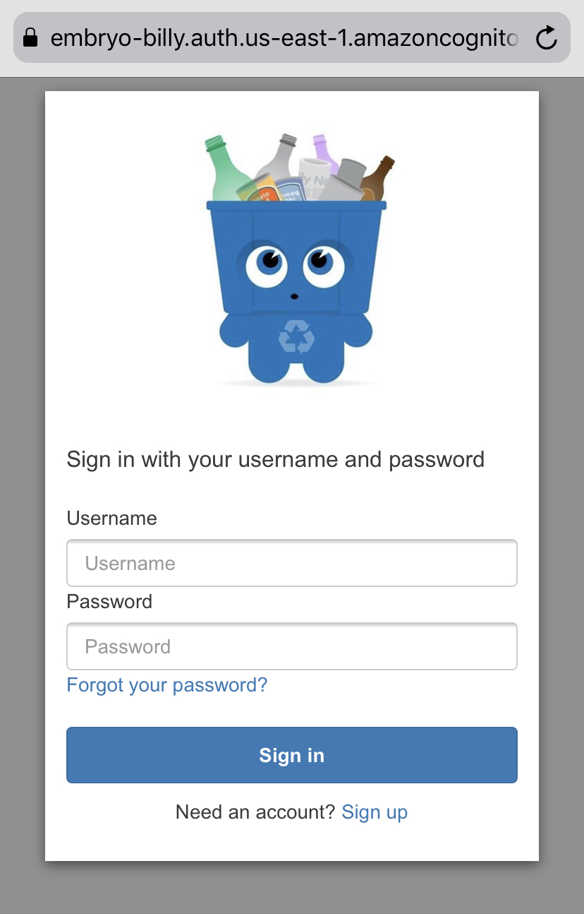
Embryo Billy
Responsive web application
Basic end-to-end flow within AWS infrastructure
Secured by authentication page and processes provided by AWS Cognito
Powered by machine learning to recognize trash type, such as metal, paper, plastic, glass and so on
Consists of two processes that are working asynchronously

Slide 14
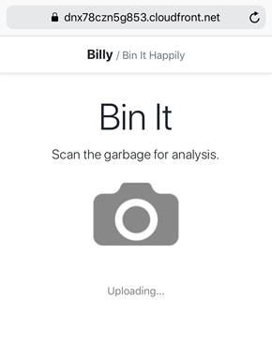
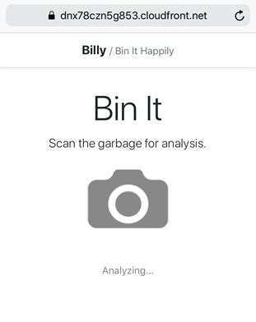
Embryo Billy / First Process
A custom built application is deployed in Amazon ECS together with Redis.
Amazon API Gateway is secured by Amazon Cognito. Amazon API Gateway accepts image upload and query requests to be forwarded to the application endpoint.
The application generates a unique ID for each uploaded images from the front end and returns the ID. That ID is used as the Amazon S3 key for the uploaded images.
The responsive web application will query the result of garbage recognition using the returned ID.

Slide 15
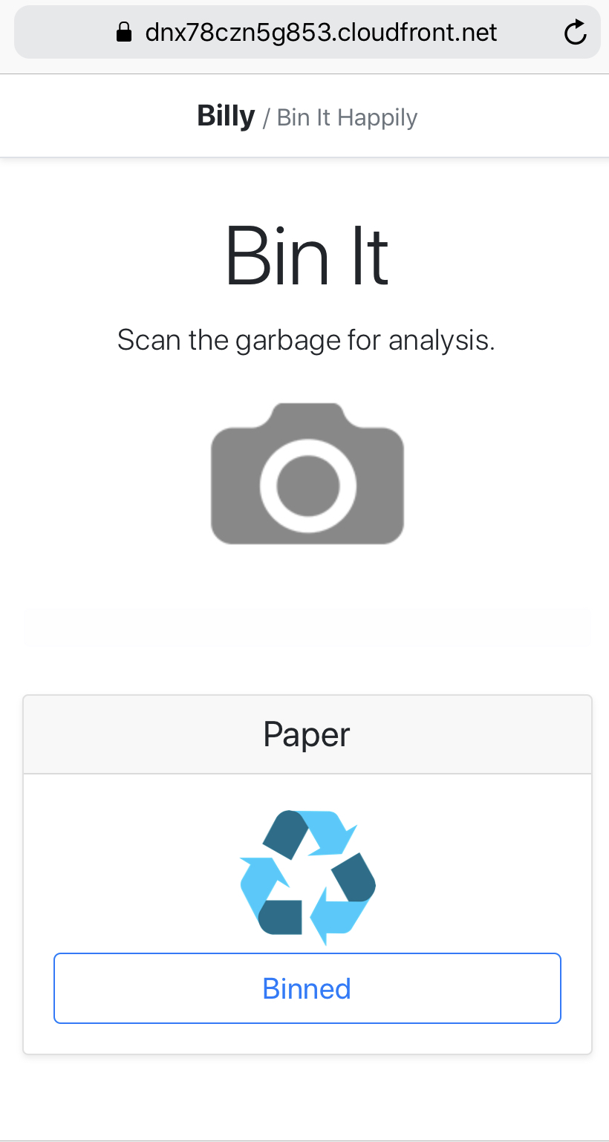
Embryo Billy / Second Process
An event is triggered to AWS Lambda every time an image is stored in Amazon S3’s specific bucket.
The lambda calls AWS Rekognition to detect objects in the respective image and forwarded the labels to AWS SageMaker to predict the garbage category.
K-Nearest Neighbors (k-NN) algorithm is used to build the model in AWS SageMaker.
The prediction consist of 6 garbage categories. Those are trash, plastic, glass, metal, cardboard and paper. Once the lambda gets the prediction result, it stores the result in Redis.

Slide 16




Embryo Billy / High Level Architecture
Smartphone
AWS Cloud
IoT Things
Camera
Camera
Camera
Billy

Slide 17












Embryo Billy / Detail Architecture
AWS Cloud
Static website
Access Control
Raw Image
S3
Amazon Cognito
S3
AWS Lambda
Amazon Rekognition
Amazon ECS
Amazon CloudFront
Amazon SageMaker
Mobile client
Application Container
Redis
Amazon API Gateway
IoT thing camera

Slide 18
Embryo Billy / Repository
Check This Out
https://github.com/jfdaniel77/BILLY---AWS-Hackday-2019.git

Slide 19
How do we nurture Billy moving forward ?

Slide 20
Baby Billy
Responsive web application & IoT devices
Allow general public to register and upload profile photos for Face ID authentication purpose
IoT devices will capture garbage photos and recognize registered users while depositing garbage
IoT devices will post the photo to the backend API together with a specific location ID
Return the detection result for statistics display
Notify relevant parties based on certain criteria, such as bin’s volume, etc.
Sign Up
IoT Recognize
IoT Capture
Process
Detection Result

Slide 21
Toddler Billy
Mobile application & IoT devices
Locked bin accessible only by registered users
Mechanism to deposit points and redeem rewards
Embrace partnerships for extensive list of rewards
Registered users will be recognized by IoT devices and open the bin
The deposited garbage will be analyzed and points will be added to accordingly to registered users
Allow registered users to redeem rewards
Recognize & Open Bin
Analyze Garbage
Points & Rewards Management

Slide 22
Kid Billy
Mobile application, IoT & robotic devices
Recognize unregistered users and offer on-the-spot registration
Able to offer rewards redemption on time-limited offer items
Motorized bin that can move to collection points once reaches its threshold
Embrace opportunities to partner with property management companies or government agencies to optimize garbage collection from lesser collection points
Capture new users
Retain existing users
Optimize adoption
Agility
Optimize collection

Slide 23
Teen Billy
Mobile application, IoT, and robotic devices
Multi compartment bin to support recycling
Recognize recyclable garbage and perform separation
Able to have a chat to offer recycling advice before depositing the garbage
Deposit more points for users who are more aware of recycling the garbage
Notify different parties related to recycling different types of garbage
Recycle
Rewards
Advice
Optimized waste management

Slide 24
Who will nurture Billy ?

Slide 25
Our Team / Overview
Daniel is an AWS Certified Professional with 17 years experiences in software development. Daniel has accumulated most of AWS certification in the past one year and has since been working with AWS services with the main interest in enterprise integration and machine learning.
Khairul is a developer with 8 years of experience in software development. Khairul has been utilizing some of AWS services with the focus in microservices implementation for supporting high volume transactions.
Agus is a techno-functional person equipped with 15 years unique combination of technical and management experiences. In the past 7 years, Agus has developed business solutions for restaurant order management, clinic record management, etc. by leveraging AWS serverless and PaaS services.

Slide 26
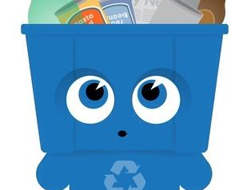
The future is bright
and by the way…… Billy says Hi!

