Slide 1
Billy – bin it happily Our Deck
Daniel – Khairul - Agus

Slide 2
Have you ever strolled around your neighborhood,
try to enjoy the scenery,
BUT then you saw this ……

Slide 3
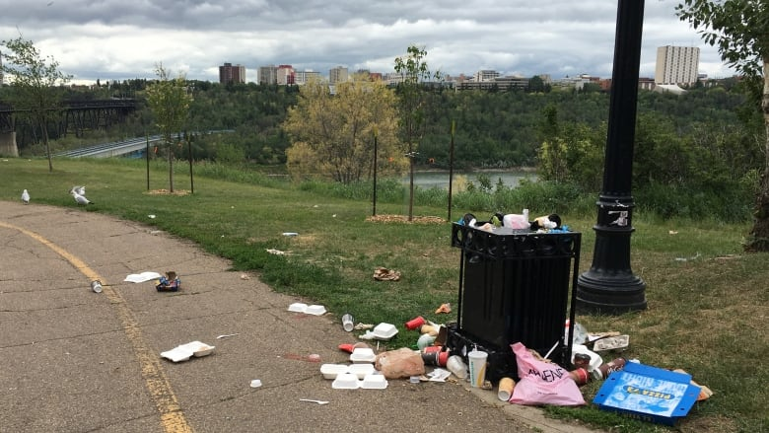

Slide 4
Garbage collection with one schedule fits all has failed,
and leave us with scattered trash

Slide 5
Perhaps you might have also seen
this irony ……

Slide 6
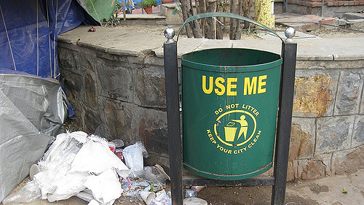

Slide 7
.. Or ..
you see everything in recycled bins
Fun Fact
40% of what is placed in recycle bins cannot be recycled
Source: Ministry of the Environment and Water Resources (MEWR), Singapore

Slide 8
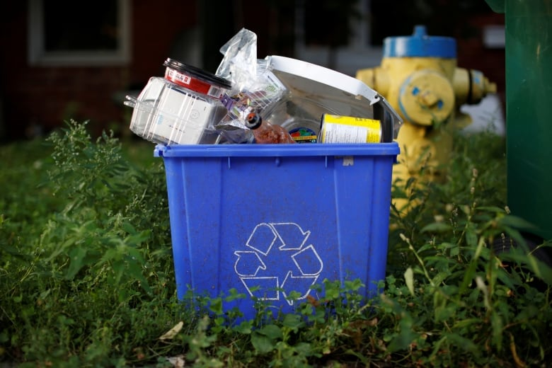

Slide 9
People are not motivated to bin the garbage properly

Slide 10
What should we do ?

Slide 11
Fear Not!
It’s time to meet Billy.

Slide 12
Billy / Bin It Happily
Waste management unlike any other
Help people to put garbage into correct bins
Notify related parties for garbage collection from lesser collection points
Put a smile on our face with rewards to be a better person everyday in keeping our environment clean

Slide 13
Global Waste Management Market / Overview
Expected to grow to $435 billion by 2023. Compound annual growth rate (CAGR) of 6.2 percent from 2017 to 2023
The majority of the growth in the emerging regions of Asia-Pacific
Rise in environmental concerns along with inevitable increases in non-hazardous waste from rapid economic growth

Slide 14
It is all started with Embryo Billy
DEMO TIME

Slide 15













Embryo Billy / Detail Architecture
AWS Cloud
Static website
Access Control
Raw Image
S3
Amazon Cognito
S3
AWS Lambda
Amazon Rekognition
Amazon ECS
Amazon CloudFront
Amazon SageMaker
Mobile client
Application Container
Redis
Amazon API Gateway
IoT thing camera

Slide 16
How do we nurture Billy moving forward ?

Slide 17
Baby Billy
Mobile Application & IoT devices
Allow general public to register and upload profile photos for Face ID authentication purpose
IoT devices will capture garbage photos and recognize registered users while depositing garbage
IoT devices will post the photo to the backend API together with a specific location ID
Return the detection result for statistics display
Notify relevant parties based on certain criteria, such as bin’s volume, etc.
Sign Up
IoT Recognize
IoT Capture
Process
Detection Result

Slide 18
Toddler Billy
Mobile application & IoT devices
Locked bin accessible only by registered users
Mechanism to deposit points and redeem rewards
Embrace partnerships for extensive list of rewards
Registered users will be recognized by IoT devices and open the bin
The deposited garbage will be analyzed and points will be added to accordingly to registered users
Allow registered users to redeem rewards
Recognize & Open Bin
Analyze Garbage
Points & Rewards Management

Slide 19
Kid Billy
Mobile application, IoT & robotic devices
Recognize unregistered users and offer on-the-spot registration
Able to offer rewards redemption on time-limited offer items
Motorized bin that can move to collection points once reaches its threshold
Embrace opportunities to partner with property management companies or government agencies to optimize garbage collection from lesser collection points
Capture new users
Retain existing users
Optimize adoption
Agility
Optimize collection

Slide 20
Teen Billy
Mobile application, IoT, and robotic devices
Multi compartment bin to support recycling
Recognize recyclable garbage and perform separation
Able to have a chat to offer recycling advice before depositing the garbage
Deposit more points for users who are more aware of recycling the garbage
Notify different parties related to recycling different types of garbage
Recycle
Rewards
Advice
Optimized waste management

Slide 21
Who will nurture Billy ?

Slide 22
Our Team / Overview
Daniel is an AWS Certified Professional with 17 years experiences in software development. Daniel has accumulated most of AWS certification in the past one year and has since been working with AWS services with the main interest in enterprise integration and machine learning.
Khairul is a developer with 8 years of experience in software development. Khairul has been utilizing some of AWS services with the focus in microservices implementation for supporting high volume transactions.
Agus is a techno-functional person equipped with 15 years unique combination of technical and management experiences. In the past 7 years, Agus has developed business solutions for restaurant order management, clinic record management, etc. by leveraging AWS serverless and PaaS services.

Slide 23
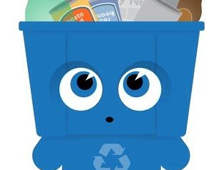
The future is bright LET’S RECYCLE RIGHT
and by the way…… Billy says Hi!

