Slide 1
Final Presentation:
Bifurcation Analysis of Cell Differentiation
from Germinal Centers
Jared Frazier
2023-10-18
Bioinformatics 1 (UvA)

Slide 2
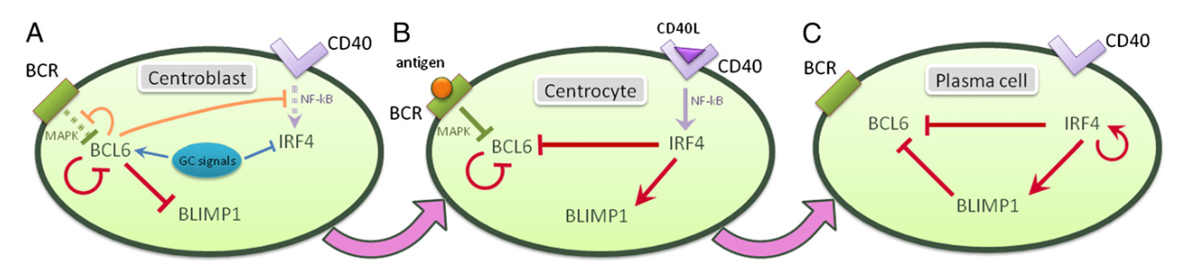
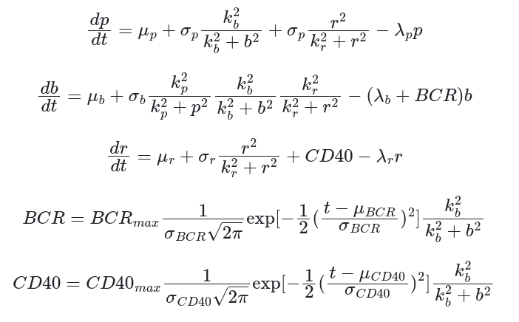
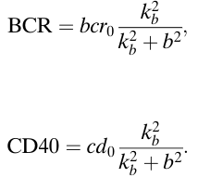
Modeling the Germinal Center
BLIMP1
BCL6
IRF4

Slide 3
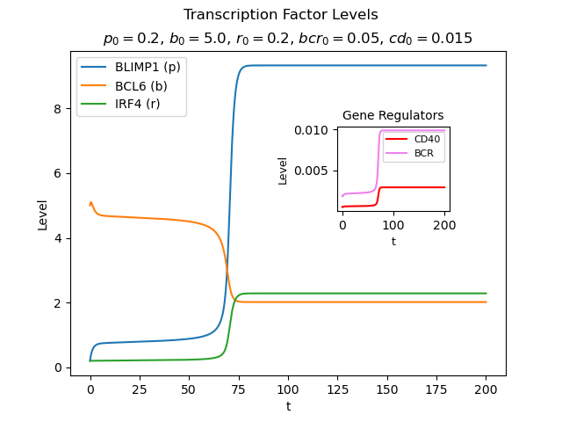
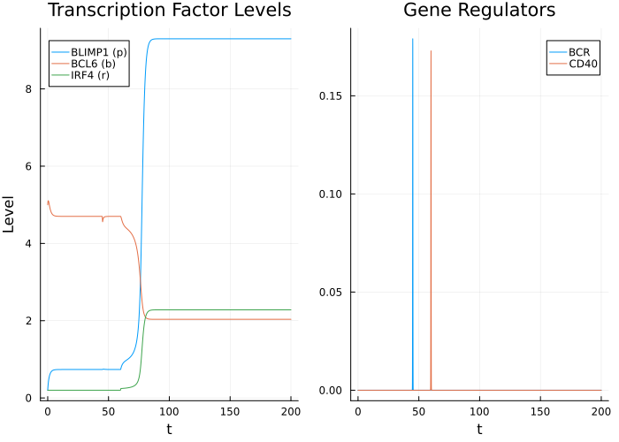
Example System Trajectories

Slide 4
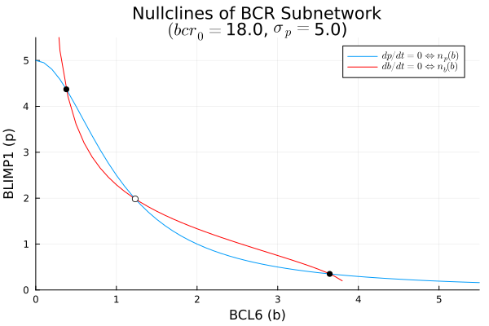
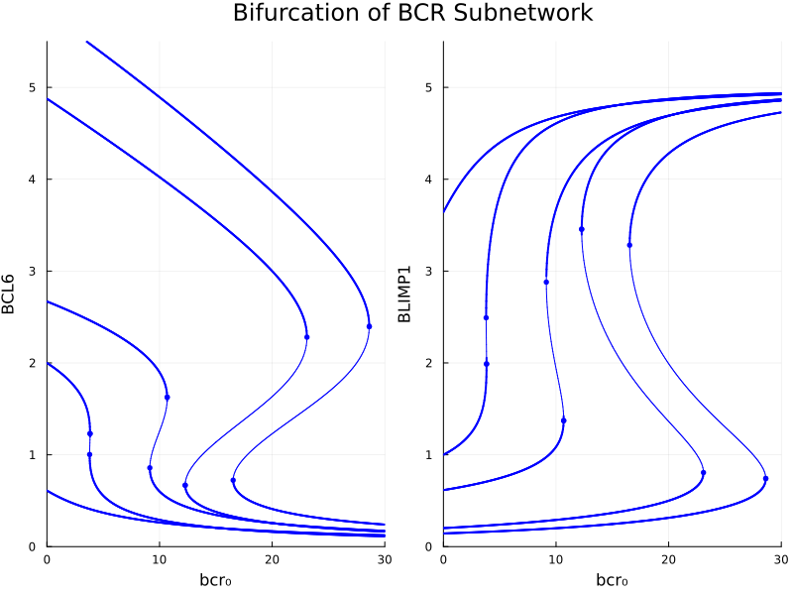
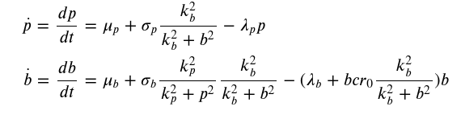

Slide 5
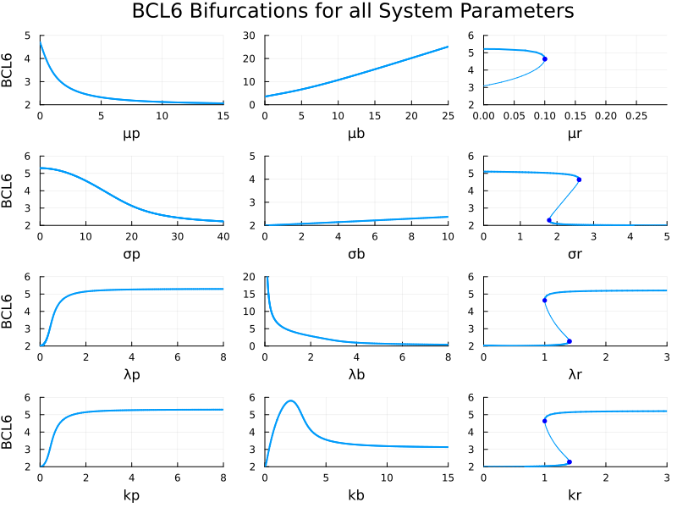

Slide 6
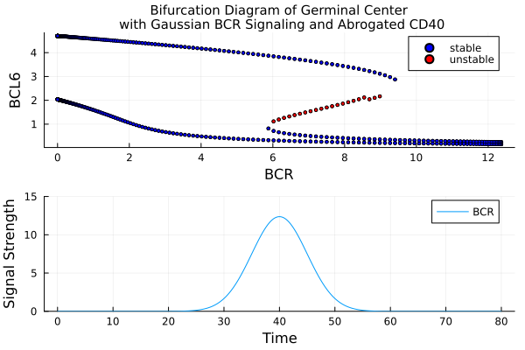
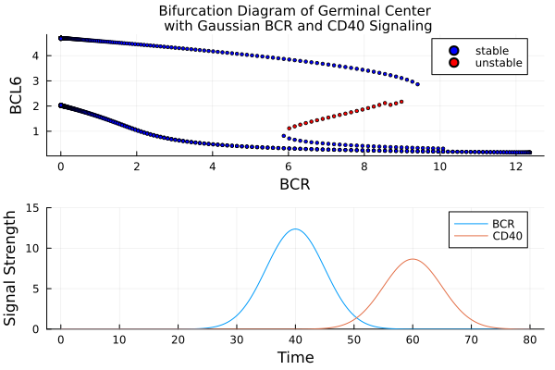
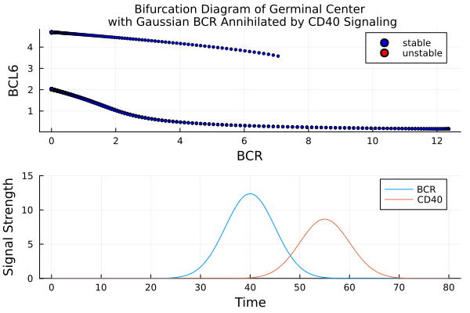
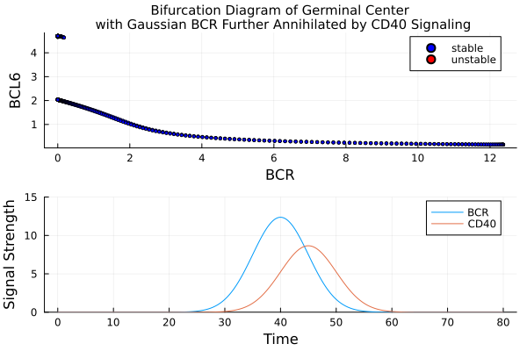

Slide 7
References
[1] M. R. Martínez et al., Proceedings of the National Academy of Sciences, vol. 109, no. 7, pp. 2672–2677, 2012. doi:10.1073/pnas.1113019109
[2] G. D. Victora and M. C. Nussenzweig, “Germinal centers,” Annual Review of Immunology,​ vol. 30, no. 1, pp. 429–457, 2012.

Slide 8
Questions?

